Slide 1
Andrey Trapeznikov
Deputy CEO RUSNANO
Russia
Russian Nanotechnologies To Tackle Climate Change
Marrakesh, Climate Summit
November 17, 2016

Slide 2
RUSNANO in a Nutshell
Who we are
Russian government Private Equity and VC vehicle
aimed at commercializing developments in nanotechnology
Purpose of creation
Build a competitive nanotechnology industry in Russia, using the capacities of Russian science and transfer of advanced foreign technologies
Investment thesis
The Russian hi-tech industrial sector has been growing 15-20% faster than Russian manufacturing overall and still has a lot of space for further expansion
Industry
focus
Nanomaterials; Electronics and optoelectronics; Healthcare; Energy efficiency; Chemicals/Petrochemicals; Others
Portfolio
91 projects in 32 Russian regions (incl. 73 plants launched)
USD 2,1bn^{*)} portfolio value
USD 233 m^{*)} net profit in 2015
(*) Based on exchange rate USD/RUB=65;

Slide 3
1
Reducing GHG
emissions
Impact
2
3
Best available
technologies
Breakthroughs

Slide 4
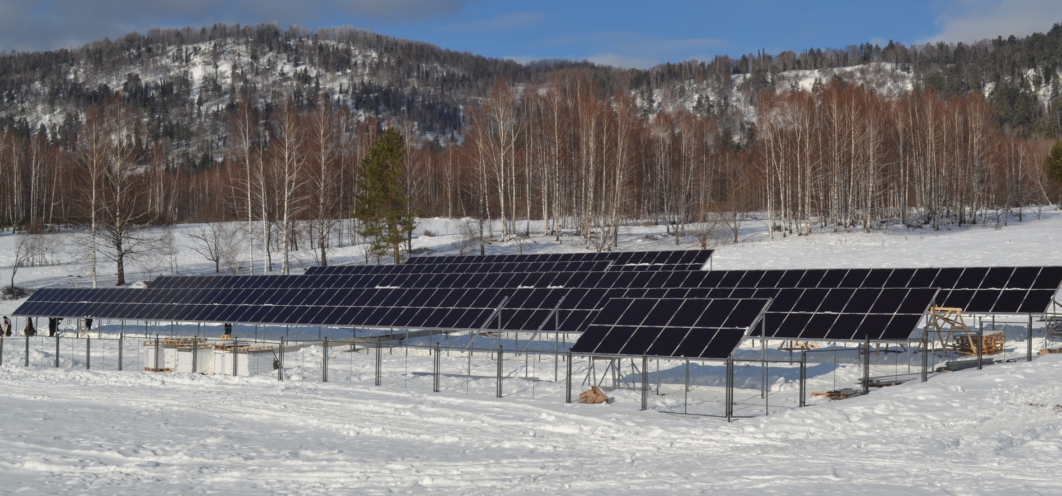
Best Available Technologies
Renewable Energy: Solar
2
New installed capacity, GW (cumulative)
HIT-technology is initially proposed by Sanyo/Panasonic
& further developed by Hevel

Slide 5
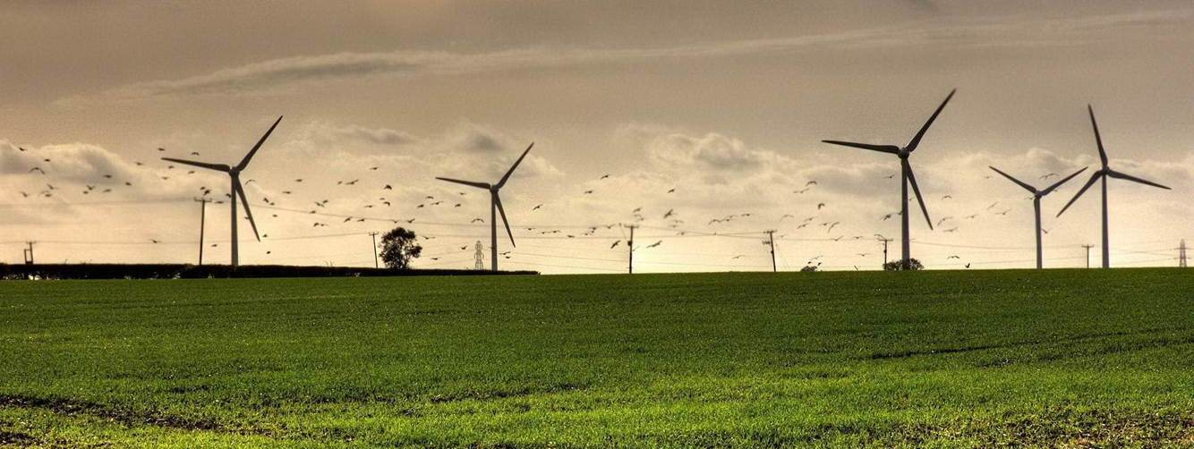
Best Available Technologies
Renewable Energy: Wind
2
New installed capacity, GW (cumulative)

Slide 6
Breakthroughs:
Single Wall Carbon Nanotubes (SWCNT): Current Status
3
4 tons / year Pilot Plant is successfully operating In 2016 produced 2.6 tons
50 tons / year Production Plan Under construction
TM

Slide 7
Breakthroughs:
Single Wall Carbon Nanotubes (SWCNT): Global Focus
3
OCSiAl: Partners and Consumers
80% of the world's Li-ion Batteries manufacturers
18 of the top-50 global chemical companies
More than 300 universities and R&D centers
4 of the top-10 manufacturers of paints and coatings
2 of the top-5 transparent conductive films manufacturers
7 of the top-20 elastomers manufacturers
4 of the top-5 drone manufacturers
1 of the top-3
car manufacturers
1 of the top-2 aircraft manufacturers

Slide 8
OCSiAl Sales:
Forecasts 2016-2020
3
$ mln
SOURCES
Market Research Report on Global Carbon Nanotube (CNT) Sales; QYR Carbon nanotube (CNT) Research Center (February 2016)
Market study: The Global Market for Carbon Nanotubes: Technologies, Production, End User Markets and Opportunities Analysis, 2015-2025; Future Markets, Inc. (January 2016)
Global CNT (Carbon Nanotube) Market: Key Research Findings 2015; Yano Research Institute Ltd. (October 2015)
Carbon Nanotubes (CNT’s) Market; Markets and Markets
The State of MWNT’s. From Damascus to Motown; LUX Research.
OCSiAl’s market share in its segment:
up to 50%

Slide 9
Cost of Transition to GHG Reduction
3
2015-2030 гг.
$6000
billion
38%
Contribution to CO₂ eq emissions reduction
Investment
$2200
billion
22%
13%
$100
billion
Energy efficiency
Renewables
Nano-augmented
materials

Slide 10
Cost of Transition to GHG Reduction
3
2015-2030 гг.
$6000
billion
38%
Contribution to CO₂ eq emissions reduction
Investment
Subsidies
$2200
billion
22%
13%
$1800
billion
$900
billion
$100
billion
$0
Energy efficiency
Renewables
Nano-augmented
materials
Nano-augmented Materials are
Radically More Cost Effective

Slide 11
Russia is strongly committed to combating global climate change
Nanotechnologies contribute to this goal

