Slide 1
Contact: Taryn Fransen | tfransen@wri.org

Slide 2
Challenges
Current pledges, plans, & policies are not ambitious enough
Will they be implemented?
Countries do not trust each other to tackle their fair share of the problem

Slide 3
Overview of Strategy
Leverage the post-CPH opportunity
Pledges
to catalyze action
Scaling up mitigation & financing ambition
by providing reliable information
Creating
Reviewing
Disseminating
and empowering stakeholders
Sharing lessons about what works
Fast-start finance
Low-C strategies
Promoting implementation
Building capacity to engage in policy processes
Contextualizing

Slide 4
Strategic Model
Action
Reliable Information & Harmonized Tools
Ambition
Trust
Accountability
Informed
Policy-Makers
Empowered
Civil Society

Slide 5
The OCN Landscape
More Consistent
Consistent National Assessments
Domestically
Oriented
Internationally
Oriented
Domestic Engagement Toolkits
Analysis & Commentary
More Flexible

Slide 6
NAF Life Cycle
National Assessment Framework
National Profile
Peer Review
Dissemination

Slide 7
NAF Components
Consistent
Consistent National Assessments
Mitigation
Finance
Benefits
Technology Transfer
Capacity Building
Domestically
Oriented
Internationally
Oriented
Domestic Engagement Toolkits
Analysis & Commentary
Flexible

Slide 8
Mitigation
What is the country's current GHG profile?
What government policies and programs exist or have been announced that are expected to have a significant influence over future GHG emissions?
What evidence is there that these policies and programs are being or will be implemented as planned?
Assuming the policies and programs are implemented effectively, what effect are they expected to have on GHG emissions?
What results have these policies and programs delivered to date?

Slide 9
Finance
How much public climate financing is the country providing to developing countries?
How and for what purpose(s) is this financing being provided?
To what extent is the donor country taking steps to ensure the effectiveness of the financing?

Slide 10
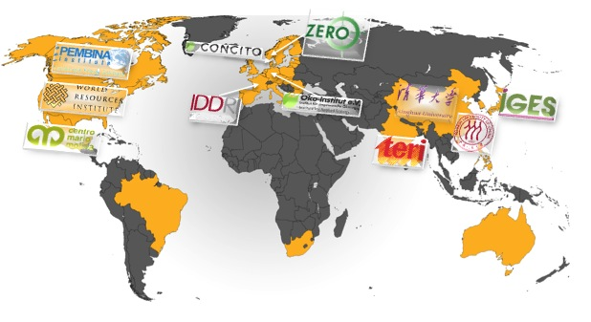
Note: Additional partnerships are under discussion.

Slide 11
Moving Forward
Establish NAF v1.0
Pilot Test
Peer Review
Publish + Round-tables
Refine & Repeat

Slide 13
Contact: Taryn Fransen | tfransen@wri.org

