Slide 1
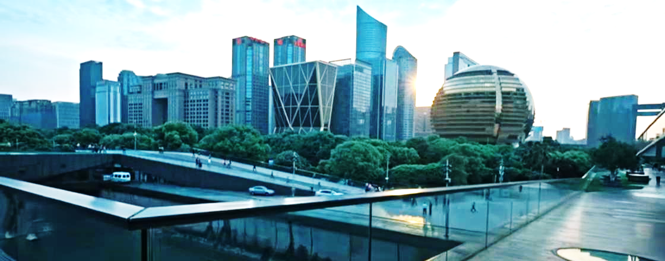
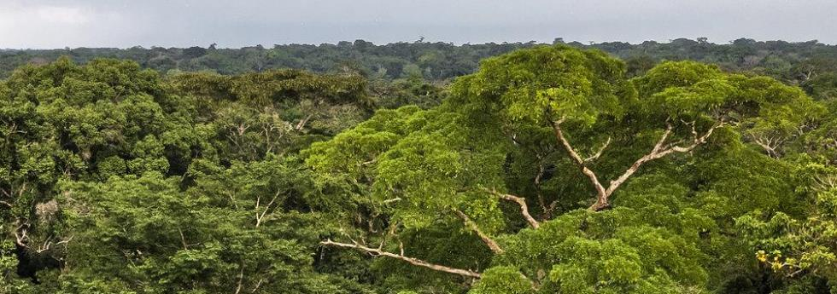
IPCC Working Group I, 7th Assessment Cycle
Working Group I contribution to the 7th IPCC Assessment Report
Robert Vautard and Xiaoye Zhang, Co-Chairs WGI

Slide 2
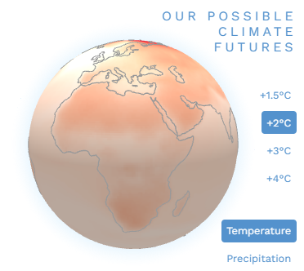
AR7 WGI Structure
Current status and trends
Futures
Information for responses
🔎
Interactive
Atlas
Chapter 8
Abrupt changes, low-likelihood high impact events and critical thresholds, including tipping points, in the Earth system
🔎= focus/deep dive
= core chapters
= xWG elements
🔎
Chapter 4
Advances in process understanding of Earth system changes
Chapter 3
Changes in regional climate and extremes, and their causes
Chapter 7
Projections of regional climate and extremes
Chapter 10
Climate information and services
Regional
Chapter 2
Large-scale changes in the climate system and their causes
Chapter 6
Global projections of Earth System responses across timescales
🔎
Chapter 9
Earth system responses under pathways towards temperature stabilization, including overshoot pathways
Global & large scale
Chapter 1
Framing, methods and knowledge sources
Chapter 5
Scenarios and projected future global temperatures
Notes:
Some more background on the structure and interlinkages:
2, 3, 6 and 7, supported by Ch.4, are the core of the classical WGI assessment, where the reader will find easy-to-use information on changes, including region-by-region in Ch.3 and Ch.7 –
2 and 6 addressing observed changes in the climate system, and projected future changes in the Earth System, at global and large-scales, with 3 and 7 doing the same for regional and subregional change.
Chapters 3 and 7 include regional extreme events, and larger-scale potential abrupt change events are detailed in depth in Ch.8
Chapter 4 is an integrated chapter dedicated to advances in process understanding across al components of the Earth system, and focuses on integrating the different systems and cycles. It is also the main home for model evaluation, thought that will be part of the assessment in other chapters as well. Chapter 4 has a critical role in supporting much of the core assessment, including the attribution assessment in c. 2 and 3, and will have a larger author team
Chapter 5 assesses the broad range of available emissions and land-use scenarios, with a focus on global temperature and the Earth's energy budget indices. It will provide an in-depth evaluation of the opportunities and limitations of lower complexity climate models and emulators, and assess the role of non-co2 forcers and carbon budgets.
It will feed into Ch.6 and 7, and have close interlinkages with Ch 4 and 9
Ch.9, as already mentioned, provides a deep dive of the specific Earth system responses to temperature stabilization, net-zero and net-negative emissions, and also examine the potential, consequences and risks of SRM.
CH.10 will largely build on assessments in Chapter 3 and 7, with a focus on accessibility and usability of climate information for different sectors and regions, including for climate services, capacity building, education etc.
It will also provide a link to the interactive Atlas, which will be build based on expertise in the relevant chapters, with support from external service providers for the implementation.

Slide 3
Highlighting key advances in science
Chapters 2&3: Improved understanding of recent anomalies (outstanding regional or global extremes and values in global indices)
Chapter 4: Integration of advances on main processes and feedbacks at the interface of Earth system components, and cycles (e.g., water-energy-carbon, ocean/land)
Chapters 5-7: Global and regional projections based on new model developments (km scale resolution, AI, emulators), incl. extreme events
Chapter 8: Fast increasing literature on potential abrupt changes and events not covered by regional projections
Chapters 9&10: Very dynamic areas of policy-relevant research (climate services, stabilization and overshoot)

Slide 4
Cross-cutting topics
WGI Report outline reflects a number of x-WG topics that were discussed in corss-WG Break Out Groups during the scoping meeting in Kuala Lumpur, and will be coordinated during the writing process with the other WGs
Biodiversity and Ecosystems (embedded across the Report)
Equity and justice (CH1, 3, 7, 10)
Health and well-being (CH10)
(Information for) losses and damages (CH10)
Overshoot (CH9)
Risk assessment approaches and regionalization (CH3, 7, 10)
Scenarios (CH5, 7, 1, 6)
Solar Radiation Modification (CH9)
Tipping points and large-scale singular events (CH8)
Technical Guidelines for Impacts assessment and Adaptation (CH10)

Slide 5
Report Process | Ten Steps
1
2
3
4
Scoping
Agreement on Outline
Nomination of Authors
Selection of Authors
The outline is drafted and developed by experts nominated by governments and observer organizations.
The Panel agrees upon the outline.
Governments and observer organizations nominate experts as authors.
The Bureau selects authors.
5
6
Government and Expert Review Second Order Draft (SOD)
7
Expert Review
First Order Draft (FOD)
Final Draft Report and SPM
Authors prepare a first draft which is reviewed by experts.
The second draft of the report and first draft of the Summary for Policymakers (SPM) are reviewed by governments and experts.
Authors prepare final draft of the report and SPM which are sent to governments.
8
9
10
Publication of Report
Government Review of Final Draft SPM
Approval & Acceptance of Report
Governments review the final draft in preparation for its approval.
Working Group/Panel approves SPM and accepts reports.
Notes:
Check for better slide from WGII
What makes IPCC reports so unique is its global reach and the review, adoption and approval of its products by all 195 member governments.
So how does this science-policy-coproduction process work in practice?
Governments, Bureau and science community are involved in different ways along the cycle. IPCC reports are produced in ten steps –
First, a group of experts nominated by governments and observer organisations, and selected by the relevant WG Bureaux, produces an outline, consisting of chapter titles and indicative bullets, as a guidance to the authors.
Second, the panel agrees on the report outline
Third, a call for nominations is issued by the Secretariat, based on the agreed outline, and governments and observer organisations nominate experts as authors. This is the stage we are at the moment, and we will explain in more detail in a moment.
Fourth, the Bureau selects the author teams, mindful of regional and gender balance, and the necessary areas of expertise based on the outlines.
The writing process thereafter is supported by four lead authors meetings, and produces a first oder draft (FOD) after the second LAM, which is reviewed by experts.
In the next and sixth steps, the second order draft, that has matured and taken aboard all review comments from the FOD, is finalized after the third LAM and sent to both experts and governments for review. This SOD also contains the first draft of the Summary for Policymakers.
Seventh, the authors produce the final draft report, and eight, the final SPM is sent to governments for review and comments (after LAM4).
Finally, the working group plenary and panel will approve the revised SPM line-by-line, and accept the underlying report, which is then published.

Slide 6
THANK YOU
FOR YOUR ATTENTION
ipcc-sec@wmo.int
ipcc-media@wmo.int
Robert Vautard
WGI Co-Chair of IPCC AR7
Xiaoye Zhang
WGI Co-Chair of IPCC AR7

