Slide 1
ENSURING FOOD SECURITY AND EFFECTIVE CLIMATE CHANGE MITIGATION THROUGH INTENSIVE COMMUNITY LED NRM INTERVENTIONS IN THE TRIBAL REGIONS OF WESTERN INDIA
Presentation By:
DR. KIRIT N SHELAT, IAS (RTD) Executive Chairman National Council for Climate Change Sustainable Development and Public Leadership (NCCSD) Email: drkiritshelat@gmail.com, Website: www.nccsdindia.org

Slide 2
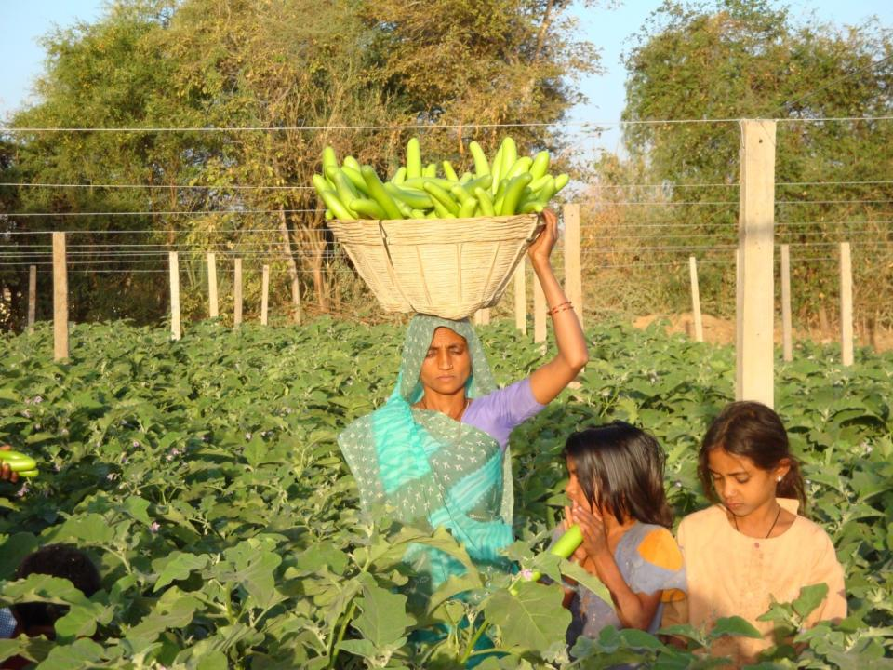
Traditional vegetable cultivation
Every year more than 20000 farmers opting vegetable cultivation

Slide 3
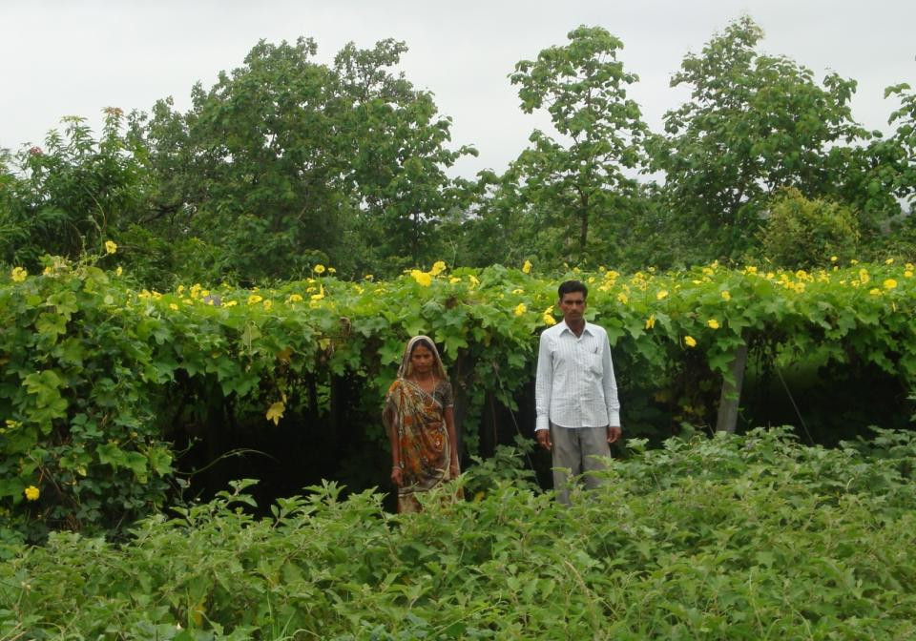
Vegetable cultivation : (Trellis system (6,087 plots and farmers)
Rs. 50,000/- to 75,000/-
Kokilaben) (Rs. 27000 )

Slide 4
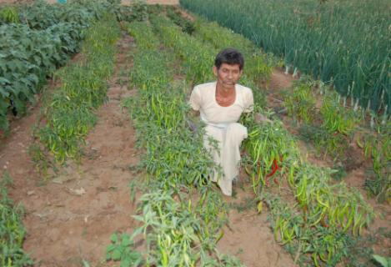
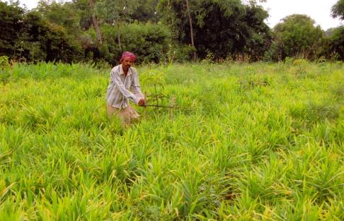
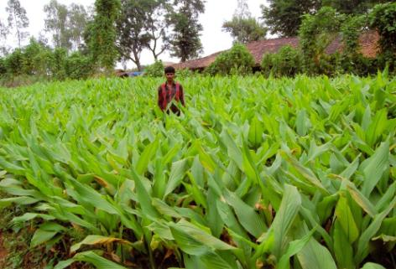
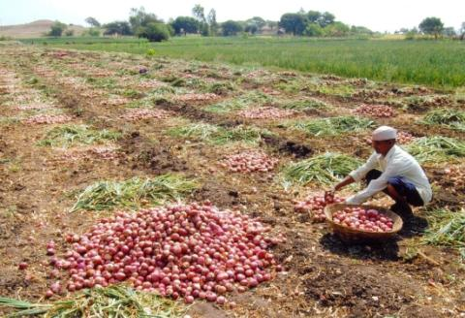
SPICES CULTIVATION
Chilly
Ginger
Turmeric
Onion

Slide 5
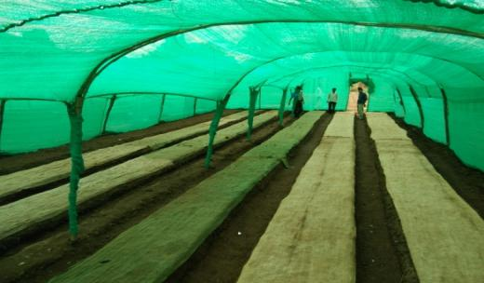
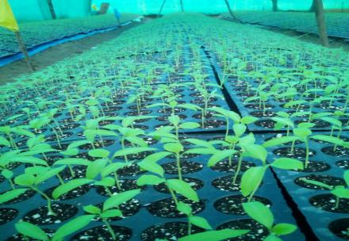
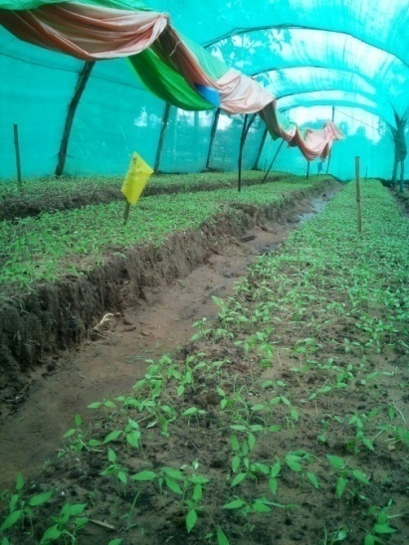
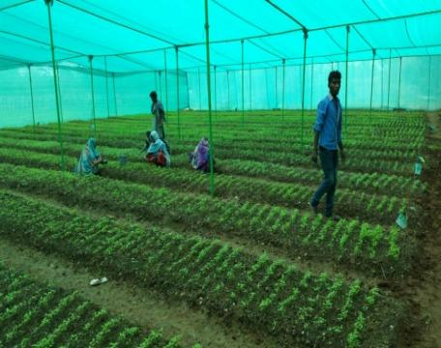
MODEL 5- ENTREPRENEURSHIP, RAISED BED AND NET BASED NURSERY RAISING: 41 LAKHS SEEDLINGS
Cost of raising seedling : Rs. 25000
Number of seedling : 60000
Net Income Rs. 52,000 - 55,000/-

Slide 6
Agriculture: eco-friendly organic manure (Vermi compost)
More than 10,000 households having Vermicompost units economizing on the use of fertilizer and cost of cultivation

Slide 7
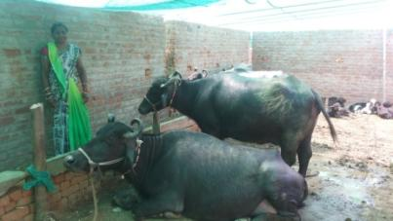
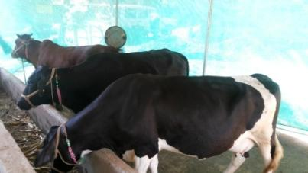
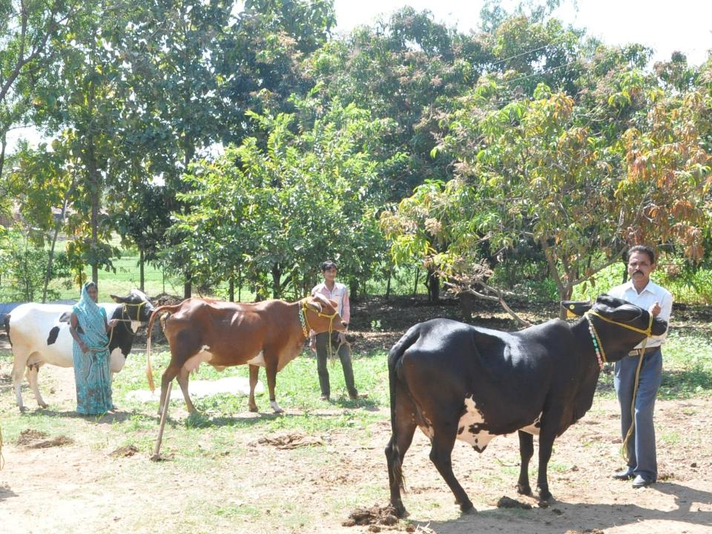
DAIRY DEVELOPMENT
The tribal youth giving up government job opted for
Self Employment in Dairy. He earns Rs.40,000/- per month

Slide 8
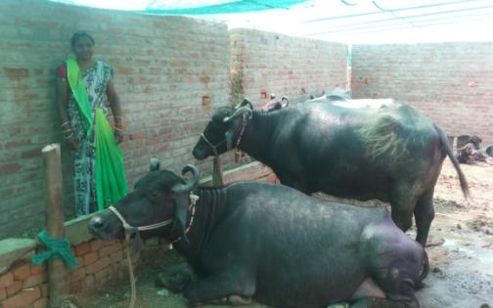
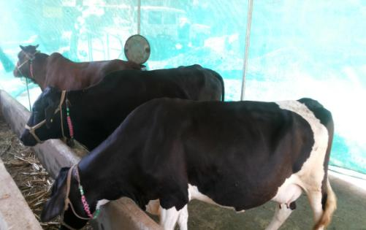
DAIRY DEVELOPMENT
Shantaben Bhuriya earning Rs. 80,000 per month from Dairy.
She is also leader of SHG Federation of Garbada taluka of Dahod district

Slide 9
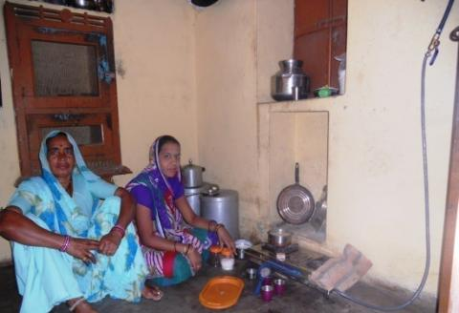
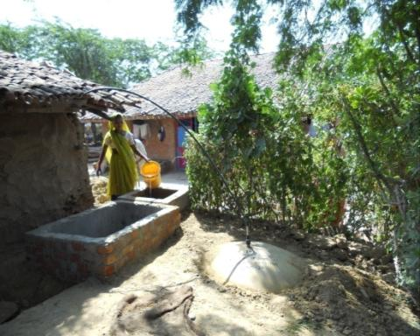
Biogas plant
Mitigating climate change
3,070 households having biogas plants and housemakers enjoying cooking with biogas
Eliminating use of fuel wood, reducing use of chemical fertilizer and kerosene

Slide 10
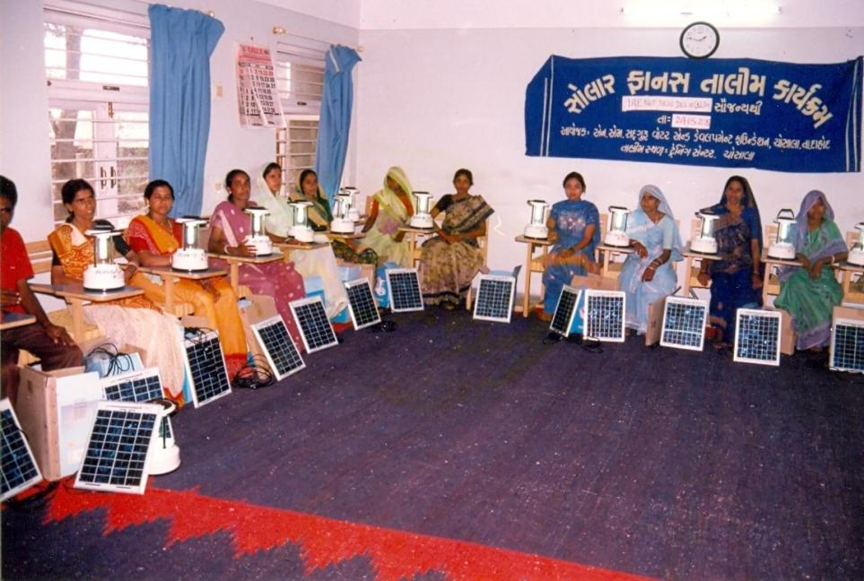
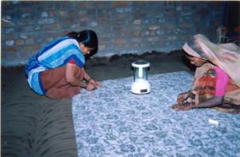
Use of Solar Lantern
Mitigating climate change

Slide 11
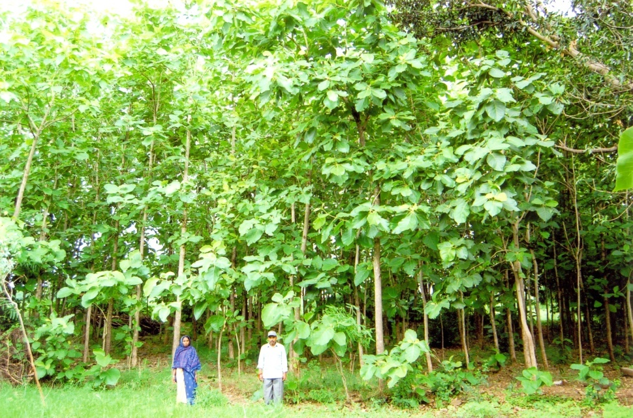
Agro Forestry : reforestation, afforestation on the barren revenue lands A natural renewable resource
Photosynthesis is the only and simplest tool to sequestrate the carbon dioxide

Slide 12
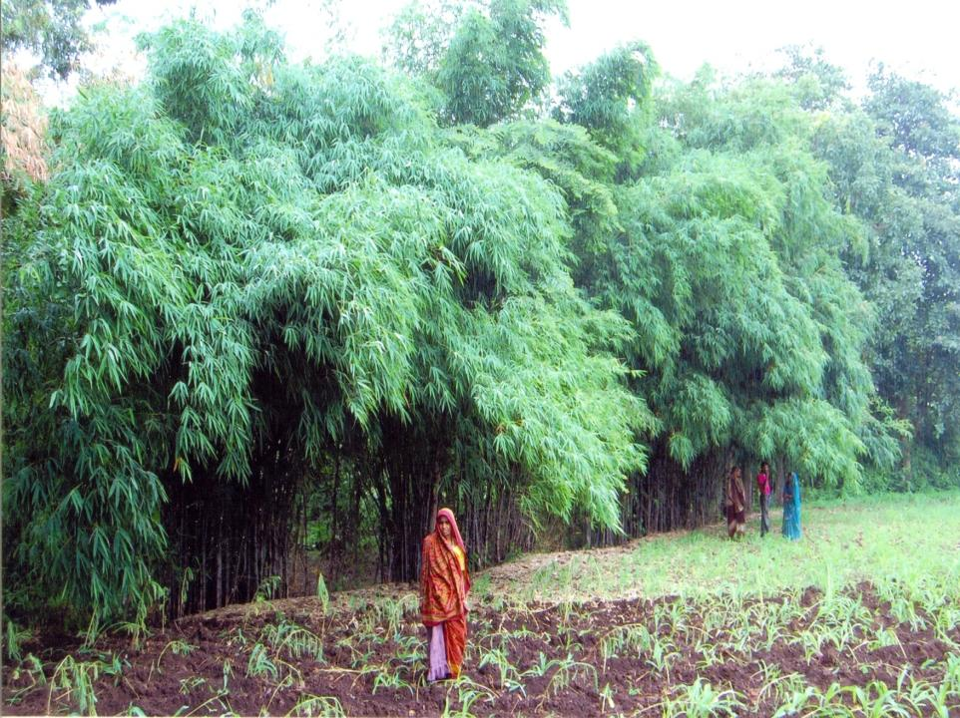
Tree plantation on the farm bunds
6,80,06,176 plants: 1,32,776 households
70,702 acres – long term survival 50 %

Slide 13
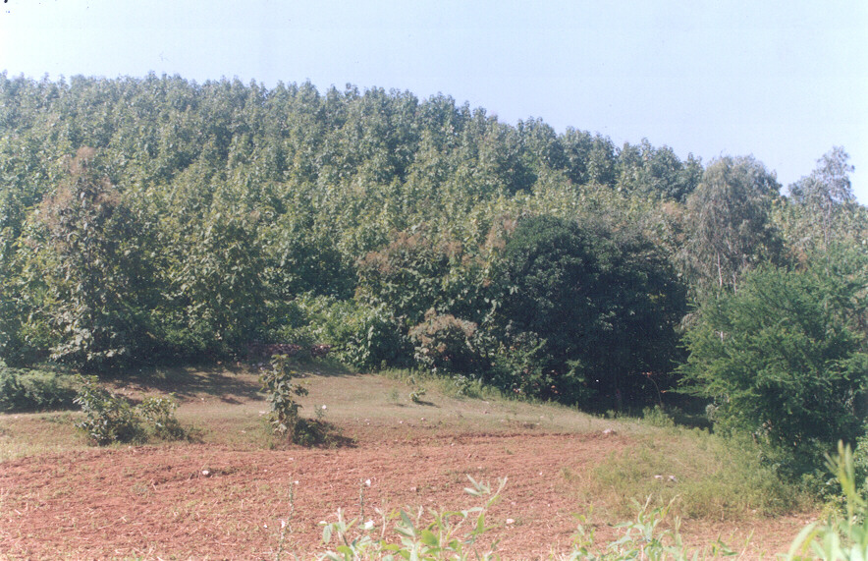
Before
After
Protection of regeneration of forest land through community transformed into a dense forest

Slide 14
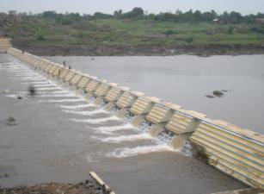
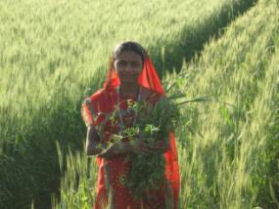
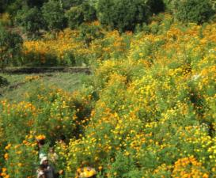
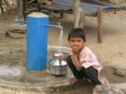
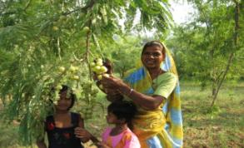
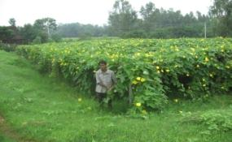
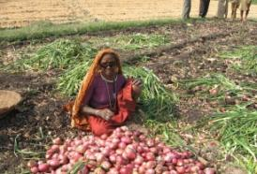
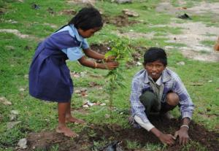
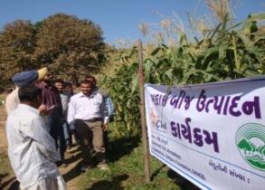
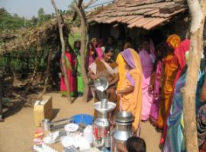
A DEVELOPMENT JOURNEY SINCE 1974 INVOLVING 5 LAKH FAMILIES
Notes:
14

Slide 15
QUALITY OF LIFE INITIATIVE

Slide 16
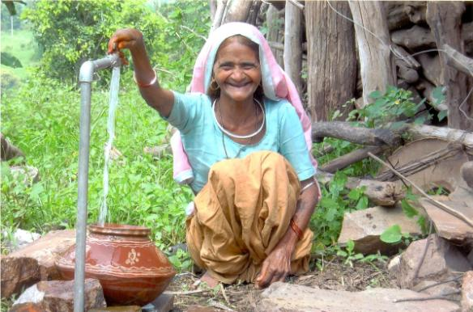
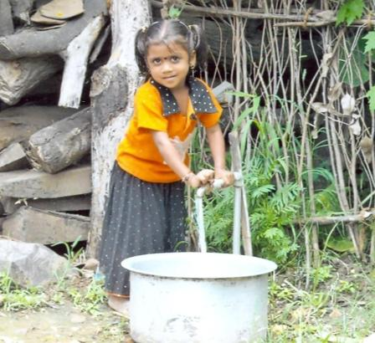
SOLAR BASED DRINKING WATER INITIATIVE
A little girl is all happy with tap water at her household in Parmar Falia, Bavka
At last, in the evening of her life, she has got something to smile which has reduced drudgery of fetching water from distance - a household connection of Parvatiben Solanki at Patelia Falia, Kamboi

Slide 17
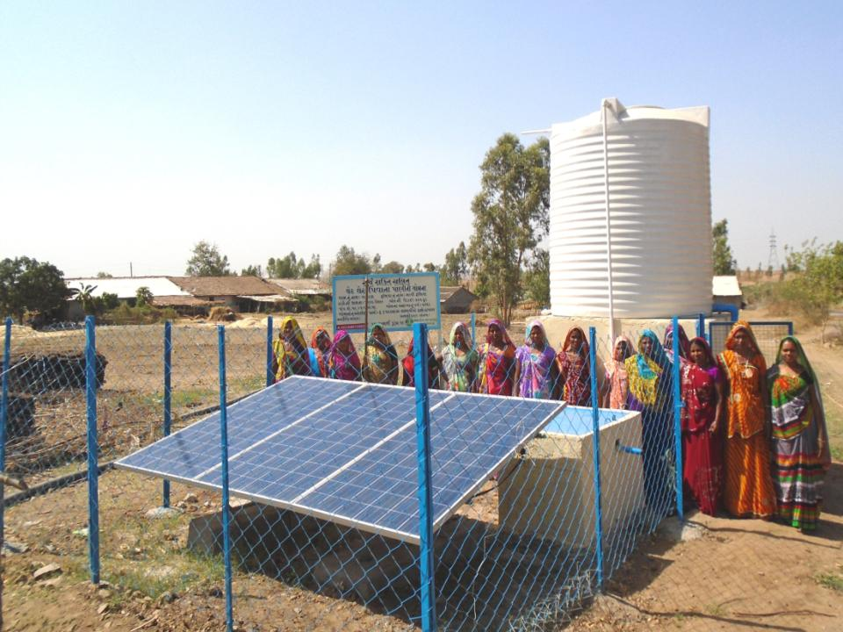
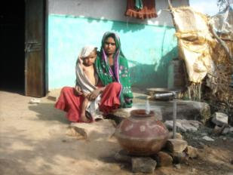
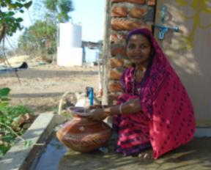
Solar powered hamlet based community drinking water systems

Slide 18
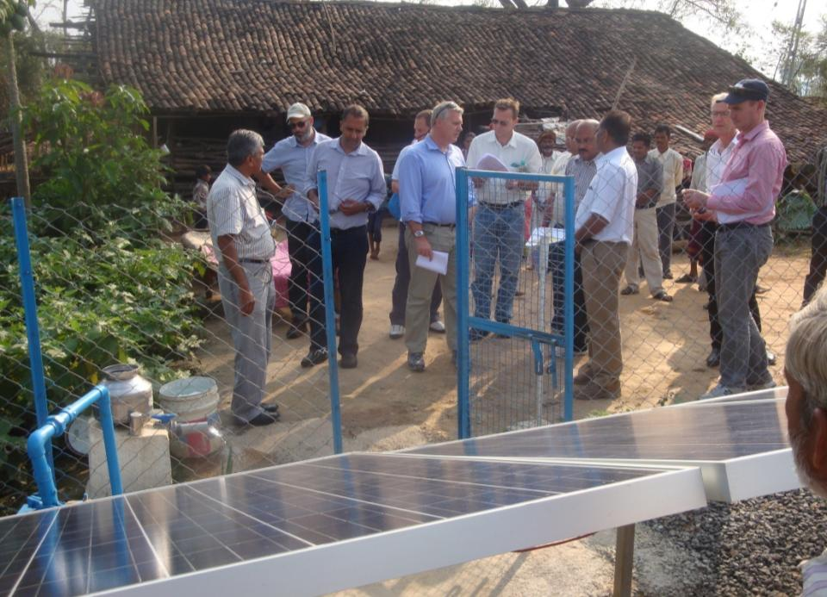
Solar Based Drinking Water System

Slide 19
CLEAN COOKING IN TRIBAL AREA

Slide 20
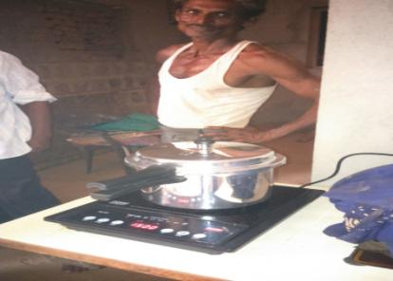
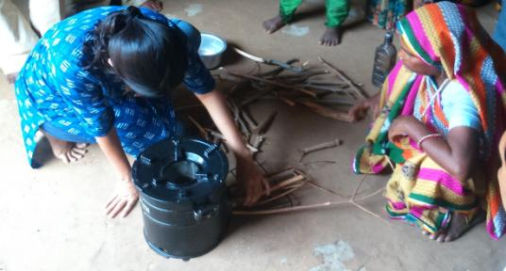
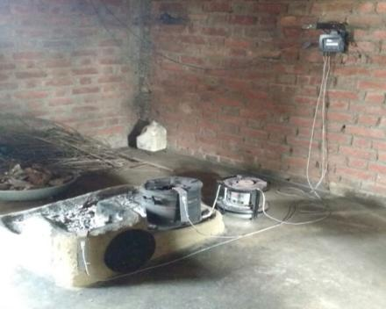
CLEAN ENERGY INITIATIVE

Slide 21
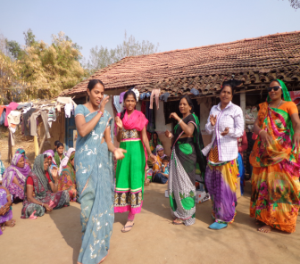
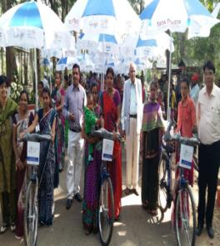
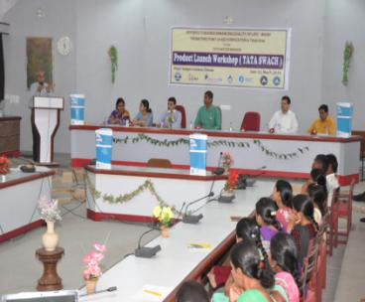
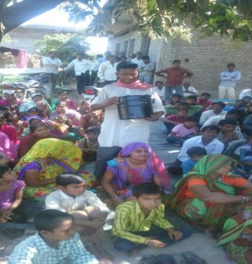
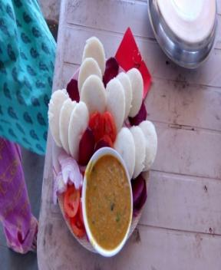
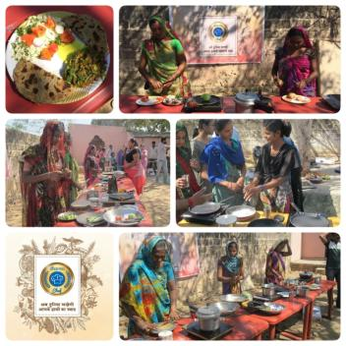
)
SOCIAL IMPACT PRODUCTS: INITIATED BY PEOPLE ORGANIZATION

Slide 22
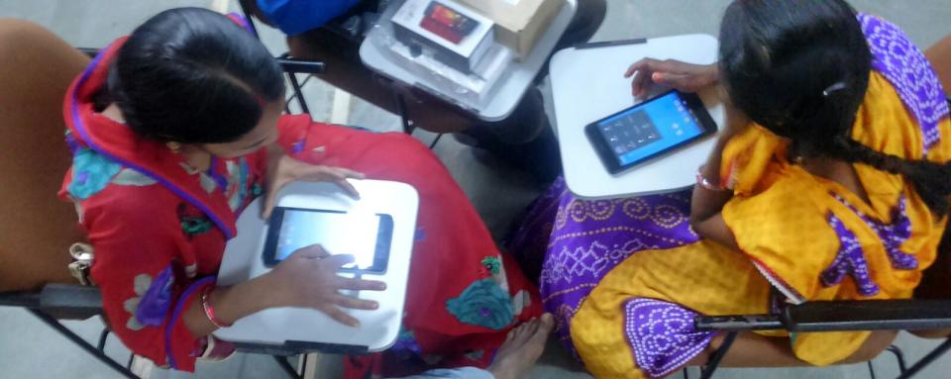
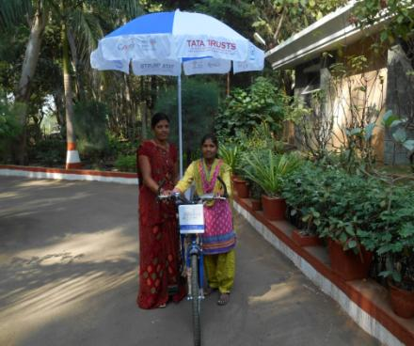
INTERNET AWARENESS THROUGH INTERNET SATHI IN TRIBAL AREA

Slide 23
MODERN HOUSE OF TRIBAL FAMILY

Slide 24
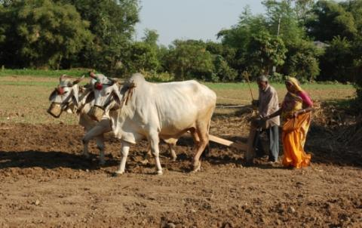
Benefits to Tribal Farmers (Reduced drudgery by providing farm machinery solutions)
SOWING
Traditional Method
-- Time consuming
-- Hard work
- Bullock required
- Unequal seeding
Mechanized Sowing
-- Easy, quick & Systematic sowing
-- Cost Effective
-- Even and Equal Distance Sowing
-- Time Saving
-- No strenuous work

Slide 25
CHANGE IN SOCIO ECONOMIC CONDITION
Sl. | Indicators | Pre Operational | Post Operational
1 | Literacy-Male | 20% | 66%
2 | Literacy-Female | 10% | 57%
3 | Drop Out | 70% | 9.77%
4 | Agriculture Engagement | 49% | 97%
5 | Entitlement
6 | Ration card | 45% | 97%
7 | MGNREGA Card |  | 85%
8 | APL | 25% | 46%
9 | BPL | 75% | 54%
10 | Kuccha House | 95% | 79%
11 | Thatched House | 5% | 21%
12 | Mobile/ Telephone |  | 67%
13 | Jewellery | 10% | 58%
14 | Electricity | 30% | 66%
Continue….

Slide 26
CHANGE IN SOCIO ECONOMIC CONDITION
Sl. | Indicators | Pre Operational | Post Operational
15 | Gas Connection | 0% | 8%
16 | Fire wood | 99% | 70
17 | Drinking water-Public water resource | 20% | 82%
18 | Drinking water-Own Sources | 0% | 8%
19 | Toilet | 2.22% | 15
20 | Migration | 51% | 9%
21 | Migration duration | 180 | 77days
22 | Irrigation sources | 10% | 66%
23 | Horticulture | 0% | 27%
24 | Livestock | 2 | Per HH 6 animal holding
25 | Availing Loan | 5% | 65%
Continue….

Slide 27
SOCIO ECONOMIC CONDITION
Sl. | Indicators | Pre Operational | Post Operational
26 | Saving | 5% | 66%
27 | Productivity Enhancement | . | 40%
28 | Source of Expensexs |  | 15% towards livelihood and 85% towards quality of life
29 | Food security | 5 Month | 12 month
30 | Annual income | 23018 | 82280
31 | % of tree density | 50% | 61%
32 | Change in Farm Assets | 10% | 78%
33 | Change in Non Farm Assets | 15% | 54%

Slide 28
CHANGE IN SOCIO ECONOMIC CONDITION
Indicators | Pre operational | Post operational
Availability of water (irrigation) | Up to October | Up to March ;in many cases till May
Availability of fodder | Up to December | Up to March and in many cases June
Availability of fire wood | Very difficult to collect from forest or other land; extreme pressure on forest | Due to massive plantation in the vicinity of tribal households fuel wood, fodder and timber is available
Continue….

Slide 29
CHANGE IN SOCIO ECONOMIC CONDITION
Indicators | Pre operational | Post operational
Cropping pattern | Traditional crop which is dependent on rain and agriculture intensity is low resulting in to unavailability of food grain hence distressed migration was cruel reality | Traditional crops along with cash crops(viz., fruits, vegetables, flowers ) and in some case milk production resulting in to food, nutritional and financial security and ultimately migration is checked
Income per acre | Less than 23018 Rs /year | More than 82280 per year (on an average)
Soil nutrient | Less in organic carbon and other nutrient | Soil enrich with organic carbon and other essential nutrients

Slide 30
OVERALL SOCIAL AND ECONOMIC IMPACT
Enhanced productivity
Enhanced socio economic status
Land is more green
Increased organic carbon in the soil
Increased area under irrigation
Increased soil moisture index
Increased ground water level
Drastic change in migration
Increased education level
Reduced drop outs
Many girls are admitted in hostel at remote places to continue their higher education)
Awareness for pre entrance coaching at major cities
Change from kuccha house in to pucca house usually with RCC roof with dish TV, mobile and bike
Continue….

Slide 31
OVERALL SOCIAL AND ECONOMIC IMPACT
Food security
Nutritional security
Financial security
Fodder and timber available in their vicinity
Availability of drinking water in their vicinity
Reduction of pressure on forest
Reduction in drop out in school
Higher education in girl child
Healthier life
Stable/ pucca house
Drastically change in number and days of migration
Empowered and confident community

Slide 32
MAGNITUDE OF IMPACT AT A GLANCE
TOWARDS CLIMATE CHANGE MITIGATE
1,47,756 acres land under irrigation (LI + Check dam + Wells)
More than 2,000 mcft water is stored
1,18,636 acres land treated under micro watershed development
6.80 crores plants / saplings planted under social forestry program
33,834 horticulture plots by equal number of farmers
30,000 farmers engaged in vegetable cultivation
60,000 farmers engaged in improved field crop production with POP
About 730 acres of land under Maize seed production of composite variety (Gujarat-6) - seed replacement ratio increased up to 40 %
4,91,697 families covered in different programs
4,53,356 acres dry land transformed under different programs

Slide 33
Thanks
DR. KIRIT N SHELAT, IAS (RTD) Executive Chairman National Council for Climate Change Sustainable Development and Public Leadership (NCCSD) Patel Block, Rajdeep Electronic's Compound, Near Stadium Six Road, Navrangpura, Ahmedabad-380 0014 Phone/Fax: (00 91 79) 26421580 Mobile: 091 9904404393 Email: drkiritshelat@gmail.com, Website: www.nccsdindia.org

