Slide 1
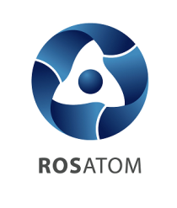
STATE ATOMIC ENERGY CORPORATION “ROSATOM”
Rosatom contribution to low carbon future
Dr. Kirill Komarov
First Deputy Director General for Development and International Business
November 17, 2016

Slide 2
Radical transformation of energy production and usage is needed to combat with climate change
GHG emissions in CO2 equivalent, Gt. (2015)
Paris Convention target
52 Gt globally
36 Gt energy related CO2 emissions
+2°
40 Gt in 2030
30%
32%
70%
68%
- 40% in energy related CO2 emissions
70% in
power sector CO2 emissions
Power generation from low carbon sources, including nuclear energy,
is a critical pillar in fulfilling the objectives of the UNFCCC
The content of this presentation is for discussion purposes only, shall not be considered as an offer and doesn’t lead to any obligations to Rosatom and its affiliated companies. Rosatom disclaims all responsibility for any and all mistakes, quality and completeness of the information.

Slide 3
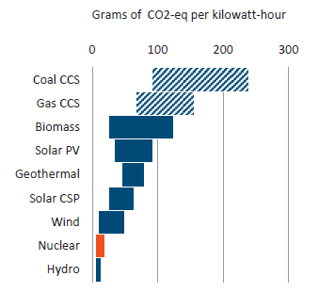
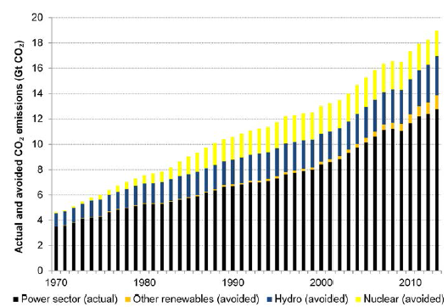
Nuclear as a vital part of low carbon electricity generation
Life cycle GHG emissions from
low carbon electricity sources
Global CO2 emissions from the electricity sector and emissions avoided by using low carbon generation technologies
Source: IAEA
Source: IAEA
Nuclear power saves almost 2 Gt of CO2 each year and has avoided more than 60 Gt of emissions over the 1970-2015 period.
The content of this presentation is for discussion purposes only, shall not be considered as an offer and doesn’t lead to any obligations to Rosatom and its affiliated companies. Rosatom disclaims all responsibility for any and all mistakes, quality and completeness of the information.

Slide 4
Nuclear generation fleet in the Russian Federation
Kola NPP
Bilibino NPP
Leningrad NPP
Kalinin NPP
Beloyarsk NPP
Smolensk NPP
VVER - RBMK - BN - EGP
Kursk NPP
Balakovo NPP
Novovoronezh NPP
Rostov NPP
Balakovo NPP
Units in operation: 4
Capacity: 4000 MW
Kola NPP
Units in operation: 4
Capacity: 1760 MW
Kursk NPP
Units in operation: 4
Capacity: 4000 MW
Leningrad NPP
Units in operation: 4
Capacity: 4000 MW
Beloyarsk NPP
Units in operation: 2
Capacity: 1460 MW
Total:
35 units
28,3 GWe
Kalinin NPP
Units in operation: 4
Capacity: 4000 MW
Novovoronezh NPP
Units in operation: 4
Capacity: 3080 MW
Rostov NPP
Units in operation: 3
Capacity: 3000 MW
Smolensk NPP
Units in operation: 3
Capacity: 3000 MW
Bilibino NPP
Units in operation: 4
Capacity: 48 MW
NPPs in Russia annually avoid 250 mln. t. СО2 emissions.
This is equivalent to volume of emissions from all automobiles in Russia for 2 years.
Contribution of Russian NPPs to low carbon electricity generation in Russia is 48%.
The content of this presentation is for discussion purposes only, shall not be considered as an offer and doesn’t lead to any obligations to Rosatom and its affiliated companies. Rosatom disclaims all responsibility for any and all mistakes, quality and completeness of the information.

Slide 5
Rosatom safe and mature VVER technology is one of the most referenced globally
Czech Republic
Finland
6
2
1
Russia
Slovakia
21
8
1
Belorussia
Hungary
2
4
2
Ukraine
Bulgaria
15
Armenia
Turkey
6
4
2
1
China
Germany
Iran
2
6
Jordan
1
2
Egypt
8
4
2
India
Bangladesh
2
2
Vietnam
4
2
Nigeria
2
Constructed VVER NPPs
VVER NPPs in implementation
Thanks to 73 VVER NPPs constructed globally 15 Gt. CO2 hadn’t been emitted.
Such volume of СО2 could be emitted by 40 coal TPPs of 1 GWe (each) during 60 years.
36 NPP units in implementation abroad by Rosatom will allow on their lifecycle to avoid in total 23 Gt. of CO2 emissions.
The content of this presentation is for discussion purposes only, shall not be considered as an offer and doesn’t lead to any obligations to Rosatom and its affiliated companies. Rosatom disclaims all responsibility for any and all mistakes, quality and completeness of the information.
5

Slide 6
Energy market transition: towards sustainable energy services
Foreign order
portfolio growth
from 12 to 36 units
(2010 – 2016)
Integrated
solution
before 2011
2011
Now
10-15 years
from now
EPC Contract
Price of kWh
Sustainable energy services
NPP
construction market:
potential foreign NPP construction
market is limited by the nuclear industry development goals of the customer-
countries
General market of generating capacities:
in case the NPP offer is based on kWh, the scale of the potential market which is available for the competitive struggle increased
Market based on demand to limit CO2 emissions at certain level. Not only nuclear with attractive kWh and sustainable fuel cycles, but renewables, smart grids, energy efficiency solutions
The content of this presentation is for discussion purposes only, shall not be considered as an offer and doesn’t lead to any obligations to Rosatom and its affiliated companies. Rosatom disclaims all responsibility for any and all mistakes, quality and completeness of the information.

Slide 7
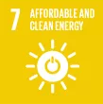
Sustainable development is top priority for Rosatom as the responsible vendor
Fighting energy poverty
Creating jobs
Sea water desalitation
Energy for water supply
Nuclear energy
Innovative non-energy& environmental solutions
Renewables
Affordable, clean and secure energy supply
Lifetime back-end solutions
Using nuclear to improve agriculture productivity
Energy for irrigation
Boosting growth through localisation
High GDP growth multiplier
Nuclear medicine
Powering hospitals and clinics
Improving infrastructure
Technology transfer
Knowledge transfer
Boosting local science school
We not just build CO2 friendly power plants and secure their entire lifecycle, but create conditions for long term GHG emissions reduction irreversible trend ensuring sustainable growth and development.
The content of this presentation is for discussion purposes only, shall not be considered as an offer and doesn’t lead to any obligations to Rosatom and its affiliated companies. Rosatom disclaims all responsibility for any and all mistakes, quality and completeness of the information.

Slide 8
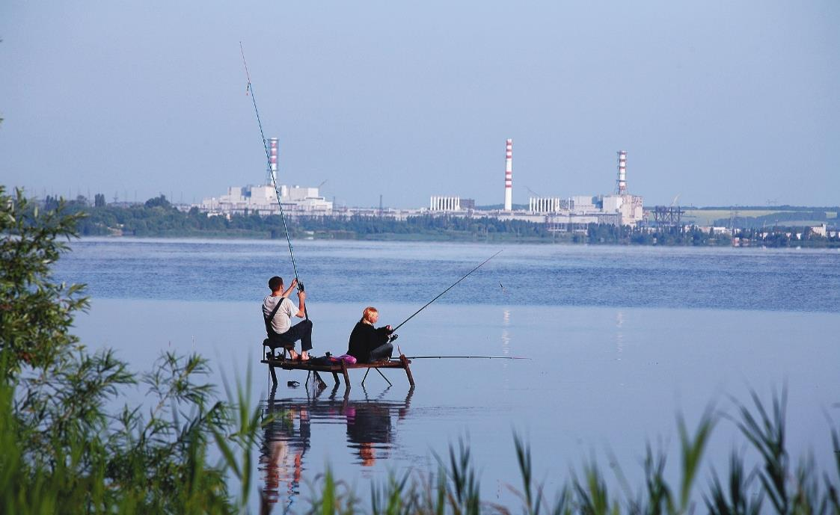
Thank you for your attention!
The content of this presentation is for discussion purposes only, shall not be considered as an offer and doesn’t lead to any obligations to Rosatom and its affiliated companies. Rosatom disclaims all responsibility for any and all mistakes, quality and completeness of the information.

Slide 9
ROSATOM – Corporation having no equal in the World
ROSATOM is the Russian state nuclear corporation
with 70 years experience in the nuclear field
Enrichment and Conversion
Uranium Mining
Nuclear
Medicine
Irradiation
facilities
Fuel
Fabrication
Research
Reactors
Equipment Manufacturing
NPP Construction, Operation, and Maintenance
Isotopes
Back End
Applied
Science
Power Generation
Power related
Non-power related
The content of this presentation is for discussion purposes only, shall not be considered as an offer and doesn’t lead to any obligations to Rosatom and its affiliated companies. Rosatom disclaims all responsibility for any and all mistakes, quality and completeness of the information.

Slide 10
ROSATOM Key Facts & Figures
360 enterprises
255,000 employees
35 NPP units (28,3 GWe) in operation in Russia
44 NPP units under construction and implementation globally
$110 bn. orders backlog for the next 10 years
Key competitive advantages:
Guaranteed supply of complete life-cycle products and services in nuclear power
Flexible capabilities of NPP supply from components and services to turn-key and BOO projects
Innovative technologies
proven by years of reliable operation and constant development
Diversified product range
stretching far beyond nuclear power
# 1
in new NPP construction
in uranium enrichment
in fast neutron reactors
in nuclear icebreakers
in floating NPP
biggest Research reactors fleet
# 2
biggest NPP fleet owned and operated
in uranium deposits
The content of this presentation is for discussion purposes only, shall not be considered as an offer and doesn’t lead to any obligations to Rosatom and its affiliated companies. Rosatom disclaims all responsibility for any and all mistakes, quality and completeness of the information.

