Slide 1
UNDP Support for the Formulation, Financing, Implementation and Reporting on Inclusive, Resilient and Low Emission Development Strategies
Low Carbon Growth in East Asia
and Japan’s Efforts
18 May, 2012, SB 36

Slide 2
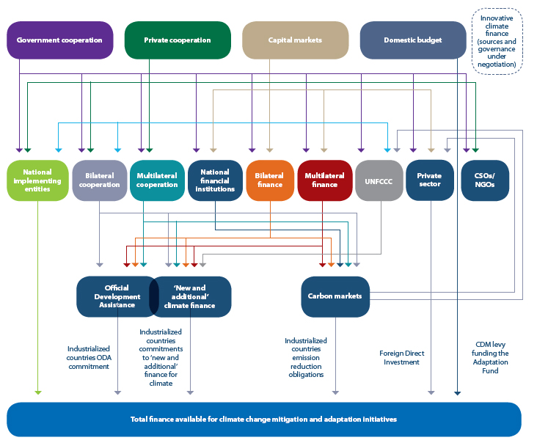
Sources, Agents and Channels of
Climate Finance – a complex picture
Source: Adapted by Yannick Glemarec from Atteridge and others (2009)
Notes:
Complex to mobilize external finance in ways that are aligned with national systems and priorities.
With more than 50 international public funds, 60 carbon markets and 6,000 private equity funds already providing “green” finance,
Multiple types of finance (such as carbon finance, finance for REDD+, etc.)
A variety of tools for delivering and packaging financing (such as sectoral approaches, performance-based payments, etc.)
International public finance used to support systems → navigate and take advantage of this landscape by accessing and using this multitude of finance

Slide 3
The “Climate Finance Readiness” Challenge
Despite growing volume/variety of resources (international & domestic, public & private), 3 key challenges to climate finance readiness:
National capacities to navigate complex landscape and allow countries to access/deliver different forms of finance
Need to catalyze private finance given public finance alone is insufficient to meet demands
Limited alignment between climate and development policy to drive economy-wide transformation

Slide 4
Approach to assist countries to plan for, access, deliver and report on finance for low emission growth
Prepare Green LECRDS
Development of Implementation Capacities
Implement and execute project, programme, sector-wide approaches
Green Markets Formation
Monitor, Report & Verify
Identify policy mix and sources of financing
Blend and combine finance
Allows to formulate transparent sector-wide approaches
Formulate project, progamme, sector-wide approaches to access finance
Build local supply of expertise and skills
Coordinate implementation
Assess needs and priorities, and identify barriers to investment
Directly access finance
Supporting national systems through this process for climate finance helps countries to use finance effectively
Building capacities for planning, accessing, delivering and MRV ensures climate finance is available and effective in all countries
Notes:
presents a four-part framework through which to understand the different components of readiness and the specific capacities needed to underpin it.
present a lens to organise the many targeted support programmes, guidebooks, publications, and toolkits on climate finance—offered by a range of other international and regional partners.
provide a framework through which to understand and the role of the plethora of tools, mechanisms, and modalities available for using climate finance—ultimately improving the capacity of policy-makers to put in place nationally-appropriate systems to manage climate finance.
Different configurations of these four components can exist within institutions, between institutions, or across national or sectoral systems. Different functions can be carried out through a variety of national systems and models, each of which is particular to its country context. Furthermore, external capacity development support is not required to build all components in all countries; many capacities within this framework already exist at the national level. In addition, in those countries where assistance is needed countries should be able to strengthen existing institutions, policies, and skills—this framework does not imply that efforts should start from scratch. The framework is intended as lens through which existing efforts and gaps can be organised and arranged; through this process, areas of further work can be identifies in a holistic and integrated manner, ultimately producing a more coherent approach at the national level.

Slide 5
Financial planning: Preparing Green Low-Emission Climate-Resilient Development Strategies (Green LECRDS)
Notes:
An umbrella for this planning work is the preparation of green, low-emission and climate-resilient development strategies. These strategies provide a vehicle for bringing needs assessments and priority setting processes together. They aim to bring about bottom-up national ownership, incorporate human development goals and take a long-term outlook.

Slide 6
Robust strategic planning must underpin financial decision-making
Develop Green LECRDS
Determine appropriate “policy-mix” and financing options
UNDP supports:
Technical and Policy Advice
Developing and Applying Methodologies
Oversight and Financial Management
Training
Multi-stakeholder Dialogues
Convening and Coordination
Generate & Share Knowledge
Establish Enabling Environment to Catalyze Capital
Catalyze Finance

Slide 7
Components of Climate Finance Readiness and Associated Capacities Required
Levels of national capacities | Financial Planning | Accessing Finance | Delivering Finance | Monitoring, Reporting & Verifying
Policy Level | Formulation of green, low-emission and climate-resilient development strategies and implementation plan, including costing | Sectoral policy incentives and regulations to catalyze private investments
Institutional Level | Effective national multi-stakeholder coordination mechanisms | Implementing entities with fiduciary systems and safeguards; national banking institutions | Implementing & executing entities with fiduciary systems and safeguards; project-level multi-stakeholder mechanisms; climate-aware public financial management systems | Centralized unit to compile data and for quality control reporting; communications unit
Individual/ skills level | Baseline assessments; I&FF assessments; expenditure reviews; costs-benefit analyses | Financial management (combining/ blending) skills; project/programme formulation skills; expertise in private sector pricing incentives | Specialist technology skills (e.g. wind energy technologies installation); project management skills | Expenditure review methodologies; GHG inventory skills; independent verification skills
Notes:
Each of the four components of climate finance readiness presented requires a combination of capacities—including policy tools, institutional capacities and technical skills—in order to function effectively. This slide presents a typology of these capacities, drawing on the discussion and examples from the sessions. The table illustrates the breadth and depth of what is required to be climate finance ready in terms of the four-component framework.
Moreover, it assists in understanding the varied capacity development and technical assistance services required to make a country ready to take advantage of climate finance, and it is thus a basis from which future readiness provisions can be designed.
A strong focus on building and strengthening these policy tools, institutional capacities, and technical skills at the national and local levels can improve the ability of developing countries to plan for, access, deliver, and monitor and report on climate finance. This leads to more effective and catalytic use of climate finance at the national level. With these capacities developing countries are better placed to overcome the key challenges outlined in the introduction of this paper—that is, to absorb finance, integrate it with overall development priorities and process and use it catalytically to generate transformations at the scale required to address climate change.
It is therefore critical that international and national decision-makers pay due attention to the breadth and complexity of the issues that need to be considered to make a recipient country climate finance ready.

Slide 8
UNDP’s support in China
Formulate provincial strategies
Develop Implementation Capacities
UNDP contributed to the design of China’s first climate change think-tank – National Centre for Climate Change Strategy and International Cooperation
Green Markets Formation
Monitor, Report & Verify
UNDP supported development of national GHG inventory in framework of National Communications
UNDP supported formulation of 32 provincial climate change programmes to implement national strategy
UNDP supported development of 2 energy efficient roadmaps
Identified priority mitigation and adaptation priority measures and associated costs
Assisted efforts to gradually develop a carbon market including a national emissions trading scheme
Critical for emission trading systems and formulation of transparent sectoral NAMAs

Slide 9
UNDP relevant support for Green LECRDS in Asia
National Communications: 24 countries
Low Emission Capacity Building: 7 countries
Mitigation: 24 countries
Adaptation: 38 countries (incl. regional projects)
Capacity Development: 28

