Slide 1
Innovative Financing for the Adaptation Fund Pathways and Potentials
Side Event COP22: Adaptation Fund – What next?
Carsten Warnecke
Marrakesh, 9 November 2016

Slide 2
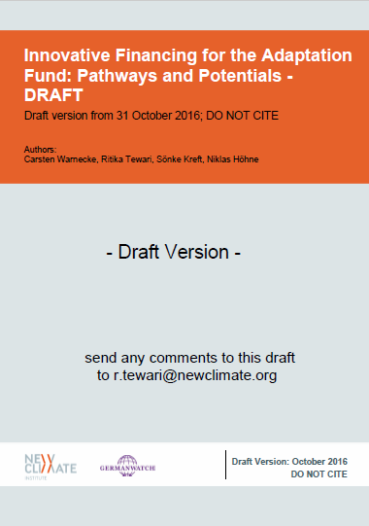
Contents of the presentation
Objectives
Selection of options
Evaluation approach
Results
Recommendations

Slide 3
Objectives of the study
Evaluation of the post-Paris landscape around finance sourcing for adaptation with focus on carbon pricing policy options as channels of innovative* climate finance
*‘being independent of the general budgets’; ‘beyond conventional ODA funding’; ‘not dependent on donor’s discretion’ and ‘new’
Market-based approaches ‘remain’ desirable…
CDM showcased their innovativeness and up-scale potential
global momentum for carbon pricing instruments
of interest to Parties and non-Party actors under PA
create visibility for the AF
…keeping this desirability in mind; our assessment focusses on options from carbon pricing policies

Slide 4
Selection of Options
A. International instruments
Option A.1: Share of proceeds (SOP) on international crediting
Option A.2: SOP from international unit transfers
Option A.3: Contributions from ICAO’s CORSIA scheme
B. National instruments
Option B.1: Earmarking auctioning revenues from national ETSs
Option B.2: Earmarking revenues from national carbon taxes
C. Instruments by non-state actors
Option C.1: SOP from Voluntary Carbon Markets
Option C.2: Earmarking auctioning revenues from subnational ETSs

Slide 5
Evaluation framework
Option A.1
Finance performance
Predictability
Performance against climate finance criteria
Option A.2
Option A.3
Impact
Climate impact
Fairness
Each sub-criteria is rated in the range of low, medium and high* on a comparative basis
Option B.1
Option B.2
Feasibility
Stakeholder support
Operational feasibility
Option C.1
Option C.2
Options
Evaluation criteria
Rating
*except for ‘climate impact’; which is rated positive, negative or neutral

Slide 6
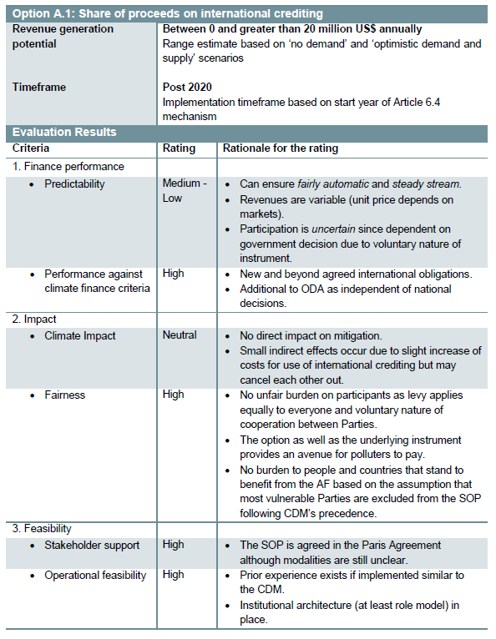
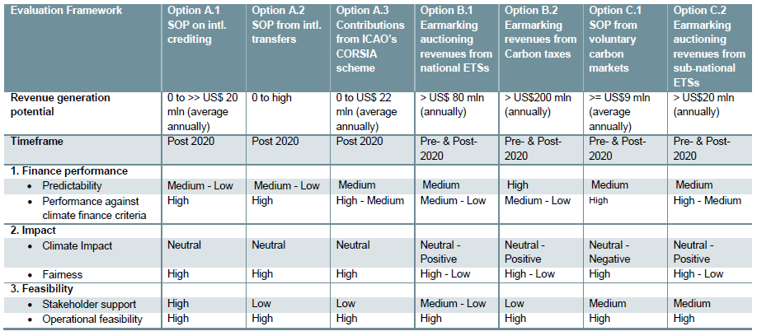
leads to…
Results for each option
Summary of results for all options

Slide 7
Results
All options have a high operational feasibility (i.e. CDM SOP; AAU & JI SOP; EU ETS earmarking)
All options can be designed to lead to fair adaptation finance contributions (i.e. SOP exclusion of LDCs; PPP)
All options can be designed with neutral climate impact overall
Limited stakeholder support is currently the main stumbling block
Overlaps in scope for some of the options lead to alternative avenues for tapping the adaptation finance potential

Slide 8
Potentials
mixed bag of prospective options with varying revenue generation potential and timeframe of implementation
National
International
Earmarking in national ETSs | > US$ 80 mln annually
Earmaking in national carbon taxes | > US$ 200 mln (annually)
SOP on Article 6.4 mechanism | 0 to 20 million US$ annually
SOP on Article 6.2 transfers | Enormous theoretical potential, but uncertain trade volumes
Contributions from ICAO | 0 to US$ 22 mln (average) annually
Non-state Actors
SOP from voluntary carbon markets | ~9 mln US$, (average) annually
Earmaking in sub-ntional ETSs | > 20 mln US$, annually
Pre-and post-2020
Post-2020

Slide 9
International Instruments
High revenue generation potential in general, although for all options a “No contribution scenario” exists
Article 6.4 SOP agreed but modalities and magnitude remains uncertain
Adaptation contributions from intl. unit transfers (Article 6.2) are rated very similar compared to intl. crediting (Article 6.4) – is the different treatment fair?
Contributions from ICAO technically feasible but lack support

Slide 10
National Instruments
ETSs and carbon taxes have a particularly high revenue generation potential
Short term potential since already operational in many countries
Obligatory nature of instruments provide reassurance and predictability for multi-year cycles
Risk of political interference can be avoided if earmarking is legally enshrined or through a multi-year political commitment

Slide 11
Non-State Actor Instruments
Smallest direct revenue generation potential
But voluntary markets and subnational ETSs can make an important contribution to transform the financing landscape
Innovative and ambitious actors to create role models for other levels
Interest from proactive jurisdictions makes this option potentially the most plausible in the pre-2020 timeframe

Slide 12
Recommendations
Follow up on all options - Finance generation based on different levels can turn markets into a relatively stable source of finance
Closely follow and continue engagement with Parties on Article 6 implementation (Article 6.4 and 6.2)
Continue pushing on contribution from ICAO (demand or supply side approach)
Engage with non-state actors to create short term success and role models for national instruments
Explore opportunities with proactive countries to create earmarking role models in national instruments

Slide 13
Carsten Warnecke; Ritika Tewari
Sönke Kreft
NewClimate Institute
Germanwatch e.V.
c.warnecke@newclimate.org
r.tewari@newclimate.org
kreft@germanwatch.org
www.germanwatch.org
www.newclimate.org

