Slide 1
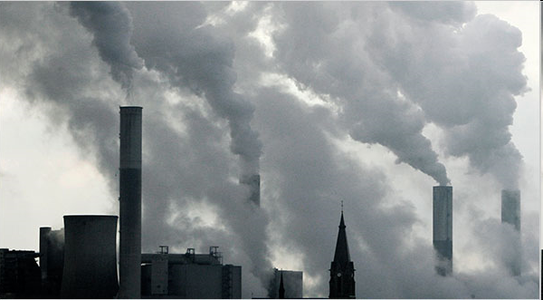
Supporting EE and CIS transition to Low Emission Development
Daniela Stoycheva
Climate change policy advisor
Side event, Bonn 9 June 2011, “Lessons learned in low-emission development strategies and …”

Slide 2
Regional Project
Assists the RBEC countries to develop capacity to formulate, mobilize finance and implement Low-emissions Development Strategies (LEDS) or Nationally Appropriate Mitigation Actions (NAMAs)
The countries will be enabled to make informed policy and investment decisions, that reduce GHG emissions, reduce poverty, create new employment opportunities and green jobs and move societies towards long term sustainability.

Slide 3
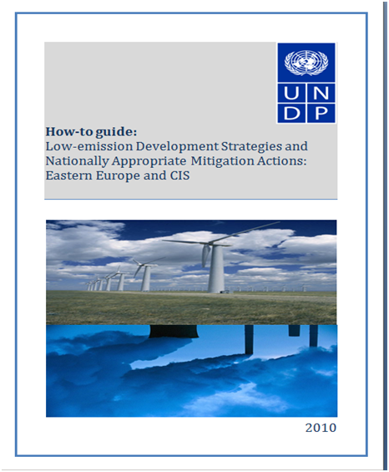
Developed:
How to Guide on Low-emission development strategies and Nationally Appropriate Mitigation Actions: Eastern Europe and CIS – in English and Russian
Drafts of LEDS in Kazakhstan and Moldova, initiated in Uzbekistan, Turkmenistan, Tajikistan, Turkey and Armenia

Slide 4
Main steps in the development of LEDS
Decision to develop LEDS/NAMAs
1. Scoping and planning
2. Development or evaluation of baseline and LED GHG emission scenario
3. Determination of mitigation options
4. Assessment of financing of mitigation options
5. Implementation, monitoring and MRV
Coordination mechanism
National expertise
Identification of NAMAs requiring support
List of NAMAs/PAMs

