Slide 1
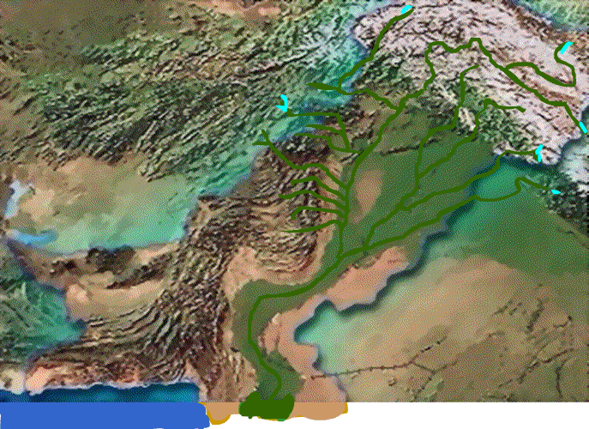
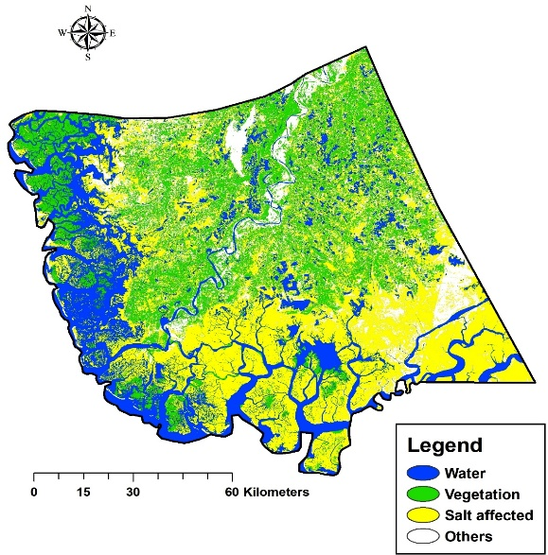
DeltasUNite - UNCCRD INDUS @ COP28
CHALLENGES
UNCCRD
CLIMATE CHANGE
FLOWS TO DELTA
HIGH RISKS OF COASTAL POLLUTION & FLOODING
SEA WATER INTRUSION
LAND DEGRADATION & GROUNDWATER CONTAMINATION
LIVELIHOOD, MIGRATION & SOCIETAL ISSUES
STAKEHOLDER AWARENESS
PUBLIC & PRIVATE PARTNERSHIP
TRANSBOUNDARY COOPERATION
FINANCIAL EDUCATION
SDG GOALS
RIVER
COP28
ISSUES BEYOND BORDERS
Focus on NATURE, LIVES & LIVELIHOOD
Deliver MITIGATION & 2x ADAPTATION
PRESIDENT asks for: “COMMITMENTS to SAVE DELTAS”
DELTA
PAKISTAN: GLOBAL & NATIONAL PLAN & POLICIES, MOUNTAINS TO DELTAS, NDC → NCCFund → National Adaptation Projects
LIVING INDUS INITIATIVE 11-17B$ + RECHARGE PAKISTAN PROJECT 78 M$

Slide 2
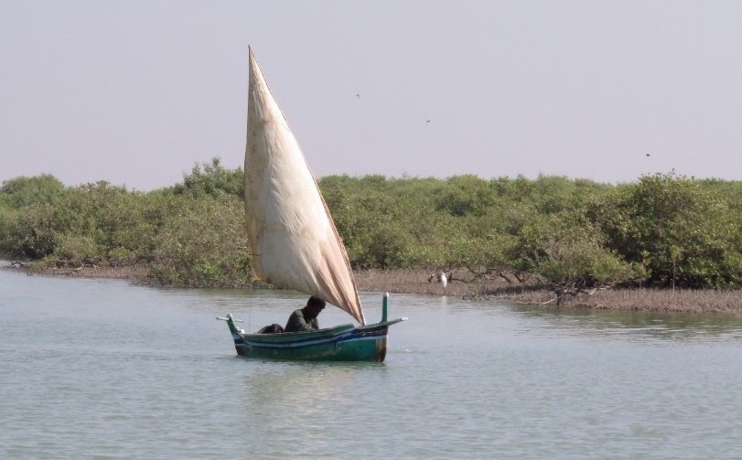
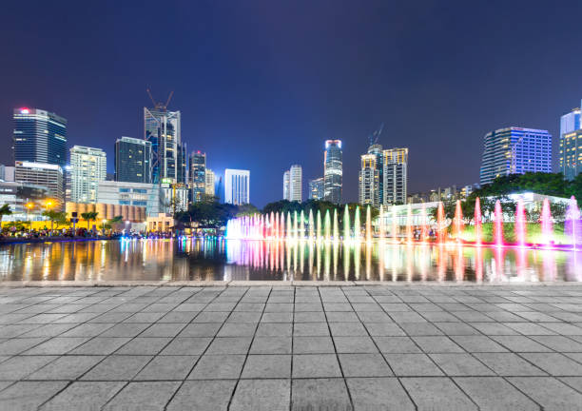
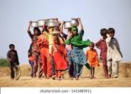
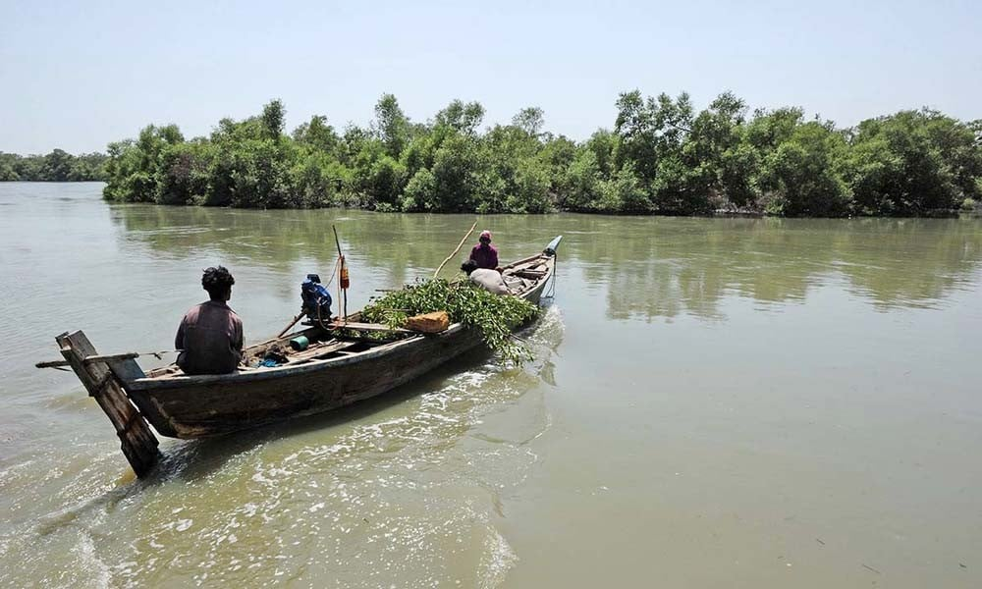
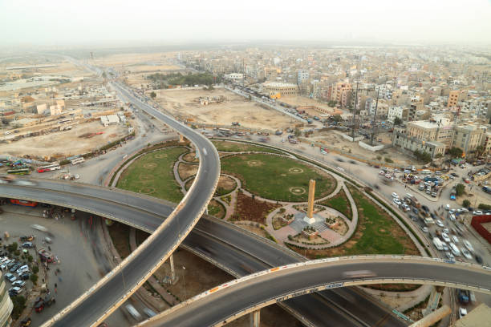
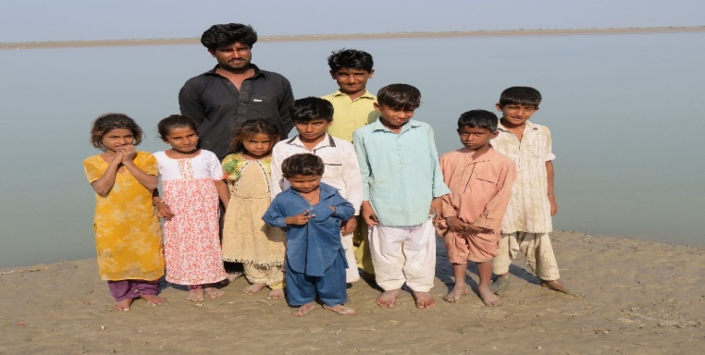
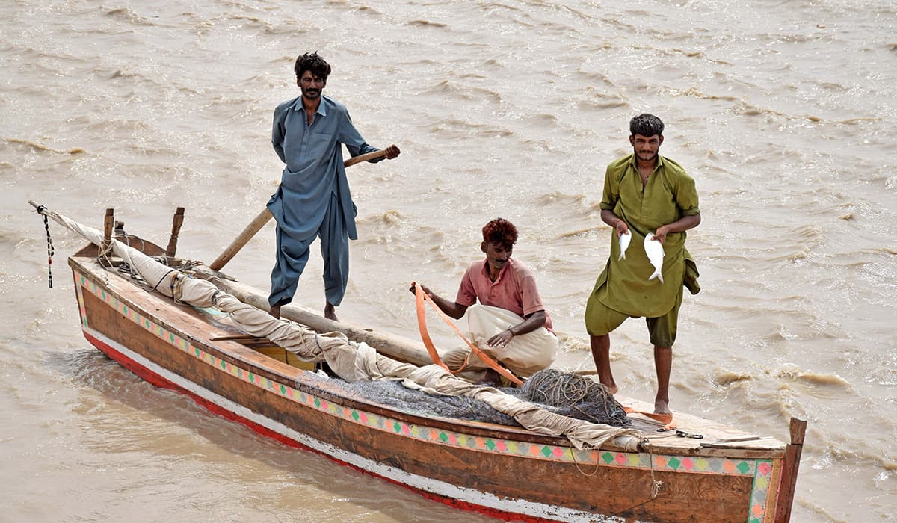
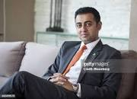
Indus Delta & City People

