Slide 1
Building Resilience to Climate Change through Sustainable Forest Management
Building resilience in the agricultural sectors for adaptation to climate change
FAO side event, UNFCCC, Bonn, 15 May 2012
Tiina Vähänen, FAO
Susan Braatz, FAO

Slide 2
Contents
Risks, implications and responses
Building resilience in natural and human systems
Building institutions that support resilience
Sustainable Forest Management as a framework for action

Slide 3
Risks, implications and responses
Risks and impacts of climate change:
Decreased forest and tree vitality and productivity; extinctions of species
Increased risk of pests & diseases; wildfires; erosion; landslides, land degradation
Socio-economic implications:
Reduced forest revenue & ecosystem services
Loss of life and property & damage to infrastructure
Response measures:
Changes to silvicultural practices and species composition; intensified pest, disease and wildfire management; increased watershed protection...
Maintaining healthy ecosystems and restoring degraded ones are the keystones of adaptation
Sustainable Forest Management (SFM) provides a robust framework for action in climate change risk reduction, resilience and adaptation

Slide 4
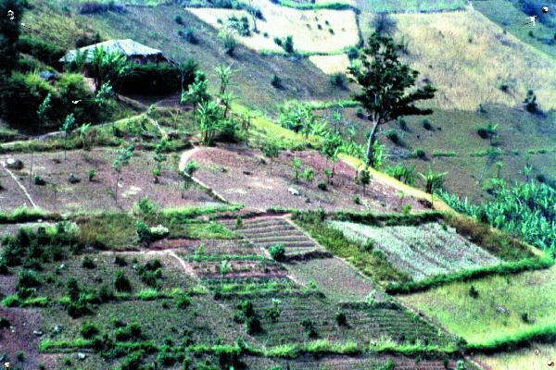
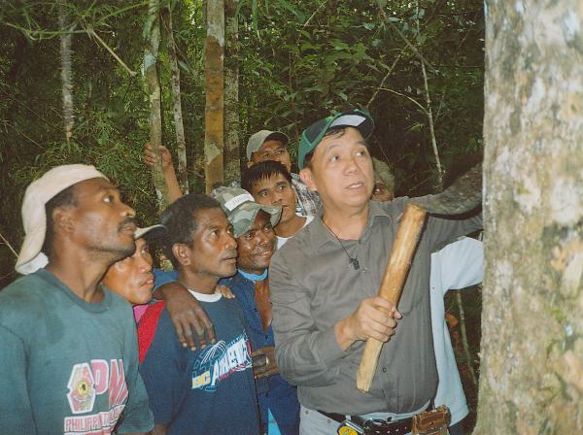
Content
Forests/trees to increase human resilience
Diversify production to reduce economic risk,
e.g. agroforestry
Offer alternative or additional employment,
e.g. small forest enterprises
Use of forests as safety-nets
Adapt and adopt traditional coping mechanisms
Notes:
Forest and tree management can contribute significantly to increasing human resilience and adaptation to climate change
1) Diversification of production in agroforestry and reducing biophysical and economic risk may be an important adaptive strategy for farmers
This picture, taken in Makamba province in Burundi shows hillsides subdivided in small plots ploughed along the contour lines and separated by greenbelts of leguminous and fodder species. Fruit trees and agroforestry are progressively expanding.
2) Forests can also offer alternative or supplementary employment
- Some examples of small forest enterprises are shown here:
- Furniture made from bamboo in Cameroon
- Mobile sawmill in Peru
- Forest communities tapping resin – or Manila copan -- an important export crop of the Philippines
3) Forests are important as safety-nets for families in times of emergency – providing food and products for sale to keep the family alive
4) Using and sharing traditional coping mechanisms of forest dwellers and forest communities is important for facilitating adaptation.

Slide 5
Content
Building resilient landscapes
Increase connectivity in the landscape
Adopt a landscape approach to planning and management
Integrated forest management, mountain development, watershed management, drylands management, coastal zone management…
Overall: more integrated natural resources management and land use planning are needed
Notes:
At the landscape level, I would like to mention two approaches for increasing resilience and adaptation to climate change.
One is to increase connectivity in the landscape, for example through forest corridors which allow species to migrate. Maintaining biodiversity and thus ecosystem functions facilitates spontaneous adaptation to climate change.
Another is adopting a landscape approach to land use planning and management, or managing the natural resources and land uses in a landscape in a coherent and integrated manner to meet human needs sustainably. Integrated mountain development, watershed management, drylands management and coastal zone management will be increasingly important for rational land use in the face of climate change and climate variability.

Slide 6
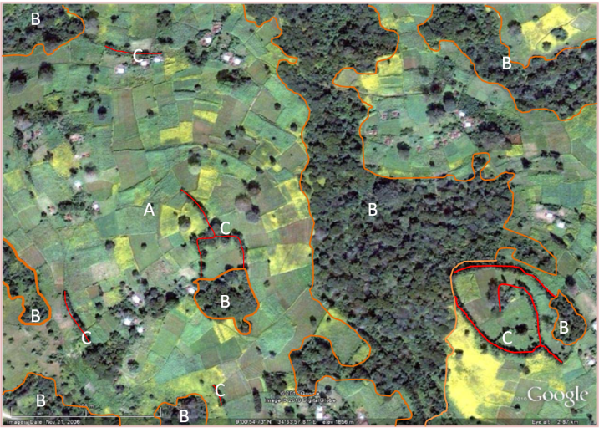
Impacts and response measures
Landscape approaches
“70 % of Africans are small-scale farmers. Agriculture is the key to our future. There is no better way to way to fight poverty and ensure food security”. (Ethiopian Prime Minister Meles Zenawi)
He advocated the approach which his country had adopted: massive reforestation, widespread irrigation, and soil and water conservation.
(Climate Smart Agriculture – Africa: A Call to Action, UNFCCC COP17 in Durban)
Notes:
The Prime Minister of Ethiopia spoke eloquently at the last UNFCCC COP in Durban about his country’s integrated approach for achieving climate smart agriculture. Agricultural production relies on soil and water conservation, including through reforestation for watershed protection and rehabilitation
This arial photograph in Ethiopia shows trees grown in mixed cropping systems and forests retained in the upper watershed.

Slide 7
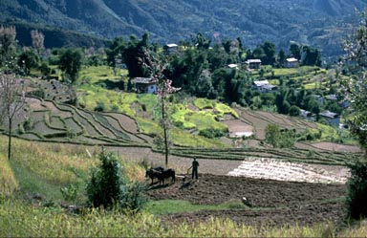
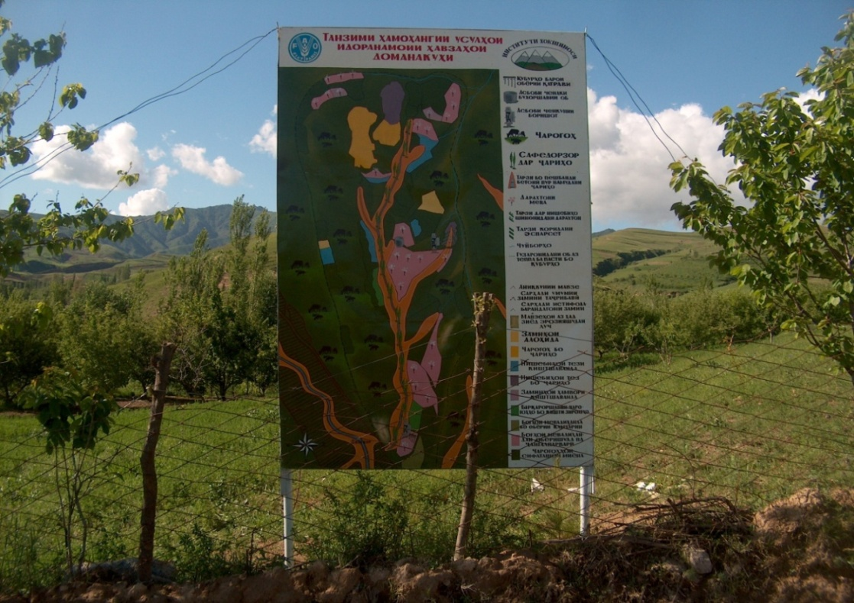
z
Policy Framework for
Integrated watershed management
Jhikhu Khola, Nepal
Forests integrated in farming systems and in the landscape
Bodomo watershed, Faizabad District, Tajikistan
Land use plan developed through a participatory process
Notes:
Here we see two examples of integrated watershed management.
1) Forest and trees are well integrated into farming systems in Nepal. The slide shows forests on steep slopes and interspersed in the farming systems. Forests are important for a range of products for household use and sale but also for fodder and bedding for livestock.
2) The other slide shows a community-developed land use map for Bodomo in Tajikistan watershed where FAO is supporting integrated watershed management through participatory planning.

Slide 8
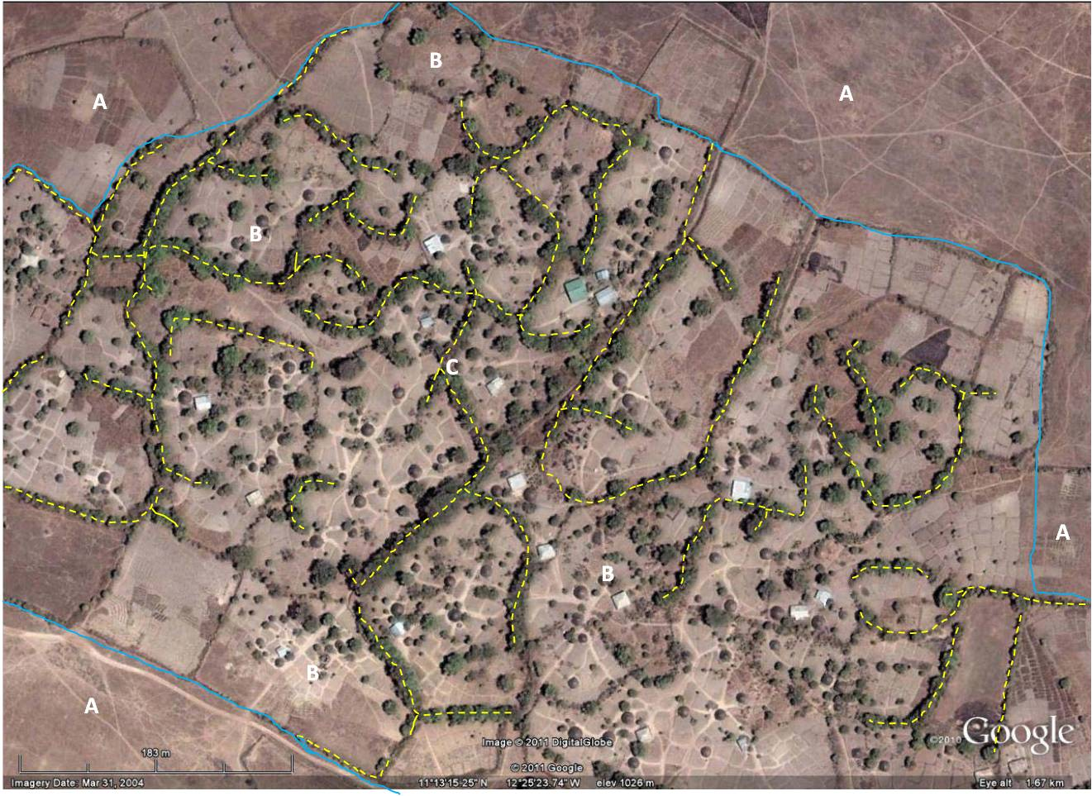
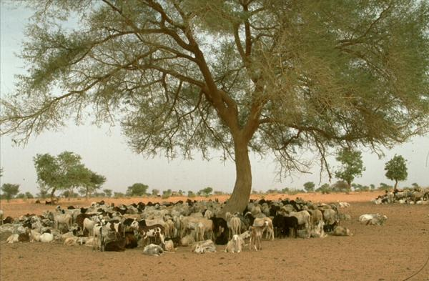
Content
z
Dryland agroforestry systems
Guinea. Mosaic of crop fields, pastures and
houses with boundary trees and wind breaks
Mali. Parkland agroforestry systems.
Acacia in sorghum fields, livestock in
fields after harvest
Notes:
Trees and forests are integral part of the agricultural landscapes in Africa, providing a range of products as well as protection against land degradation.
Here we see two examples.
1) The photograph in Guinea shows a mosaic of crop fields, pastures and house with boundary trees and windbreaks.
2) Trees in the acacia parkland agroforestry system, common throughout the Sahelian region of west Africa, contribute to soil fertility of croplands, provide food and shade for livestock, furnish wood for human use, and offer some protection to soils from erosion.

Slide 9
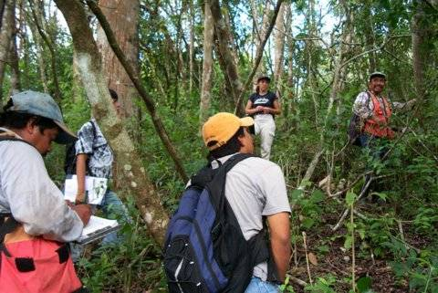
Content
Policies & institutions supporting resilience
Coordinated action and policies at national level
Strong local institutions
Capabilities for monitoring
Support adaptive research
FAO Forestry
Notes:
Enabling policies and strong institutions are needed to support adaptation actions on the ground.
Forest policies may have to be adapted. Active intersectoral coordination is needed more than ever.
Strengthening local institutions so that they are able to take appropriate and timely action and empowered to do so, is crucial. We see examples here in the sellers of non-wood forest products in front of their stand in a market in Cameroon, and a meeting of a women’s forest users group in Nepal.
Monitoring of forests and forest products and their use will help to identify needs and opportunities for climate change adaptation. This and adaptive research will help drive adaptive management.

Slide 10
Content
Sustainable Forest Management
“ a dynamic and evolving concept intended to maintain and enhance the economic, social and environmental value of all types of forests for the benefit of present and future generations” (UN General Assembly)
Seven thematic elements of SFM:
Extent of forest resources
Forest biodiversity
Forest health and vitality
Productive functions of forest resources
Protective functions of forest resources
Socio-economic functions of forests
Legal, policy and institutional framework
National Forest Programmes:
first commonly agreed framework for SFM - applicable to all countries and to all types of forests - promote participatory approaches
Notes:
The overriding goal of SFM has driven global, regional and national forest policy for over two decades. The concept of SFM has been universally accepted. The description adopted by the UN General Assembly is that SFM seeks to maintain and enhance the economic, social and environmental value of all types of forests for the benefit of present and future generations.
Seven thematic elements of SFM – defining its scope --have been identified.
National forest programmes is a commonly agreed policy framework, guided by a set of principles, to support country efforts in SFM. A range of approaches, tools and practices, as already mentioned, support the application of good management practice in the field.
SFM is considered to be a robust foundation to support climate change adaptation. It recognizes the need to adapt to changing circumstances, to work intersectorally and to use participatory processes to reach agreement on the appropriate balance of social, environmental and economic functions of forests and the benefit sharing thereof.

Slide 11
z
Policy Framework for SFM
Key messages
Sustainable Forest Management (SFM) provides a solid foundation for reducing risk, enhancing resilience and implementing adaptation measures
Many tools and successful approaches to support SFM exist
More needs to be known about climate change impacts and resilience of both natural and human systems
Building local capacities and institutions to provide for adaptive decision making is crucial
Resilient forest ecosystems support landscape resilience
Increased livelihoods resilience
Multiple benefits for people and environment
FAO Forestry

