Slide 1
The contribution of the CDM to technology transfer
CMP.6 - Side Event
Cancún, Mexico, 3 December 2010
Andrew Howard (OIC Manager – Strategy & Policy)
Erik Haites (UNFCCC Consultant)

Slide 2
What is this study about?
It measures a co-benefit of the CDM – its contribution to the transfer of technology (TT)
We investigated the receipt of TT:
countries receiving technology through CDM
CDM project types for which TT is prevalent
factors determining the level of CDM TT
trend of CDM TT as the mechanism has matured
….and the supply of TT:
countries from which technology originates
diversity of technology suppliers by project type
the relationship between technology supply and acquisition of CERs

Slide 3
Context of the work
Parties are currently deliberating on:
Reforms and improvements to CDM
Market instruments as a components of response to climate change
A Technology Mechanism to increase the transfer of and access to environmentally sound technologies and know-how
Carbon markets are making adjustments based on evidence
The study is useful for enhancing the CDM and informing the design of any future market instruments that aim to scale up and channel technology and financial support for mitigation in developing countries
The paper advances thinking on how to ensure the effective implementation of the Technology Mechanism once it is agreed by Parties
It provides empirical evidence for market adjustments

Slide 4
Definitions & scope
Definition of TT = the use by the a CDM project of imported equipment and/or knowledge
Analysis based on statements relating to TT in PDDs
Analysis covers all 4,984 projects in the pipeline as of 30 June 2010 (rejected, withdrawn projects excluded)
Covers all projects since the start of the CDM
Projects located in 81 host countries
Projects cover 25 project type/technology categories defined by UNEP Risoe
NOTE Project type definitions have changed
Extends similar earlier studies by the Secretariat (2007 and 2008) and by other researchers
More projects and longer time permit new analyses

Slide 5
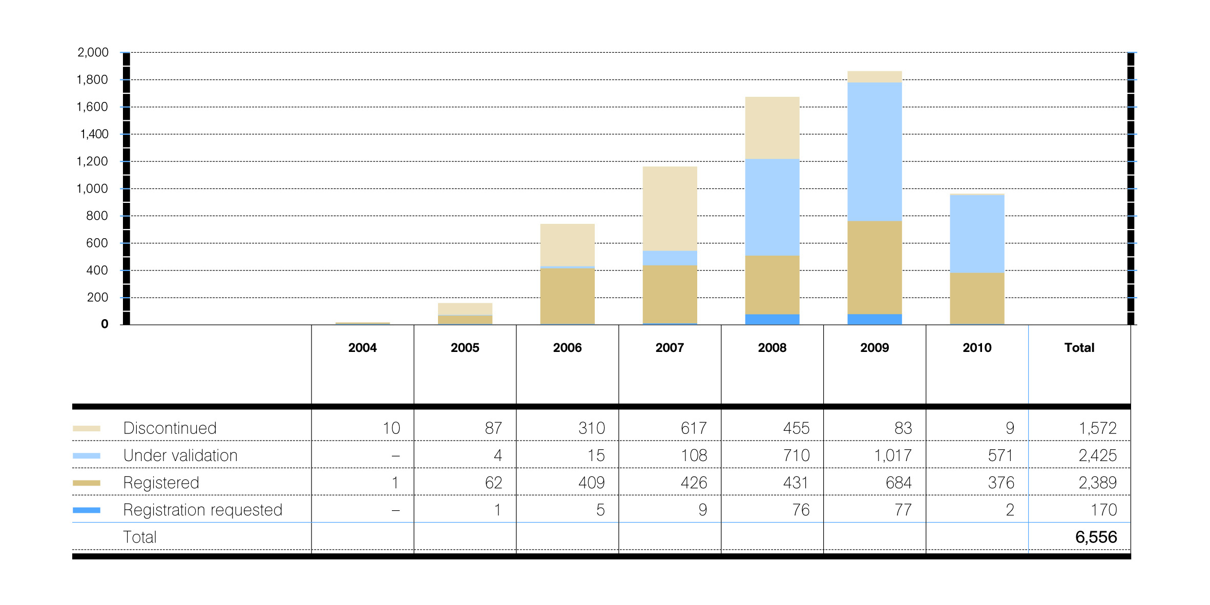
Number of projects entering the pipeline by year (with project status as of 30 June 2010)

Slide 6
TT Categories
Based on information in the PDD, a project is categorized as:
No technology transfer – clear statement that project will not involve technology transfer
Technology transfer – project involves transfer of
Knowledge only
Equipment only
Both knowledge and equipment
Unknown – no statement in the PDD relating to TT
Past studies assumed that ‘unknown’ projects involved no technology transfer

Slide 7
Follow-up Survey
Projects covered by 2008 report were surveyed
11% responded; this sample is representative
Key findings:
Categories of ‘TT’ and ‘No TT’ quite accurate; almost 90%
Nature of technology transfer – Knowledge only, Equipment only, or Both knowledge and equipment – NOT accurate; Substantially higher rate of Both K&E than indicated in the PDDs
About 60% of Unknown projects involve TT
Implications:
Need to exclude ‘Unknown’ projects (about 20%) from the analysis
Consolidate all TT – knowledge, equipment, both – into one category

Slide 8
Frequency of TT
Assuming ‘Unknown’ = No TT frequency has fallen:
2007 – 39% of projects, 64% of reductions
2008 – 36% of projects, 59% of reductions
2010 – 30% of projects, 48% of reductions
Real frequency of TT has been higher because ‘Unknown’ projects involve TT
2010 – 40% of projects, 59% of reductions
Possibly as high as 44% of projects

Slide 9
Frequency of TT
TT usually more common for larger projects
Most projects are ‘Unilateral’ – have only participants from the host country when the PDD is posted for public comment
Unilateral projects about 10% smaller than average
TT is less common for unilateral projects, but more frequent for larger unilateral projects
About 45% of projects use a small-scale methodology
Small-scale projects average 29 ktCO₂e/year
TT is less common for small-scale projects, but more frequent for larger small-scale projects

Slide 10
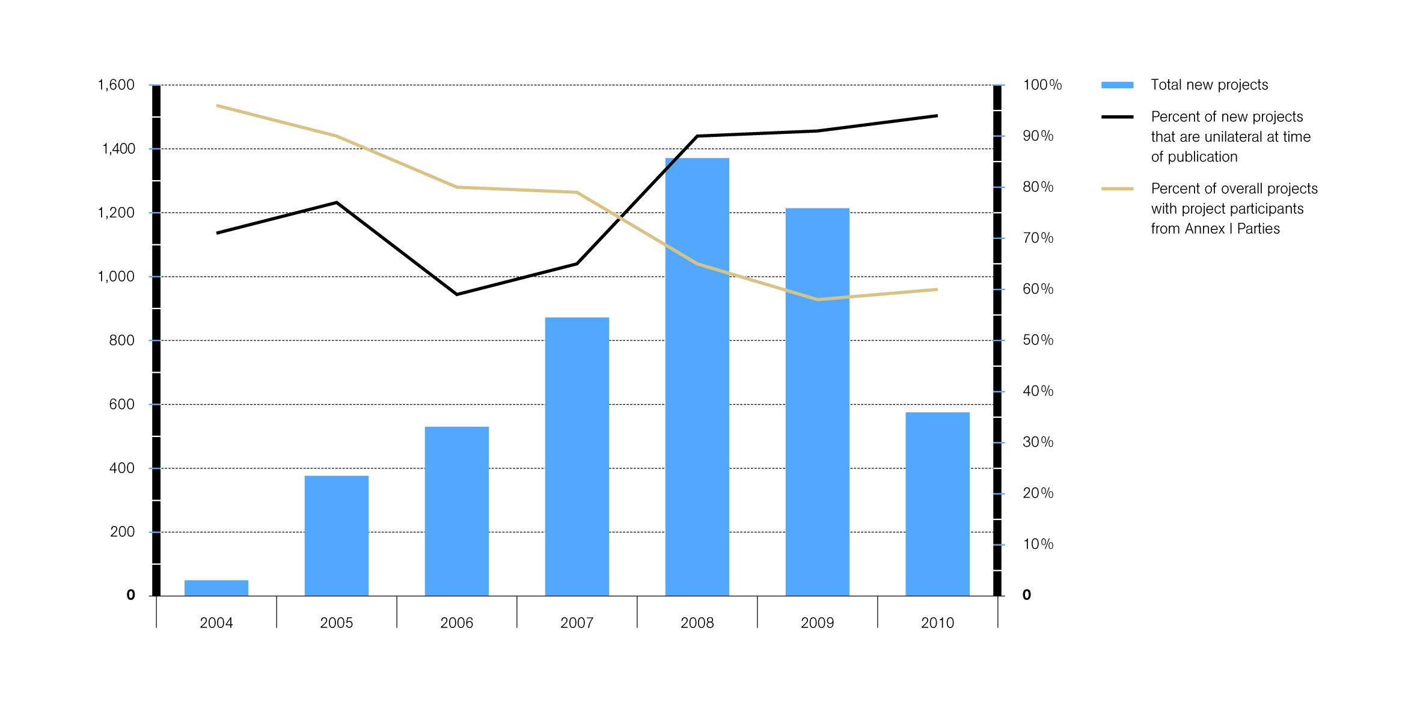
Number of projects entering the pipeline by year and the extent of unilateral projects (as of 30 June 2010)

Slide 11
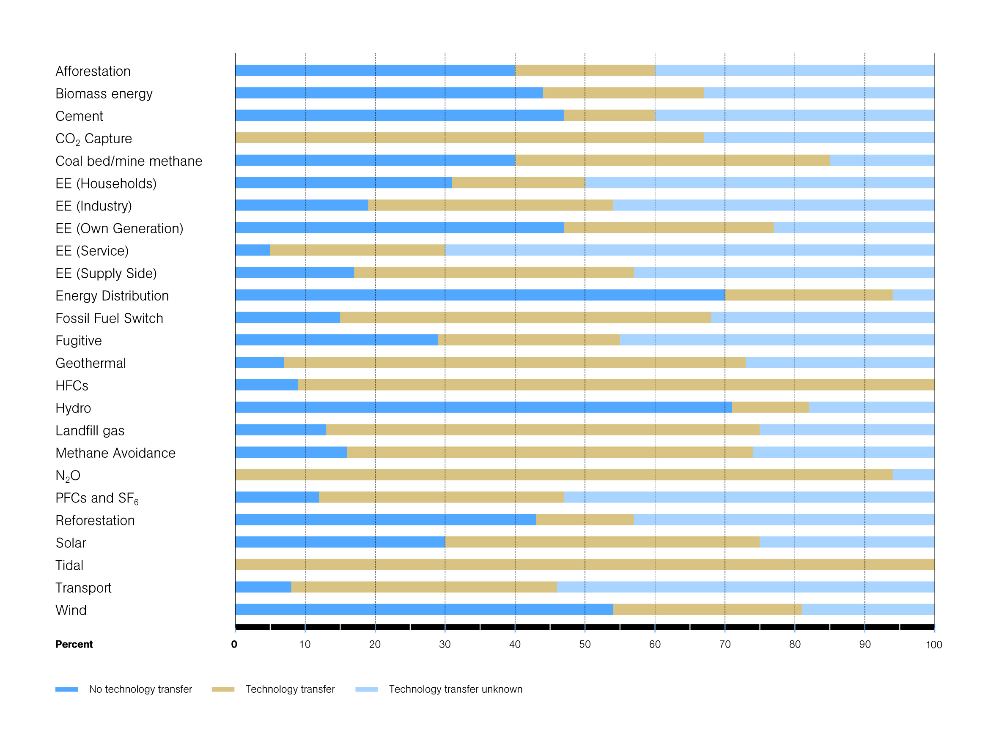
Technology transfer by project type as a % of projects

Slide 12
Frequency of TT by Project Type
Frequency of TT varies widely by project type
Energy Efficiency (Industry), HFCs, N2O, Transportation and Wind projects more likely to involve TT
Afforestation, Biomass Energy, Cement, Fugitive Gas, Hydro, PFCs and SF6 and Reforestation projects less likely to involve TT
Frequency declines as the number of projects of the same type in a host country increases, suggesting that technology transfer often occurs beyond the CDM projects

Slide 13
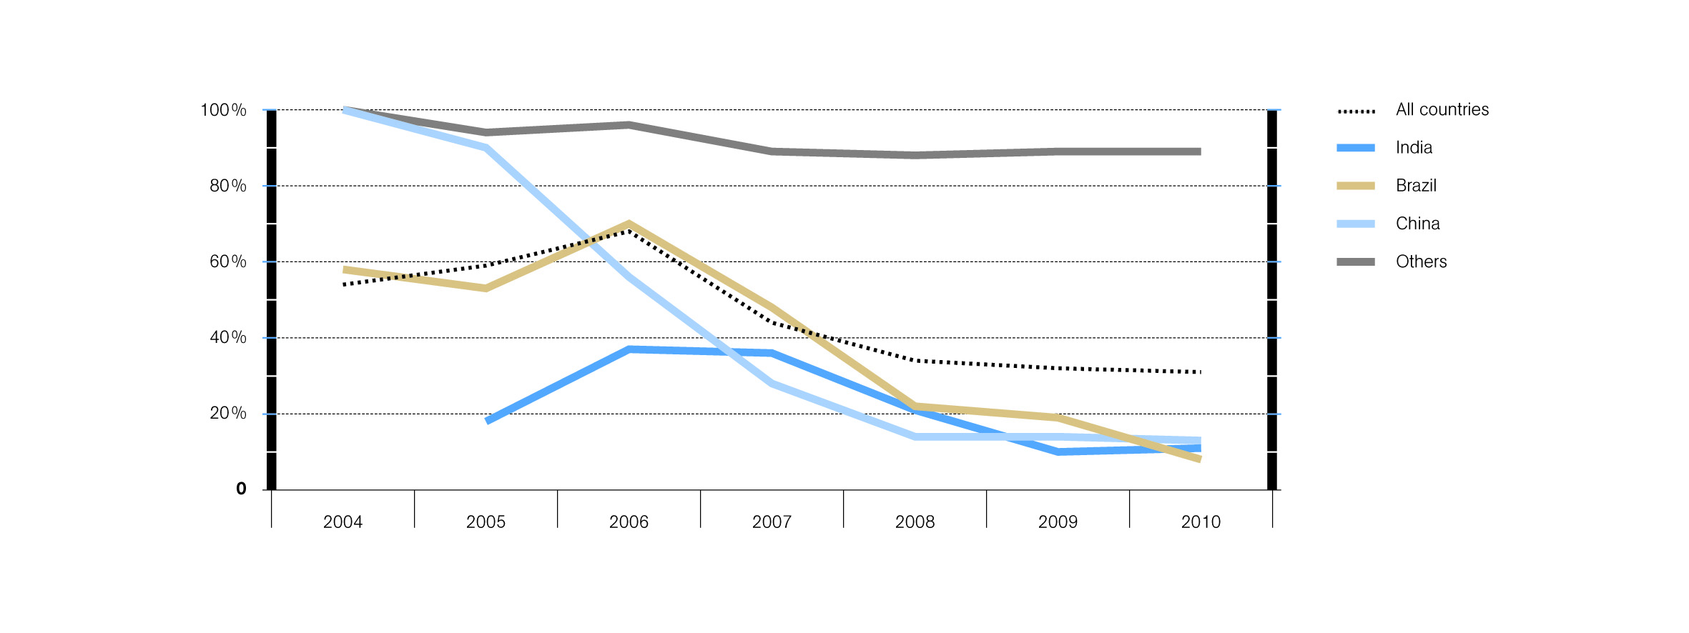
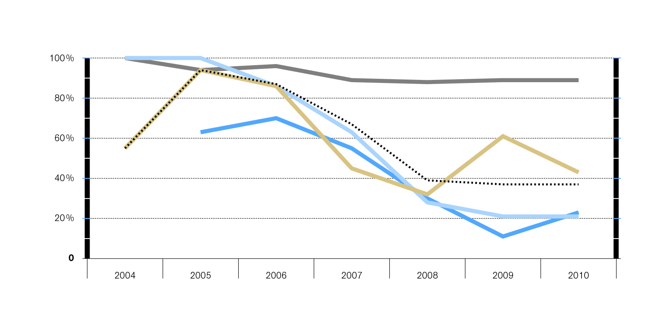
Trend in technology transfer
by number of projects
by annual reductions

Slide 14
TT Trend by Country
Most CDM projects located in China, India, Brazil
Frequency of TT has declined significantly over time for all of these countries
Technology has been transferred to those countries by CDM projects and other channels
Since they host most projects, the overall frequency of TT has also declined
Frequency of TT remains very high for all other host countries

Slide 15
Host Country Key to Frequency of TT
Statistical analysis shows that almost every host country plays a significant role in frequency of TT
Can do this explicitly through the criteria it establishes for approval of CDM projects.
Other factors, such as tariffs or other barriers to imports of relevant technologies, perceived and effective protection of intellectual property rights, and restrictions on foreign investment also can affect the extent of technology
Host countries with smaller populations, lower ODA per capita, less developed business infrastructure, lower import tariffs, a lower democracy indices and lower technical capacity more likely to CDM projects with technology transfer

Slide 16
Barriers to TT
Preliminary analysis conducted for 43 countries where barriers could be identified by technology (project type) from TNAs (not representative of all host countries)
TNA identifies Economic/market, Human, Information, Institutional, Infrastructure, Intellectual property, Policy, Technical, Regulatory and Other barriers
Information barrier lowers the rate of TT for CDM
Economic/market and Intellectual property rights barriers raise rate of TT, perhaps because CDM can help overcome them
Results are preliminary

Slide 17
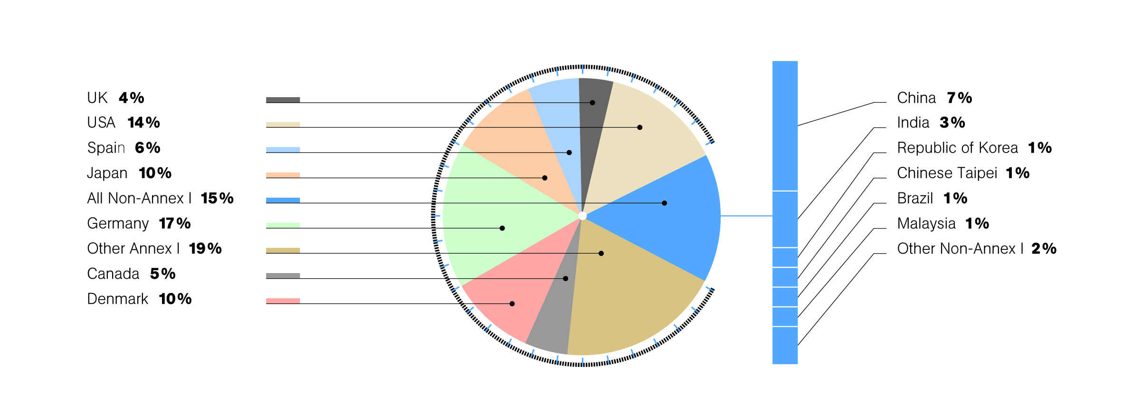
Leading sources of technology transfer (as a percentage of projects)

Slide 18
Technology Suppliers
Top five technology suppliers are Germany, the USA, Japan, Denmark and China
Most project types draw on technology from several countries (next slide)
Project types (14) for which sufficient data are available suggest that project developers have a choice among a number of domestic and/or foreign suppliers with no dominant supplier able to restrict the distribution of the technology and/or keep the price high
Most Annex I countries tend to receive CERs from projects for which they are a technology supplier, although the nature of this relationship is not known

Slide 19
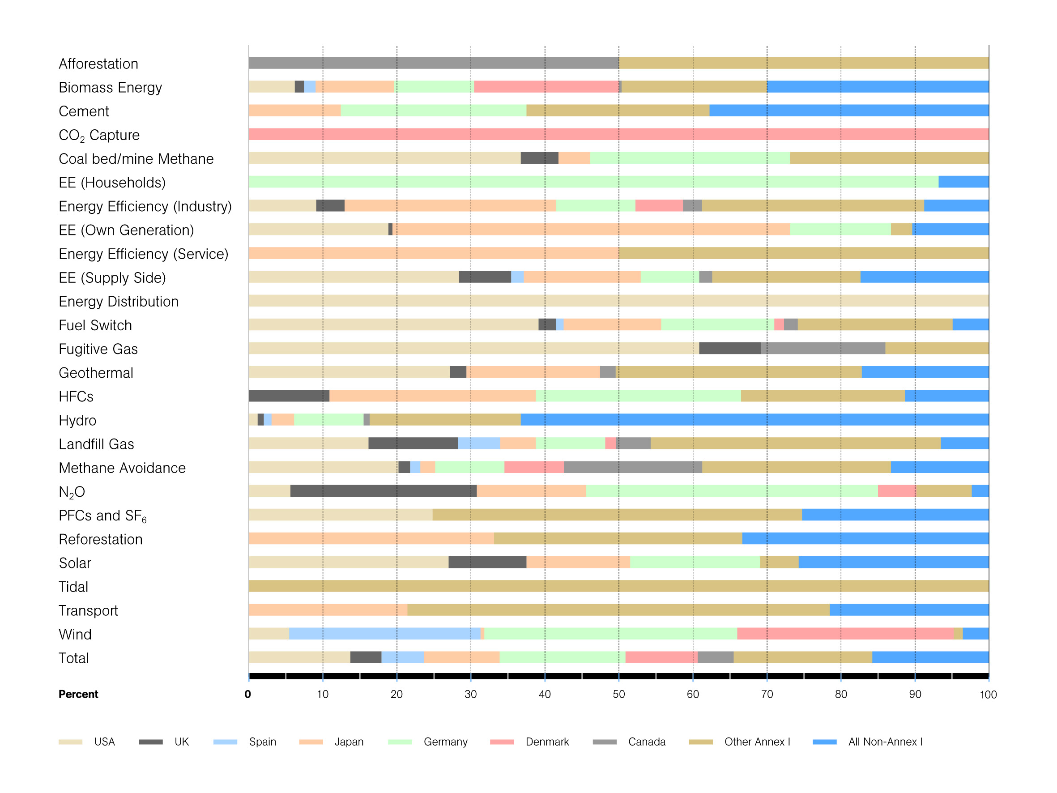
Origins of technology transfer by project type (as a percentage of projects)

Slide 20
Summary
CDM has helped deliver technology to developing countries
CDM project creates capacity in countries so later projects rely more on local knowledge and equipment
Technology transfer increases as the number of projects of a given type in a host country rises
Rates of technology transfer in previous studies are too low
Rates reported in this study are conservative
TT is more common for larger projects
TT is more common for projects with foreign participants (less common for unilateral projects)

Slide 21
Summary
Small-scale projects are less likely to involve technology transfer
TT very diverse by project type
For most project types frequency of TT is higher for larger projects
TT is most likely to involve both knowledge and equipment
Almost every host country plays a significant role in frequency of TT
Frequency of TT has declined significantly over time in China, India and Brazil
Frequency of TT remains very high for all other host countries

Slide 22
Summary
Preliminary results suggest Information barriers lower the rate of TT and that the CDM may help overcome Economic/market and Intellectual property rights barriers
Top five technology suppliers are Germany, the USA, Japan, Denmark and China (84% of projects)
Project developers have a choice among a number of domestic and/or foreign suppliers with no dominant supplier able to restrict access to the technology and/or keep the price high
Most Annex I countries tend to receive CERs from projects for which they are a technology supplier, although the nature of this relationship is not known

Slide 23
Opportunities for Improvement
Much was done to improve the data, but more could be done
Reduce the number of projects where TT is ‘Unknown’
Reduce the number of projects where technology supplier is not known
Improve the accuracy of the TT classification through follow-up. Knowledge/Equipment/Both
More time series data for independent variables to test different time lags
More TNAs that identify barriers by technology
More country/technology specific variables such as technical capacity, and ‘taxes’ on CERs
Measures of demand for technology by host country

Slide 24
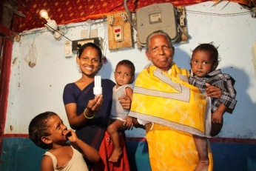
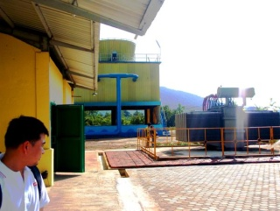
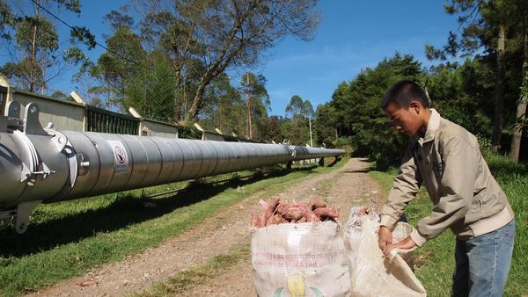
A thank you to those authors not present today:
Stephen Seres Kevin Murphy
www.unfccc.int

