Slide 1
Damage and losses in the agriculture sectors and its influence on National Adaptation Plan outcomes
Julia Wolf Natural Resources Officer Climate and Environment Division, FAO

Slide 2
The impact of disasters on agriculture
Share of climate-related disasters’ damage and losses absorbed by agriculture in developing countries (2003-2013)
Damage: Total or partial destruction of physical assets and infrastructure in disaster-affected areas.
Losses: Changes in economic flows arising from the disaster
Source:
FAO (2015), based on 78 PDNAs

Slide 3
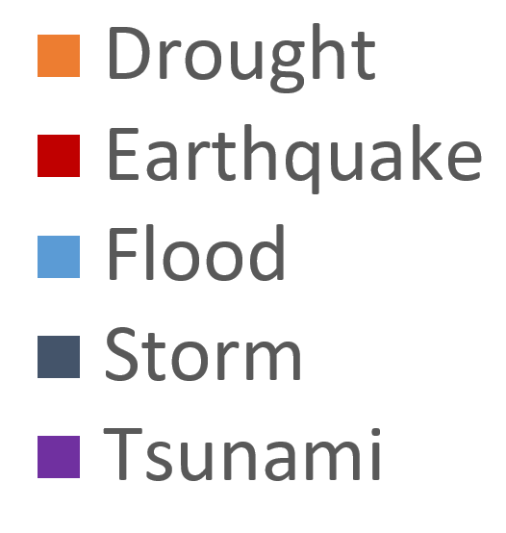
Damage and Losses to agricultural sectors by climate-related disasters
Source:
FAO (2015), based on 78 PDNAs

Slide 4
Building resilience in the agriculture sectors
Source: Gitz and Meybeck (2012)

Slide 5
Barriers to harnessing synergies between disaster risk reduction and climate change adaptation
Separate global and national agendas
Institutional arrangements
Development agendas
Capacity constraints

Slide 6
Bridging gaps through the NAP process
Element A: Lay the groundwork
Element B: Preparatory elements
Element C: Implementation Strategies
Element D: Reporting, monitoring and review
Entry point: improved access to climate change information
Entry point: integration of mutual concerns in sectoral planning and programming
Entry point: integration of mutual concerns in sectoral actions and investments
Entry point: sharing of lessons learned and best practices

Slide 7
Integrating agriculture in National Adaptation Plans (NAP-Ag) Programme
The NAP-Ag Programme has four main objectives:
Strengthen technical capacity
Develop integrated roadmaps for NAPs
Improve evidence-based results for NAPs
Promote agricultural NAPs through advocacy and knowledge sharing

Slide 8
Where do we work?
11 Countries
Asia
Nepal
The Philippines
Thailand
Viet Nam
Latin America
Colombia
Guatemala
Uruguay
Africa
The Gambia
Kenya
Uganda
Zambia

Slide 9
Commonalities and differences
Source: FAO, 2015
CCA
Science-based CC impact scenarios
Climate-related hazards
Includes changes to average conditions
Medium to long-term focus
DRR/M
Origins in humanitarian development
All (natural) hazards
Focuses on extreme events
Analysis based on past and current events
Short to medium-term focus
Similar objectives
Mutually complementing Poverty and underlying risk/vulnerability reduction
Mainstreaming
Resilience
Kyoto Protocol
Kobe 2nd WCDRR
Cancun Framework,
Warsaw Mechanism
Hyogo Framework
COP 21
Sendai Framework
Sustainable Development Goals (SDGs)
Mitigation to Adaptation
Disaster Response to Prevention and Preparedness
CCA/Resilience?

Slide 10
THANK YOU!
fao.org/climate-change

