Slide 1
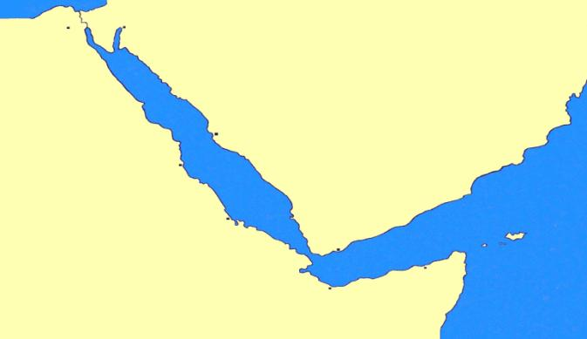
Coastal Ecosystem based Adaptations to the impacts of Climate Change in the Red Sea and Gulf of Aden Region: Perspectives and Policy Options
الهيئة الإقليمية للمحافظة على بيئة البحر الأحمر وخليج عدن
Ahmed S. M. Khalil
Programme Coordinator
Living Marine Resources & Climate Change
PERSGA
ahmed.khalil@persga.org

Slide 2
Outline
The Region’s comparative advantage for Coastal EbA solutions
Policy options for EbA implementation in the region
PERSGA Strategy
Regional Strategy for Adaptation to the Impacts of Climate Change
Means and Tools: Habitat specific RAPs, MPAs Network-RMP & other program activities

Slide 3
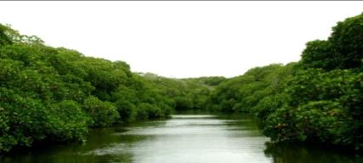
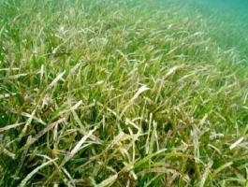
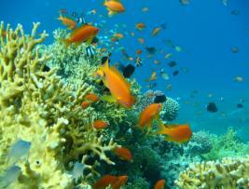
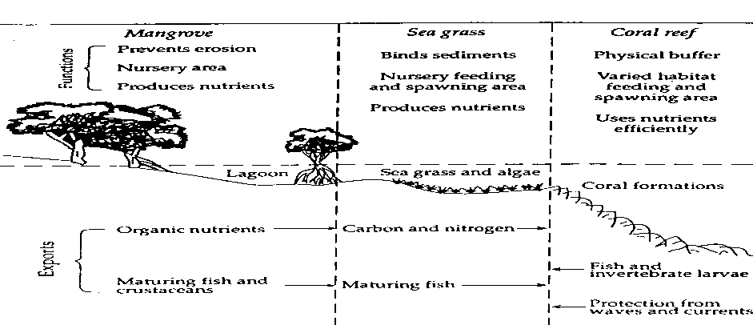
Key marine ecosystems/ the resource base is rich in the Red Sea and Gulf of Aden (PERSGA region)

Slide 4
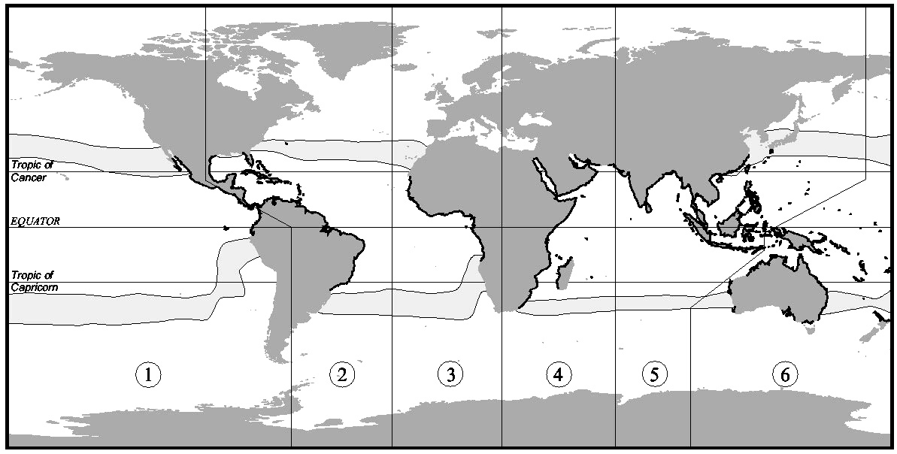
World Mangrove Distribution

Slide 5
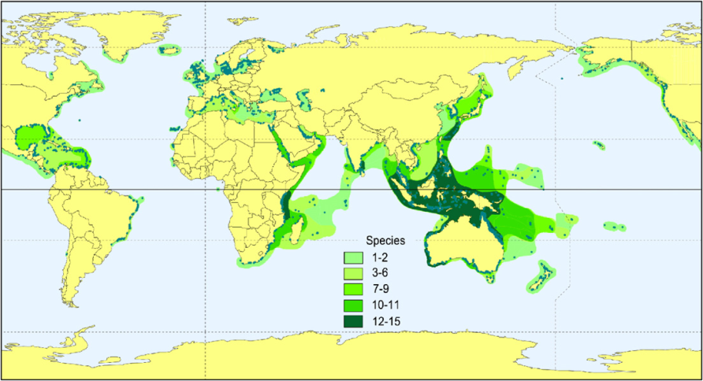
World Seagrass Distribution

Slide 6
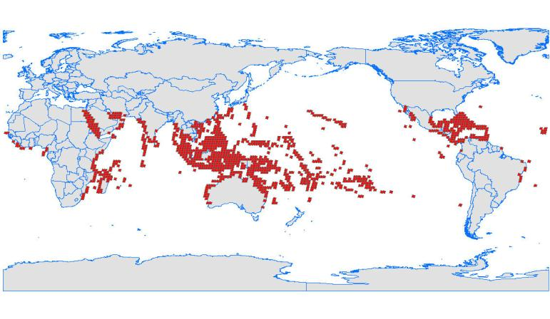
World Coral Reefs Distribution
The Red Sea represents less than 0.2 per cent of the world’s ocean, while it supports around 6 per cent of the world’s coral reefs

Slide 7
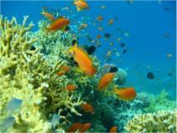
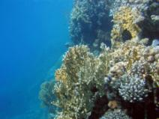

Slide 8
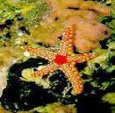
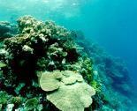
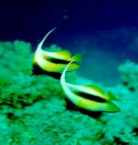
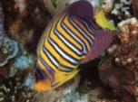
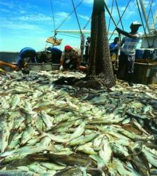
The Red Sea is one of the most important repositories of marine biodiversity in the world.
Coral reef: ≈ 300 species
Echinoderms: ≈ 170 species
Decapoda: ≈ 130 species
Polychaetes: ≈ 567 species
in comparison: Arabian Sea 141 species
Arabian Gulf 231 species
The Gulf of Aden is an area of oceanic upwelling, resulting in high productivity of fishery resources

Slide 9
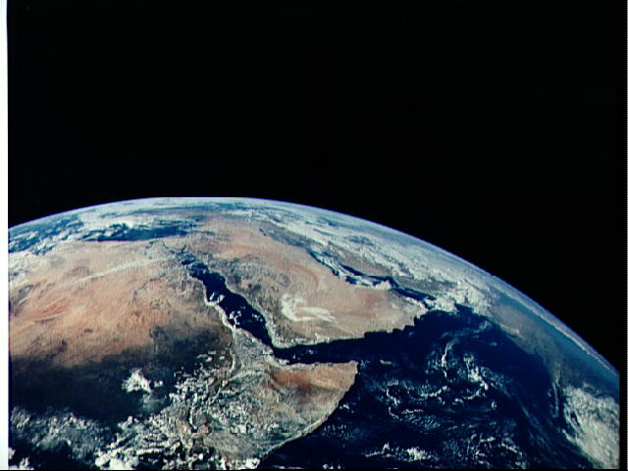
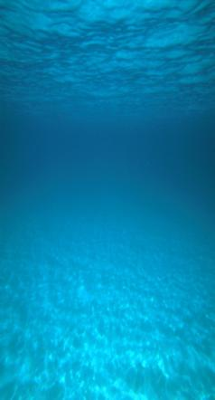
The Red Sea has distinctive geology and oceanography
Red Sea is the warmest among the world’s seas
Arid area, very low precipitation; absence permanent freshwater inflow
Limited water exchange with the Indian Ocean
Red Sea has long water retention time ≈ 200 years
Gulf of Aden is strongly affected by the Monsoons
Thermocline
Semi-permanent thermocline
Vertical mixing is limited

Slide 10
Policy options for implementation of Ecosystem based Adaptations in PERSGA region
Integrated management planning for strengthening resilience of key coastal habitats
Education and Awareness for Sustainability
Sustainable Utilization of Marine Resources
Coastal Marine Protected/ Managed Areas (CMPAs /MMAs)
Control of Sea-based and Land-based Pollution
EbA Research and Economic Valuation

Slide 11
PERSGA Regional Strategy for Adaptations to CC Impacts
Coastal Vulnerability Assessment and Monitoring
Capacity Building
and Awareness
Establish Regional CC Observation System
Ecosystem-Based Adaptations
Mobilize Funding for Adaptation
7 regional workshops during 2008-2012:
Coastal Vulnerability: Assessment methods (2 workshops)
Coastal CC induced risks: assessment and management
Monitoring CC impacts on coral reefs
Red Sea climatology & climate variability
Adaptation Funding
Ecosystem based Adaptations in coastal areas
In collaborations with UNEP and ISESCO
Demo projects:
assessment of coastal vulnerability and support EbA projects development and implementation in PERSGA countries

Slide 12
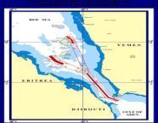
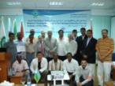
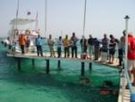
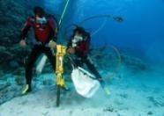
Regional Action Plan Major Objectives
Assessment of Coastal-Marine environment
Guidelines for Sustainable Resource Management
Legal Base for Cooperative Efforts
Support Institutional Mechanism
Mainstreaming in PERSGA Program Components
Living Marine Resources Program
Biodiversity-MPAs Program
Regional Monitoring Program
Land-Based Activities Program
EMARSGA
Adaptations to Climate Change
Environmental Education and Awareness
Supportive/ Crosscutting
Programs
Annual Training Program: Capacity Building
PERSGA Information System
Demo Activities Program: Demo Projects

Slide 13
PERSGA achieved interventions addressing key Marine Habitats, Biodiversity and Living Resources
Develop Standard Survey Methods and Monitoring of the Key habitats Region (Mangroves, Coral Reefs, Seagrass beds) in 2000
First Regional and National Status Reports (2003)
Develop Regional Action Plans (RAPs), and National Action Plans for the member States (NAPs)- 2004-2005
Establish the regional legislation framework (Regional Biodiversity & MPAs Network Protocol) in 2005
Regular training and guidelines on assessment, management, and restoration methods, and
Demo projects in the countries to enhance implementation of the NAPs

Slide 14
Other comprehensive interventions
ICZM baseline assessment, planning and implementation (since 2001)
Adoption of Ecosystem Approach to Fisheries Management (since 2009)
Establish Regular Process for Integrated Assessment & the State of Marine Environment Reporting (SOMER) since 2006
Regional Strategy for Adaptations to Climate Change Impacts in Coastal and Marine Environment (since 2008)

Slide 15
PERSGA Annual Training Programme: multiple objectives
Capacity building
Networking
Building partnerships
Exchange expertise
Address emerging issues
Technology/knowledge transfer

Slide 16
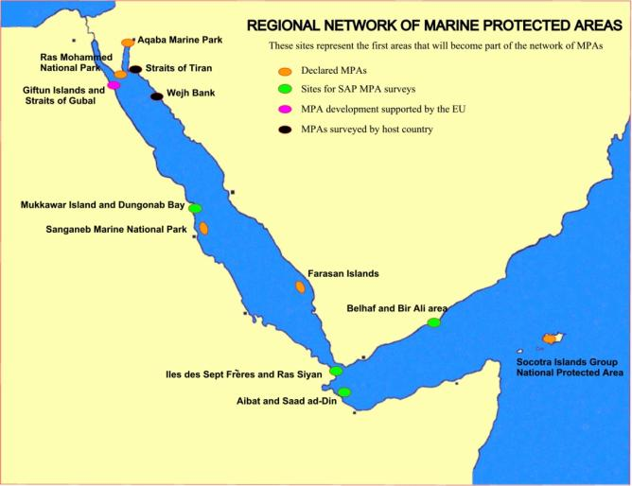
The Regional Network of MPAs
Total area of the already defined MPAs in the Regional Network is around 11,000 km²
Support developing MPAs master plans and capacity building.
Follow-up interventions:
Regional coordinating meetings
Training on MPA management
Demo activities and projects
Notes:
16

Slide 17
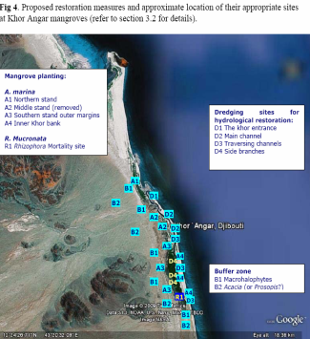
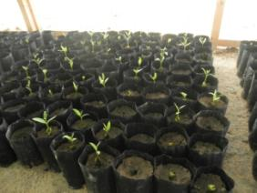
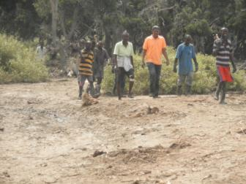
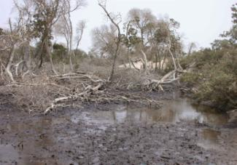
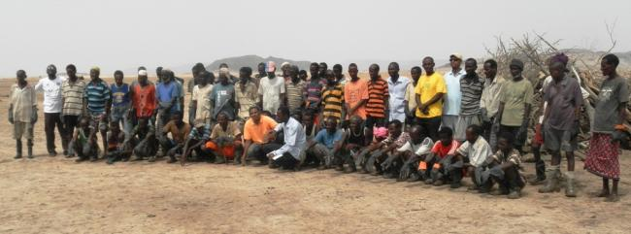
Djibouti: mangrove based adaptation activities Project: Strengthening ecosystem resilience for adaptation to CC impacts
PERSGA has supported developing a GEF funded project for coastal vulnerability assessment and adaptations to CC impacts
The project focuses on mangrove restoration, improve capacities of water and coastal flooding risk management

Slide 18
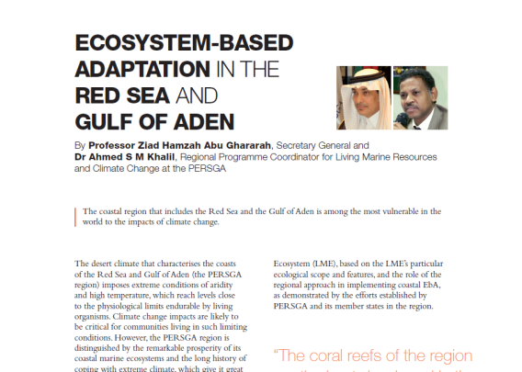
For more information on the Ecosystem based Adaptation issues in PERSGA Region: PERSGA publication in Climate Action 2012/2013 release page 164-167 www.climateactionprogramme.org

Slide 19
www.persga.org
Thank You…

