Slide 1
Up and down the scales of time and place: Integrating global trends and local decisions to make the world more food-secure by 2050 International Food Policy Research Institute (IFPRI)

Slide 2
Building Climate Smart FARMERS
The Indian Perspective
Presented by
DR. KIRIT N SHELAT, I.A.S. (Rtd)
National Council for Climate Change, Sustainable Development and Public Leadership (NCCSD)

Slide 3
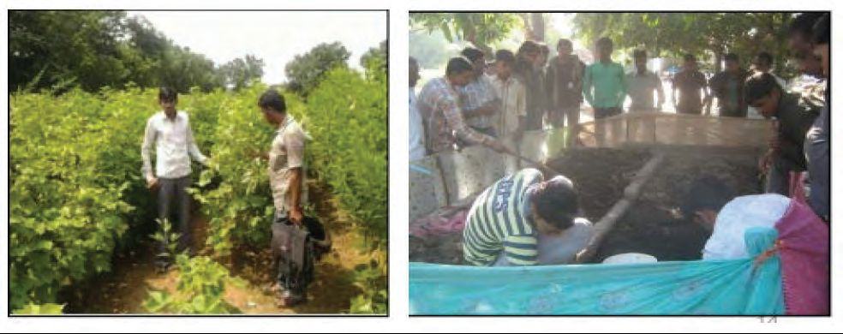
Use of Balanced Fertilizer based on Soil Health Analysis – the case
study of Jambusar, Bharuch, Gujarat
Maheshbhai Sindha, Piludra of Jambusar Taluka of Bharuch district owns three acres of land. He was using intensive chemical fertilizer and seeds with cheaper price. In his cotton , expenses were high and the yield was low. Based on Soil Health Analysis in 2012 , he started using certified seeds and balanced doze of fertilizer both organic and in organic-chemical. This reduced his cost in agricultural operations by Rs.2,800 and increased productivity in cotton by 4 quintal. He started using crop residue and cow dung along with worms to develop compost fertilizer. This increased productivity further by one quintal and simultaneously, he started selling worms to other farmers to make their compost. Within two years, his income increased to Rs.31,500/-.

Slide 4
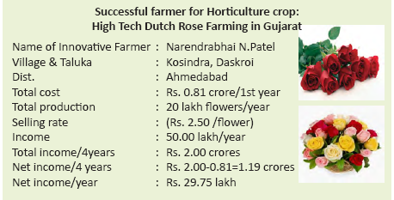

Slide 5
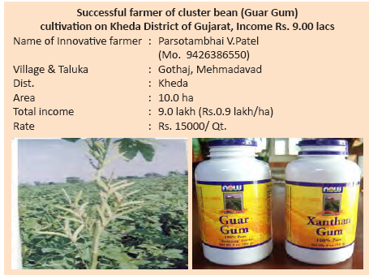

Slide 6
AGRO MICRO ENTERPRISE

Slide 7
Initiative Needed at International level for Local Problems Enhancing Food Security and Reduce of Poverty
National Council for Climate Change, Sustainable Development and Public Leadership
International Community need to:
Recognize agriculture as a major mitigation tool and adopt mechanism to address the loss and damage associated with the impacts of climate in highly vulnerable countries to restore agriculture and immediately prepare farmers for adaptation including mid-season. – Agro Advisory.
Allocate green fund for
- Technology transfer from “those who have it to those who need it”
- Bring new areas such as wasteland and wetland under agriculture for creating livelihood opportunities and to meet the challenges of food security.
Make available special financial support for community bio-gas plants, grassland development in desert areas.
Identify crops – plants species which survive on saline water soil and sea water.
Sensitize national governments to provide safety net to farmers in terms of insurance and fallback employment in community projects.
Set International Weather Advisory to support countries who do not have local advisory
Promote international trade for value added agriculture.

Slide 8
LEADERSHIP FOR GREENER AGRICULTURE
National Council for Climate Change, Sustainable Development and Public Leadership
Global Warming is a threat, but it can be converted into an opportunity. It is possible to make this happen a win-win situation for all, if all efforts are channeled towards sustainable development with Greener Agriculture at its centre.
Countries-Governments-all over the world will have to view the impact of climate on farmers with a grave concern. The change which is creeping in rapidly-with dangerous consequences to habitat and its stability. This confrontation is on “Nature’s Front”. Nuclear weapons or armies are no solution. The solution lies in bringing back balance in nature’s forces : the atmosphere, the sun, the earth, the water and the vegetation. The solution lies at local level. Our endeavor should be to overcome this challenge and convert it to an opportunity.

Slide 9
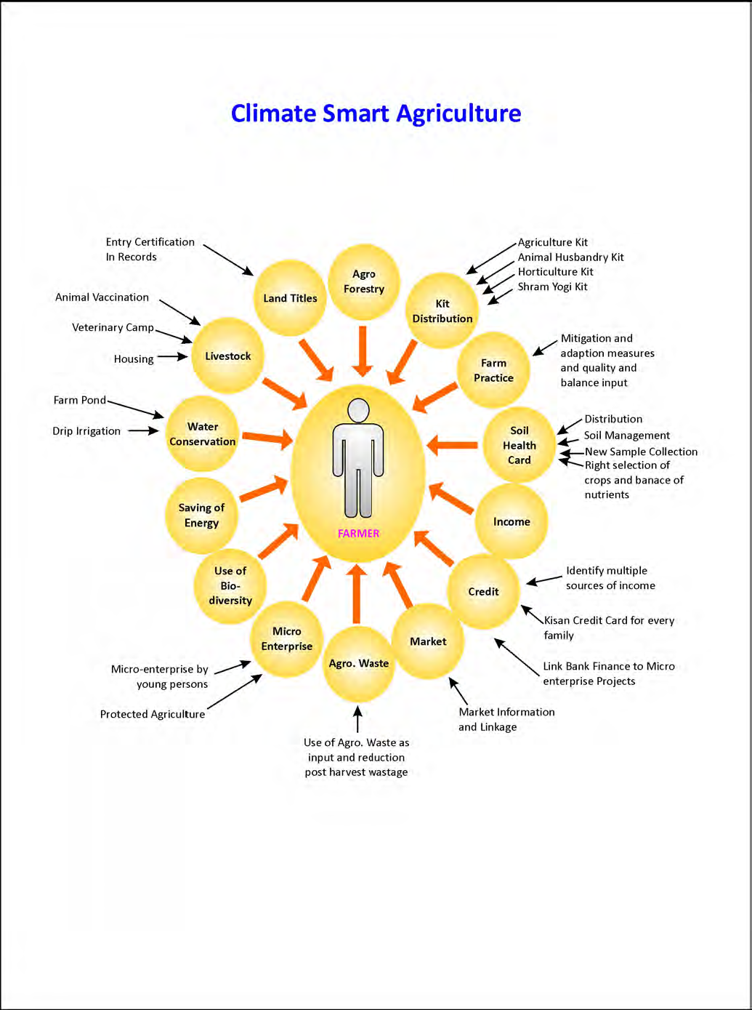

Slide 10
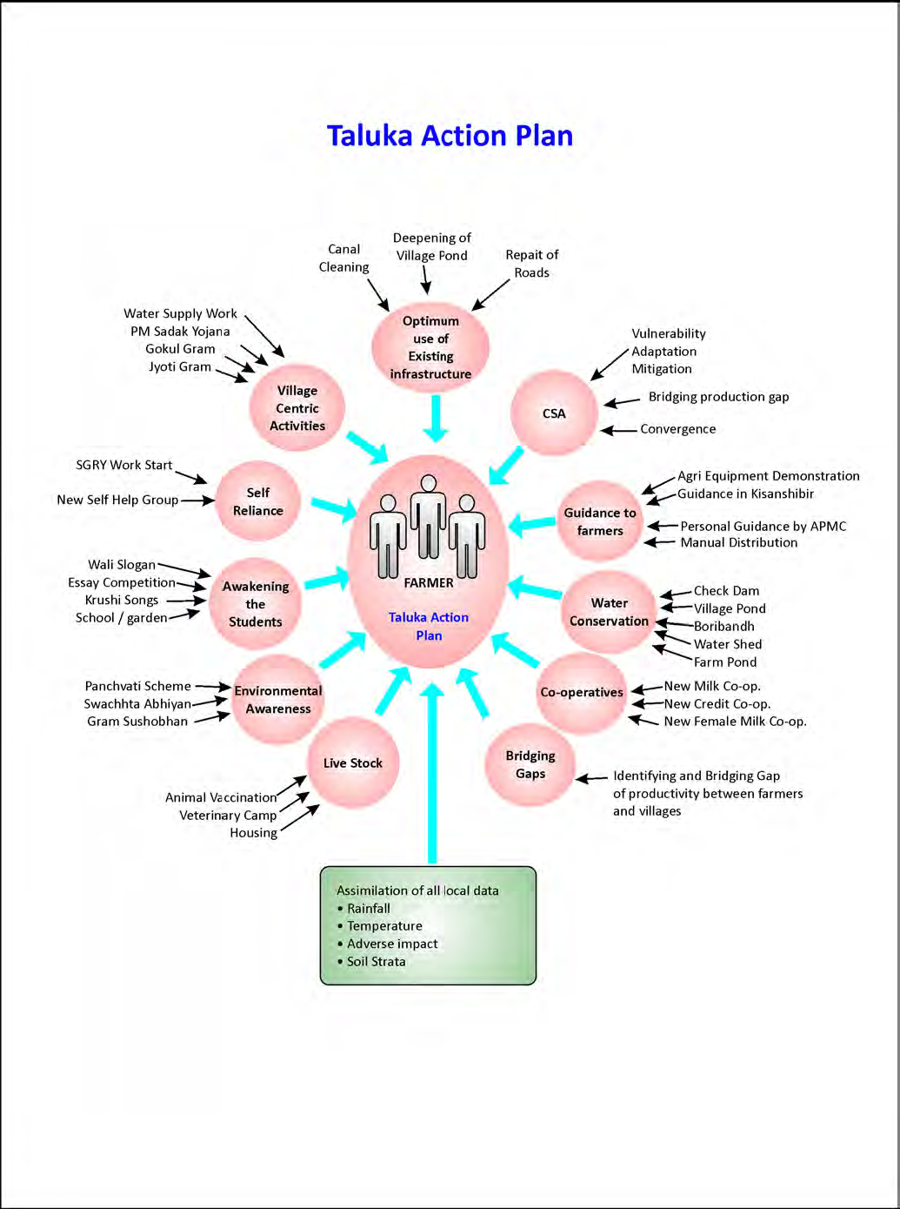

Slide 11
Let's Learn & Share Together for a global mission
Mainstreaming Agriculture for Climate Change Mitigation

Slide 12
Thank You for your patient hearing
Dr. Kirit Shelat
National Council for Climate Change, Sustainable Development
and Public Leadership (NCCSD)
Post Box No. 4146, Navrangpura Post Office, Ahmedabad – 380 009.
Gujarat, INDIA.
Phone: 079-26421580 (Off) 09904404393(M)
Email: drkiritshelat@gmail.com Website: www.nccsdindia.org

