Slide 1
Adressing the Protection Needs of People Displaced in the Context of Disasters and Climate Change

Slide 2
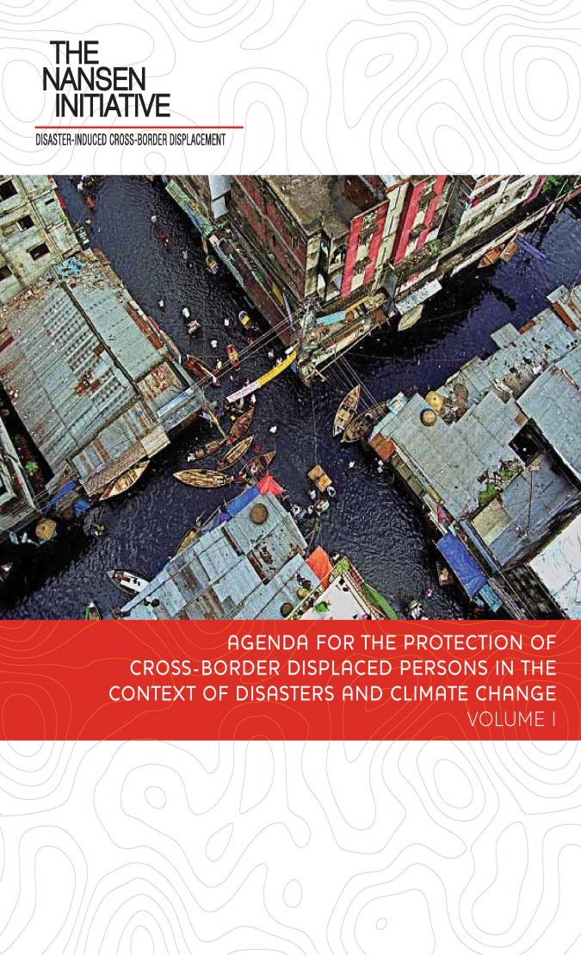
Agenda for the Protection of Cross-Border Displaced Persons in the Context of Disasters and Climate Change
Endorsed by 109 States, October 2015
Non-binding
Not calling for a new binding international convention
Tool Box of policy options

Slide 3
Platform on Disaster Displacement
Knowledge and data gaps
Enhance the use of identified effective practices
Policy coherence
Promote policy and normative development in gap areas

Slide 4
Platform on Disaster Platform and the UNFCCC
Cancun Adaptation Framework (14 f).
Paris Agreement
Warsaw International Mechanism (WIM) and Task Force on Displacement
Mandated to develop recommendations to…
Avert
Minimize
Address
…..Displacement related to the adverse effects of climate change

Slide 5
www.disasterdisplacement.org
Thank you!
Questions?

