Slide 1
Socioeconomic Impacts of Climate Change on Health
Kristie L. Ebi, Ph.D., MPH
Executive Director, WGII TSU
Emerging Scientific Findings and Ongoing Dialogue with the Research Community
COP 16
3 December 2010

Slide 2
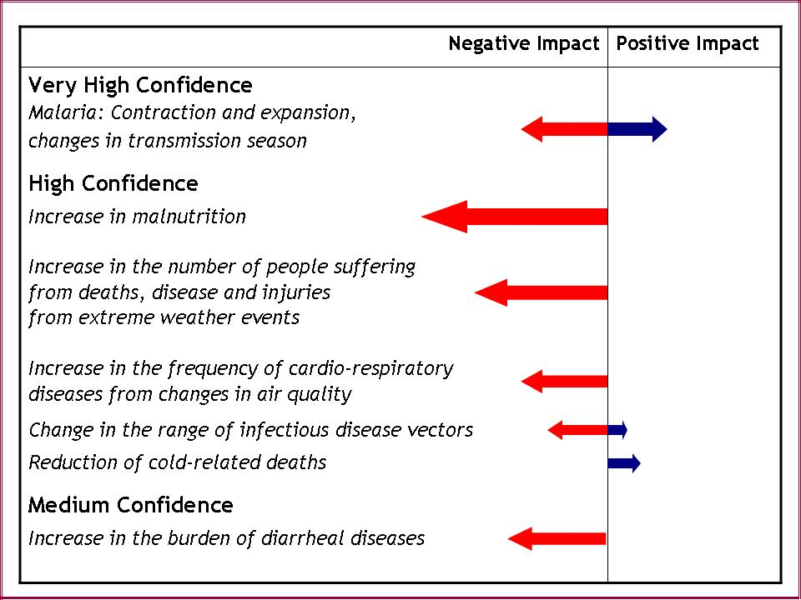
Direction and Magnitude of Climate Change Health Impacts
IPCC 2007

Slide 3
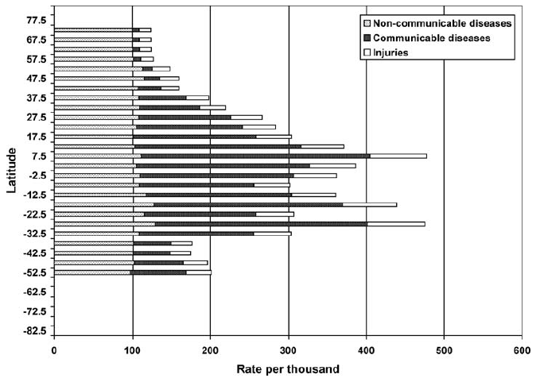
Sum of Years of Life Lost and Years of Life Lived with Disability
Annual deaths:
Diarrheal diseases =2
million deaths
Malaria = 1 million
Malnutrition is an underlying
cause of 50% of the 10.5
million annual childhood deaths
Pitcher et al. 2008

Slide 4
Global Environmental Change and Human Health
Atmospheric composition changes and their health impacts
Land use/land cover changes and human health
Infectious disease and global environmental changes
Food-producing systems and health
Urbanization and health
Vulnerability, social representation, and resilience building

Slide 5
Progress in Understanding the Health Risks of Global Change
Better estimates of current risks
Current vulnerabilities
Exposure-response relationships between weather / climate and health outcomes
Identifying thresholds
Estimates of the current health burden attributable to climate change
Effectiveness and costs of adaptation actions
Projections of future health risks
Using a systems based approach
Identifying needs for additional adaptation

Slide 6
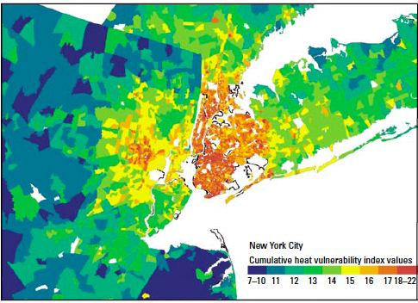
Mean Cumulative Heat Vulnerability Index, New York City
Reid et al. 2009

Slide 7
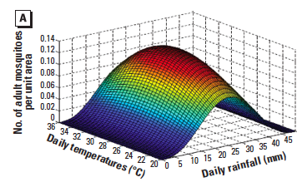
Effect of Temperature and Precipitation on Mean Number of Anopheles Mosquitoes, Tanzania
Parham and Michael 2009

Slide 8
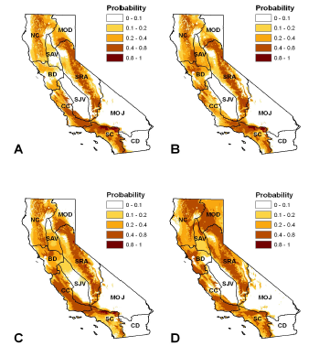
Current Distribution of Plague in Ground Squirrels, California
Holt et al. 2009

Slide 9
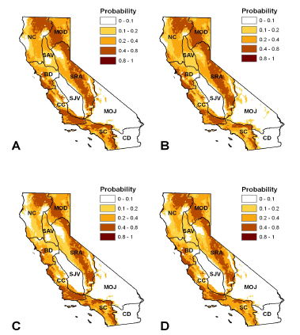
Projected Distribution of Plague, California, 2020 and 2050
Holt et al. 2009

Slide 10
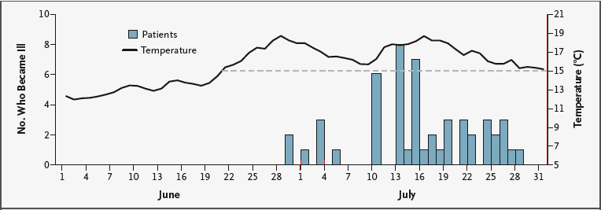
Vibrio parahaemolyticus Infections by Harvest Date and Mean Daily Water Temperature
McLaughlin et al. 2005

Slide 11
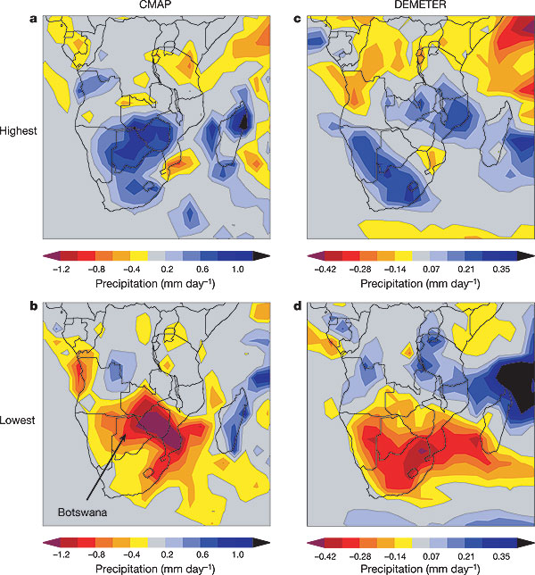
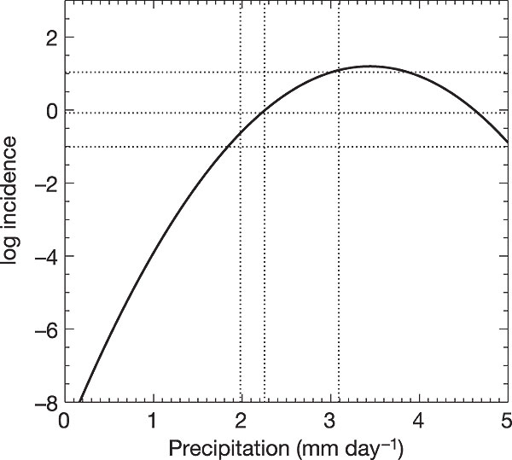
Use of Climate-Health Data for Early Warning Systems
Observed summer (Dec-Feb) rain
Forecast (November- modelled) summer rain
Highest malaria incidence years
Derived relationship between summer rainfall and subsequent annual malaria incidence – used successfully for forecasting malaria
Lowest malaria incidence years
Thomson et al. 2006

Slide 12
Climate Change Impacts in 2030 under 750 ppm CO₂ Scenario (thousands of cases)
Estimated costs to treat the climate change-related cases = $3,992 to $12,603 million
 | Diarrhea | Malnutrition | Malaria
Total | 4,513,981 | 46,352 | 408,227
Climate change impacts | 131,980 | 4,673 | 21,787
% increase | 3% | 10% | 5%
Ebi 2008

Slide 13
