Slide 1
SBSTA 34 Side Event: Tracking REDD+ Finance Tropical Forest Group Case Study “Past United States support for tropical forest conservation and restoration”
June 10, 2011
Made possible with generous support from the Gordon and Betty Moore Foundation
John-O Niles
jniles@tropicalforestgroup.org

Slide 2
The Set Up
Research: Test whether United States support for tropical forest conservation/restoration in past years can be aligned with impacts in developing countries (hectares saved, tons avoided, trees planted, etc)
Methods: Compile and verify publicly stated finance and impacts from key US agencies
USAID (approximately $100 million/year)
Treasury Department (approx. $20 million/year)

Slide 3
Background
2008 and 2009 support was not REDD+
Agencies receive budgets from congress, execute programs, report on impacts
US agencies report both finance and impacts, but the money trail can be hard to follow

Slide 4
USAID 2008 and 2009
USAID is primary vehicle for international development support and cooperates with other agencies
Funds go through country missions, regional programs and central programs
In 2008/2009, USAID spent $106/$103 million on tropical forest programs
Claimed approximately 100 specific impacts in more than 20 countries

Slide 5
Countries with impacts stated
Ethiopia
Ghana
Guinea
Kenya
Madagascar
Malawi
Mali
Rwanda
Senegal
Sudan
Ecuador
El Salvador
Nicaragua
Panama
Peru
Tanzania
Uganda
Bangladesh
Cambodia
Indonesia
Nepal
Philippines
Bolivia
Brazil
Colombia
Guatemala
Haiti
Honduras
Jamaica

Slide 6
Indonesia USAID impacts: 2008

Slide 7
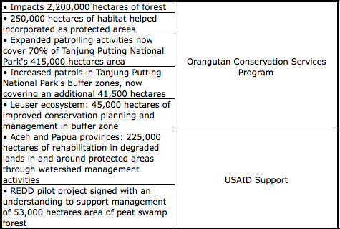
Indonesia USAID impacts: 2009

Slide 8
Next Steps
Finish compilation
Agency reviews
Country validations primarily through interviews
Possible independent GIS research on impacts
Peer review and publication of findings
Commitment to absolute transparency and ease of information access
Notes:
US Fast Track REDD+ pledge of $1 billion is a substantial increase and it is vulnerable

