Slide 1
ClimateTechWiki – a clean technology platform
Laura Würtenberger (ECN)
Bonn
23.5.2012

Slide 2
ClimateTechWiki – a clean technology platform (http://climatetechwiki.org)
Developed as a supporting tool for the Technology Needs Assessments (TNAs) under the UNFCCC and for the updated UNDP TNA Handbook
Offers an on-line database with up-to-date and “up-datable” descriptions of about 150 mitigation and adaptation technologies
Technology descriptions contain information on how the technology works, its feasibility, market potential, sustainable development benefits and costs
In addition, ClimateTechwiki contains case studies and links to other sources of information
ClimateTechWiki has been developed and supported by

Slide 3
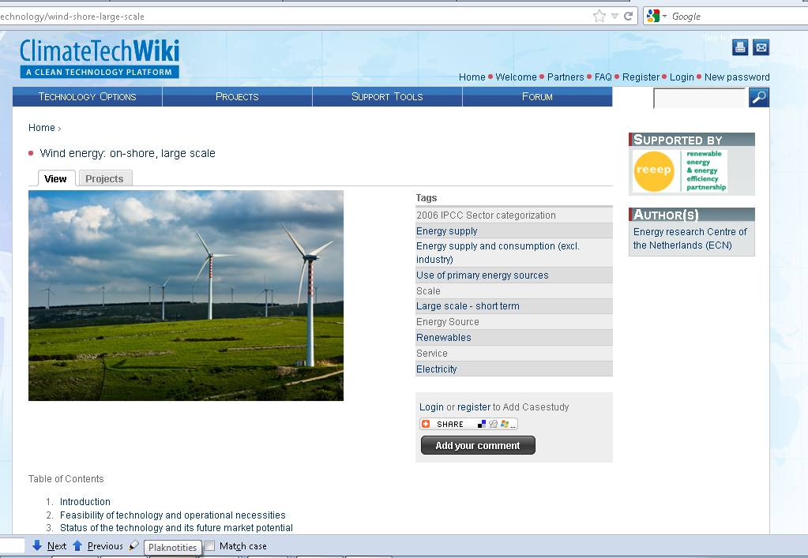

Slide 4
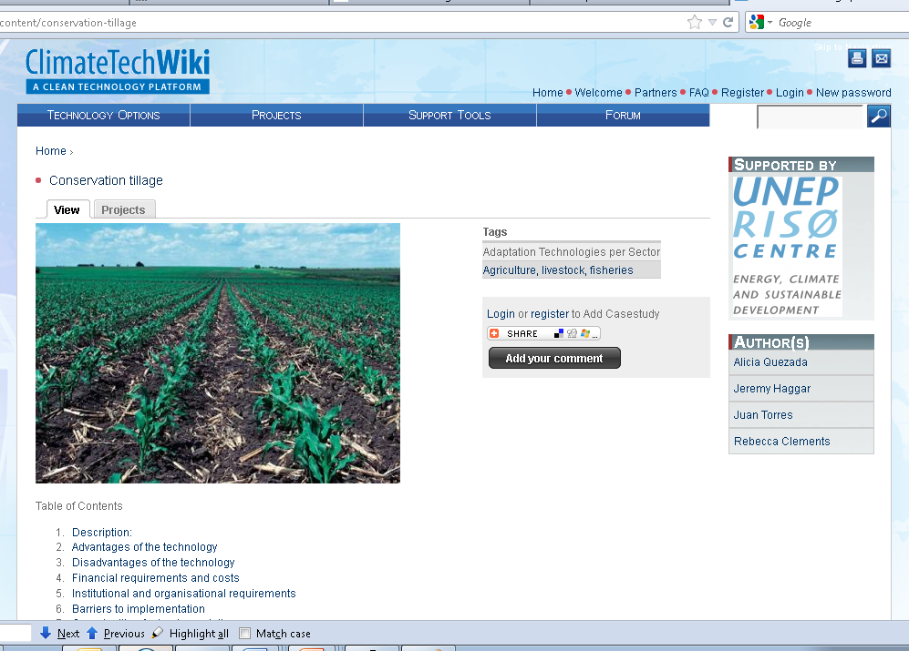

Slide 5
Further development of ClimateTechWiki (http://climatetechwiki.org)
Offer information on financing options and project development
Provide country-/region specific technology information
Develop a ‘community of practitioners’ where people can contribute to the information and have forum discussions
Improve interactive features and outreach
Any suggestions? – Contact info@climatetechwiki.org or wuertenberger@ecn.nl

