Slide 1
Tracking REDD Finance through Climate Funds Update
Jessica Brown
Research Officer, ODI

Slide 2
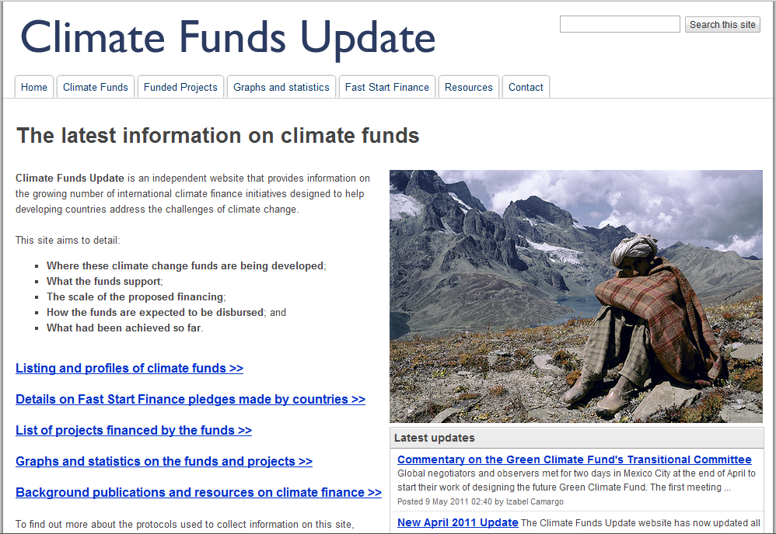
Climate Funds Update
Notes:
Tracking funds flowing through dedicated bilateral and multilateral funds – broader than REDD, but includes REDD. Goes from donors to projects. Tracking pledged funding to when it goes out the door.
We do include some private finance and OOFs contributed by Japan – mainly because we haven’t yet figured out how to disaggregate that.

Slide 3
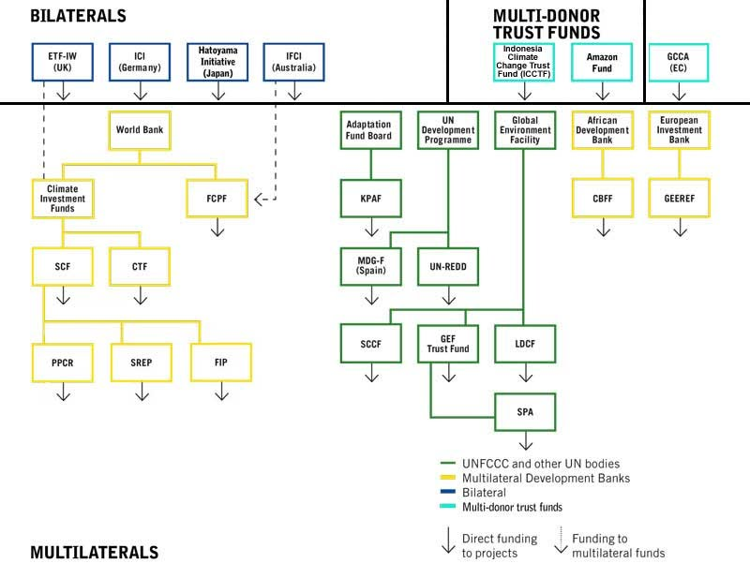

Slide 4
22 international climate change funds: current status
USD billions
Approved REDD:
$463 mn
Disbursed REDD:
$250 mn
Notes:
May be slightly more for REDD – 307 mn from Japan’s FSF report, but unclear what specific projects and activities they are supporting. From the annex where they report specific projects and activities implemented, their support for REDD only adds up to 85 mn.

Slide 5
Areas of focus (approved funding = USD 9.6bn)
Mitigation-general
Mitigation-REDD
adaptation
Multiple foci

Slide 6
Example of fund-level data
Forest Carbon Partnership Facility

Slide 7
Example of fund-level data (cont’d)
Forest Carbon Partnership Facility

Slide 8
Interesting findings and challenges – on delivery
Very limited data on the extent to which money has ‘hit the ground’
Bilateral and multilateral funds and funders report ‘disbursement’ as funding that has been approved, funding that can be drawn down, or funding that is transferred to implementing agency – none of them report on funding delivered to specific project or government recipients. Most funds/donors do not even know if/when this happens.
Need better understanding of how high-level financial commitments are being delivered on the ground – who the main recipients are, etc
Notes:
In fairness, the actual delivery and disbursement of finance is often hard to measure given the nature and complexity of how finance is channelled. International public finance flows from North to South tend to pass through several intermediary channels before reaching the end user, making the actual flow and delivery of finance hard to follow. Because of the intermediary steps through which the finance passes, a donor may consider the money disbursed without the project receiving any money at all, because from the donor’s perspective funds have been ‘disbursed’ from their accounts to another (implementing agency’s) account.
In part because of this complexity, FSF and climate finance more generally tends to be rather slow in its disbursement, getting caught up in intermediary institutions and channels. Multilateral funds often give particular status to international implementing organisations with complex sign-off procedures that tend to have in-country capacity issues (see e.g. the GEF and its implementing agencies, the World Bank, UNDP, UNEP and others). International climate funds also tend to have a fair amount of ‘hoop jumping’ involved with the project approval process, which can cause severe delays in project delivery time. Moreover, projects can be easily conceptualised and budgets created, but actual implementation of complex activities (particularly given the fact that addressing adaptation within countries is a new issue which lacks experience and proficiency) takes time and delays are common

Slide 9
Thank you
www.climatefundsupdate.org

