Slide 1
Rukmavati River Basin Management
J S Gosalia
Vivekanand Research & Training Institute
Mandvi – Kutch, Gujarat, India
www.vrti.org

Slide 2
Presentation Structure
VRTI
River Basin Management – concept
Rukmavati river basin – area context, need & potential
Project activities
Scale of implementation
Impact (Realized)
Future Planning

Slide 3
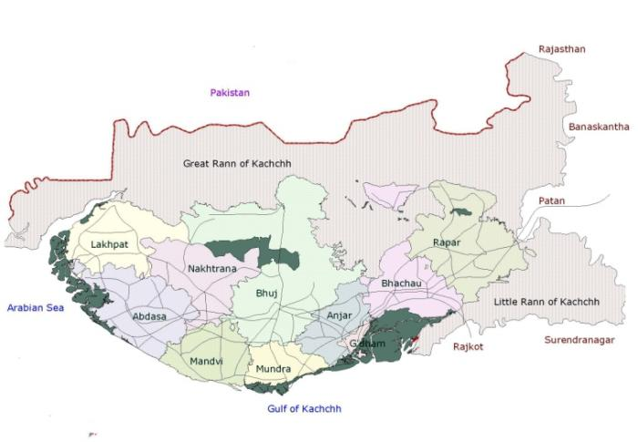
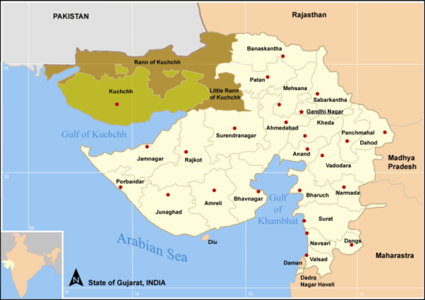
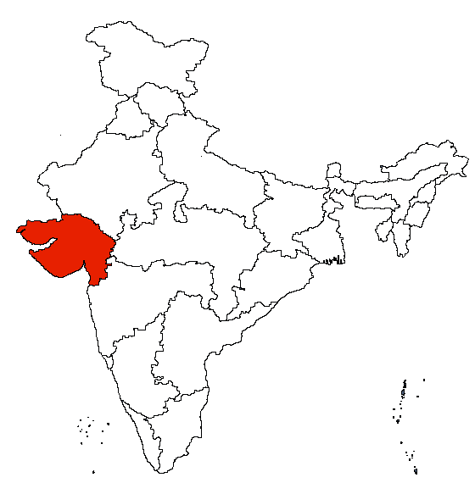
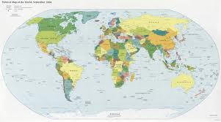
VRTI – Serving to Community In Kutch
Vivekanand Research & Training Institute

Slide 4
About Kutch
Semi arid climate – average 330 mm of rainfall in 15 rainy days
Recurring drought – forcing migration of community in search of livelihood and fodder for their animal
Low productivity of agricultural land
Coastal area prone to salinity ingress

Slide 5
VRTI – A vision of Mr. Kantisen Shroff
“We have spent over 40 years in arid drought prone Kutch to understand and emerge with workable solutions on livelihood issues of the community. Community should be made more productive and competent where they live (Rural area)”.
VISION:
Efficient use of natural resources which promotes sustainable development in synergy with surrounding environment.
MISSION:
Need based community development with focus on capacity building of community, linkages with different institutions involved in rural development and promote decentralized agro industrialization.

Slide 6
Landscape Restoration
Initiating journey through Rain water harvesting
Prevention of Salinity ingress in coastal area
Water storage capacity of different structure – 100,000 million liter
Watershed programme – 42,000 Ha
Managing agricultural land – 40,000 Ha
IMPACT
Holistic rural development

Slide 7
Contemporary Challenges
Climate change
Increasing temperature
Change in season cycle
Increasing extreme events – droughts, floods, cyclones
It has induced focusing bigger landscape – river basin as a modular planning unit

Slide 8
Integrated River Basin Management
“It is a process of coordinating conservation, management and development of water, land and related resources across sectors within a given river basin.”
It ensures Economic, Social and Environmental sustainability and ensure Food, Water & Energy security along with good quality of life with objective to provide sustainable livelihood.

Slide 9
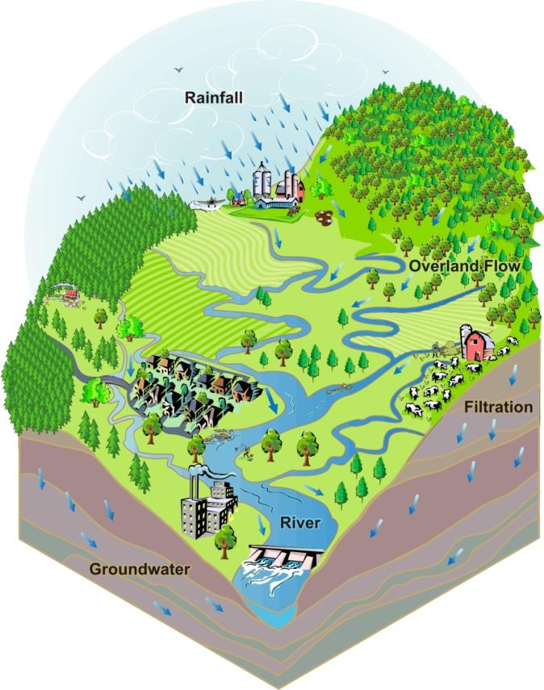
River Basin as a Planning Unit
A natural unit with watershed boundary
A unit sharing common water resources
Management of river basin is important to restore landscape.

Slide 10
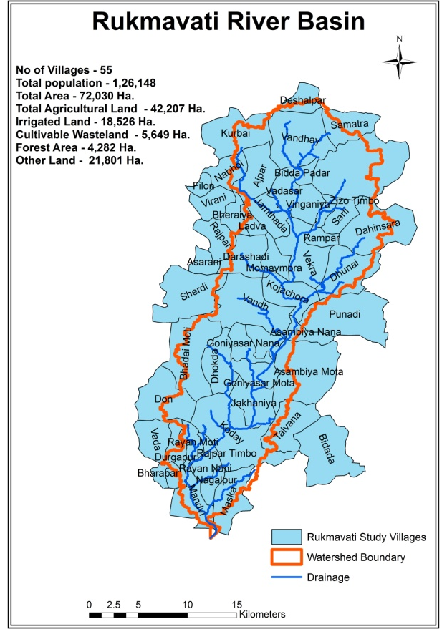
Rukmavati River Basin – Pilot Project
No of Villages | 55
Total population | 1,26,148
Total Area | 72,030 Ha.
Total Agricultural Land | 42,207 Ha.
Irrigated Land | 18,526 Ha.
Cultivable Wasteland | 5,649 Ha.
Forest Area | 4,282 Ha.
Other Land | 21,801 Ha.

Slide 11
Rukmavati River Basin Project
Focusing water resource management
Promoting efficient water use-Closed pipe, Drip
Farm waste recycling & efficient resource management
Supplementing Farm income for reducing vulnerability due to climate uncertainties, by
Animal Husbandry
Traditional skills in Handicrafts ,Embroidery
Improving forward & backward market linkages
Empowering women in supportive role

Slide 12
Project Highlights
Total convergence – Rs. 600 million in 6 years span
Water Resource management (Hydrology):
107 new rain water harvesting structures, 1692 beneficiaries farmers, 3784 Ha of lands got irrigation security, improvement in ground water quality
99 renovation (desilting) of existing structures – 485 beneficiaries farmers, 625 Ha area received fertile silt which resulted in reduced requirement of chemical fertilizer
Efficient use of water through promotion of drip irrigation – 4100 Ha of land, 50% saving in irrigation water

Slide 13
Project Highlights
Natural resource management (soil, agriculture)
Promotion of composting – 900 farmers, Instead of burning farm waste, farmers converting it to compost thereby improvement in soil fertility (2000 MT waste converted to compost from 400 Ha of area)
Promoting legume as inter crop – nitrogen fixation in soil and also providing food security (Nitrogen fixation - 103 MT in 3600 Ha (224 MT urea saving)

Slide 14
Project Highlights
Animal husbandry
Pasture land development in about 540 Ha of land providing fodder security
Improving market linkage, 20% increase in income
Tree plantation
40,000 trees planted in basin area to improve greenery
Promoting horticultural plantation – 983 Ha land having permanent green cover

Slide 15
CO2 sequestration in Rukmavati River Basin

Slide 16
CO2 sequestration in Rukmavati River Basin
CO2 sequestration enhanced by 113,722 MT per year in 2014 with respect to 2009 in whole basin, which is 21% increase in sequestered CO2
Data Used
Landsat 7 and 8 data from USGS (United StatesGeological Survey) website.
Solar irradiance, temperature, rainfall data from meteorological observations.
Crop coefficient data from FAO (Food and Agriculture Organization) database.

Slide 17
Agenda in Progress
Crop suitability maps through GIS tool which will help in conserve more resources and better land utilization
Agriculture productivity improvement – soil & water management, good agricultural practices
Agricultural produce value addition through cluster based promotion of warehousing, processing and market linkage
Animal health, nutrition and productivity improvement

Slide 18
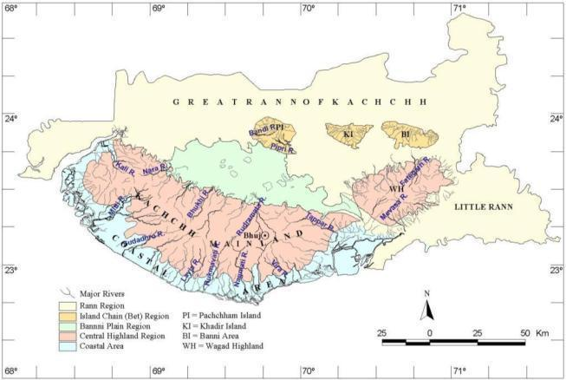
Way Forward
Utilization of experience gained in Rulmavati River Basin Development Model, to Other River Basins of Kutch.
97 River Basins of Kutch

Slide 19
Vivekanand Research & Training Institute, Nagalpur Road, Near Jain Ashram, Mandvi – Kutch, Pin – 370465, India Web: www.vrti.org Email: gosalia.jayprakash@excelind.com, vrtimandvi@gmail.com
J S Gosalia

