Slide 1
Non Annex I GHG Software NAIS
From excel to a specialized software tool
Durban, South Africa, 30 November 2011

Slide 2
The task
Design and build a tool for non-annex I Parties to report their greenhouse gas emissions in according with the revised 1996 IPCC guidelines and applicable UNFCCC guidelines
Lessons learned:
Base the software on clear requirements ....
... And build on the existing understanding of handleing large amounts of GHG Data → The UNFCCC data interface (http://unfccc.int/ghgdi).
Intergare it with other UNFCCC systems
Ensure it is a web based solution (protection of the Parties inventory data) with a ofline workaround for users who do not always have access to the internet.
Enable a future upgrade path to new or revised guidelines if decided by Parties.
First build a Prove of Concept and then move towards real development.

Slide 3
The approach
Parties
BA
Business requirements
Architect
System Architecture
Business Analyst
Architect
Technical designer
UI Designer
Software engineers
Metadata developers
Database admin
System admins
System testers
Acceptance testers
Project manager
Business sponsor
Admin support
Helpdesk support
PM
NAIS 96 Gl
Reporting
Framework
NAIS reporting solution
Hosting
Test
Solution

Slide 4
The approach
Need to use tool by Parties → Requirements.
Need to have a good solution → Architecture.
Developers build reporting framework and implement the 1996 IPCC guidelines (as per requirements and architecture).
Testers test the software.
DB and System administrators host the solution and make it available.
Project manager ensures all aspects are considered.
PRINCE2 methodology used for project management.
Many people are involved / many roles.

Slide 5
The functionality
User actions:
Data entry
XML file input
Excel file input
Functions:
Validations
Calculations
Auto complete
Aggregation
Databases:
GHG Data
Meta data
Input
Data viewing
Reporting tables
Get reporting XML
Get Excel input files
Output
Screens layout
Data selection
XML generation
Excel generation
Managing functions: Users Inventories Submissions

Slide 6
Phased approach
Hosting
Submission management
Inventory management
User management
XML import and export
Reporting tables
Future steps
Depending on mandates
Durban prove of concept
Completed
Data entry
Reporting Framework
Database
Meta data

Slide 7
End
Thank you for your attention

Slide 8
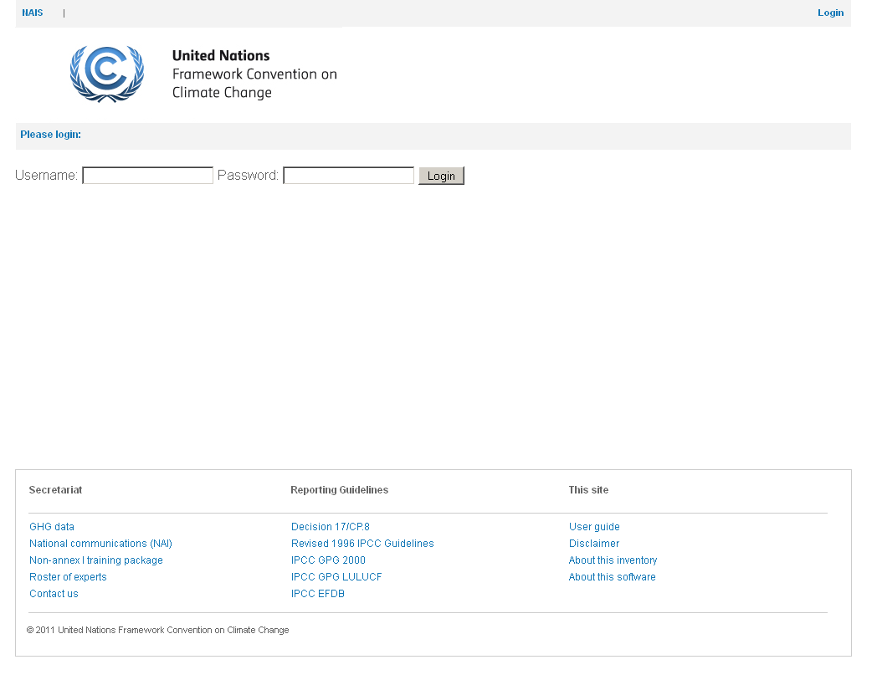

Slide 9
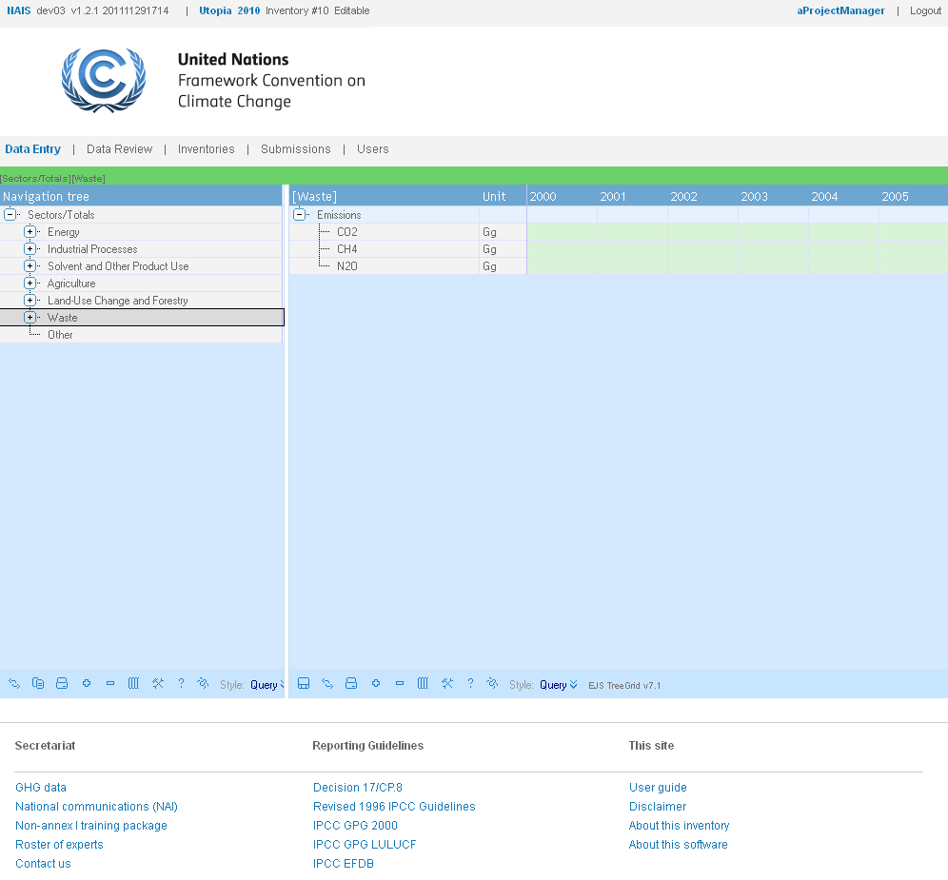

Slide 10
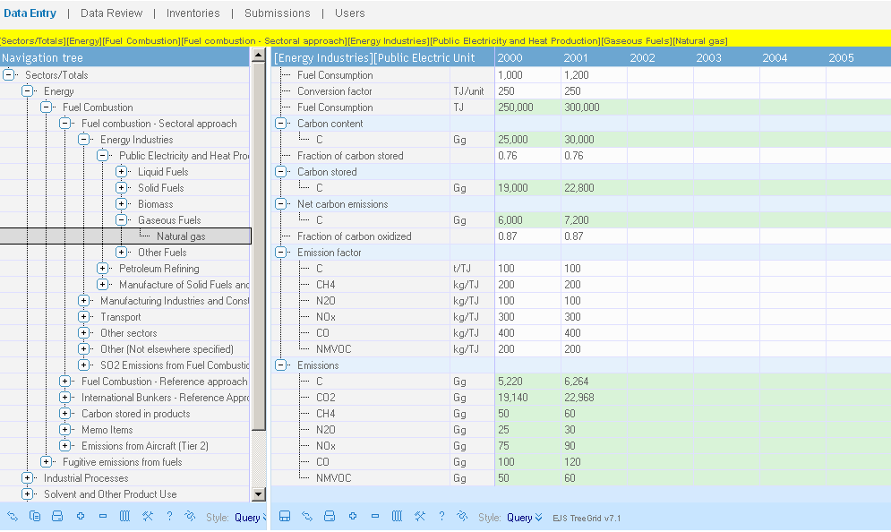
Data entry: Calculations on the server

Slide 11
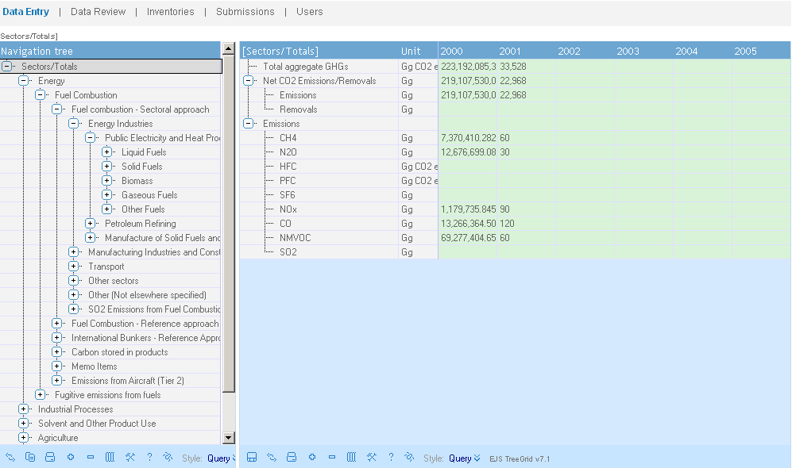
Data entry: Aggregation to the top

Slide 12
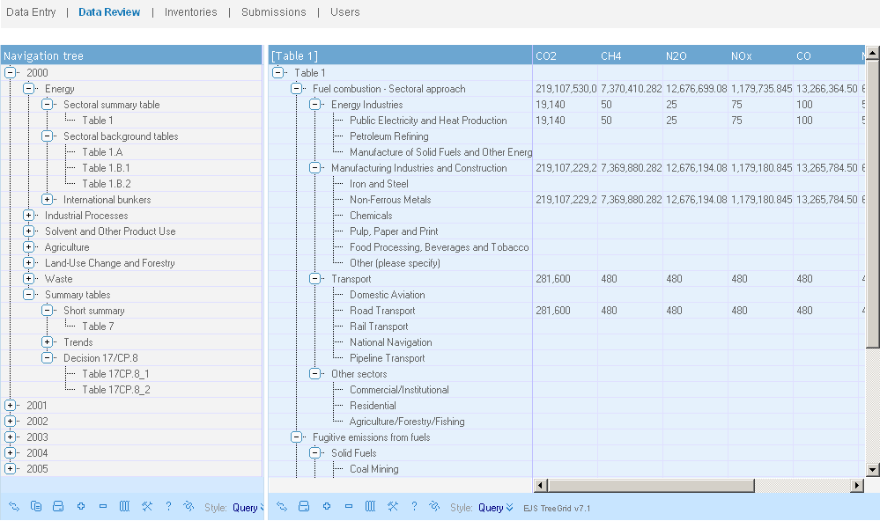
Reporting Tables: Table 1

Slide 13
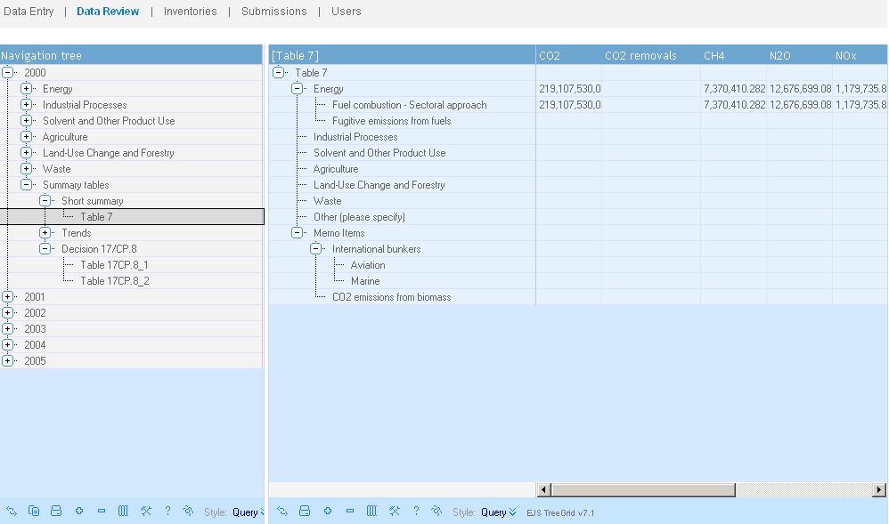
Reporting Tables: Table 7

Slide 14
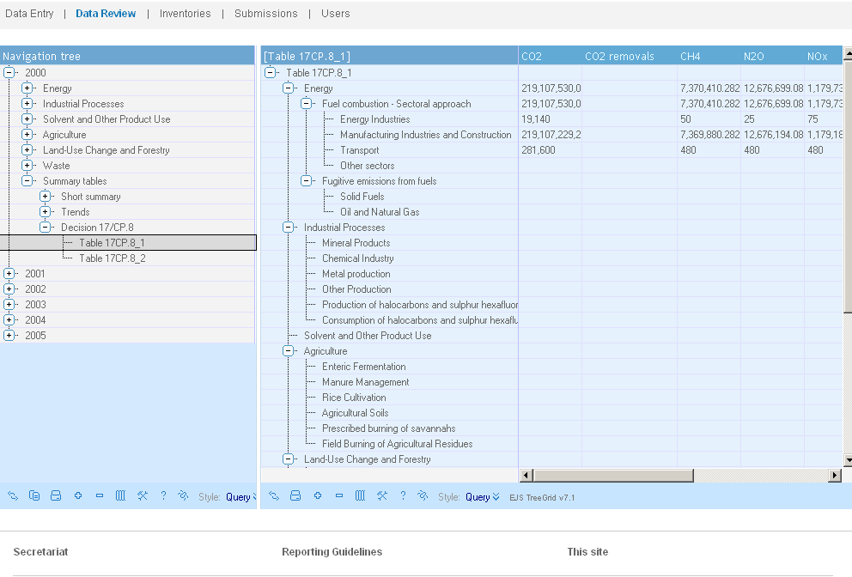
Reporting tables: 17CP.8.1

Slide 15
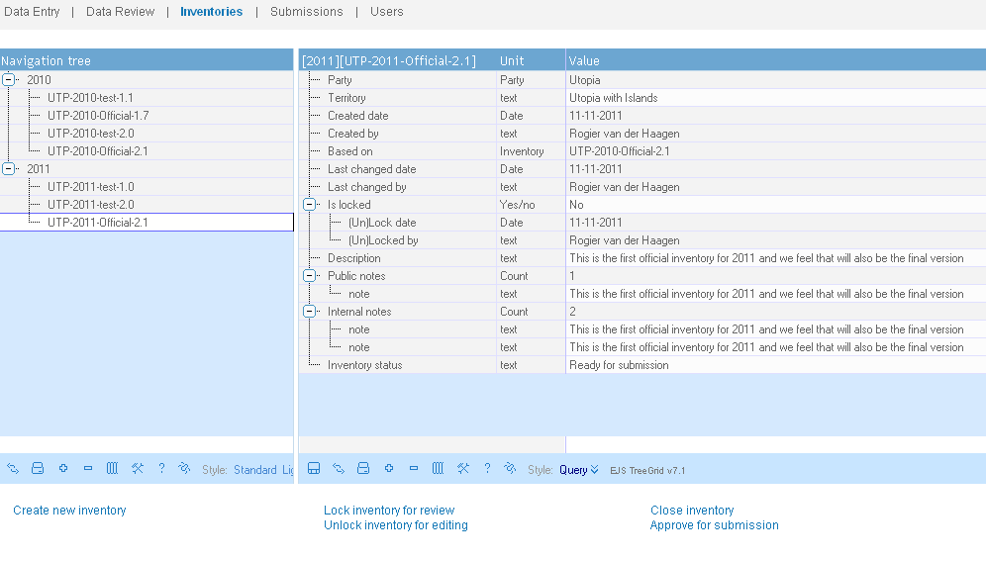
Manage inventories.

Slide 16
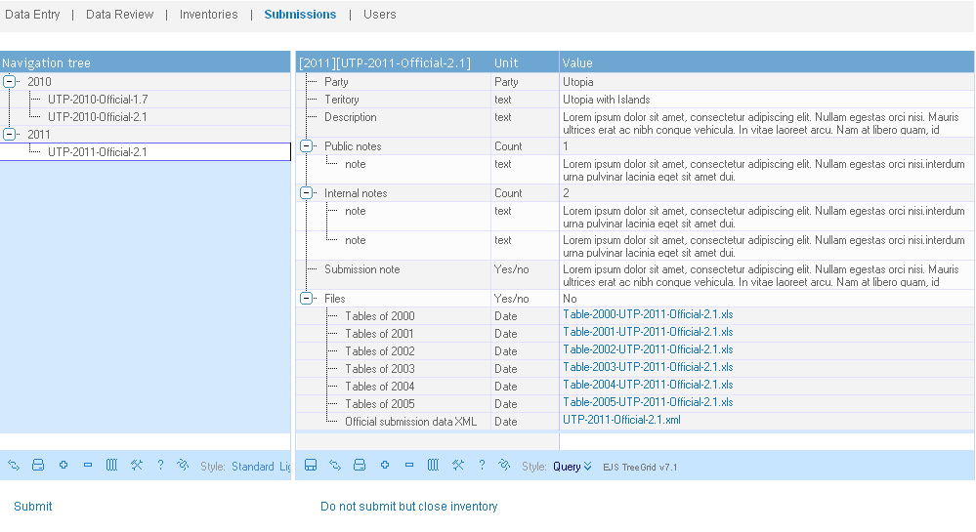
Manage Submissions.

Slide 17
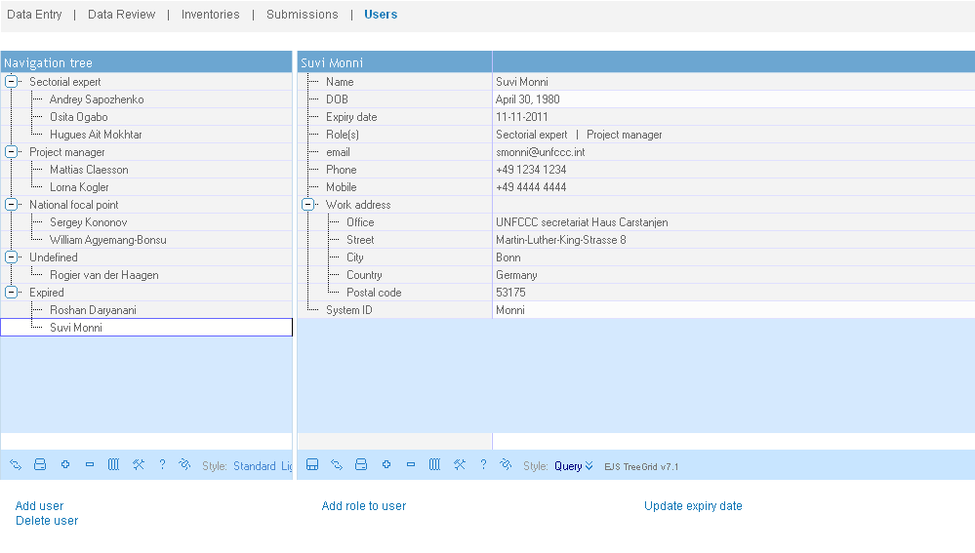
Manage Users.

