Slide 1
Safeguards in the CDM: Where are we and where do we go from here?
Alyssa Johl
Center for International Environmental Law

Slide 2
Introduction
What are the existing CDM standards/processes?
Sustainable development criteria
Local and global stakeholder consultation processes
Proposed appeals procedure (currently being negotiated)
Are these standards effective in protecting the rights of peoples and communities directly affected by CDM projects?
What policies and processes are needed to ensure that the CDM promotes sustainable development and rights protections?
Notes:
SUSTAINABLE DEVELOPMENT IS THE HIGHEST PRIORITY; ALSO, ENGAGEMETN OF LOCAL COMMUNITIES WILL CONTRIBUTE TO THE SUCCESS OF CDM PROJECTS…

Slide 3
CDM Standards: SD Criteria
No international “do no harm” standards or safeguard policies
Sustainable development criteria developed and implemented at the national level
Generally consist of a general list of non-binding guidelines rather than clearly defined standards

Slide 4
CDM Standards: SD Criteria
India’s Sustainable Development Indicators (www.cdmindia.gov.in)
Following aspects should be considered while designing CDM project activity:
1. Social well being: The CDM project activity should lead to alleviation of poverty by generating additional employment, removal of social disparities and contribution to provision of basic amenities to people leading to improvement in quality of life of people.
2. Economic well being: The CDM project activity should bring in additional investment consistent with the needs of the people.
3. Environmental well being: This should include a discussion of impact of the project activity on resource sustainability and resource degradation, if any, due to proposed activity; bio-diversity friendliness; impact on human health; reduction of levels of pollution in general;
4. Technological well being: The CDM project activity should lead to transfer of environmentally safe and sound technologies that are comparable to best practices in order to assist in upgradation of the technological base. The transfer of technology can be within the country as well from other developing countries also.
Notes:
MENTION WHAT’S IN THE PDD

Slide 5
CDM Standards: Local Consultation Process
During the project approval process, project developers must:
Invite local stakeholders to submit comments
Provide a summary of comments received
Provide a report on ways in which comments have been addressed
No specific guidance or standards on how local consultation processes should be undertaken
Notes:
ANALYZE SECTION OF PDD ON COMMENTS RECEIVED

Slide 6
CDM Standards: CDM Appeals Procedure
Mandate established at COP15; currently under negotiation in the SBI
Would allow appeals on matters relating to due process
Key issue of concern that is being debated is the scope of appeals, specifically whether local stakeholders should be allowed to submit appeals

Slide 7
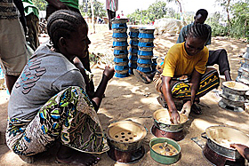
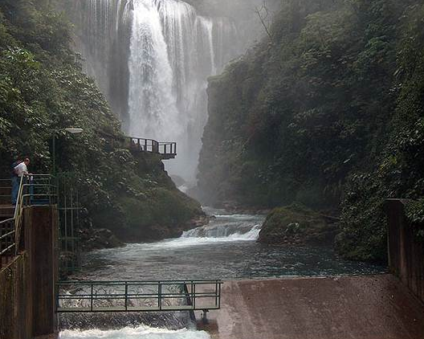
CDM Standards: Are they effective at protecting project-affected peoples and communities?

Slide 8
What is needed to protect the rights of project-affected peoples and communities?
Elements of an institutional safeguard system
International safeguard policies or SD criteria
Monitoring system to ensure that safeguards are effectively implemented throughout the project cycle
Appeals procedure to ensure that local stakeholder scan raise their concerns and have them addressed in a timely manner
Process to withdraw DNA letter of approval
Opportunities for meaningful and effective participation in all stages of decision-making processes
Notes:
ADD MORE SPECIFICS…

