Slide 1
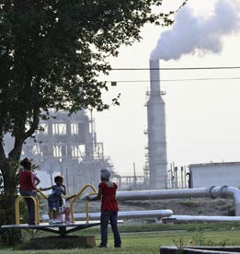
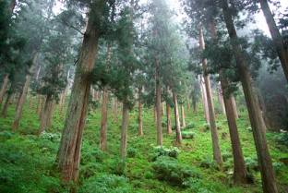
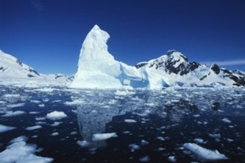
Safeguarding REDD+ Activities
Daniela Rey
December 2, 2011

Slide 2
Why Safeguard REDD+?
Photo: LoggingOff

Slide 3
Progress in Safeguarding REDD+
Set of 7 REDD+ Safeguards
2. Specified that REDD+ activities should be undertaken “in accordance with” the REDD+ safeguards
3. Requested developing country Parties to develop a system for providing information on how REDD safeguards are addressed and respected

Slide 4
REDD+ Safeguards Language
(a) Actions complement or are consistent with the objectives of national forest programmes and relevant international conventions and agreements;
(b) Transparent and effective national forest governance structures, taking into account national legislation and sovereignty;
(c) Respect for the knowledge and rights of indigenous peoples and members of local communities;
(d) The full and effective participation of relevant stakeholders, in particular indigenous peoples and local communities;
(e) Actions are consistent with the conservation of natural forest and biological diversity, ensuring that REDD is not used for the conversion of natural forests, but instead used to incentivize the protection and conservation of natural forests and their ecosystem services, and to enhance other social and environmental benefits;
(f) Actions to address the risks of reversals; and
Actions to reduce displacement of emissions

Slide 5
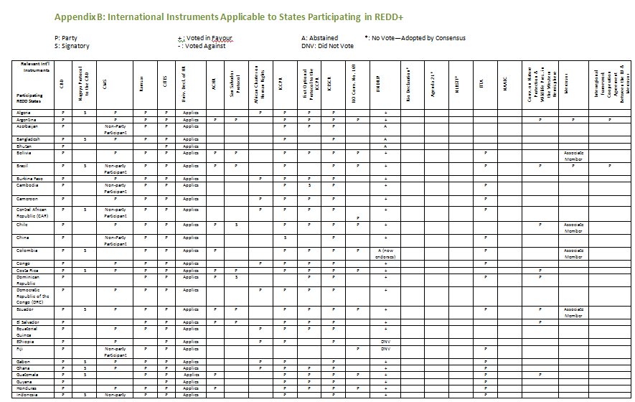
International instruments relevant to REDD+ safeguards

Slide 6
II. Safeguard Information System (SIS)
A robust Safeguard Information System is essential to ensure the successful implementation of the REDD+ safeguards
The SIS is meant to provide information on the REDD+ safeguards implementation, but its specific role and how it would operate at the national and international level remains unclear

Slide 7
Effective Grievance Mechanism in REDD+
Successful implementation of REDD+ safeguards requires establishment of a grievance mechanism capable of addressing impacts to rights, livelihoods and ecosystems
Should address:
Impacts to rights (including rights to lands, territories and resources; social, economic, political and cultural rights, including FPIC);
Impacts to forest-dependent livelihoods (including unfair distribution of benefits);
Impacts to the environment and ecosystems (including loss of biodiversity; forest conversion; and failure to reduce emissions);

Slide 8
Grievance Mechanisms under Relevant International Instruments

Slide 9
Thank you for your attention!
Questions?

Slide 10
Contact details:
Daniela Rey
Lawyer, Climate & Forest Programme
ClientEarth
drey@clientearth.org
+(0) 203 30305962

