Slide 1
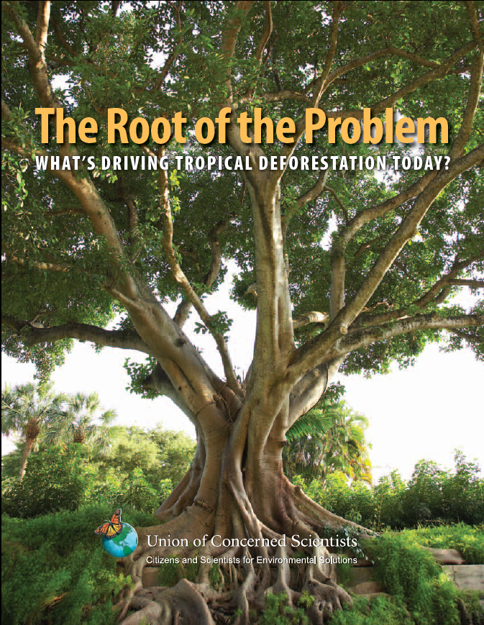
The Drivers of Deforestation and Forest Degradation: Different Levels, Different Views
Doug Boucher, UCS
dboucher@ucsusa.org
UCS’ The Root of the Problem report, released July 2011, is a comprehensive review of the literature on the drivers of deforestation

Slide 2
The drivers of deforestation in the UNFCCC negotiations
A two-year UNFCCC process began with the Cancun Agreements in December 2010
Recent scientific literature shows that they have changed fundamentally in the last few decades

Slide 3
Different levels, and at each level, new views of what are the drivers:
Ultimate drivers or Underlying level, e.g.
Deforestation is driven by population growth in tropical forest countries; vs.:
Global demand, in markets in both developed and developing countries, drives deforestation
Proximate drivers or Agents, e.g.:
Peasant farmers, through their subsistence agriculture and firewood gathering, are the main agents of deforestation; vs.:
Commercial agriculture and forestry – especially soybeans, beef cattle, palm oil and timber – are now the major drivers

Slide 4
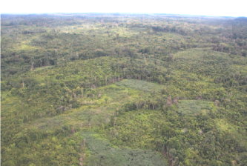
The Underlying Demand

Slide 5
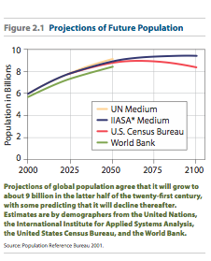
Population and Diet
Previous assumption was: Increasing rural populations are the main cause of pressure on forests
Recent studies say that: Urban populations and export markets, not population growth, are the chief sources of the demand that drives deforestation

Slide 6
Demographic changes in recent decades
Population growth has slowed everywhere
In the past four decades world population increased by about 100% -- an increase of 3.5 billion people
In the next four decades it is projected to grow by about 30% -- an increase of 2.1 billion people
Rapid urbanization in developing countries
Rural population growth has slowed to low levels or zero:

Slide 7
Implications about underlying demand
The pressure of population growth has slowed in recent decades, especially in rural areas, and will continue to slow in the future
Changes in diet – especially greater consumption of meat, other livestock products, feed grains for them, and vegetable oils – will increasingly be the main cause of demand growth

Slide 8
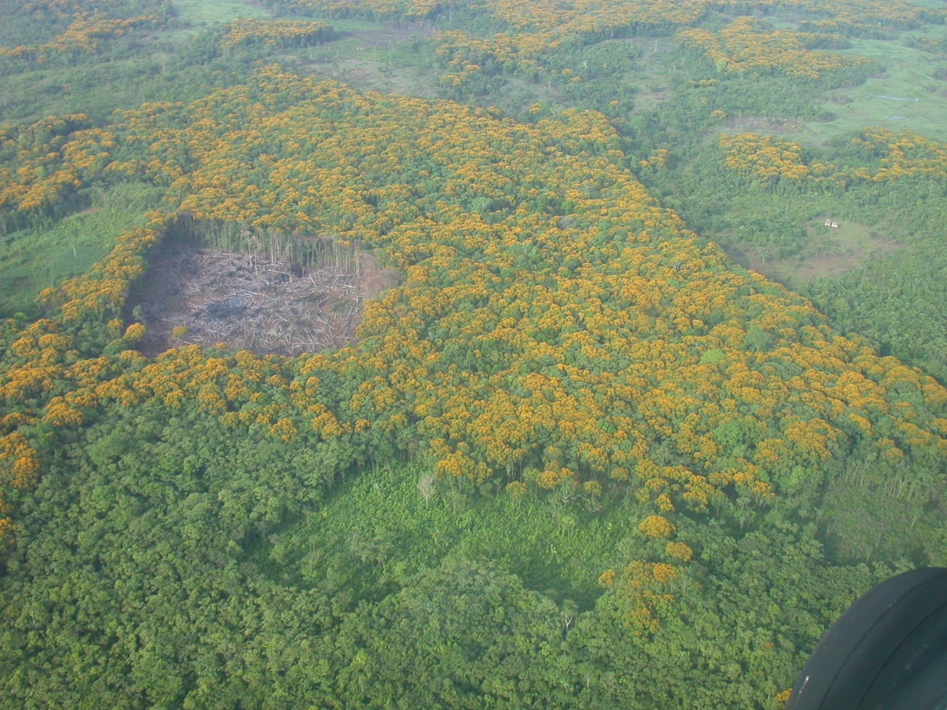
Agents of Deforestation

Slide 9
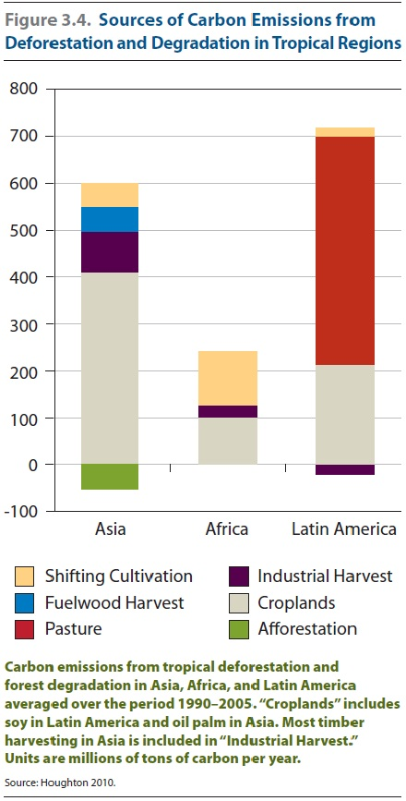
The agents differ among continents
However agriculture (pasture, cropland and shifting cultivation) has been predominant everywhere
(1990-2005 data)
From R.A. Houghton, WHRC Cancun side event, 7 Dec 2010
Notes:
9

Slide 11
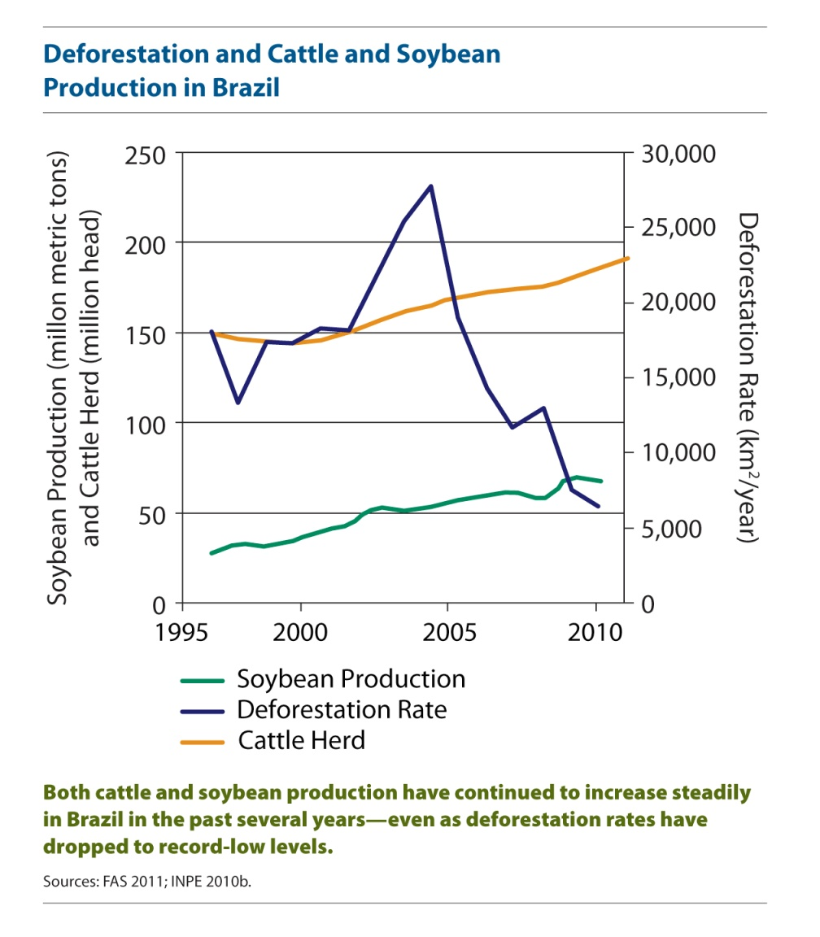
Soybeans
Large-scale commercial soy production grew rapidly in the late 1990s, becoming the cause of about one-fourth of Amazon deforestation
However, civil-society pressure and business responses have successfully reduced the deforestation caused by soybeans in Brazil to low levels
Macedo et al. 2012, Rudorff et al. 2011

Slide 12
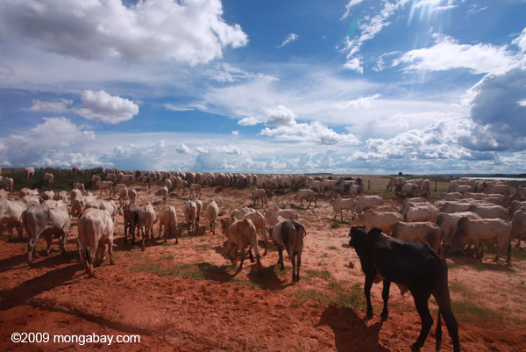
Beef cattle
Growing beef production, for both domestic and export markets, is causing most Amazon deforestation

Slide 13
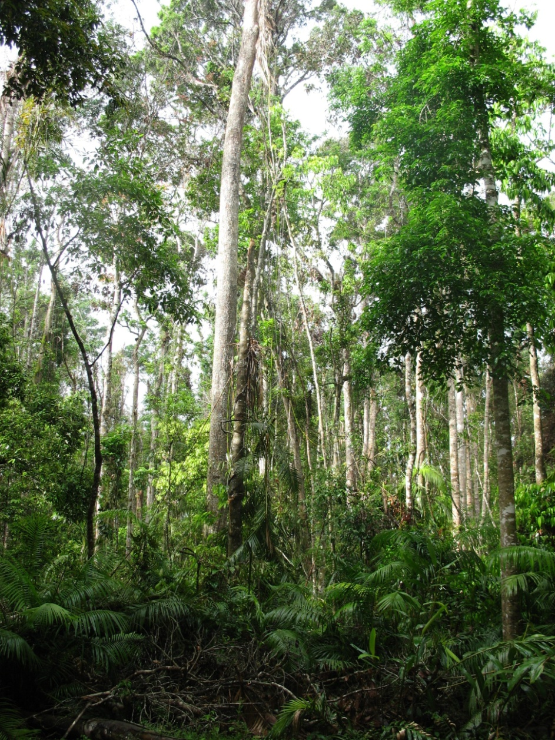
Timber and pulp
Tropical timber and pulp production creates roads for the other drivers and is economically important to deforestation in Southeast Asia
The timber industry there is closely connected to, and its profits help finance, expanding palm oil and pulp and paper plantations

Slide 14
Conclusions
The drivers of deforestation have changed fundamentally as we have moved into the 21st century
Underlying demand will increasingly be driven by shifts in diet, not population growth
Large commercial agriculture and wood-products production have become agents of deforestation

Slide 15
Thanks to: The ClimateWorks Foundation The Bellona Foundation Pipa Elias, Estrellita Fitzhugh, Lael Goodman, Katherine Lininger, Calen May-Tobin, Sarah Roquemore and Earl Saxon
This UCS report and shorter fact sheets on our work can be downloaded at:
www.ucsusa.org/whatsdrivingdeforestation
and at www.ucsusa.org/forests

