Slide 1
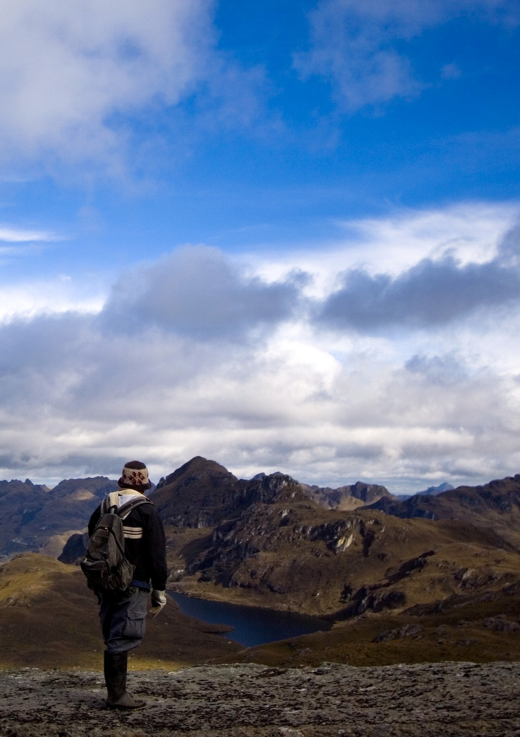
REDD+ Roundtable: Issues for 2011 Amazon Environmental Research Institute (IPAM), Conservation International (CI), Environmental Defense Fund (EDF), Rainforest Alliance (RA), The Nature Conservancy (TNC), Union of Concerned Scientists (UCS), Wildlife Conservation Society (WCS), Woods Hole Research Center (WHRC), and World Vision International

Slide 2
Issues for 2011
SBSTA:
Reference levels
Measuring, monitoring, reporting and verifying carbon for REDD+
Safeguards
LCA:
Finance

