Slide 1
SIDE EVENT: Demand side Strategies and Buildings Energy Efficiency - Opportunities in the GCC region.
Strategies And Opportunities For Greening The Building Sector In The GCC Countries
By: Dr. Anhar Hegazi
Director, Energy and green Development Group
Cairo, Egypt. Email: anharhegazi@gmail.com
DOHA, 29-11-2012

Slide 2
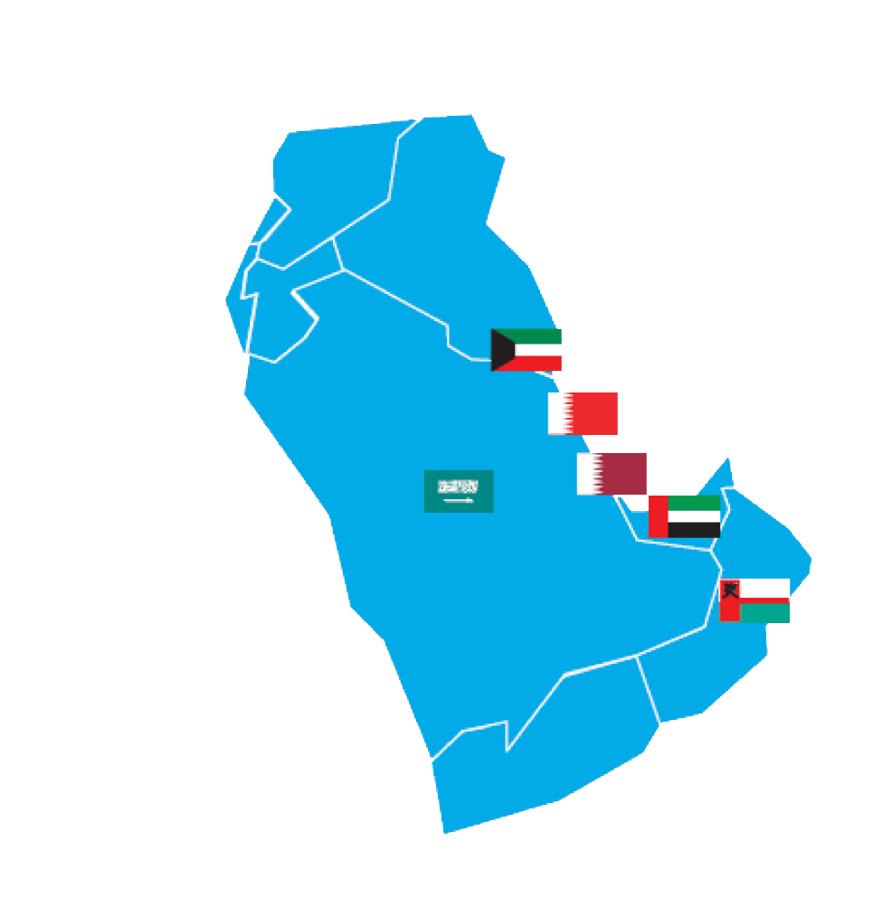
SIDE EVENT: Demand side Strategies and Buildings Energy Efficiency - Opportunities in the GCC region. Anhar Hegazy, Strategies And Opportunities For Greening The Building Sector In The GCC Countries
Core Issues:
Trends of the GCC Construction and Building Sector.
Strategies for Greening the Building Sector.
Initiatives for Greening the Building Sector.
Greening the Building Sector; the Potential Impacts.
Conclusions.
DOHA, 29-11-2012
Page 2

Slide 3
SIDE EVENT: Demand side Strategies and Buildings Energy Efficiency - Opportunities in the GCC region. Anhar Hegazy, Strategies And Opportunities For Greening The Building Sector In The GCC Countries
Trends of the GCC Construction
and Building Sector.
Construction is a major industry in GCC Countries and is considered the second most important economic activity. The sectors share in GDP is approaching 10% in some countries, without the real estate services. The sector is growing rapidly in all countries of the region.
The residential market is a strong sector in Saudi Arabia. The demand for residential units is expected to increase due to the young growing population and the new mortgage law. This new law will enable home ownership for the majority of population (currently one in every five Saudis is a house owner.
Abu Dhabi’s Economic Vision 2030, which focuses on education, health care, and infrastructure, identifies construction sector as an enabler of development in all these sectors. It is expected that the population will grow from a current 1.5 million to 3.5 million inhabitants in the Emirate.
DOHA, 29-11-2012
Page 3

Slide 4
SIDE EVENT: Demand side Strategies and Buildings Energy Efficiency - Opportunities in the GCC region. Anhar Hegazy, Strategies And Opportunities For Greening The Building Sector In The GCC Countries
Trends of the GCC Construction
and Building Sector.(Cont.)
In Qatar, The country’s sustainable economic growth has resulted in a parallel growth in the construction sector (17% in 2009). In addition to residential units, Qatar is experiencing an increase in demand for office spaces.
The past three years have seen a significant change in attitude in the Gulf to the importance of minimizing the environmental impact of its construction projects. Meanwhile, there are growing signs that the demand for green buildings in the GCC region is rising too. This is due to the growing shift towards liberalizing energy prices, the increased global push towards energy efficiency, as well as due to the local water scarcity problem.
DOHA, 29-11-2012
Page 4

Slide 5
SIDE EVENT: Demand side Strategies and Buildings Energy Efficiency - Opportunities in the GCC region. Anhar Hegazy, Strategies And Opportunities For Greening The Building Sector In The GCC Countries
Strategies for Greening the Building Sector.
Green The building sector is a process that is environmentally responsible and resource-efficient throughout a building's life-cycle: from siting to design, construction, operation, maintenance, renovation, and demolition. Complements the classical building. Design concerns of economy, utility, durability, and comfort.
The objective is to reduce the overall impact of the built environment on human health and the natural environment by:
Conserving Energy: through building insulation, orientation, passive and active solar energy, daylight, shading and sustainable sources of material.
Conserving Water: Through native landscaping requiring less irrigation, reuse grey water, treat sewage and conserve domestic water consumption.
Reducing Waste and Pollution: Through recycling, control sources of pollution and finding alternatives to polluting substances.
DOHA, 29-11-2012
Page 5

Slide 6
SIDE EVENT: Demand side Strategies and Buildings Energy Efficiency - Opportunities in the GCC region. Anhar Hegazy, Strategies And Opportunities For Greening The Building Sector In The GCC Countries
Strategies for Greening the Building Sector.(Cont.)
Several GCC Countries have adopted strategies and policies targeting greening the building sector. Examples are:
In Bahrain: Measures have been taken to reduce losses in the water distribution network to less than 17% including:
Installation of water meters to record consumption.
Develop terms for ground water pumping systems and rationalization of consumption.
Awareness programs.
Waste water recycling and treatment.
DOHA, 29-11-2012
Page 6

Slide 7
SIDE EVENT: Demand side Strategies and Buildings Energy Efficiency - Opportunities in the GCC region. Anhar Hegazy, Strategies And Opportunities For Greening The Building Sector In The GCC Countries
Strategies for Greening the Building Sector.(Cont.)
In Saudi Arabia: Several National initiatives have been taken by King Abdul Aziz City for Science and Technology and the Ministry of Water and Electricity including:
Rationalization of energy consumption in building.
Load management to reduce air conditioning loads and use thermal insulation in buildings.
Auditing the electrical energy consumption in government buildings.
The use of efficient lighting appliances.
Building data bases on energy efficiency of house hold appliances.
DOHA, 29-11-2012
Page 7

Slide 8
SIDE EVENT: Demand side Strategies and Buildings Energy Efficiency - Opportunities in the GCC region. Anhar Hegazy, Strategies And Opportunities For Greening The Building Sector In The GCC Countries
Initiatives for Greening the Building Sector.
Almost all GCC countries have adopted different approaches to introduce and promote Green Buildings, including:
Introducing Green Building Codes, Regulations and Specifications.
Implementing Green Building Projects.
DOHA, 29-11-2012
Page 8

Slide 9
SIDE EVENT: Demand side Strategies and Buildings Energy Efficiency - Opportunities in the GCC region. Anhar Hegazy, Strategies And Opportunities For Greening The Building Sector In The GCC Countries
A. Introducing Green Building Codes, Regulations and Specifications.
In Dubai: The Dubai Electricity and Water Authority (DEWA) in Support of Dubai’s Strategic Plan has introduced the Green Building Regulations and Specifications to:
Create a more sustainable urban environment and extend the ability of the Emirate’s infrastructure to meet the needs of future development. And
Improve the performance of buildings in Dubai by reducing the consumption of energy, water and materials, improving public health, safety and general welfare and by enhancing the planning, design, construction and operation of buildings to create an excellent city that provides the essence of success and comfort of living.
DOHA, 29-11-2012
Page 9

Slide 10
SIDE EVENT: Demand side Strategies and Buildings Energy Efficiency - Opportunities in the GCC region. Anhar Hegazy, Strategies And Opportunities For Greening The Building Sector In The GCC Countries
III.A. Introducing Green Building Codes, Regulations and Specifications (Cont.)
Applicability:
Villas, Residential/ Commercial, Public Buildings. All new Buildings additions, extensions and refurbishment of existing buildings.
Exemptions:
Large scale & specialized nature projects, and the Heritage Buildings, identified by Dubai Municipality.
In AbuDhabi: The Urban Planning Council (UPC) has launched its Estidama (Sustainability) ratings system focusing on five categories of building design and life cycle performance: Site, Water, Energy, Materials and Indoor Environment.
DOHA, 29-11-2012
Page 10

Slide 11
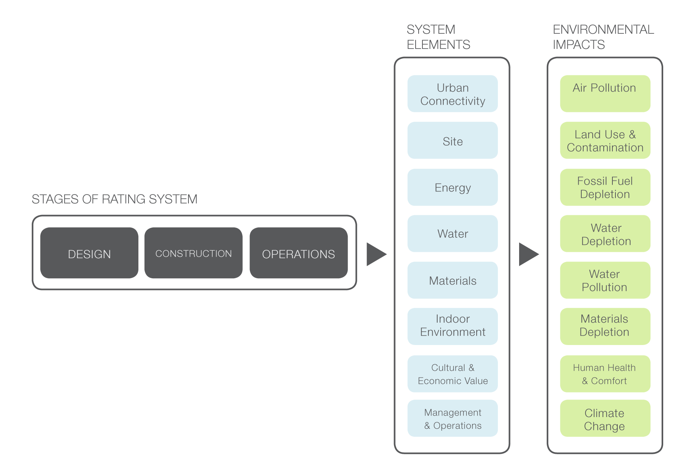
SIDE EVENT: Demand side Strategies and Buildings Energy Efficiency - Opportunities in the GCC region. Anhar Hegazy, Strategies And Opportunities For Greening The Building Sector In The GCC Countries
III.A. Introducing Green Building Codes, Regulations and Specifications (Cont.)
In Qatar: The Qatar Sustainability Assessment System (QSAS), was established by Qatari Diar Company.
Objectives:
To create a sustainable built environment that minimizes ecological impact through the development of a sustainability rating system supported by a set of performance based standards that addresses the specific regional needs and environment of Qatar.
System Overview:
DOHA, 29-11-2012
Page 11

Slide 12
SIDE EVENT: Demand side Strategies and Buildings Energy Efficiency - Opportunities in the GCC region. Anhar Hegazy, Strategies And Opportunities For Greening The Building Sector In The GCC Countries
III.B. Green Building Projects.
In Saudi Arabia: at a cost of more than US$60B SA has planned and begun constructing four Economic Cities (EC) located in Rabigh(King Abdullah EC), Hail (Prince AbdulAziz bin Mousaed Economic City), Madinah (Knowledge Economic City) and Jazan (Jazan Economic City).
In Bahrain: The World Trade Building opened in 2008, this is the world’s first sky scraper to use wind turbines in its design. The project has received a number of awards for Sustainable Design.
In Kuwait: Sabah Al Ahmed International Finance Centre, a 40-storey tower able to generate its own energy from a PV system and roof mounted wind turbines.
Source: Construction Projects in the GCC: The Opportunity and the Missing Link for a GCC-Based Eco-Innovation. By Sami Mahroum (INSEAD)
with contributions from Dr. Mazen Omran (ARUP) and Souheir Mahroum (freelancer)
DOHA, 29-11-2012
Page 12

Slide 13
SIDE EVENT: Demand side Strategies and Buildings Energy Efficiency - Opportunities in the GCC region. Anhar Hegazy, Strategies And Opportunities For Greening The Building Sector In The GCC Countries
III.B. Green Building Projects. (Cont.)
Bawadi, Dubai: to be the world’s largest hospitality, shopping and entertainment district, incorporating green and sustainable design throughout the development. It will incorporate 60,000 hotel rooms.
Qatar: Energy City utilizing the latest green building technology, this will be a modern business and residential facility occupied by a diverse mix of energy- related companies.
Source: Construction Projects in the GCC: The Opportunity and the Missing Link for a GCC-Based Eco-Innovation. By Sami Mahroum (INSEAD)
with contributions from Dr. Mazen Omran (ARUP) and Souheir Mahroum (freelancer)
DOHA, 29-11-2012
Page 13

Slide 14
SIDE EVENT: Demand side Strategies and Buildings Energy Efficiency - Opportunities in the GCC region. Anhar Hegazy, Strategies And Opportunities For Greening The Building Sector In The GCC Countries
Greening the Building Sector, the
Potential Impacts.
Governments have begun introducing green building codes to encourage the industry become more energy efficient, however they of that region have not sufficiently recognized the potential link between construction, and techno-economic development.
The compounded effect of a strong local demand construction in general and green buildings in particular provide a unique opportunity for the GCC region to use the construction sector as a driver of economic development and not only an enabler.
Given GCC unique position in the construction market, governments should accelerate their efforts towards greening the building sector, as an engine for knowledge transfer and economic diversification.
DOHA, 29-11-2012
Page 14

Slide 15
SIDE EVENT: Demand side Strategies and Buildings Energy Efficiency - Opportunities in the GCC region. Anhar Hegazy, Strategies And Opportunities For Greening The Building Sector In The GCC Countries
Greening the Building Sector, the
Potential Impacts.(Cont.)
While considering all applicable options for greening the building sector, energy efficiency, water resource management and waste treatment systems should be given priority.
A recent study estimated the impact of these new regulations is likely to be significant; estimates suggest their application is expected to result in 30 percent building energy savings for cooling and air-conditioning; 9 percent savings for artificial lighting and 6 percent for heating water. At the same time they will also reduce water consumption in buildings by up to 30 percent (Gulf News, 2007).
DOHA, 29-11-2012
Page 15

Slide 16
SIDE EVENT: Demand side Strategies and Buildings Energy Efficiency - Opportunities in the GCC region. Anhar Hegazy, Strategies And Opportunities For Greening The Building Sector In The GCC Countries
Conclusions.
The GCC Countries have developed remarkable efforts towards Greening the Construction and Building Sector, yet they still need to utilize the construction boom in their countries to enhance economic diversification, mitigate GHG gasses and achieve social well fare of the people.
Achieving the above would require:
Adopting strategies and policies that link the growth of the Construction/ Building Sector to new technologies and innovations.
Enforcing the established codes, regulations and standards and update it regularly to match new green technologies.
DOHA, 29-11-2012
Page 16

Slide 17
SIDE EVENT: Demand side Strategies and Buildings Energy Efficiency - Opportunities in the GCC region. Anhar Hegazy, Strategies And Opportunities For Greening The Building Sector In The GCC Countries
Conclusions. (Cont.)
Intensifying efforts for relevant capacity building and awareness dissemination programs.
Subsequently, the GCC governments will need an innovation policy that links environmental policies and economic development policies together. This can be achieved through a number of policy instruments, including Public Procurement, Smart Regulations and Standards.
DOHA, 29-11-2012
Page 17

Slide 18
SIDE EVENT: Demand side Strategies and Buildings Energy Efficiency - Opportunities in the GCC region. Anhar Hegazy, Strategies And Opportunities For Greening The Building Sector In The GCC Countries
Wishing You All a Greener & Greener Future
Thank you
DOHA, 29-11-2012
Page 18

