Slide 1
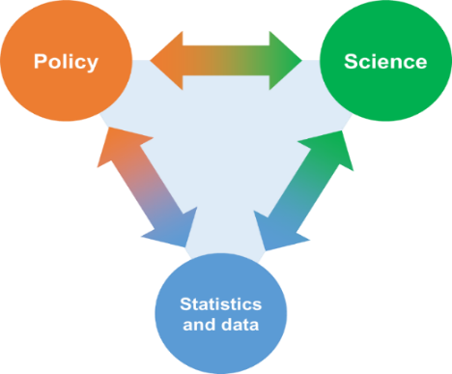
UNECE Task Force on the role of national statistical offices in achieving national climate objectives
Data is integral to the implementation of the Paris Agreement
Guidance needed to showcase what national statistical systems offer to support climate action and help to bridge the gap between producers and users (draft available, to be finalized in June 2024)
50+ members from national statistical offices, ministries of environment and international organizations (Armenia, Azerbaijan, Belarus, Canada, Costa Rica, Denmark, Ireland, Italy, Netherlands, Poland, Serbia, Spain, Türkiye, UK, Ukraine, UNFCCC, UNSD, UNEP, UNECE, ECLAC, ESCAP, ECA, IMF, IEA, EEA, Eurostat, PARIS21)
How can the statistical community contribute to climate action?
Enhanced Transparency Framework and Global Stocktake
Enabling new research
Possible involvement in GHG inventories, NDC tracking reporting on adaptation – from providing source data to active collaboration
Improving availability of internationally comparable data to facilitate both ETF and Global Stocktake
GLOBALLY

Slide 2
UNECE Task Force on the role of national statistical offices in achieving national climate objectives
How can the statistical community contribute to climate action?
Mitigation
Adaptation
Just transition
Monitoring energy transition and its enablers
Complementary approaches to GHG emission estimates, e.g. carbon footprints
Data on populations, infrastructure and ecosystems which are vulnerable or exposed to risk
Localized, granular data
Impact of policies by populations groups, gender, regions, e.g. energy poverty
Decoupling growth from emissions
NATIONALLY AND LOCALLY
Informing the public
Making statistics and data easy to access and use – dedicated portals, explanations for users with various levels of expertise, various dissemination formats, e.g. for analysts, journalists, students, bloggers
Building trust and public awareness through transparent, reliable and relevant data
NSOs have a strong basis for supporting work as statistical frameworks and indicator sets are in place
Coordination within and between policy domains, research institutes and data producers needs to be strengthened to identify the gaps, set priorities, mobilize resources and produce new statistics

