Slide 1
How Policy Can Make You Happy
Dan Delurey
President
Demand Response and Smart Grid Coalition (DRSG)

Slide 2
I am from Washington and I have good news for you……

Slide 3
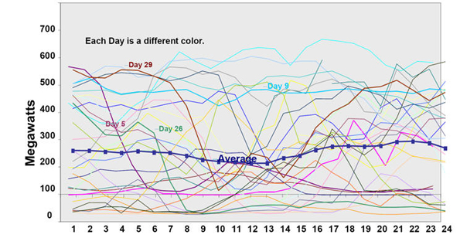
Why is this good news?

Slide 4
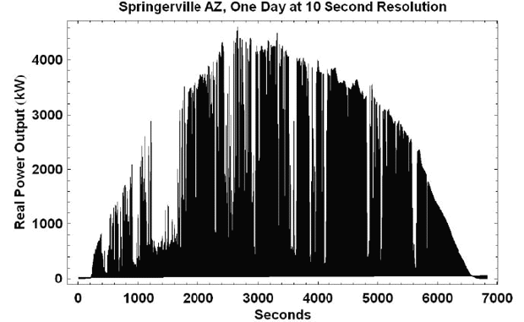
Why is this good news?

Slide 5
Short History of an Old Industry
Ben Franklin
Thomas Edison & Nicholas Tesla
Town by Town Utilities
Aggregation and Anti-Trust
Obligation to serve
Federal/State Bright Line
Three Types of Utilities:
Investor-Owned Private
Municipal and other Public
Rural Electric Cooperatives
Deregulation/Restructuring
The Smart Age

Slide 6
Additional Historical Perspective
Electricity is among the most – if not the most – regulated and politically influenced industries in the U.S.
Utilities are seen as a captive subject by interest groups that want to makes changes – both energy related and not.
Utilities are not well liked by their customers
Utilities have not tried hard to be liked by their “ratepayers”
Restructuring has stalled.

Slide 7
Demand – An Evolutionary Perspective
Conservation
Running out of oil
Efficiency – Phase 1
Get the same benefit with less energy
Demand Side Management
Utility-oriented
Efficiency – Phase 2
Beyond the end use
Efficiency Phase 3
The Smart Age
Dynamic Efficiency (DR) based on communications, information and prices
Systems approach: Smart Grid, Buildings, Appliances

Slide 8
DR and Energy Efficiency Siblings in the “Demand-Side” Family
Energy efficiency saves more kwh
DR’s highest value is KW
DR results on average in a net conservation effect
DR is dynamic, controllable and dispatchable a.k.a. “dynamic efficiency”
DR is more measurable and verifiable
DR technologies provide information that fosters overall energy efficiency

Slide 9
DR is no longer just LC
No longer a blunt weapon
No longer a phone call to curtail
No longer just about peak
No longer just about MW/KW
No longer separate from energy efficiency
No longer separate from ancillary services
No longer just about emergencies

Slide 10
Why Utilities Like DR
Vehicle for them to modernize their companies and operations
New ability to optimize their operations and lower costs
Customers can be made happier by giving them new information and choices
Technology that enables DR can help improve customer service and field operations

Slide 11
Smart Grid Options

Slide 12
Smart Grid Technologies
Smart Meters
Communications Networks
Home Area Networks and Information Displays
Demand Response Technologies
Energy Storage
Plug-in Electric Vehicles
Automated Sensors and Controls
Dynamic Energy Management
Substation Automation
Automated Outage Management
SynchoPhasers and other Transmission technologies

Slide 13
Smart Grid – Groping the Elephant
Smart Grid, i.e. as in THE Smart Grid
Smart Grid, i.e. as in A Smart Grid
Regional
State
Service Territory
Local
Micro
Smart Grid, i.e. as in the concept
Smart Grid, i.e. as in the design principle
Smart Grid, i.e. as in the operating mode
Smart Grid, i.e. as in the type of technology
Smart Grid, i.e. as in the religion

Slide 14
If you are doing Demand Response, you are doing Smart Grid…….
Demand Response is the smart grid in action….

Slide 15
Challenges for Policy Makers

Slide 16
Why Policy Makers Like DR
Dampens Market Power
Lowers Prices to Customers
Provides New Choices and Control Options for Customers
Improves Reliability
It’s necessary to bring on intermittent and variable wind and solar
Improves EMV
Provides new information to customers
Creates additional efficiency reductions
Creates additional management data

Slide 17
Why is this good news?

Slide 18
Why is this good news?

Slide 19
DR Myths that have been dispelled
Customers (you) won’t show up
DR Providers won’t deliver
DR and Efficiency are not related
DR and Renewable Energy are not related
DR and Climate Change are not related
Customers don’t like it
DR is simply a case of load shifting

Slide 20
Demand Response Potential in the United States
Forecasted 2019 Peak Demand Reduction by State
Legend
 | 5% - 10% of peak
 | 11% - 15% of peak
 | > 15% of peak
Source: FERC, A National Assessment of Demand Response Potential, June 2009 / Achievable Participation Scenario

Slide 21
Forecasted Demand Response Growth
Achievable DR potential expected to exceed 137 GW (14% of peak) by 2019.
Dispatchable resources make up 40% of achievable DR potential.
Source: FERC, National Assessment of Demand Response Potential, June 2009.

Slide 22
Small and Medium C&I Market is Under Served
Source: FERC, National Assessment of Demand Response Potential, June 2009.
Percentages shown represent Small/Medium C&I as a % of Large C&I

Slide 23
Why a Policymaker’s Love Will Matter
The more policymakers try to encourage DR, the more policy will be put in place to incentivize and otherwise make it happen
The more pressure to put DR in place the higher value and more vibrant market for your DR

Slide 24
Why We All Need to Connect the Dots
Dot 1: A federal decision on economic methodology for DR compensation in wholesale markets
Dot 2: RTOs/ISOs use it to design and operate programs and pay for DR
Dot 3: State Regulators use it to design pricing & compensation for retail/utility payments for DR
Dot 4: DR Providers design new programs to capture the added/lowered value
Dot 5: Companies participating in DR make more/less money

Slide 25
Demand Response Policy – A History
PURPA 1978
Load Control Directives and Approvals
Restructuring – Competitive Metering and New Choices
FERC directives to ISOs/RTOs
RTP for large customers
System benefit funding
Mega-mandates (CA, Ontario)
EPACT 2005
FERC/State Action
Energy Independence Act 2007
ARRA 2010

Slide 26
What (Mr/Ms Policymaker) have you done for me lately?
Capacity Markets
Energy Markets
Ancillary Services
Energy Efficiency
Peak Reduction Standards
National Action Plan on Demand Response
NIST Interoperability
NAESB M&V

Slide 27
How you can help yourself?
Work within your industry to educate policymakers
Urge your industry to get involved
Urge your company to talk to policymakers
Consider weighing in at FERC right now
Don’t assume that someone else will do it

Slide 28
Thank You
Dan Delurey
President
Demand Response and
Smart Grid Coalition

Slide 29
Smart Grid in Practice
Outage Management
Grid Optimization
Energy Efficiency
Demand Response
Renewable Energy Integration
Cybersecurity
Dynamic Storage
Time-based Pricing
Customized Products and Services

Slide 30
Smart Grid – Positive Prospects
Inevitable that technology be integrated into grid operations
Utilities are very much on board; they want to modernize their companies and provide new and better services to customers
Policymakers at Federal and State levels are supportive of concept
More understanding of how renewable energy needs smart grid and DR
More understanding of how smart grid will lead to a new era of sustainable energy efficiency
The term has entered the public vernacular – Super Bowl Ad

Slide 31
Why the Smart Grid will Win
Utilities realize the benefits for them
Modernization of their infrastructure
New means of operating their business
New options for maintaining reliability and security
New information about their customers
Ability to offer new choices to customers
Increased customer satisfaction
Inevitable that technology available elsewhere will be applied to electricity
Measurement and Verification will require it
CFLs vs Plasma TVs
Customers “get it”…they see it elsewhere…they will want it

Slide 32
Challenges for Policy Makers
Connecting Resources to Demand (Interconnection)
Ensuring Reliability
Ensuring Least Cost Planning and Operations
Introducing Time-Based Prices
Approving Infrastructure Investments
Ensuring Privacy
Ensuring Openness and Flexibility
Ensuring Marketplace Innovation
Getting into the Transportation Business
Providing Incentives for Action
Keeping Prices Low
Mitigating market Power
Giving Customers Options for Bill Control
Implementing Integrated Resource Planning
Implementing RPS
Using Demand Response and Smart Grid to address Climate Change

Slide 33
Smart Grid in Practice
Outage Management
Grid Optimization
Energy Efficiency
Demand Response
Renewable Energy Integration
Cybersecurity
Dynamic Storage
Time-based Pricing
Customized Products and Services

Slide 34
What is it then?
Dynamic efficiency (vs traditional efficiency)
Dispatchable efficiency
Equal to Supply
Better than Supply
Best-yet Evaluation, Measurement & Verification

Slide 35
DR and Smart Grid – different silos?
No – different parts of the same picture
Symbiotic relationship
DR – the smart grid in action
Catch 22 between technology and economics
Yes – but the vend diagram has a lot of overlap

