Slide 1
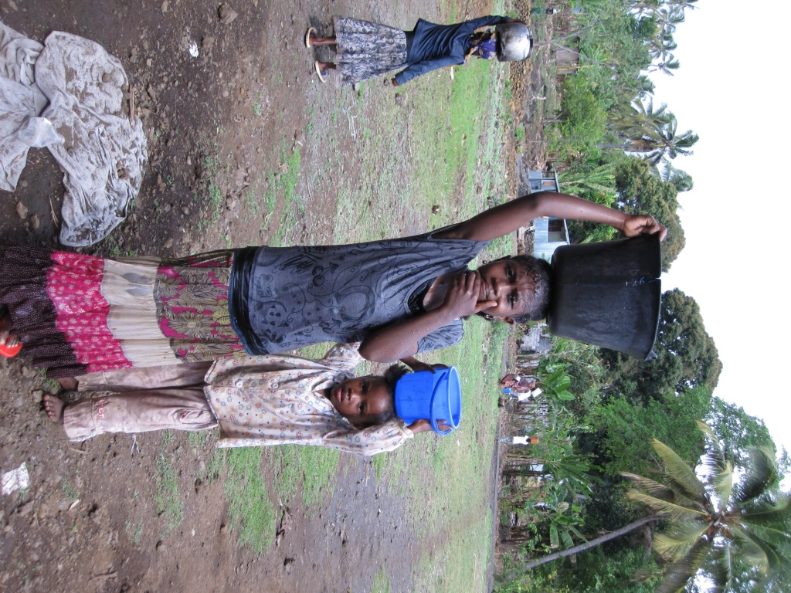
Mainstreaming Gender in the GEF: Good Practices from the Climate Change Adaptation Portfolio
UNFCCC Climate Talks - June 2011 Bonn, Germany
Bonizella Biagini
Head
Climate Change Adaptation Strategy and Operations Global Environment Facility
bbiagini@thegef.org

Slide 2
Background: GEF support to adaptation
Financing: overview of LDCF, and SCCF
Focus on Gender: LDCF/SCCF strategy
SGP
Questions/Comments

Slide 3
Adaptation Financing
The most vulnerable countries and poorest communities, and women within these communities are and will continue to be the ones most adversely affected and least able to respond to the effects of climate change.
GEF support to adaptation includes: a pilot under the GEF TF, the Least Developed Countries Fund (LDCF) and Special Climate Change Fund (SCCF) and secretariat services to the Adaptation Fund.
LDCF and SCCF were established under the UNFCCC in 2001, to finance, as a priority, adaptation projects; they are managed by the GEF in addition to the conventional operations under the GEF Trust Fund.
TODAY: More than 600 million dollars raised in voluntary donor contributions to the two funds (LDCF and SCCF).

Slide 4
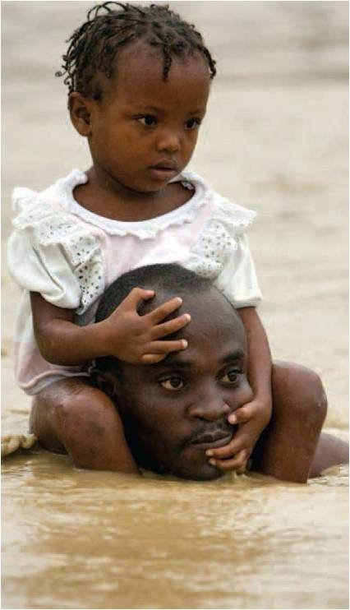
3 Pillars of LDCF/SCCF Adaptation Strategy
1) increasing adaptive capacity
2) decreasing vulnerability
3) promoting technology transfer
___________________
COP guidance so far has
been gender neutral;
however, many
accomplishments have
already been achieved

Slide 5
Innovative Features of LDCF and SCCF
Financing concrete adaptation actions on the ground (using existing studies and assessments)
Application of the Additional Cost principle
Full-cost Funding
Expedited Project Cycle
Streamlined cycle for projects <$2M (Mid-Sized Projects/LDCF)
Ongoing dialog with recipient countries, especially LDCs

Slide 6
LDCF
Aimed at addressing the special needs of the LDCs under the Climate Convention; adaptation has been identified as most relevant issue; the LDCF finances most urgent and immediate needs
COP Parties asked the LDCF to support the preparation and implementation of National Adaptation Programmes of Action (NAPAs)
Supported preparation of 48 NAPAs, 45 complete
45 implementation projects have eeb submitted and approved, of which 23 already under implementation
Total LDCF resources $460M for adaptation grants
Activities include: water mgt, ag, food security, disaster risk management, and NRM (as identified and prioritized by the NAPAs).

Slide 7
SCCF
The SCCF is open to all vulnerable developing countries.
4 windows : (A) Adaptation; (B) Transfer of Technologies; (C) Energy, transport, industry, agriculture, forestry, and waste management; (D) economic diversification for fossil fuel dependent countries.
Adaptation as top priority (as per COP guidance)
SCCF activities include health, integrated coastal management, water resources in response to glacial retreat, floods, and drought, and potential use of fiscal instruments (as per COP guidance).

Slide 8
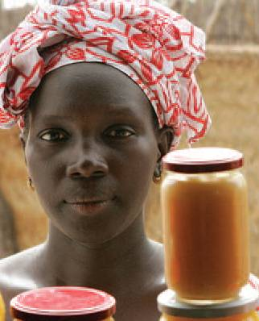
Specific Focus on Gender in GEF Adaptation Strategy for LDCF and SCCF
LDCF/SCCF prioritize a broad range of sectors that support livelihoods
Ensures that project design and the Result-Based management considers socioeconomic and gender issues
GEF has developed specific policies to further the goal of gender equity in the context of GEF operations, which will become part of project design requirements and part of project review criteria for LDCF/SCCF as well

Slide 9
ADAPTATION TO CLIMATE CHANGE (LDCF/SCCF) FRAMEWORK
CCA-2: Increasing Adaptive Capacity: Increase adaptive capacity to respond to the impacts of climate change, including variability, at local, national, regional and global level | Outcome 2.1: Increased knowledge and understanding of climate variability and change-induced threats at country level and in targeted vulnerable areas Indicator 2.1.2 Vulnerability and risk perception index, disaggregated by gender (Score)
 | Outcome 2.2: Strengthened adaptive capacity to reduce risks to climate-induced economic losses Indicator 21.2.2 Capacity perception index, disaggregated by gender (Score)
 | Outcome 2.3: Strengthened awareness and ownership of adaptation and climate risk reduction processes at local level Indicator 2.3.1 Targeted population awareness of predicted adverse impacts of climate change and appropriate responses, disaggregated by gender (Score) Indicator 2.3.2 % of population affirming ownership of adaptation processes, disaggregated by gender (% of population)
CCA-3: Adaptation Technology Transfer: Promote transfer and adoption of adaptation technology | Outcome 3.1: Successful demonstration, deployment, and transfer of relevant adaptation technology in targeted areas Indicator 3.1.1 % of targeted groups adopting transferred adaptation technologies by technology type, disaggregated by gender (Score)
 | Outcome 3.2: Enhanced enabling environment to support adaptation-related technology transfer Indicator 3.2.2 Strengthened capacity to transfer appropriate adaptation technologies, disaggregated by gender (Score)

Slide 10
NAPA and Gender
NAPA guidelines
Participatory
Inclusion of local communities
Recognizes the importance of gender equality
notes that climate change in most cases disproportionately affects women
guidelines are not meant to be prescriptive
procedures may be flexible based on individual country
circumstances

Slide 11
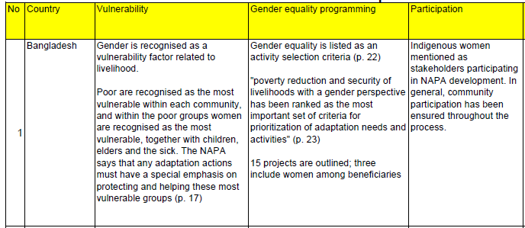
Addressing Gender Issues
As of April 2009 38 countries mentioned gender inequality as an issue in their NAPAs
Community-based Adaptation to Climate Change through Coastal Afforestation in Bangladesh (LDCF grant: $3.7 M; agency: UNDP)
- Inclusion of project component that to train 100 community women in climate risk reduction
- Participatory approach for gender-sensitive livelihood diversification

Slide 12
Addressing Gender Issues
Country | Vulnerability | Gender Equality Programming | participation
Niger | The NAPA recognizes that women are more vulnerable as a result of poverty | Women are beneficiaries of three livestock/crop farming projects; one includes land ownership and exploitation by women as an activity. | Women were consulted throughout the process.
Implementing NAPA priority interventions to build resilience and adaptive capacity of the agriculture sector to climate change in Niger (LDCF grant: $4M; agency: UNDP)
-Ensure involvement of women in project activities including participation in management committees for cereal banks, fodder banks, and distribution of resistant crops etc

Slide 13
Example: Burkina Faso
Making agriculture sector resilient to cc impacts in 6 villages (LDCF Grant $3.3M agency: UNDP)
LDCF project was designed with gender considerations from inception
Full participation of women in the NAPA Steering Committee
Female farmers identified as among the most vulnerable groups => the project responds directly to their needs
Women are also included in training for climate resilient technologies
Credit will be provided to at least 10 women livestock farmers per year

Slide 14
Small Grants Programme
Launched in 1992
Supports activities of nongovernmental and community-based organizations in developing countries in GEF focal areas while generating sustainable livelihoods.
Gender is one of the main criteria considered for the approval of grants.
Gender balance is a prerequisite to participate in the initial stages of project conception, approval and implementation.
Needs assessment is done at the project development phase and is used to define the roles of women and men early in the project.
SGP documents the contribution of women to project
SGP National Steering Committees employ checklists and criteria to assess and screen projects for how they mainstream gender.
SGP holds “proposal writing workshops” and accepts project proposals in local languages and even in oral formats through participatory video proposals. Thus encouraging maximum participation by women, indigenous peoples
SGP encourages women stand-alone projects in line with the GEF focal areas
National Steering Committees—a voluntary body that makes all decisions on grant making— are required to include a gender specialist.

Slide 15
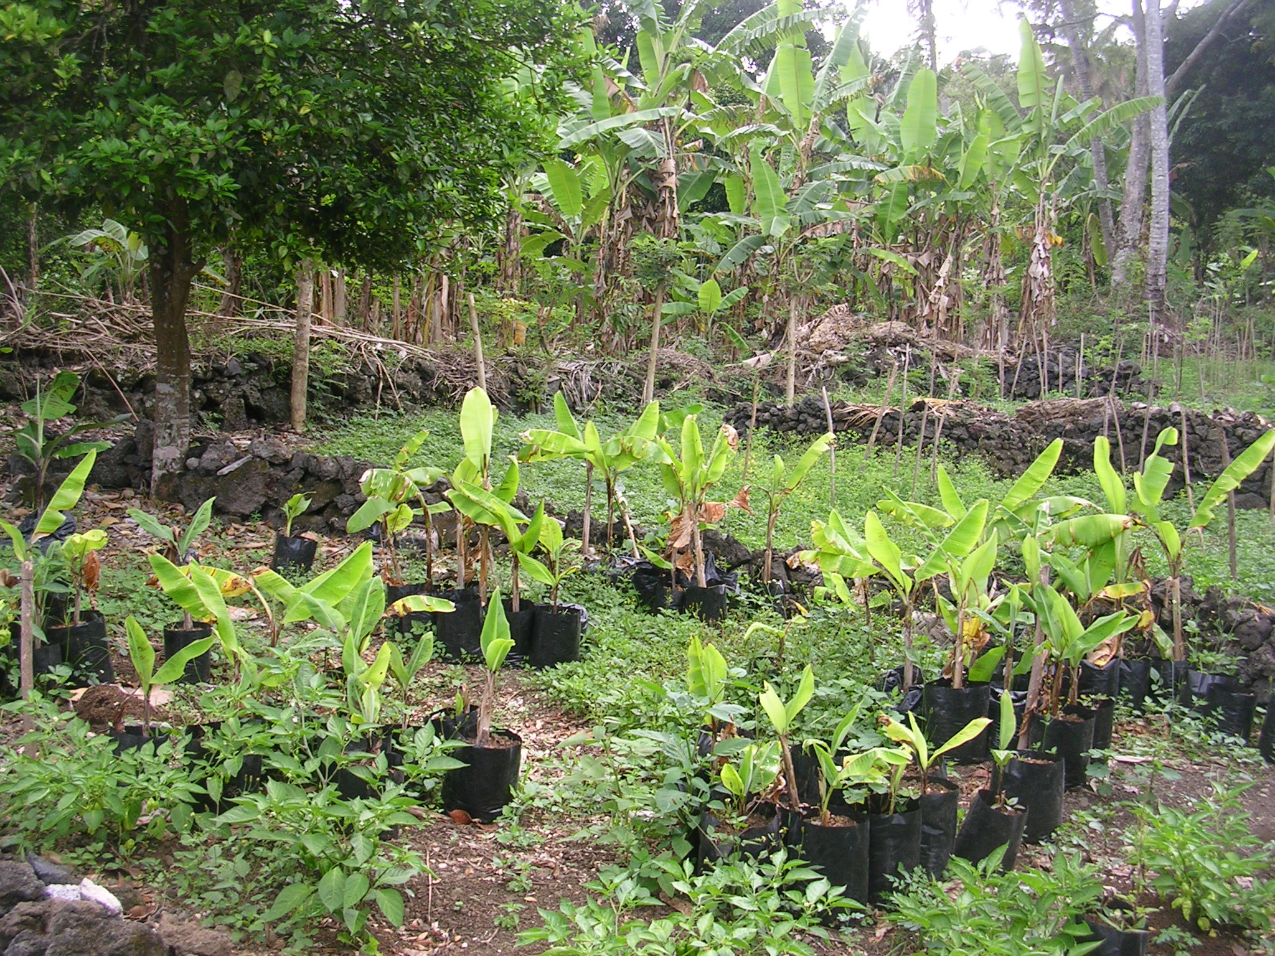
Thank you!
Contact Information
LDCF/SCCF : bbiagini@thegef.org
SGP: sgp.info@undp.org

