Slide 1
NAP-NDC Linkages: Process in the Philippines
Atty. Railla Veronica D. Puno
Climate Change Commission

Slide 2
Notes:
As of 2016, 13th in the Climate Change Vulnerability Index.

Slide 3
PHILIPPINE CLIMATE CHANGE POLICY
1991: IACCC Established (A.O. 220)
2011: National Climate Change Action Plan
2004: DENR as Designated National Authority for CDM (EO 320)
2012: Peoples’ Survival Fund (RA 10174)
2007: Presidential Task Force on Climate Change created
2013: Supplemental Guidelines for Integrating Climate Change Adaptation and Disaster Risk Reduction & Management on Comprehensive Land Use Planning
2009: Climate Change Act of 2009 (RA 9729) and creation of the Climate Change Commission
2014: Institutionalizing the Philippine Green House Gas Inventory Management and Reporting System (EO 174)
2010: Philippine Strategy on Climate Change Adaptation
2010: National Framework Strategy on Climate Change
2015: Joint Memorandum Circular DBM-CCC 2015-01 Climate Change Expenditure Tagging
2010: Philippine National REDD+ Strategy
2011: Cabinet cluster on Climate Change Adaptation and Mitigation (EO 43)
2016: Adopting the Policy on Ensuring Sustainable RE Resource Management (EO 206)
Notes:
Inter-agency Committee on Climate Change (Administrative Order 220) – Chaired by DENR Secretary, co-shared by DOST secretary tasked to monitor and assess climate change impacts, formulate policies on climate change, designate focal to the UNEP and WMO.
Clean Development Mechanism (CDM) – market mechanism under the Kyoto Protocol which aims to assist developed countries to meet their emission reduction target while at the same time assist development countries to attain their sustainable development goals. One of the prerequisites for participating in the CDM is to designate a national authority. For the Philippines, DENR served as Designated National Authority
Climate Change Act of 2009 (Republic Act 9729) – An Act Mainstreaming Climate Change Into Government Policy Formulations, Establishing the Framework Strategy and Program on Climate Change, Creating for this Purpose the Climate Change Commission, and for other purposes. Some of the salient features of the Act are:
- Creation of the Climate Change Commission
- Mainstreaming of climate change actions in national government, sectoral and local policies and programs. Acknowledge that local government units are the frontline agencies in the formulation, planning and implementation
of climate change action plans
- Formulation of NFSCC and NCCAP
- Establishment of Panel of Technical Experts
Philippine Strategy on Climate Change Adaptation – This was incorporated in the National Framework Strategy on Climate Change.
National Framework Strategy on Climate Change – Long-term objective is to build the adaptive capacity of communities and increasing the resilience of natural ecosystems to climate change. The NFSCC was then translated into the NCCAP
Cabinet Cluster on Climate Change Adaptation and Mitigation - Pursuing Our Social Contract With the Filipino People through the reorganization of the Cabinet Clusters
Supplemental Guidelines for Integrating Climate Change Adaptation and Disaster Risk Reduction and Management on CLUP – CCC with UNDP and HLURB developed guidelines to support the national strategic priority on mainstreaming disaster risk reduction and climate change adaptation in the development processes with emphasis on the formulation of climate- and risk-sensitive CLUP and zoning ordinance
Institutionalizing the Philippine Green House Gas Inventory Management and Reporting System (EO 174) - established to institutionalize the GHG inventory management and reporting system in relevant government agencies to enable the country to transition towards a climate-resilient pathway for sustainable development
Joint Memorandum Circular DBM-CCC 2015-01 Climate Change Expenditure Tagging - issued by DBM and CCC to tag government expenditures for CC adaptation and mitigation in the budget process; CCC developed typologies for Adaptation and Mitigation issued for all national government agencies, commissions, state universities and colleges
Adopting the Policy on Ensuring Sustainable Renewable Energy Resource Management (EO 206) – encourages DOE to accelerate the development of indigenous energy resources, along with this, the CCC issued a resolution that would a comprehensive review national policies and development of a framework for energy

Slide 4
NATIONAL CLIMATE CHANGE ACTION PLAN 2011-2028
Intermediate Outcomes
Successful transition towards
climate-smart development.
Enhanced adaptive capacity of communities, resilience of natural ecosystems, and sustainability of built environment to climate change.
Ultimate Outcomes
Notes:
National Climate Change Action Plan (NCCAP)
Outlines the specific long program and strategies for adaptation and mitigation, spanning across three political administrations
Aims to address urgent and immediate needs and concerns of the country relating to the dangerous consequences of climate change to vulnerable sectors such as agriculture, water resources, ecosystems, humans and infrastructure services
Ultimate Goal - Build the adaptive capacities of women and men in their communities, increase the resilience of vulnerable sectors and natural ecosystems to climate change, and optimize mitigation opportunities towards gender-responsive and rights-based sustainable development
Results Based Monitoring and Evaluation System
Established in order to accurately and progressively capture the impact of the NCCAP
Employs evidenced- based methods and analyses in monitoring and evaluating climate related activities
Vision: A fully operational results-based M&E system by Jan. 1, 2016 serving as a tool to improve and adjust NCCAP targets and activities from 2014 to 2028.
Mission: To accurately and progressively capture the impact of the NCCAP through evidenced-based methods and analyses, which will serve as bases for periodic refinements and recalibration of NCCAP strategies and tactics.

Slide 5
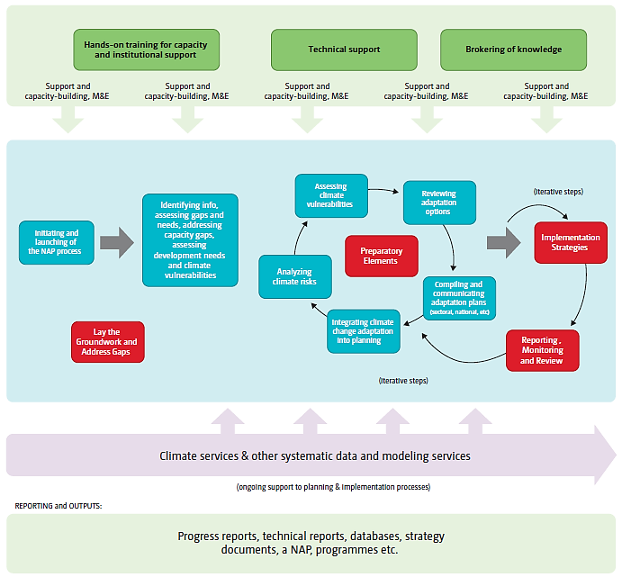
CCC Advisory Board
NCCAP Cluster Agencies
NCCAP RBMES
National Panel of Technical Experts (NPTE)
Community of Practice
Climate Change Institute
Climate Vulnerable Forum
NAP Process
NCCAP 2012-2015 Monitoring and Evaluation
Enhancement and Updating
Sectoral Agencies
Notes:
We have also begun to adopt the NAP Process in the PH context.
The Philippines puts premium on a multi-stakeholder, participatory and inclusive NAP process that supports the country’s long-term development vision and medium-term development plan. It will build-on existing institutional arrangements to minimize introduction of planning “layers” and avoid redundancy in the planning process. The process will be guided by a roadmap that will serve as the CCC blueprint in engaging the key agencies and other stakeholders.
This figure, modified to reflect the PH context, nicely captures the iterative process of adaptation planning. It indicates the different entry points where key agencies/actors can contribute in the process. The PH also started to look into developing NAP process worksteams that can be implemented in parallel, led by key government agencies.

Slide 6
INDC Process

Slide 7
Features of the Philippine INDC
Adaptation as an overarching priority
Prioritization of mitigation actions that have adaptation co-benefits
Emission reduction to come from the energy, transport, waste, industry, and forestry sectors.

Slide 8
NDC Roadmap
Revisit
INDC assumptions and parameters
MRV Framework (NICCDIES)
EO 174 Implementation
Reconstruct
Calculations, assumptions and methodologies
Setting up the institutional arrangements
MRV system improvements
Integrate in development and sectoral plans
Identify legislative policies
Private Sector engagement
Sub-national level activities
Report
1st NDC
Update NDCs every 5 years
Robust MRV system
Notes:
The NDC Roadmap will be divided into 3 main components:
First is to revisit the INDC and existing plans and policies relevant to the transition from INDC to NDC. Activities include a review of the assumptions and options identified in the INDC submission and ascertain measures to improve the calculations with better data as agencies will now implement Executive Order 174 Institutionalizing the GHG Inventory. A review of the current MRV framework will be done to ensure that the system will be flexible to accommodate latest decisions of the COP in preparation for the ratification of the Paris Agreement
Second phase will involve recalculations and revisions of the assumptions and methodologies. Having a robust, clear and transparent method of calculating the baselines, emissions inventory and projections are critical in monitoring progress of achieving the target that will be set by the Philippines. Identification and setting up of the necessary institutional arrangements are critical components for a successful formulation and monitoring of NDCs. It is also in this phase where a series of consultations and workshops will take place involving different key stakeholders such as the academe, CSOs, private sector and the whole of government including those at the sub-national level.
The third phase would include finalization and reporting of the 1st NDC. At this stage, it is envisioned that the MRV system is up and running and that the system is robust to enable the Philippines to monitor and to report regularly to the UNFCCC its progress in implementing the NDC.

Slide 9
Remaining challenges
Studies on slow onset impacts
Methodologies and tools to help us quantify impacts, cost benefit analysis of adaptation measures
Vulnerability assessments nationwide and taking note of diversity of local situations
Downscaling of global climate models
Notes:
This is why we are here today, so we learn from your experiences and we may solve our own remaining challenges.

Slide 10
THANK YOU
Climate Change Commission (Philippines)
Website: http://climate.gov.ph

