Slide 1
Up and down the scales of time and place: Integrating global trends and local decisions to make the world more food-secure by 2050 International Food Policy Research Institute (IFPRI)

Slide 2
Building Climate Smart FARMERS
The Indian Perspective
Presented by
DR. KIRIT N SHELAT, I.A.S. (Rtd)
National Council for Climate Change, Sustainable Development and Public Leadership (NCCSD)

Slide 3
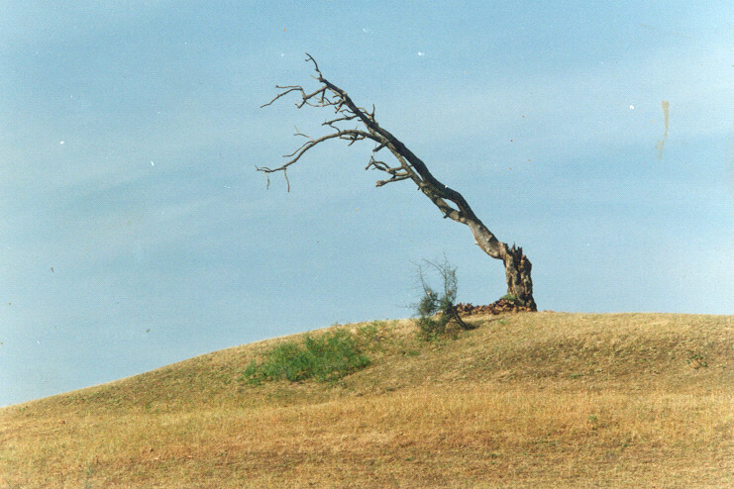
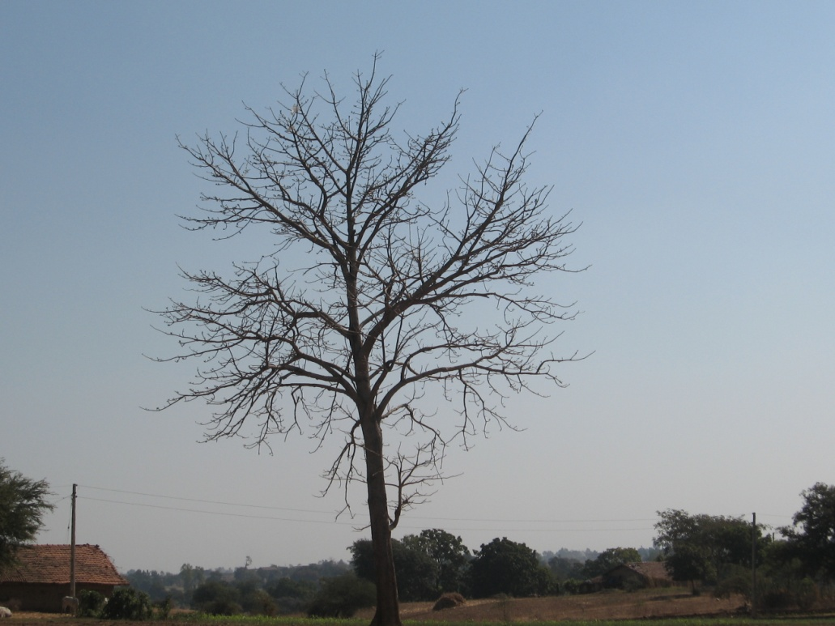
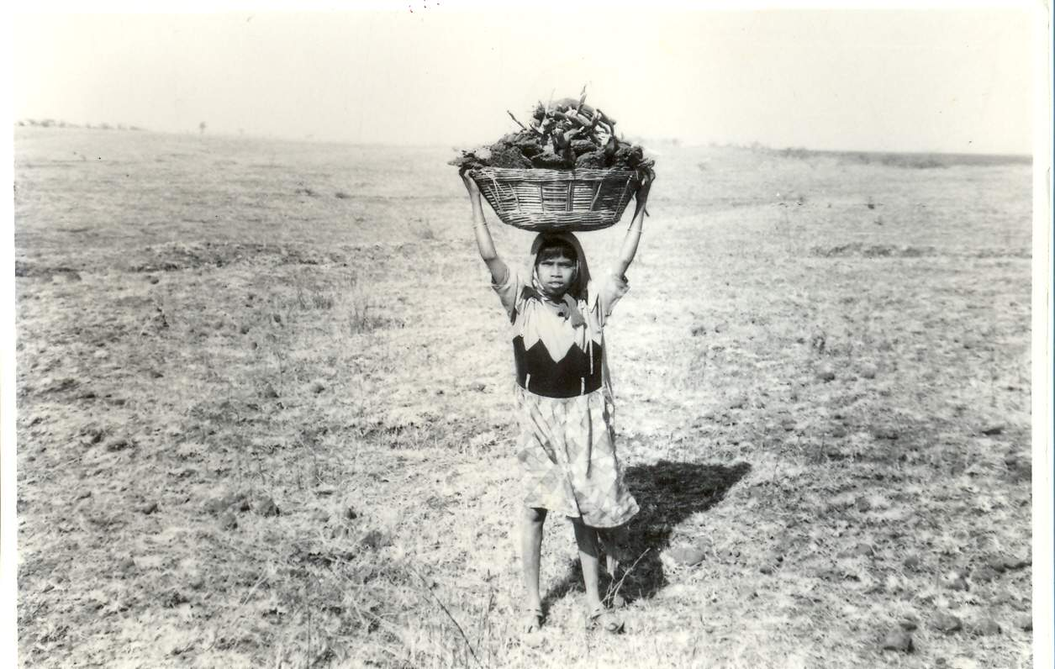
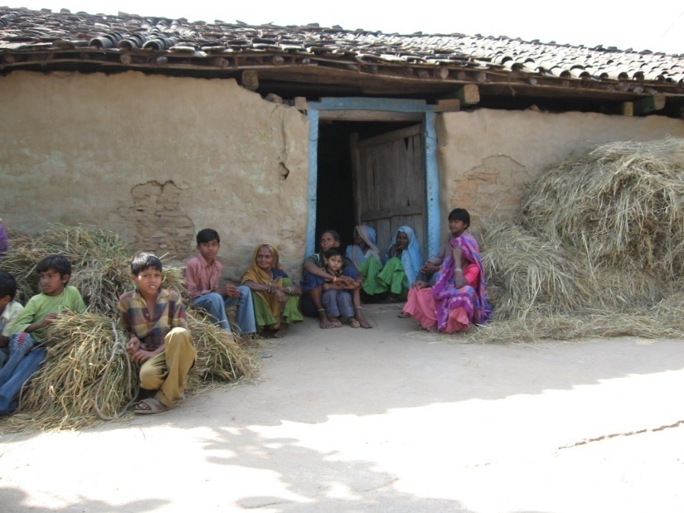

Slide 4
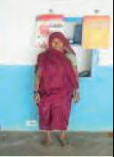
CASE STUDIES VILLAGE LEVEL
Vanbandhu Kalyan Yojana
Farmers Success Stories
Rathava Keriben Ganiyabhai
• Age: 55
• Occupation: Agriculture
• BPL No: VACHHJ00500140
• Contribution: Rs. 500/-
• Received inputs: Maiz-8 kg.- 2 bags, D.A.P-50 kg.-1 bag,
Urea-50 kg.- 1 bag, Pottash- 50 kg.- 1 bag
• Village: Judavant, Taluka: Chhota-Udepur, District: Baroda Says Smt. Keriben, We used hybrid seed of maize in all seasons & received double income. I was able to
grow 1.4 tons (14 Kwintal) of the maize from this kit.

Slide 5
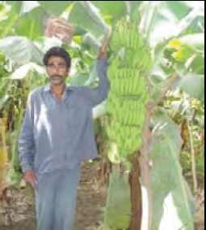
Rathava Motesinghbhai Bhanatabhai
• Age: 45
• Occupation: Agriculture
• BPL No: VAJETG0100066
• Beneficiary’s contribution: Rs. 2500/-
• Received inputs: Banana tissue-culture
plantlets -1370 Nos. of plants, D.A.P-200
kgs.-4 beg, Yuria-650 kgs.-13 begs, Pottash-
900 kgs.- 18 bag, Lansargold-500 grams,
Monocrotophos-500 ML, Saf-350 grams,
Aishwarya Gold-250 ML
• Village: Ghutanvad, Post: Ghutiya, Taluka: Pavi- Jetpur, District: Baroda Says Shri Motesinghbhai, I am able to earn Rs. 110000/- in a acre . Produce22 to 27 kg. of every bunches of bananas because of this kit.

Slide 6
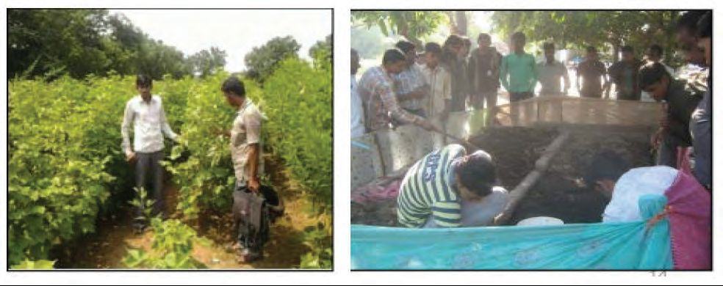
Use of Balanced Fertilizer based on Soil Health Analysis – the case
study of Jambusar, Bharuch, Gujarat
Maheshbhai Sindha, Piludra of Jambusar Taluka of Bharuch district owns three acres of land. He was using intensive chemical fertilizer and seeds with cheaper price. In his cotton , expenses were high and the yield was low. Based on Soil Health Analysis in 2012 , he started using certified seeds and balanced doze of fertilizer both organic and in organic-chemical. This reduced his cost in agricultural operations by Rs.2,800 and increased productivity in cotton by 4 quintal. He started using crop residue and cow dung along with worms to develop compost fertilizer. This increased productivity further by one quintal and simultaneously, he started selling worms to other farmers to make their compost. Within two years, his income increased to Rs.31,500/-.

