Slide 1
AGRO-ECOLOGY

Slide 2
Human beings had a symbiotic relationship with nature

Slide 3
Pesticide Companies
Fertilizer Companies
Declined productivity
Price fluctuation
FARMERS
Seed Companies
Climate Change
Traders
Dependency
Suicides

Slide 4
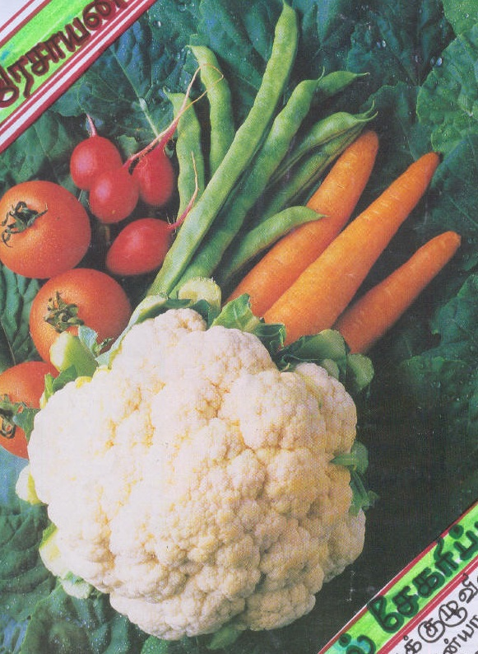
POISONING OF THE FOOD

Slide 5
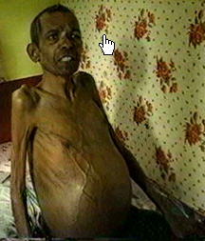

Slide 7
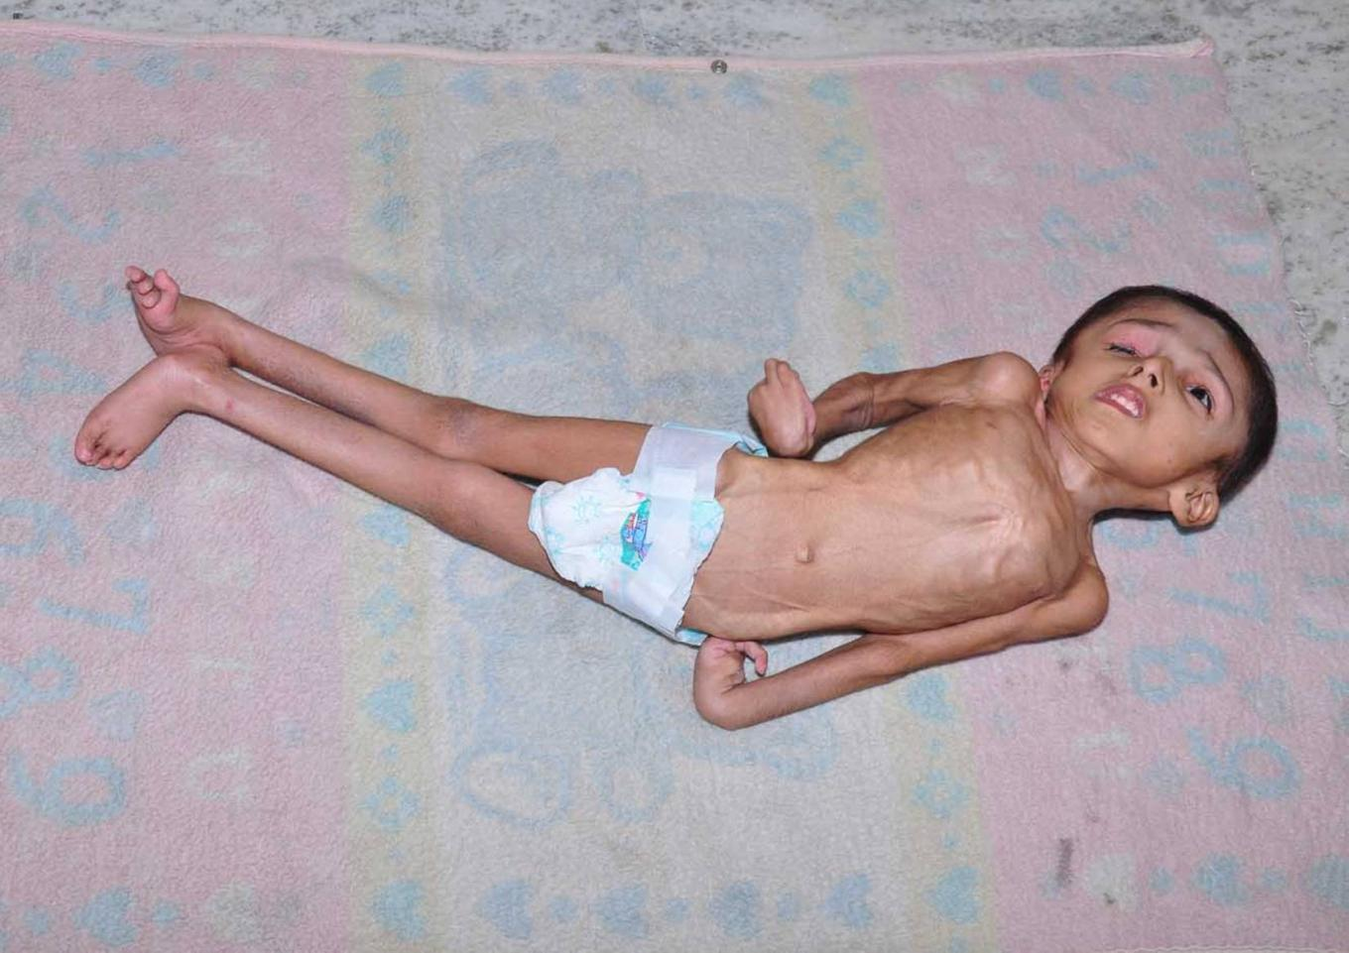

Slide 8
The scientific findings have confirmed that nitrous oxides are 300 times more damaging than CO2 in contributing to green house gas emissions.

Slide 9
AGRI-CULTURE
RESPECT TO NATURE
CULTURE
Happiness
Better Health
More Profit
Low Dependency
Toxin Free
Integration

Slide 10
AGRO-ECOLOGY

Slide 11
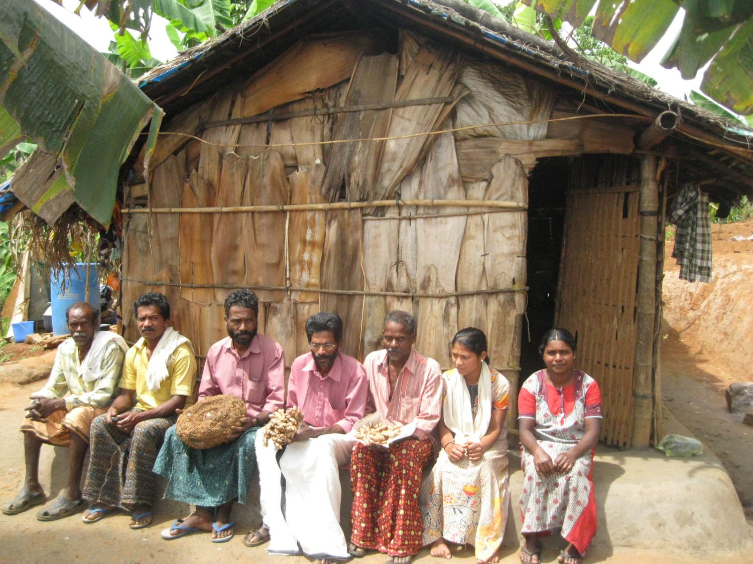

Slide 12
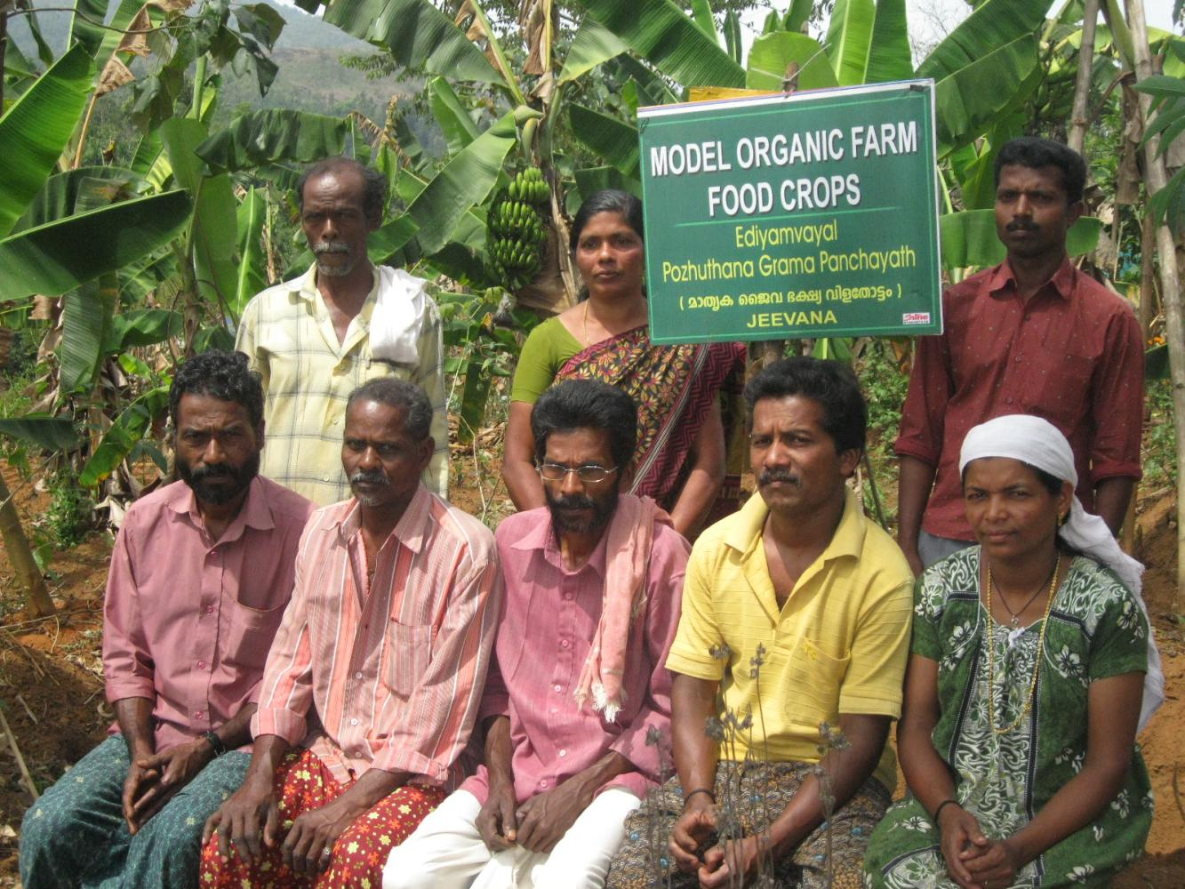

Slide 13
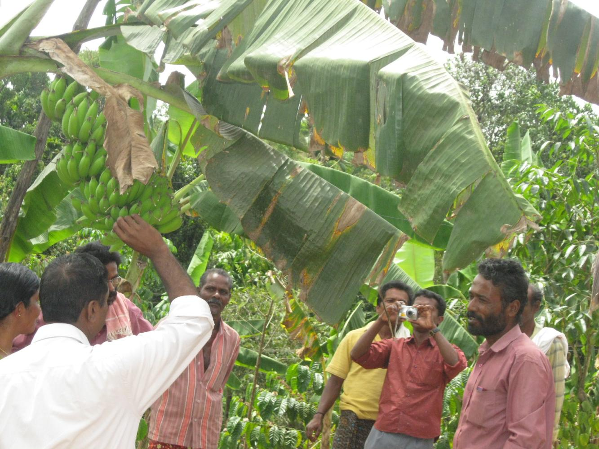

Slide 14
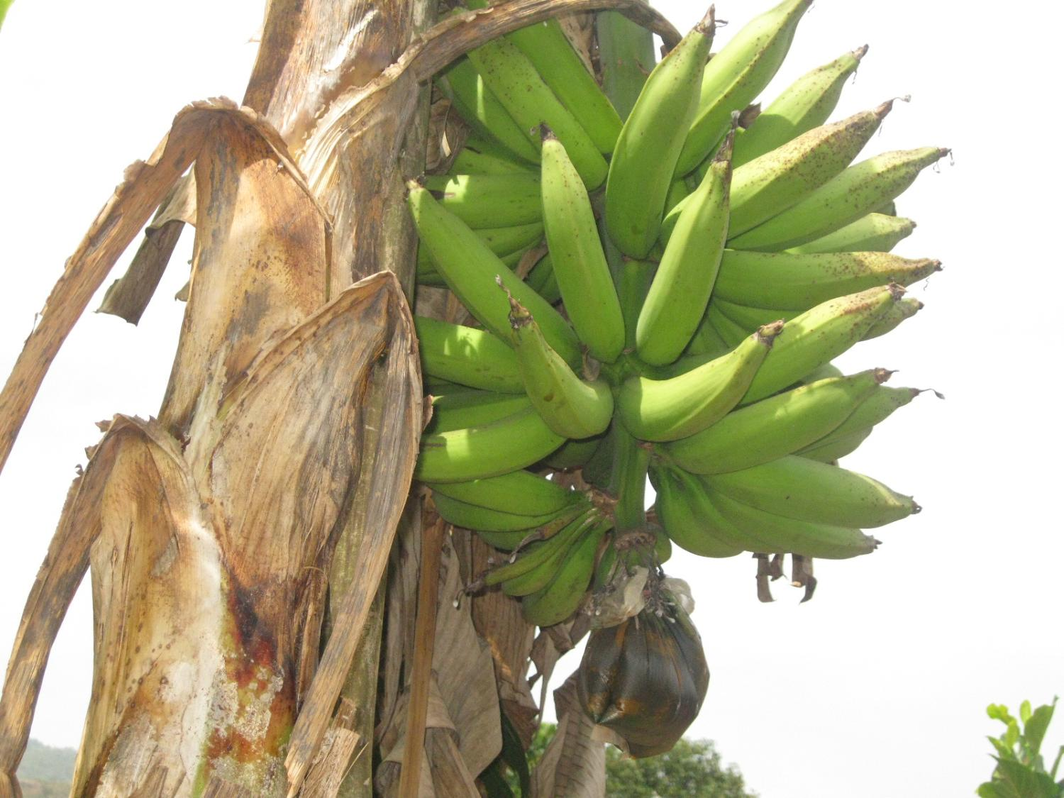

Slide 15
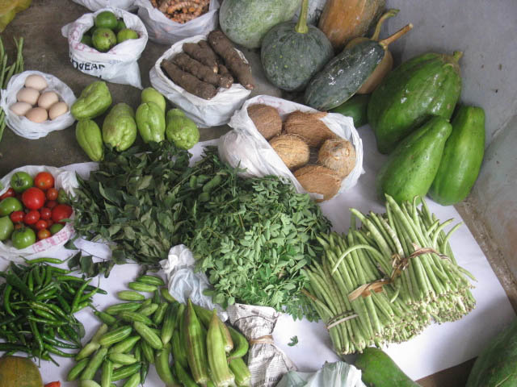

Slide 16
CROPS | BEFORE |  | AFTER
 | Before January 2011 | Value | Now | Value
Tapioca | 100 plants yielding 4 kg./plant | 700 | 3000 plants yielding 10 kg./ plant | 3000
Banana | 50 plants yielding 5 kg/plant | 250 | 2000 plants yielding 12 kg./ plant | 24000
Elephant Foot Yam | 50 plants yielding 5 kg./ plant | 250 | 4000 plants yielding 7 kg./ plant | 28000
Taro | 200 plants yielding 5 kg./ plant | 1000 | 5000 plants yielding 8 kg./ plant | 40000
Coffee | Nil | - | 5000 plants started yielding | -
Ginger | Tried but not yielding | - | Got 1850 kg. this year | 55500
Turmeric | Less than 1000 kg. | 8000 | Got 32800 kg. this year | 328000
Yam | Nil | - | Got 30000 kg. this year | 270000
Chinese Potato | Nil | - | Got 300 kg. this year | 7200
Beans (long) | 150 plants yielding 225 kg | 4500 | 1500 plants yielding 2250 kg. | 45000
Tomato | Nil | - | 200 plants yielding 600 kg. | 6000
Cabbage | Nil | - | 265 plants yielding 300 kg. | 3000
Qualiflower | Nil | - | 50 plants yielding 35 kg. | 1050
Carrot | Nil | - | 800 plants yielding 160 kg. | 3200
Bitter Guard | 5-6 plants yielding 40 kg | 800 | 500 plants yielding 3500 kg. | 70000
Snake guard | Nil | - | Failed except the one cultivated by Ms. Valasala. She got 25 kg. from 5 plants | 375
Brinjal | Nil | - | 50 plants yielding 200 kg. | 2000
Lady Fingers | Nil | - | 50 plants yielding 75 kg. | 1125
TOTAL VALUE |  | 15,500 |  | 8,87,450
DIFFERENCE IN INCOME |  | 887450-15500 = 871950

Slide 17
Crops | Crops added | Before January 2011 | March 2012
Tapioca. Banana. Yam. Taro, Ginger, Turmeric, Bitter Guard | Tomato, Coffee, Chinese potato, Cabbage, Qualiflower, Cabbage, Brinjal, Snake guard, lady fingers, Coffee, | 15500 US$ 310 | 887450 US$ 17749
Difference in Income: 871950 = US$ 17439

Slide 18
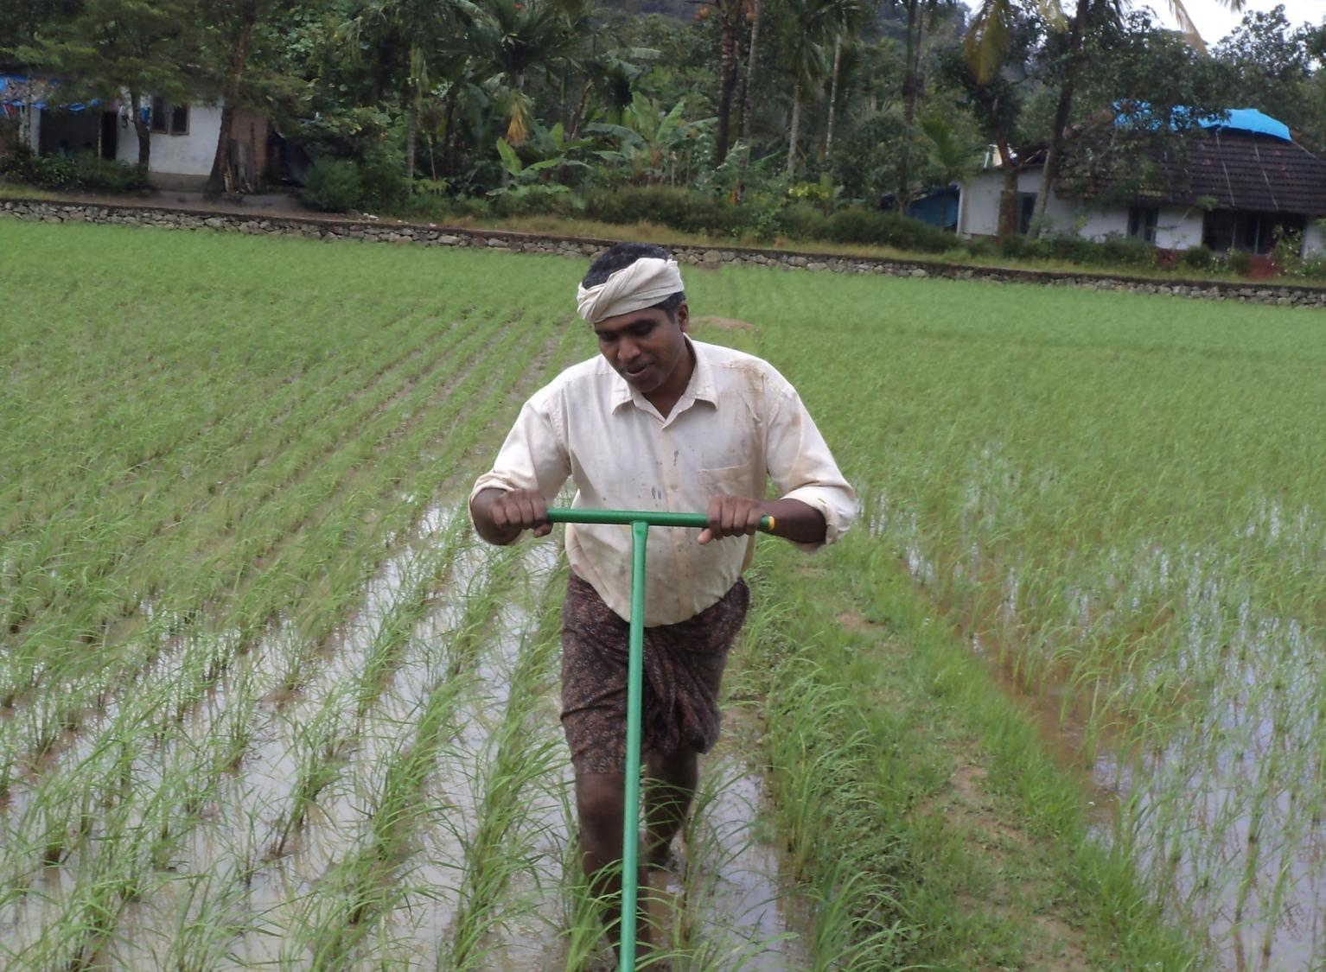

Slide 19
Particulars | Conventional | SRI
Total Expense | 7980 | 4810
Yield from 50 cents | 700 kilogram | 1200 kilogram
Rate per 1 kilogram of paddy | Rs. 15 | Rs. 15
Amount received | 700 x 15 = 10500 | 1200 x 15 =18000
Net profit from 6.18 cents | 10500-7980= Rs.2520 | 18000-4810 = Rs. 13190
Difference in income from 50 cents land | Rs. 10670

Slide 20
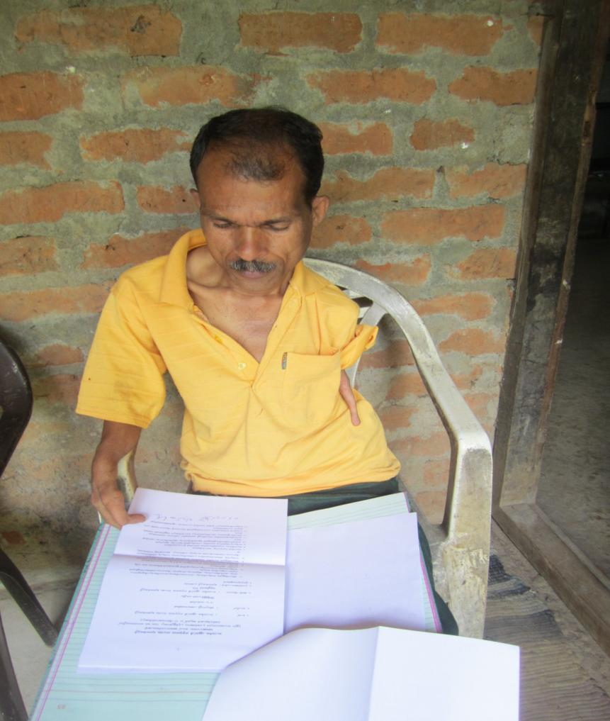
Mr. Rajan: The Lead Farmer

Slide 21
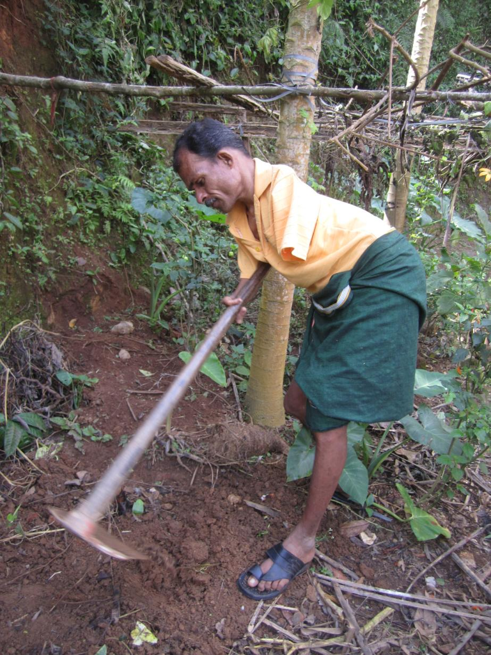

Slide 22
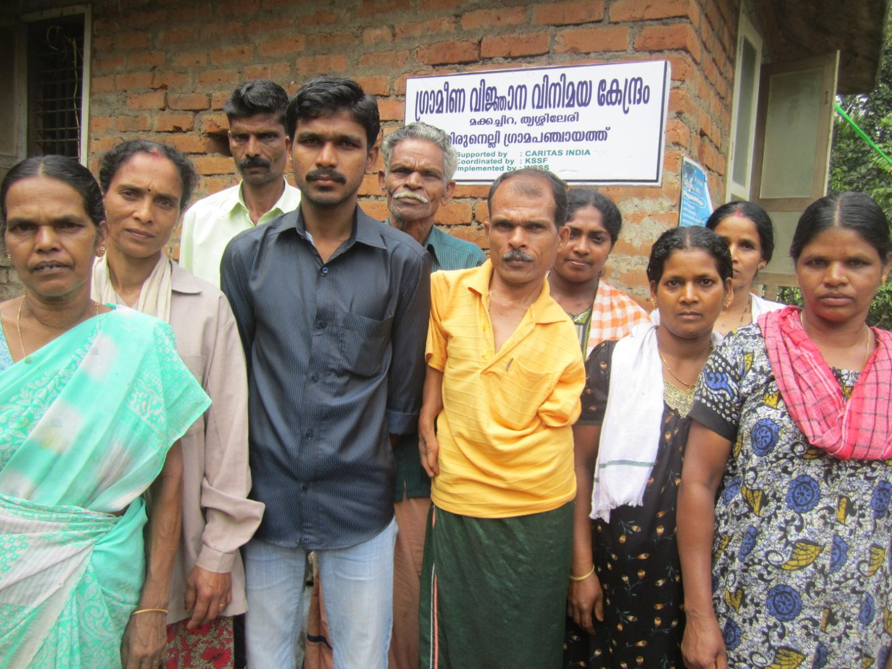

Slide 23
WHAT SHOULD WE DO?

Slide 24
Production, Productivity, Procurement, Processing, Packing
& Marketing

Slide 25
Agriculture promotion keeping in mind the symbiotic relationship with nature = AGROECOLOGY

Slide 26
Bring together all “actors” (CSO’s, Govt., R&D, Framers, Corporate)– focusing on improved production through Agroecological methods
More Investment is needed in innovative agroecology methods
Enabling policy environments at national and international levels to recogniaze and support SHF

Slide 27
Increased support for the establishment and expansion of smallholder farmers’ collectives
Encourage Farmer-to-Farmer learning (Information and best practice sharing)

