Slide 1
Integrating adaptation and mitigation in agriculture
Jason Funk
Environmental Defense Fund

Slide 2
How do issues and incentives fit together?
Mitigation
Adaptation
Synergy
Adaptation Fund
LULUCF
LDCs Fund
REDD+
Special Climate Change Fund
Green Climate Fund

Slide 3
Adaptation strategies for smallholders
Examples of pastoralist coping strategies: Kenya and Ethiopia
Mobility
Herd accumulation
Bank accounts, informal savings and credit mechanisms
Supplementary feed, intensification of animal disease management; pay for access to water.
Livelihood diversification away from pastoralism
Intra-community mechanisms distribute both livestock products and the use of live animals
IPCC AR4 WGII Ch. 5.4.7
In general, we know little about such examples.

Slide 4
Barriers to mitigation in agriculture
Barriers
Maximum Storage
Baseline
Uncertainty
Displacement of emissions
Transaction costs
Measurement and monitoring costs
Property rights
Other barriers
IPCC AR4 WGIII Ch. 8.6.2
Potential way forward
Focus on non-CO₂ gases
Historically anchored projections
Further research
Sustainable intensification
Focused innovations
Research and innovation to support modeling, etc.
Policies and legal interventions to secure rights

Slide 5
What are the key challenges?
Mitigation
Barriers that restrict
the speed and scale
of mitigation efforts.
Adaptation
Limited experience,
difficulty in localizing
forecasts of future climate, and failure
to transmit useful knowledge.

Slide 6
What are the key challenges?
Mitigation
Adaptation
Synergy
Barriers and limitations
in knowledge, resources, and communication, along with inequality and mistrust.

Slide 7
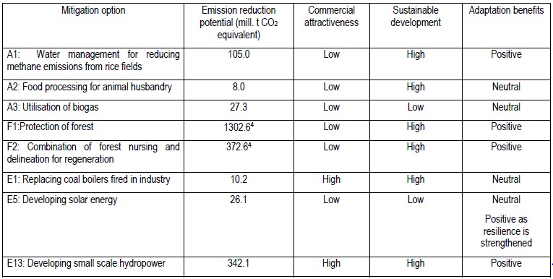
What do we know about synergy in agriculture? Example: Vietnam
Dang et al 2003

Slide 8
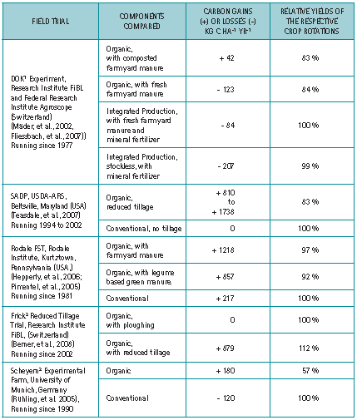
Experiments in Switzerland, USA, and Germany found that organic farming could increase carbon storage greatly, but often resulted in lower yields than conventional agriculture.
Niggli et al. 2009

Slide 9
Adaptation is a relationship between farmers and the changing climate
“Adaptation in agriculture is the norm rather than the exception. In addition to changes driven by several socio-economic factors (chiefly market conditions and policy frameworks), farmers always had to adapt to the vagaries of weather, on weekly, seasonal, annual and longer timescales. The real issue in the coming decades will be the rate and nature of climate change compared to the adaptation capacity of farmers.”
“As opposed to adaptation to changes in mean conditions, which require adjustments in agronomic techniques (e.g., planting calendars, cultivar types, input amounts), adaptation to future changes––likely an increase—in climate variability may require an attention to stability and resilience of production, rather than to improving its absolute levels.”
Rosenzweig and Tubiello 2007

Slide 10
EDF approach to adaptation and mitigation in rural India
Low carbon rural development
On-farm activities
Community activities and infrastructure
Household
energy needs
Community forest
Notes:
Source: climate-smart ag website

Slide 11
Goals: Improving livelihoods and resilience
Decrease variability in income by diversifying crops and activities
Reduce costs by making more efficient use of inputs
Improve durability through long-term natural resource maintenance
Notes:
Stability of income by diversification is a norm, because profitability on the farm has gone down (can be done by reducing input costs and connecting to C markets)

Slide 12
A menu of options for farmers
Nutrient management
Soil conservation
Efficient water utilization
Integrated pest management
Integrated livestock management
Improved cook stove utilization
Incorporation of energy production processes
Notes:
Source: climate smart ag. Info sheet

Slide 13
Barriers to mitigation in agriculture
Barriers
Maximum Storage
Baseline
Uncertainty
Displacement of emissions
Transaction costs
Measurement and monitoring costs
Property rights
Other barriers
IPCC AR4 WGIII Ch. 8.6.2
Potential way forward
Focus on non-CO₂ gases
Historically anchored projections
Further research
Sustainable intensification
Focused innovations
Research and innovation to support modeling, etc.
Policies and legal interventions to secure rights

Slide 14
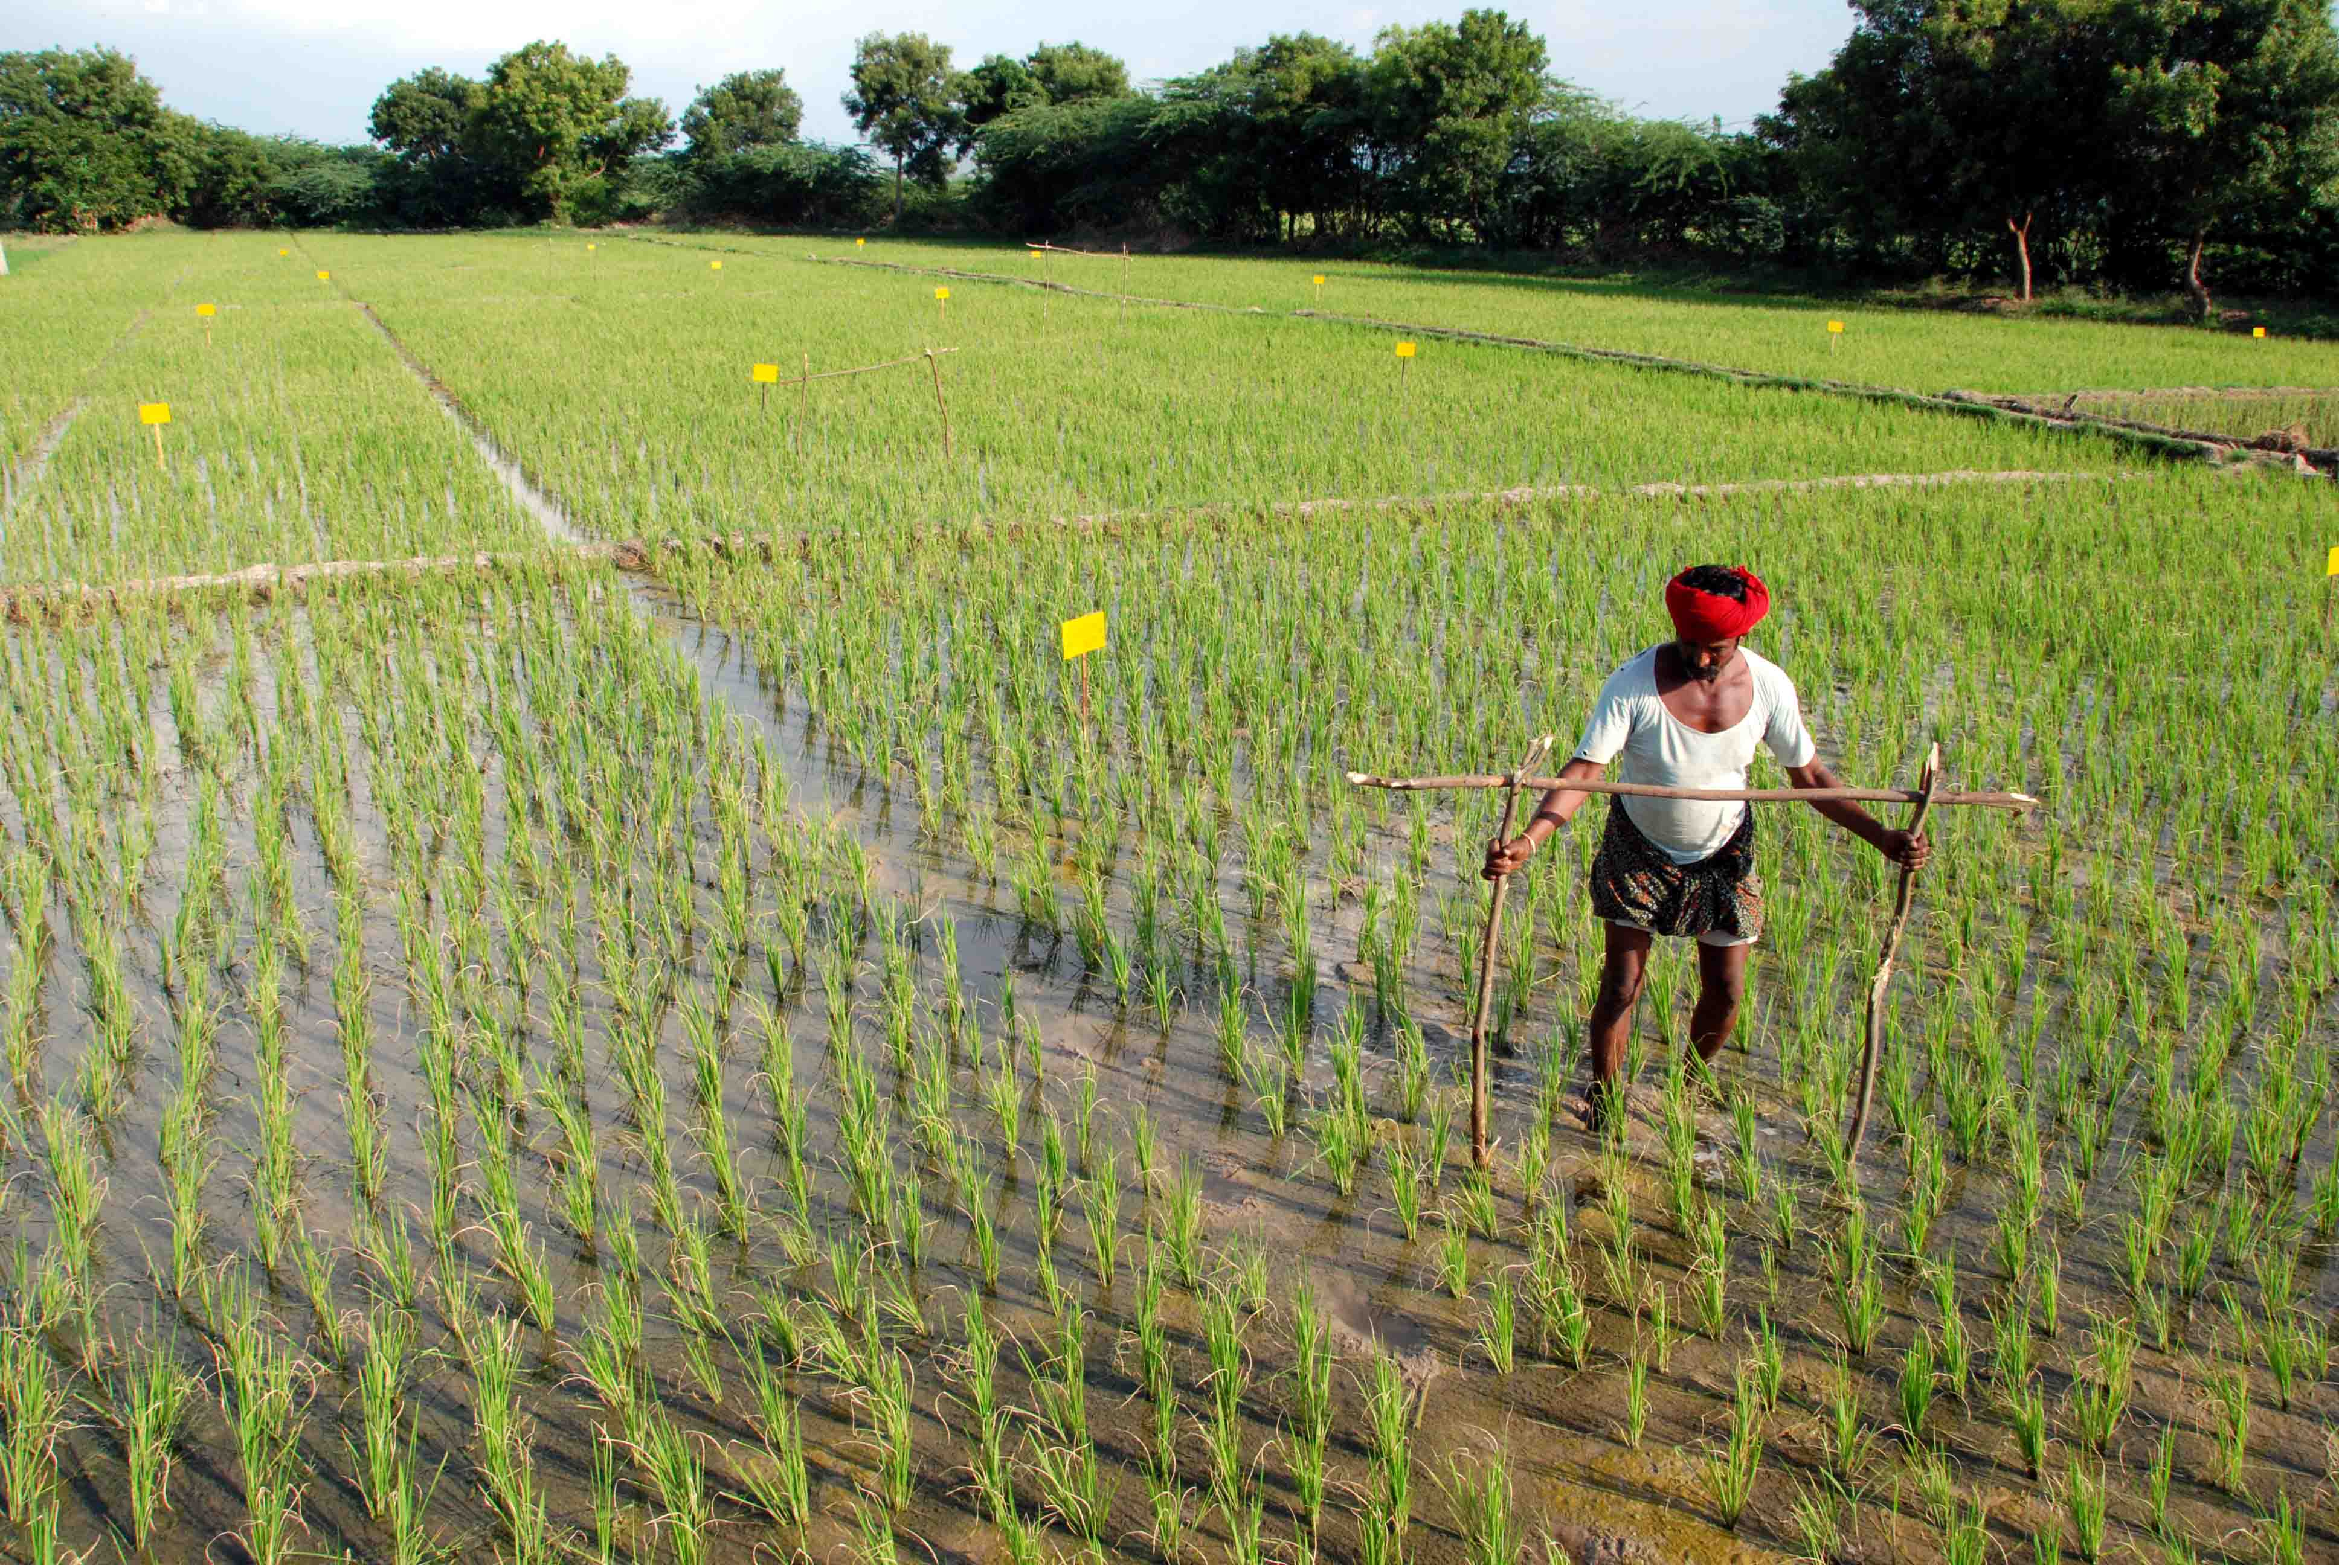
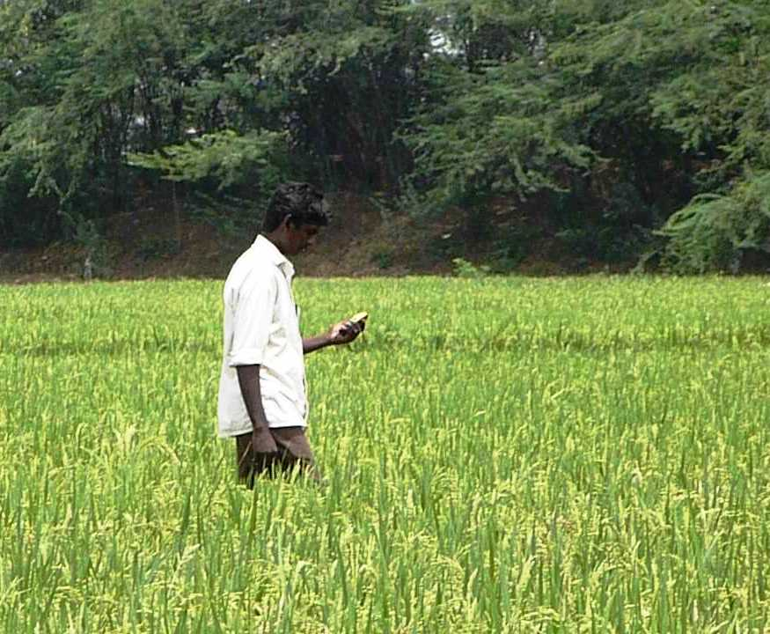
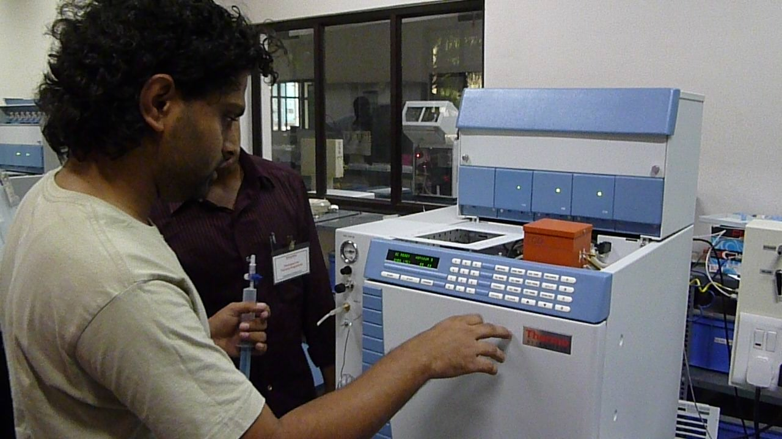
Addressing barriers
Potential way forward
Focus on non-CO₂ gases
Historically anchored projections
Further research
Sustainable intensification
Focused innovations
Research and innovation to support modeling, etc.
Policies and legal interventions to secure rights

Slide 15
Project Benefits: toward synergy
Freeing up human resources: Reduced time spent in field and collecting firewood
Chance to improve skills: Increased school attendance or investment in alternate income-generating activities
Maintenance of natural resource base: Reduced degradation – air, water, soil quality
Improved health: fewer hospital visits, decreased morbidity
Do these actually improve resilience?

Slide 16
For discussion: Some challenges that remain
How to evaluate and sustain adaptation benefits?
How to best combine state-of-the-art science with community knowledge?
How to improve the menu of options, as farmers and conditions change?
Notes:
Farmer-centric not climate-centric -> Climate co-benefits-> farmers must be able to talk about it
Talk about the way forward: doing our best to be transparent, would like to share and then also learn from others, collaboratively.

