Slide 1
Synthesizing Needs for Reform
Future context of CDM will focus on LDCs
Potential issues with more than 5000 projects registered by 2012
Eva Filzmoser, CDM Watch
Side Event: CDM Policy Dialogue Panel meets Civil Society
Eva.filzmoser@cdm-watch.org

Slide 2
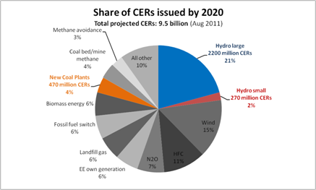
Overview of CER issuance by 2020

Slide 3
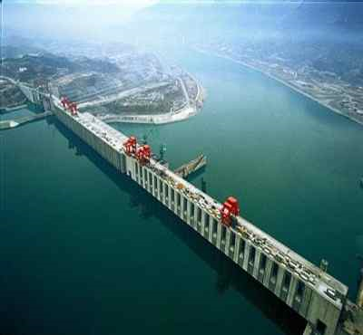
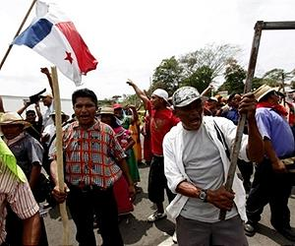
Large Hydro: Not Additional and Not Sustainable
Additionality
Cost competitive technology
The countries with the most CDM projects have aggressive targets for hydropower
Decisions to build individual projects are made by governments not the private sector
Sustainability
Loss of water quality impact on fisheries, reduced fresh water availability and quality
Loss of biodiversity
Loss of livelihood, infrastructure, agricultural land
Human rights abuses

Slide 4
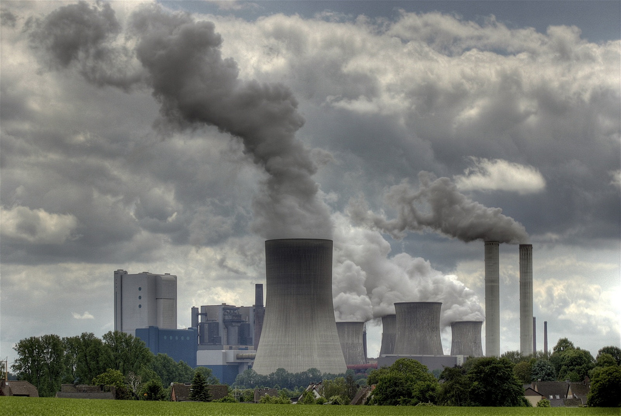
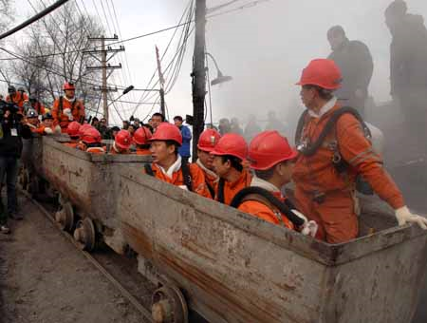
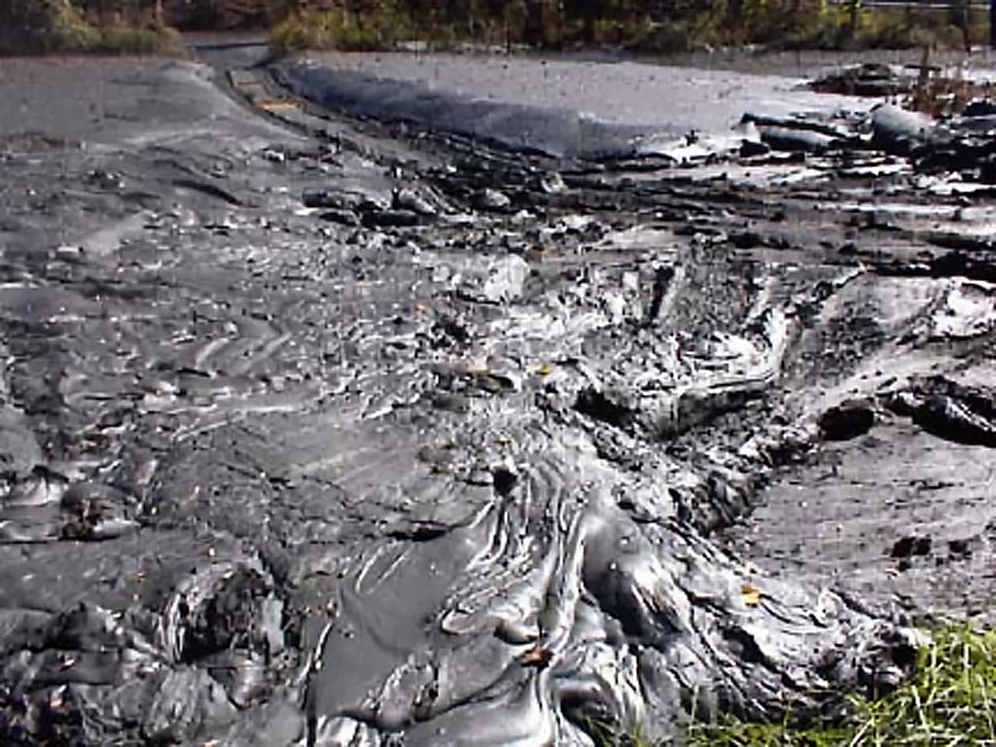
Coal Projects: Not Additional and Not Sustainable
Additionality
Financing often secured, construction well underway, coal prices rising
Costs estimates are skewed
Government efficiency mandates
Sustainability
No benefits for local communities
Use of climate finance to support long-lived emissions-intensive infrastructure that undermine the ability to meet 2 C target

Slide 5
2 key mandates of the CDM:
Role of the CDM under future scenarios for the international carbon market must deliver on both objectives:
Reducing GHG emissions in a cost-effective way, AND
2) Delivering sustainable development benefits
Project activities must deliver on both objectives in order to be eligible under the CDM.

Slide 6
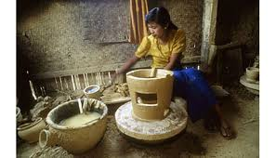
Sustainable Development – Crucial Questions:
Incentives: How can we direct investment to projects that have sustainable development benefits?

Slide 7
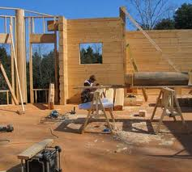
Sustainable Development – Crucial Questions:
Monitoring: How can we ensure that the claimed benefits are achieved?

Slide 8
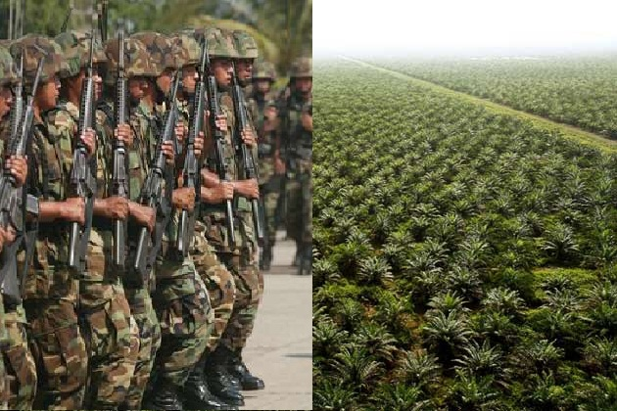
Sustainable Development – Crucial Questions:
Safeguards: How can we ensure that the projects don’t cause harm (e.g. uphold human rights) ?

Slide 9
Sustainable Development – The Challenge:
Status quo: Assessment of whether a CDM project contributes to sustainable development is left to host countries
Changing the status quo - introduction of M&Ps on SD:
1) Individual countries or groups of countries, e.g. EU could introduce own additional requirements (demand side)
2) M&Ps should be implemented at UNFCCC and operationalised by the CDM Executive Board (supply side)

Slide 10
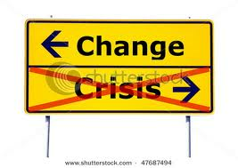
Sustainable Development – Game Changer !
Investors/Buyers care for sustainable development practices: The UN Global Compact and WBCSD urges companies to help address the global challenges highlighted by the UN Conference on Sustainable Development (Rio+20), including a focus on energy & climate

Slide 11
Sustainable Development –
SD benefits need to be linked to monetary value: SD element in the CDM needs to be incentivized:
SD monitoring report as pre-requirement for CER issuance
Suspension of issuance in case SD benefits are not met or safeguards violated
Withdrawal of LoAs by Parties involved if national and/or international requirements are violated
Ineligibility of project types that do not contribute to SD (e.g. fossil fuels)

Slide 12
Sustainable Development M&Ps elements:
Sustainable development benefits indicators to assess the environmental, social and economic impact
Detailed requirements for stakeholder involvement
International or national monitoring provisions including an independent assessment to ensure that claimed benefits are met, e.g. as a prerequisite for credit issuance
Safeguard criteria to ensure that projects don’t cause harm
Details about development benefits for local communities as the beneficiaries benefit from the project
Description of how local communities are involved in certifying project’s contribution to sustainable development

Slide 13
Sustainable Development Monitoring:
SD monitoring in addition to monitoring emission reductions.
Sustainable development monitoring plan as part of the PDD.
Monitoring plan should cover compliance with the safeguard criteria and, if applicable, all sustainable development indicators
SD monitoring report should be submitted to the stakeholders that were involved in the ex ante stakeholder consultation.
SD monitoring reports should be validated and verified by DOEs
CDM CDM EB reference!

Slide 14
Political Context
REDD safeguards have already been agreed and safeguard discussions in other for a, e.g. LULUCF and GCF are currently being conducted
Experience with A/R projects essential for REDD+
New market mechanisms that should contribute to sustainable development are currently being discussed

Slide 15
Recommendations for the future of the CDM
Incentivize sustainable development element in the CDM, e.g. linking SD benefits to the issuance of carbon credits
Sustainable development benefits indicators to assess the environmental, social and economic impact
Safeguards to ensure that projects don’t cause harm
International or national monitoring provisions to ensure that claimed benefits are met
Local communities should have a role in certifying a project’s contribution to sustainable development
Clear rules and guidance how local stakeholder consultation is to be conducted and validated
Grievance mechanism for affected stakeholders
Ineligibility of project types that do not meet the 2 objectives , e.g. not additional or not sustainable (e.g. coal projects, large hydro projects)

