Slide 1
Experiences and lessons learned from the TNA of Indonesia
Widiatmini Sih Winanti
National Council on Climate Change of Indonesia
Presented on
UNFCCC Side Event on Implementing the result of TNA
Bonn, 9 June 2011

Slide 2
Technology Needs Assessment (TNA) Decision 4-CP7
Definition
Technology needs and needs assessments are a set of country-driven activities that identify and determine the mitigation and adaptation technology priorities of Parties other than developed country Parties, and other developed Parties not included in Annex II, particularly developing country Parties. They involve different stakeholders in a consultative process to identify the barriers to technology transfer and measures to address these barriers through sectoral analyses. These activities may address soft and hard technologies, such as mitigation and adaptation technologies, identify regulatory options and develop fiscal and financial incentives and capacity building.
Purpose
The purpose of technology needs assessments is to assist in identifying and analysing priority technology needs, which can form the basis for a portfolio of EST projects and programmes which can facilitate the transfer of, and access to, the ESTs and know-how in the implementation of Article 4, paragraph 5, of the Convention.

Slide 3
Indonesia’s TNA
Submitted first TNA in 2002 which entitle “Identification of Less Greenhouse Gases Emission Technologies in Indonesia”
Updated TNA, conducted since 2007-2009 which entitle “Indonesia’s Technology Needs Assessment on Climate Change Mitigation”, submitted to UNFCCC in 2010 (TNA 2010)
Currently joint the Global TNA program under UNEP Coordination

Slide 4
Lesson learned from TNA 2010
Coordinated by Indonesia Transfer Technology Working Group; participated by related ministries, research institution, universities, association, private sectors, universities and NGO.
Solely limited to the technology for the mitigation for 7 sectors: Energy, Transportation, Industry, Forestry, Agriculture, Waste and Ocean, and comprises of:
Identification of the potential of greenhouse gas emissions at present time
Identification of technologies for mitigation of greenhouse emissions
Prioritization of technologies needed by Indonesia
Calculation of potential reduction for the greenhouse gas emissions through chosen technological applications.
Investment cost estimation of each technology applied and transferred in each sector
Identify the barriers and challenges

Slide 5
Lesson Learned TNA 2010
The first learning of stakeholder processes
Need long time: 2007-2009
Done in very intensive stakeholder processes
Stake holder participation, experts from each sector and relevant sector for technology transfer in mitigation of climate change were invited during each discussion forum
Several Focus Group discussions , meetings, seminar, workshops with extended stake holder views by involvement of private sectors
Reviewers from inside and outside the country related to the major issue of TNA
Outreaching and welcoming feedback / inputs from national level (cross cutting issue meeting among sectors and consultation meeting with the National Communication team) as well as international (International reviewer, Side event during COP14 in Poznan)
Present the overarching issues on technology transfer in Indonesia

Slide 6
Lesson Learned TNA 2010
Focusing on sector ownership:
Involved related sectors; about 50 stakeholders
Done and write mostly by sector themselves
Data input and support from related sector
Reftected the national and sector priority programs
Focusing on the sector benefit:
Not only for transfer technology program, but would give benefit to sectors:
Identification of existing technology being used in each sectors
Evaluation of the efficiency of existing technology
Identification of less greenhouse gas emission technology options available, including its cost effectiveness and GHGs reduced
Identification and recommendation to resolve barrier hampering efficient technology development
TNA documents as a pictures of the sector priorities and policies in low carbon technology that could be used also for their further programs and activities.

Slide 7
Lesson Learned TNA 2010
Stakeholder aware of the important and benefit of low carbon technology for efficiency and reducing GHGs
Almost all further activity programs and documents related to climate change have been done though the stakeholder processes mechanism
TNA 2010 used as references for further country documents such as:
Second National Communication,
Climate Change Roadmap,
cost curve calculation,
assessment of financial incentive,
National Mitigation Action on reducing 26% GHGs emission in 2020 nationally and sectoraly
Global TNA under UNEP coordination

Slide 8
Global TNA
TNA 2010 was focusing on sector ownership and sector benefit, but have the disadvantage:
The sector document quality and the deep of data analysis is varies among sectors.
Technical supports was limited (only for calculating GHG emission, energy consumption projection, compiling document that written by sectors, etc.).
Technology prioritizing has only used expert judgment method (except ocean sector using multi criteria analysis)
Big document (about 400 pages)
Needs further prioritization
Further and better data analyzing and technology prioritization
Technology Action Plan (TAP) for transfer technology implementation
Mitigation and Adaptation

Slide 9
Global TNA
3 sectors on Mitigation (Energy, Forestry and Waste) and 3 issue of Adaptation (Food Security, Coastal Vulnerability and water resources)
Conducted through stakeholder processes.
Develop TNA, consist of:
Overview of existing documents, such as TNA 2010, Second National Communication (SNC), Indonesia Climate Change Sectoral Roadmap (ICCSR), the National Mitigation Actions Plan, Sectoral documents, etc;
Prioritizing the technology needs using Multi Criteria Analysis .
Develop Technology Action Plans (TAPs) which consist of

Slide 10
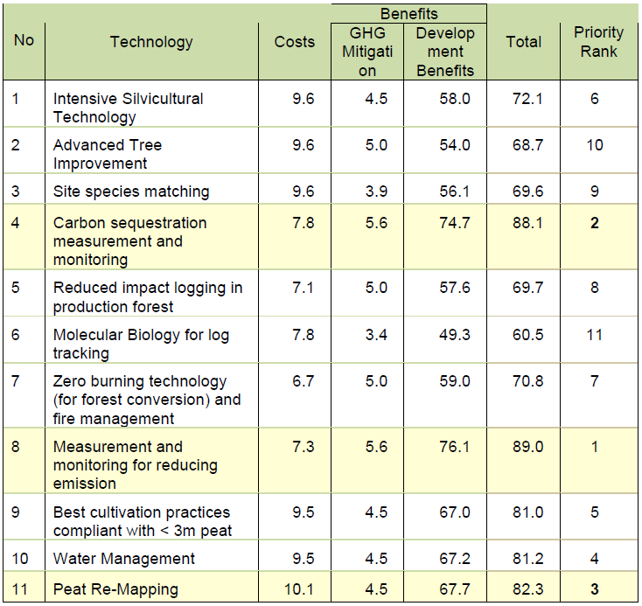
Progress Result of Global TNA, Mitigation
Prioritized Technology Needs on Forestry Sector

Slide 11
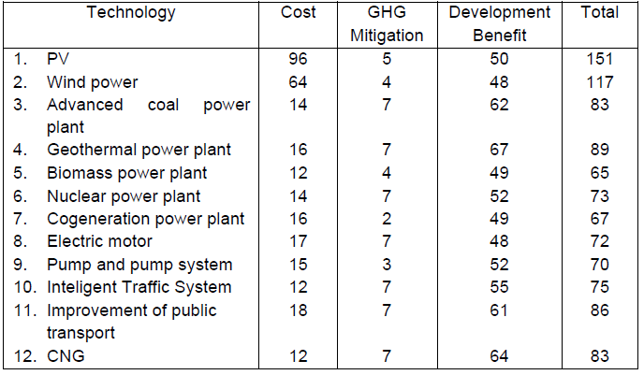
Progress Result of Global TNA, Mitigation
Prioritized Technology Needs on Energy Sector

Slide 12
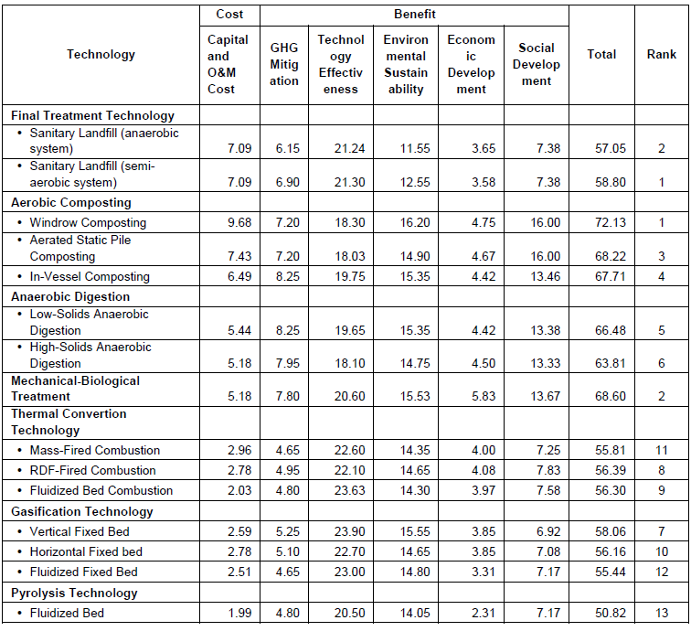
Progress Result of Global TNA, Mitigation
Prioritized Technology Needs on Waste Sector

Slide 13
Terima kasih

