Slide 1
CLIMATE SCIENCE RESEARCH IN THE
UNITED STATES AND U.S. TERRITORIES
Goldman, E.B. and M. Hyams. 2019. Climate Science Research in the United States and U.S. Territories: Survey of Scientific Publications from Selected Public Universities (2014-2018). The National Council for Science and the Environment: Washington, D.C. https://www.ncseglobal.org/climate-science-research-united-states-and-us-territories

Slide 2
Methodology
Universities selected based on land-grant status, largest research institution in the state, and/or host for the state climatology office.
Bibliometric analysis through Web of Science used to identify papers published at 80 public universities in the U.S. and U.S. territories between 2014-2018 that focus on climate-related science.
Keyword analysis using VOSViewer identified titles and abstracts of published journal articles to identify key areas of research in each state.

Slide 3
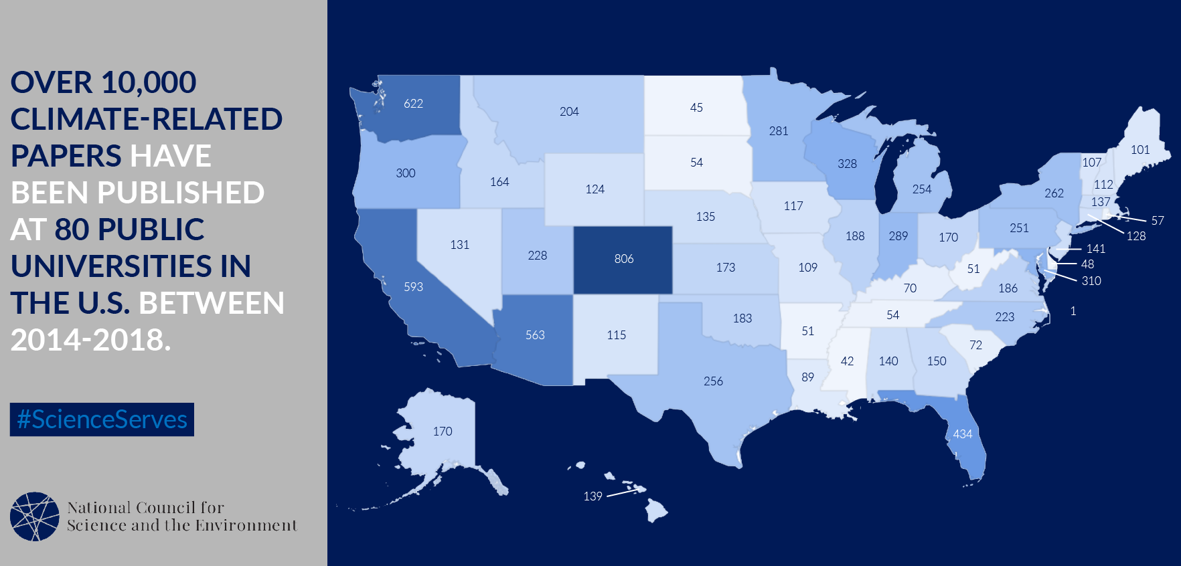
Major Finding 1: Climate research is happening in all states and U.S. territories

Slide 4
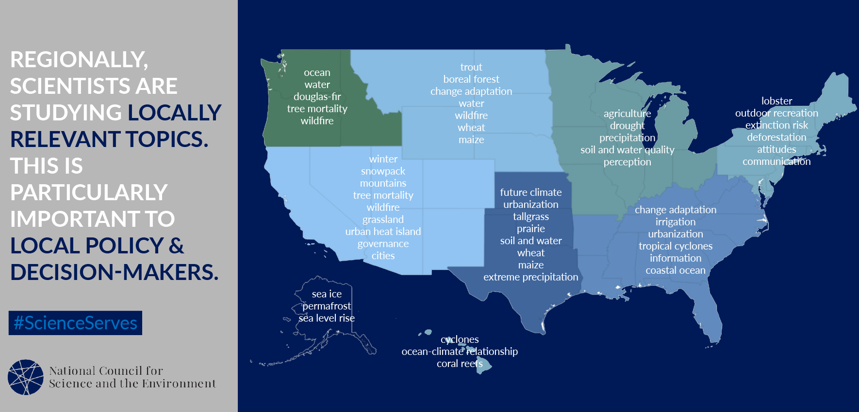
Major Finding 2: Regionally, scientists study locally relevant topics

Slide 6
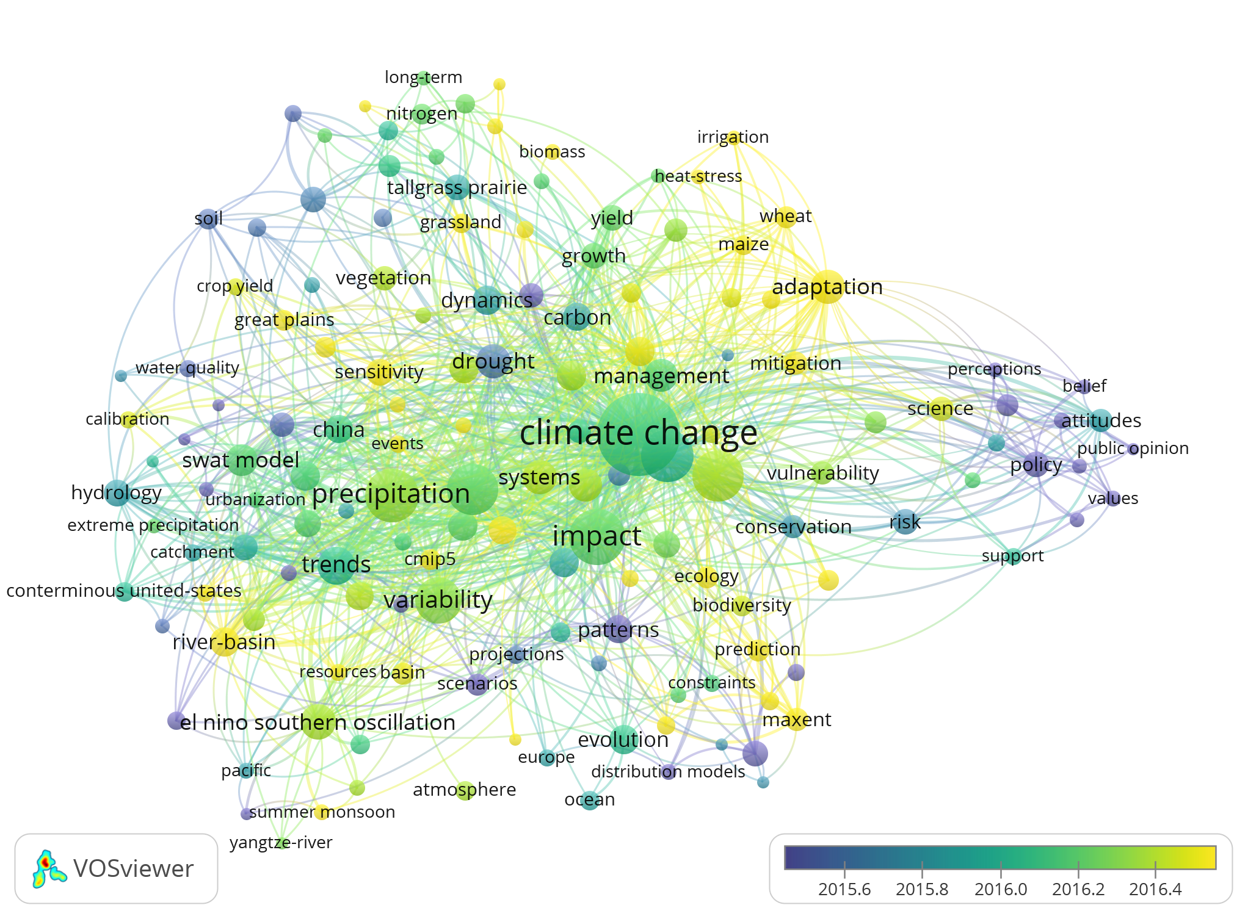
Major Finding 3: Climate science research increasingly focuses on impacts
Southern Great Plains link strength analysis over time.
Note the emergence of more adaptation-oriented keywords over time (transition blue to yellow), including ‘adaptation,’ ‘irrigation,’ ‘crop yield,’ ‘heat stress,’ and ‘river basin.’
This suggests a shift away from more fundamental climate science (see prevalence of keywords such as ‘El Nino’ and ‘dynamics’ in 2015 as compared to more recent years).

Slide 7
Major Finding 4: Universities do not provide comprehensive and uniform access to these resources through online repositories
University websites are highly variable in terms of the information they provide related to climate science research on campus.
Locally-produced research can help decision-makers respond to local climate-related issues and may invoke more trust with local constituencies, but ready access to this information by decision-makers remains a challenge.

Slide 8
Discussion
Other examples of what institutions are doing related to climate action
Ideas on how to enhance boundary-spanning between:
Institutions and communities
Researchers/educators and the public
Researchers and decision makers at the local, regional, national and international levels

