Slide 1
Up and down the scales of time and place: Integrating global trends and local decisions to make the world more food-secure by 2050 International Food Policy Research Institute (IFPRI)

Slide 2
Building Climate Smart FARMERS
The Indian Perspective
Presented by
DR. KIRIT N SHELAT, I.A.S. (Rtd)
National Council for Climate Change, Sustainable Development and Public Leadership (NCCSD)

Slide 3
Climate Resilient Agriculture Indian Perspective
National Council for Climate Change, Sustainable Development and Public Leadership
What Climate Resilient Agriculture means:
It contributes to achievement of sustainable development goals
It integrates – social, economical and environmental development to meet challenge of providing (a) sustainable livelihood to farmers (b) food security to hungry millions, and ( c) eradication of poverty.
It aims that despite climate change, the income of farmers should not decrease. They should have enough to live and their income should gradually increase.
Notes:
3

Slide 4
Climate Resilient Agriculture Indian Perspective
National Council for Climate Change, Sustainable Development and Public Leadership
What Climate Resilient Agriculture means:
It aims to use agriculture, it has capacity to absorb CO2 from atmosphere through photosynthesis process as a major nature's tool for mitigation and to expand it on un-cultivable wasteland, fallow land – margin areas of desert and sea shore by using modern technology. This supports livelihood to poor and provide food security to hungry millions.
Notes:
4

Slide 5
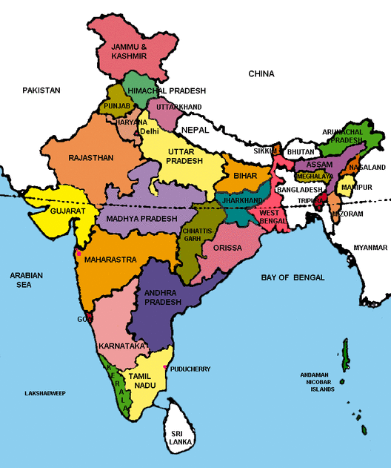
Indian Situation

Slide 6
Indian Situation
National Council for Climate Change, Sustainable Development and Public Leadership
India’s success over six decades:
2 % to 3% sustainable agriculture growth
Brought many out of poverty from 90% below poverty line to 20%.
Tackled many adverse climate and geographic challenges including droughts.
Validated research into rise in productivity
Several states and individual farmers with productivity, higher than, or equal to international level
Adverse impacts of climate change pushes even successful farmers back to poverty
Farmers suicide / large scale exodus to urban centers
By 2030 India will need to produce additional 100 M. Tones for its growing population.
India had to import food in its early phase of development, but now it is self sufficient.

Slide 7
Small farmers stared at big losses the last monsoon season
National Council for Climate Change, Sustainable Development and Public Leadership
In the current year, 302 of 604 districts have experienced deficit rain conditions
This rainfall deficit to 10% for entire country. Last year (2014) had deficit of 12%.
Farmers are staring at poor crop with lack of soil moisture.
There is likely deficit in crops like wheat and pulses.
Stressed farm income have led to slump in rural wages which has further impact on rural demand.

Slide 8
Soil, Water & Climate Change
National Council for Climate Change, Sustainable Development and Public Leadership
Soil Moisture content is affected
Soil erosion, washing away of upper crust of fertile soil.
Soil productivity
reduced
capacity to grow and sustain crop not certain with low yield or crop failures.
Salinity ingress due to sea water rising
Drying of existing water bodies – making irrigation a challenge.
Notes:
8

Slide 9
Effect of Climate Changes on Live stock
Na
National Council for Climate Change, Sustainable Development and Public Leadership
Milch cattle: milk yield has reduced in increased heat or cold wave condition.
Poultry: egg yield have gone down
Fisheries: fish catch goes away

Slide 10
Indian Situation
National Council for Climate Change, Sustainable Development and Public Leadership
India has taken series of initiatives targeting meeting of challenges at local level by farmers with emphasis on strengthening their knowledge, capacity and provide them tools to make their agriculture Climate Resilient.
The initiative include National Missions on:
Food security
Integrated development of Horticulture
Sustainable Agriculture
Soil Health Card
Water Mission
Integrated water harvesting, conservation and use of micro irrigation.

Slide 11
National Initiative for Climate Resilient Agriculture (NICRA) – Indian Council of Agricultural Research
National Council for Climate Change, Sustainable Development and Public Leadership
It is a Comprehensive Research , Development & Extension Education Programme.
Contingency Plan for every Block - how to manage crops in wake up of unforeseen weather like delay in rain, floods etc.
Implemented throughout the country.

Slide 12
THE INITIATIVES
National Council for Climate Change, Sustainable Development and Public Leadership
Soil Health Card
Soil Health Card is a key to climate resilient crops.
It is a comprehensive new extension approach to provide individual farmer, a written guidance for management of soil and selection of crops which can be sustained by it. This in contrast to current system which provide farmers oral guidance. This is based on Soil Health Analysis of his land.
.

Slide 13
Multiple Source of Income
National Council for Climate Change, Sustainable Development and Public Leadership
Farmers are encouraged to have multiple source of Income. If one fails, other helps to survive – e.g.
Poultry / Cattle with Crop
Rice – Fish
Agro Forestry
Handicraft

Slide 14
Other Initiative include
National Council for Climate Change, Sustainable Development and Public Leadership
Livestock Management - shelters and vaccinations and milk cooperative.
Micro enterprise for rural youth based on local production, market and agro services needed.
Special capacity building for woman farmers
Use of Science & Technology, Bio-technology use of Tissue Culture
Use of Information and Communication Technology (ICT) services to reach out farmers. Special KISAN (farmers) T. V. channel and special F.M. Radio broadcasting.
Weather forecasting and Agro Advisory based on that for long term, medium term and short term by Indian Metrological Department up to Block level.
New crop pattern - mixed crops, Perennial crops, agro forestry, organic farming.

Slide 15
Other Initiative include
National Council for Climate Change, Sustainable Development and Public Leadership
Community Bio-gas plants with Vermi-compost . This mitigates GHG emission by cattle, provide clean fuel and organic fertilizer.
Credit to farmers – opening of Bank account even without deposit - JAN DHAN scheme.
Promotion of solar appliances for drying of crops, pumping of water and street light.
Promotion of participative scheme for water harvesting, Check dams, Community ponds and farm ponds for every village.
Promotion of Micro irrigation .
Helpline for guidance on phone managed and replied by Agriculture experts.

Slide 16
Climate Justice
National Council for Climate Change, Sustainable Development and Public Leadership
Comprehensive Crop Insurance scheme
Statutory employment guarantee scheme up to 150 days in lean season in rural areas to all families below poverty line.
Food security – availability of food as reasonable price
Public Grievance Redressal System at District Level
Public distribution system for essential commodities for poor families
In wake of disaster like cyclone or drought, assistance for
Replacement of cattle
Household utensil
Support for re-building house and cattle shelter
Employment in community projects
Restoration of land
Accident insurance cover to farmers.

Slide 17
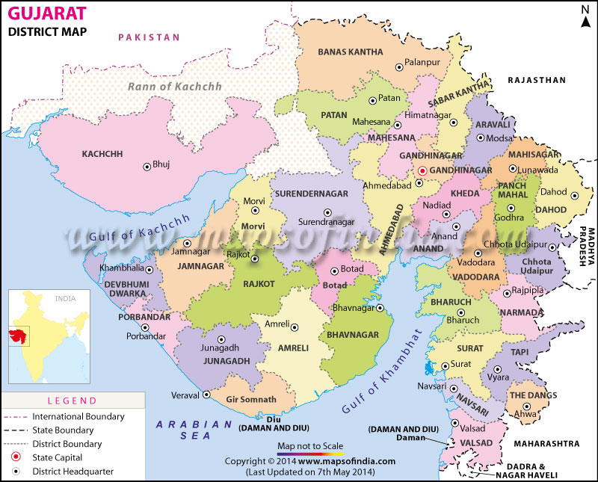
CASE STUDY GUJARAT – INDIA - EXPERIENCE NEW EXTENSION APPROACH A Door step approach to farmers

Slide 18
GUJARAT – INDIA - EXPERIENCE NEW EXTENSION APPROACH
REACH OUT TO FARMERS AT DOORSTEP : ‘KRISHI MAHOTSAV APPROACH’ –
THE GUJART EXPERIENCE OF SUSTAINABLE CLIMATE RESILIENT AGRICULTURAL DEVELOPMENT
Gujarat is situated on the western coast of India. Diverse in its topography, it has 1600 km coast line and is home to the largest desert in the country known as Rann of Kutch.
The state has had all possible handicaps faced by agriculture such as 70% of agriculture being rain-fed, recurrent droughts, untimely/irregular rainfall and some areas receiving rain only three to four days in a year.
Gujarat’s agriculture suffered heavily whenever there were droughts. The growth rate of agriculture used to be negative during such years. In a normal year, the agricultural growth rate used to be 1 to 3%.

Slide 19
NEW EXTENSION APPROACH
In the new millennium, Gujarat, with determination and persistent efforts, changed the agriculture scenario. From 2004 onwards, agriculture witnessed a major turnaround with a growth of 11% per year. This was an initiative in all 18,000 villages known as “Krishi Mahotsav” – the festival of Agriculture.
This was led from top by Chief Minister (Who is now the Prime Minister), Shri Narendra Modi. For action at bottom - the village level and at individual farmer level.
Entire model was developed based on the needs of farmers and to provide knowledge and technology to them at their door steps.
The speaker was responsible for developing policy and the detailed implementation framework and to develop module to monitor its implementation.

Slide 20
NEW EXTENSION APPROACH – 1
Farmers as centre point with services of
multiple departments
Farm Pond
Horticulture

Slide 21
NEW EXTENSION APPROACH
The key to this success was direct involvement of public leadership both elected and non-elected members of Public Governance System.
Effective soil and water management and proper land use
On the water front, more than 1,00,000 check dams got constructed compared to 6000 in the last decade with public private participation. It interlinked rivers such as the Mahi, Sabarmati and Narmada.
Scientific agriculture was introduced by distributing Soil Health Card to every farmer to make them informed choice in the selection of crops. Farmers now sowed crops that gave them higher return and were sustainable in the soil of their farms.
The poor farmers were focused for assistance. Every year 15 poor farmers of each village were assisted with quality.

Slide 22
NEW EXTENSION APPROACH - 2
FARMERS IN THE CENTRE

Slide 23
NEW EXTENSION APPROACH
A direct door-to-door extension programme for guiding the farmers at village level was introduced under a pre-Kharif (pre-monsoon) programme.
Every village was visited by a development team comprising of agri-scientists and officers from the veterinary department, co-operative, irrigation department, rural development department and local banks etc. High-yield crops were identified.
Bhaskaracharya Institute For Space Applications and Geo-Informatics prepared a micro-level plan for land use by identifying sites for check dams and village ponds for every village which were made available to each village.

Slide 24
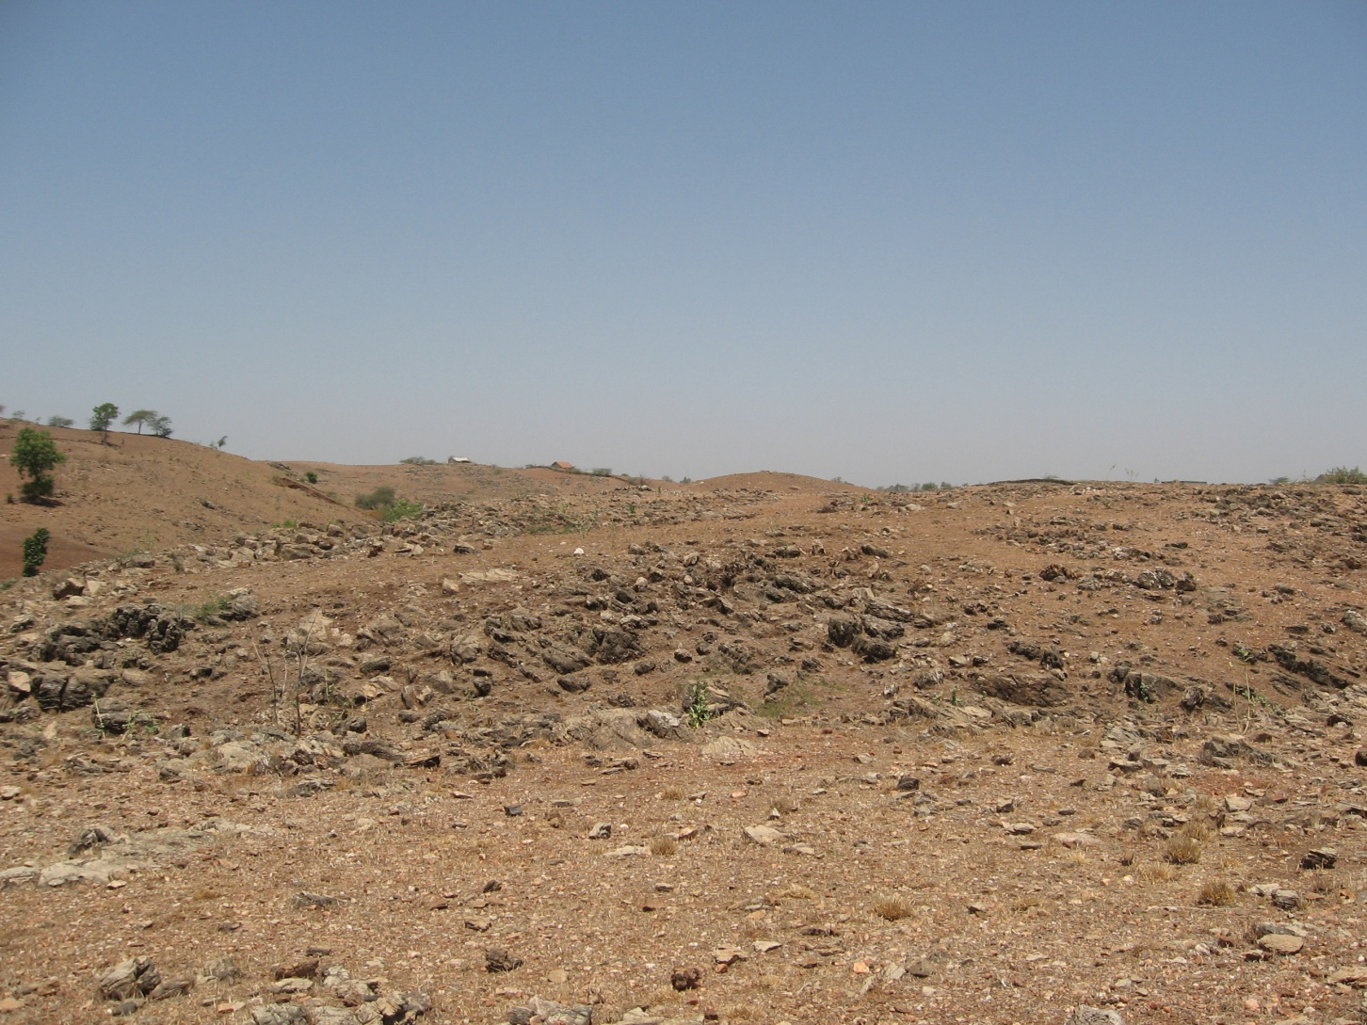
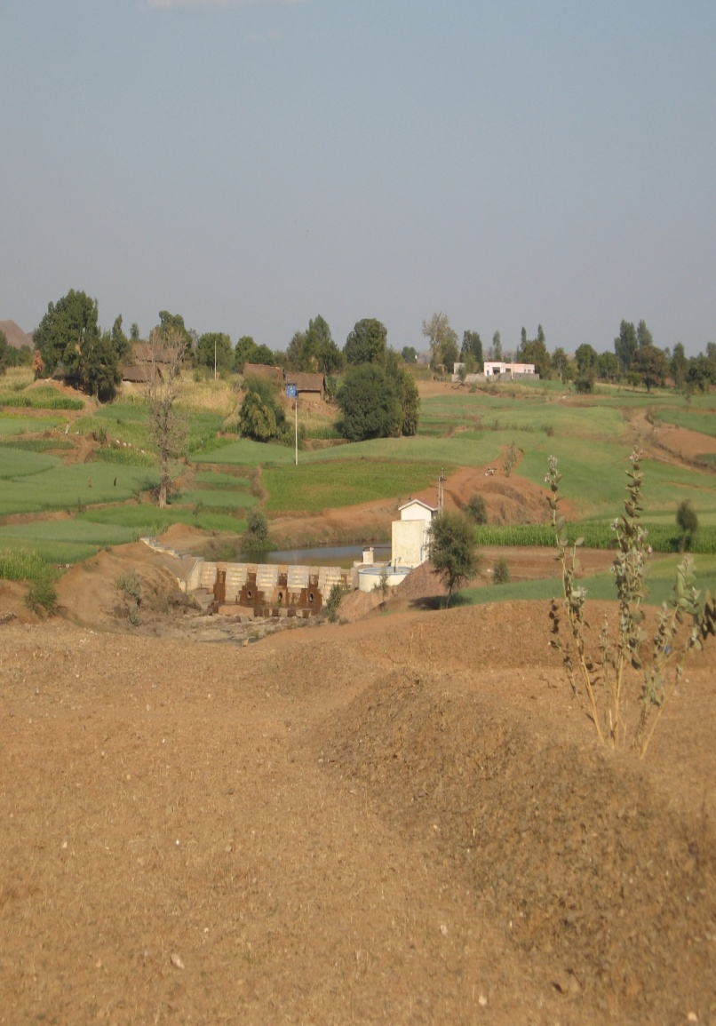
CASE STUDY : Transforming Dahod –
Dahod District – Gujarat – India
Before
After

Slide 25
Prior to 1974
poorest district in the state & country too Roughly 90 % people in tribal villages facing acute poverty Migration rate in non-irrigated villages between 50-70 % The irrigation coverage 10 % in records, in reality around 5 % Agriculture yields poorest in the state Milk production lowest in the state Literacy rate - lowest in the state – women literacy in one digit Landscape almost barren with hardly any tree cover Most forest land - without tree cover No horticulture activity No vegetable cultivation No floriculture
In 2010
Achieved food security Housing conditions improved School enrolment and attendance increased manifolds Ground water improved - CGWB Irrigation coverage is around 30 % 450 community water resources developed & managed by community 2,500 village institutions - users groups managing their affairs & assets 65 rivers and rivulets made perennial through series of structures migration rate 10-15 % six Crore trees planted with 50 % survival at long run About 25,000 farmers opted for horticulture

Slide 26
