Slide 1
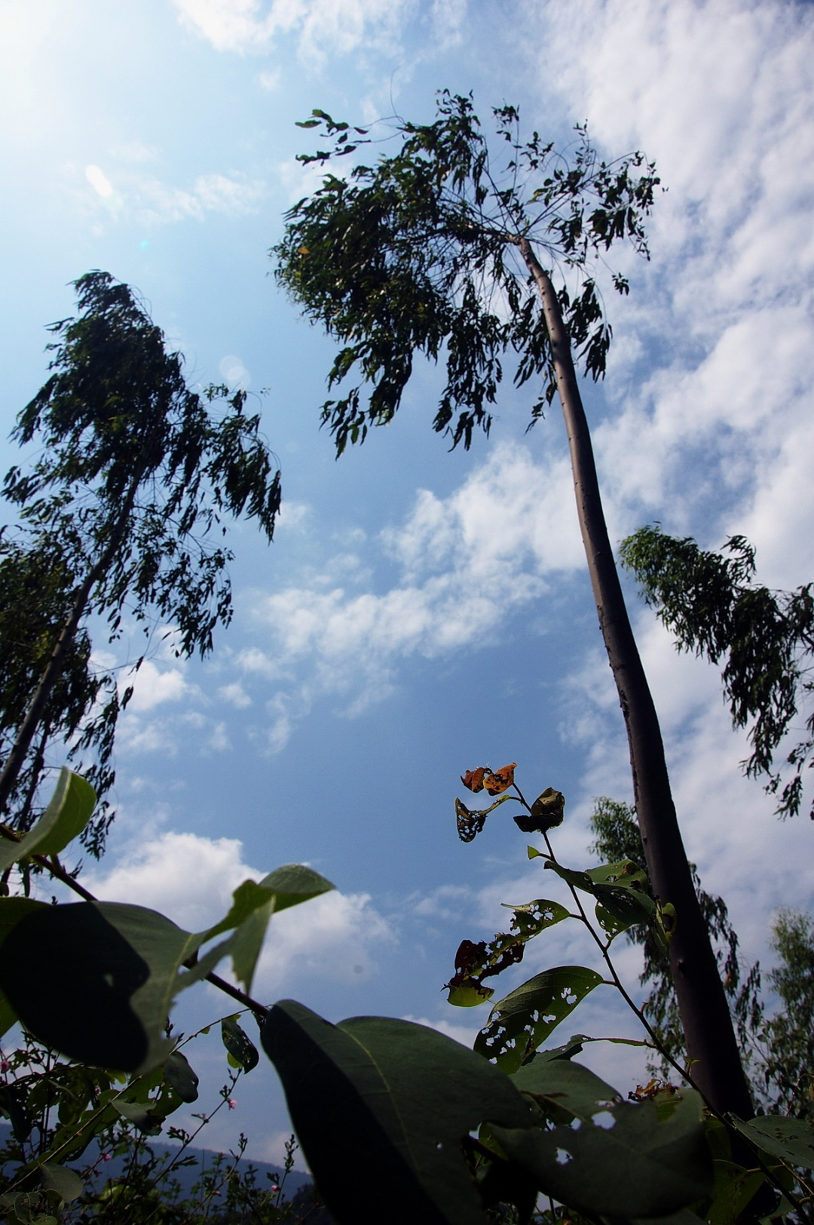
Unholy
Keeping people out of consultations is not a sacrosanct practice in CDM projects
Ranjan K Panda
Water Initiatives Odisha
ranjanpanda@gmail.com

Slide 2
The Project
Improving Rural Livelihoods through Carbon Sequestration (as per PID)
Sector (Agro-) Forestry (100%)
Date PID Prepared: May 1st, 2007
PID Appraisal Authorization: April 4th, 2007
Date of Registration: 28th February 2011
Project Ref No. : 4531
Crediting Period: 25.06.2004 – 24.06.2034
1st Monitoring period: 24.06.2004 to 31.08.2011 (Awaiting issuance request)

Slide 3
Project name changed to:
Improving Rural Livelihoods Through Carbon Sequestration By Adopting Environment Friendly Technology based Agroforestry Practices
Estimated Annual Reductions: 4,896 metric tonnes CO2 equivalent per annum metric tonnes of CO2

Slide 4
Background
Project activity will mobilize resource-poor farmers to raise tree plantations on farmlands.
To link resource poor farmers and end users of wood products in order to optimize the land use and to facilitate the co-ordination of wood producers, agronomists, financial institutions and non governmental organizations to improve the livelihood opportunities of rural households.
The project activity is implemented on the degraded farmlands or lands used for rainfed subsistence agriculture.
Project implemented in 501 villages in 6 districts of Orissa and Andhra Pradesh. (increased from 333 villages planned originally)
Some of the poorest districts of India i.e. Rayagada, Koraput, Kalahandi (in KBK of Orissa) and Visakhapatnam, Srikakulam, and Vizianagaram in Andhra Pradesh.
These districts have a pre-dominance of indigenous population, notified as Scheduled Tribes and Scheduled Castes in India, with the majority of them being poor.

Slide 5
Specific objectives of the project
To pilot reforestation activities for generating high-quality greenhouse gas removals by sinks that can be measured, monitored and verified.
To develop plantation and agro forestry models, which can provide multiple benefits to farmers in terms of timber, firewood and non-wood forest products.
To provide additional income and to promote livelihoods of resource poor farmers through carbon revenues.
To reforest degraded lands to control soil and water erosion and reclaim lands.
To reduce the dependence of industry on natural forests thereby conserving biodiversity.
To build capacity of various stakeholders to benefit from global mechanisms.

Slide 6
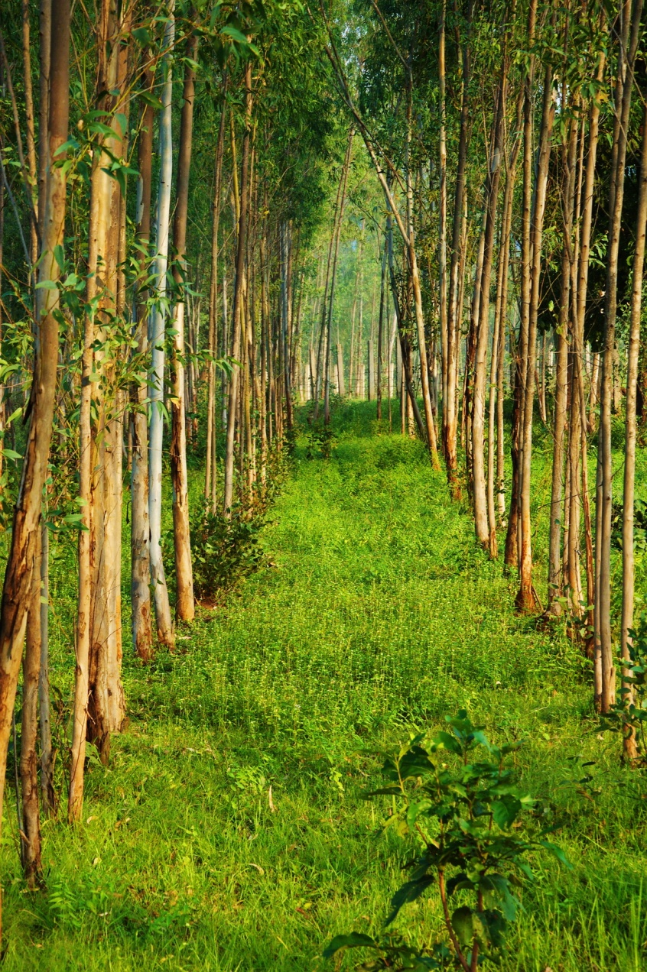
What exactly will be done?
The project implements reforestation on 3,607.32 ha of degraded lands in the states of Andhra Pradesh and Orissa. This was reduced to 1607.7 in 2009.
The reforestation activities under the project were initiated in 2004 with a plan to complete them over a period of 4 years.

Slide 7
People’s opinion not counted
The company has encased on the poverty of the region and the vacuum created by lack of proper government intervention.
In villages which we visited, and which are in the list of the PDD, the villagers said that they are always looking for some alternatives because agriculture fails quite often due to erratic monsoon, lack of ensured irrigation, lack of a support mechanism from government and lack of controlled marketing of produces.
But, people prefer agriculture – paddy, millets, cereals, pulses and vegetables to anything else. They are concerned about the food security.
In some of the lands where people have already been growing raw materials for the company, they have done it only to get good profit and it’s no informed choice as put in the PDD.

Slide 8
Wrong situational analysis
The PDD describes that the people are poor, mostly tribal and indigenous communities and have been put the land to subsistence agricultural use only.
The company therefore will provide additional income to the poor people (both from farm forestry as well as earning Carbon Credits) and unlike its previous model of involving only big land holders, this project will involve more small land holders.
In reality, none of the farms are barren.
Small land holders profit more from paddy, cereals, pulses, maize, vegetables as they get a rotating income from all these along with income from daily wage and forest produce collection. The so called PRA exercises done by the company for the CDM project has neither provided any account of these sources nor has made a valuation of income people already earn from the land at present.

Slide 9
One agenda – grow raw material for us
In fact, in villages which we visited, people have not been informed by any company official about the carbon credits. They have just been motivated to go for eucalyptus plantation so that they can get an assured income.
Company promised them 50 to 60 thousand rupees of profit per acre; helped them in getting loans from State Bank of India and local regional banks in which a condition was that the people have to buy saplings from the company. In fact, bank used to deduct the amount from the loan and paid it directly to the company.
The company signed some agreements with farmers assuring technical support for farming but most of the small farmers said they never saw the company officials after that. The buy back arrangement was also not working as local dalals are taking the produce from the farmers and there was no way the farmers can know the exact quantity of the produce.

Slide 10
A partnership to misery
While most of the farmers complained that the promised yield never happened; most missed out on the cycles of harvesting as there was very less produce.
To understand how the company’s regular mechanism works, we looked into farmers who are planting raw materials for the company since long and found that in some cases the farmers, who had planted eucalyptus in 1992 with loan are yet to harvest and repay the loans. The result, their land documents are kept in mortgage in the banks and they miss out on all other schemes. In fact, only the rich farmers have benefited to some extent from the scheme.
Even when farmers have got assured harvest(though not the price), they have to keep the land fallow (virtually) for at least 12 to 15 years to harvest the three cycles of plants. So, even if someone was to fetch the maximum price of 60 thousand rupees per acre in minimum term of 12 years it worked out to be 5000 per year. Deduct the operation and management cost and it comes to about 3000 rupees a year. In the same land, even if someone goes for subsistence agriculture it earns the farmer at least 6000 rupees considering 6 quintals (the least that can a non-irrigated land in a forested area can produce, as the people said) of paddy. And we are not counting the other crops which is a general practice.

Slide 11
Risks and comparative ecological & economic analysis missing
There are potential benefits of Afforestation/Reforestation credits, but I caution that that alien species may arrive via the plantation process. M. Danesh Miah, University of Chittagong, during XXIII IUFRO WORLD CONGRESS , August 2010.
There are conflicts between silviculture, which aims to enhance select forest functions, and nature conservation, which aims to maintain an ecosystem’s historic conditions…. Jürgen Bauhus, University of Freiburg, XXIII IUFRO WORLD CONGRESS , August 2010.
All these economies and ecological comparisons have not been calculated and detailed in the PDD. There is also no mention of the price the company will offer to the farmers and what is the mechanism to assure that price. The company only says that a system will be developed, a common account will be opened and the farmers will earn extra profit.
Going by the experience of farmers, most of them have complained that the company saplings have not delivered the desired result in most of the cases and the company does not listen to any complaints. Only big farmers, who have other sources to bank on, have been able to influence the company to some extent.

Slide 12
Accelerating the ongoing exploitation
Further, the education level and lack of any monitoring, the poor farmers will only lose out on whatever land and food security they have. Farmers have complained that once they go for eucalyptus and fail, production of paddy and other crops reduce by almost half and water retention capacity of the land reduces drastically. However, that’s only if someone realizes the failure in one/two years and restores the land for food security agriculture. If one waits for all the three harvest cycles, then perhaps the land will take a few years to come back to any tillable level.

Slide 13
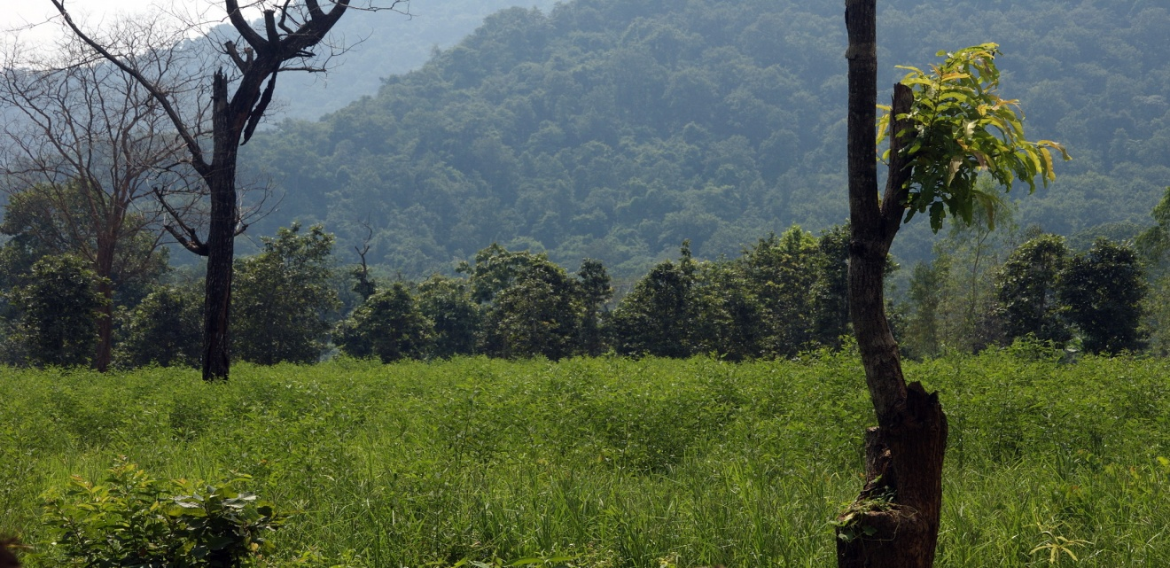
Had the people been consulted?
It has been a traditional socio-economic and cultural practice of the farmers in the select districts to promote agroforestry of a natural forest kind. With proper planning, they can earn innumerable benefits to enhance their food, fuel and economic sustainability from such agro-forestry rather than going into monoculture that raises wood only for a company’s profit and has no other economic and ecological value. (Contrary to what the PDD mentions, farmers said they don’t use eucalyptus for fuelwood and other purposes. In fact, the dalal takes away everything).

Slide 14
Alternatives not taken into account
Almost half the agricultural land in the world, about a billion hectares, has more than 10 percent tree cover, but there is still huge potential to increase the number of trees on farmland and improve their productivity.
Incorporating trees within farming landscapes, or agroforestry, can increase soil fertility, raise and sustain yields, increase income through the sale of timber and other tree products, and produce fodder and fuelwood. XXIII World Congress of the International Union of Forest Research Organizations in Seoul, August 2010
In many rural settings, trees provide subsistence needs and people can earn money from the sale of fruits, nuts, leaves and animal fodder; high value oils, gums and resins; timber and fuelwood for cooking, and medicines from various parts of trees.
A study of around 1000 smallholders in Kenya found that 55 percent sold fruits to earn income. This is more than those who sold the country's major staple crop, maize.

Slide 15
Alternatives not taken into account
In Haryana and surrounding states in northern India, hundreds of thousands of smallholders are growing poplar trees within irrigated wheat and barley fields, and this is generating about US$1 million a day for the growers. XXIII World Congress of the International Union of Forest Research Organizations in Seoul, August 2010
In fact, traditional agro-forestry can not only be a carbon sink but also can save agriculture from climate variations; can enhance soil fertility and water retention ability of crop fields. In eucalyptus on the contrary, soil fertility goes down and water resources dry up.

Slide 16
JK’s CDM is a Unnecessary Evil
The fact that this CDM promotes agroforestry to provide raw material to a company that already emits 288701 MT/ANNUM GHG. That too as estimated by the company. Without any independent verification this figure cannot be believed from a company that has been getting notices from the Pollution Control Board for not adhering to pollution control norms.
It, at the first instance, defeats the very basic objective of mitigating climate change through measures like CDM. Climate change makes the poor, who do not contribute to GHGs, more vulnerable.
But through this project the poor will feed into a company that contributes GHG emissions and at the same time get further poor.

Slide 17
Open Questions:
- Who carries the risk of pilot projects with marginal land holders?
- Would the people really chose plantation over irrigation if they had a choice?
- How many local stakeholder consultations are necessary for a project involving more than 1.500 farmers?
- How do you ensure that over a lifetime of 30 years, the claimed sustainability is achieved as stated in the PDD?

Slide 18
Thank You !
ranjanpanda@gmail.com
+91-94370-50103

