Slide 1
The Gathering Storm
Displacement in the context Climate Change, Disasters and Conflict
Perspectives from– Ethiopia
Mo Hassan and Nina M. Birkeland

Slide 2
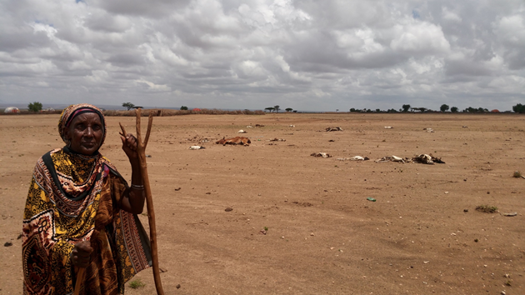
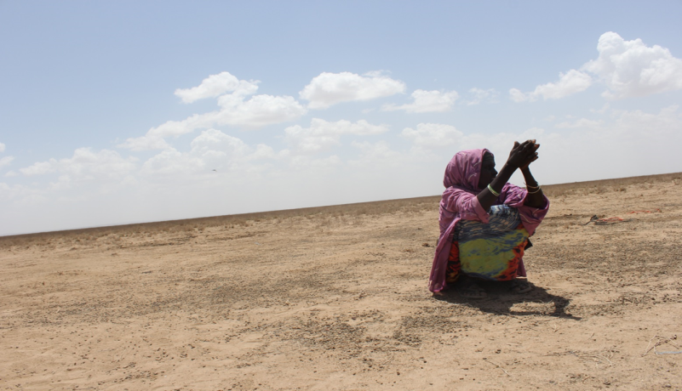
Displacement in Ethiopia
Ethiopia population is close to 100 million
Hosts over 1.3 million refugees and IDPs
Recovering from the worst drought in 50 years – El Nino attributed
Threatened by climate change

Slide 3
How climate change affects
Over 5 million population
Primary livelihoods
Livestock 70%
Subsistence agriculture 15%
Changes in rainfall patterns lead to droughts
Frequency and intensity of droughts
Leads to conflict over resources – Pasture, water and land – causes conflict displacement
Causes disaster displacement

Slide 4
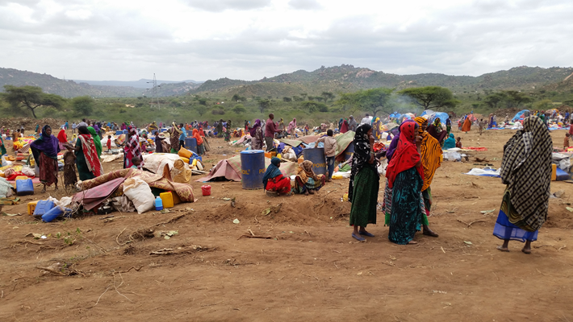
Faces of Displacement
Drought efect
New displacement in Annod
Resource based conflict

Slide 5
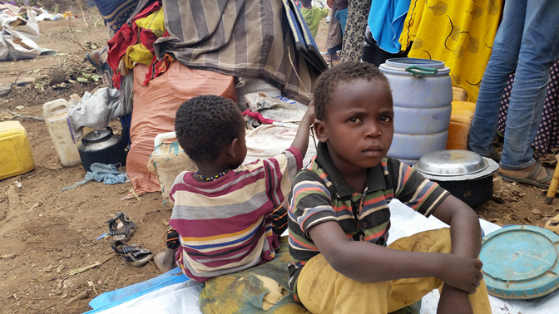
Faces of Displacement
Children are Silent victims in
displacement

Slide 6
Climate vulnerability loop
Affected Community
Climate hazard - Drought
Limited access to pasture and water
Mini population movement
Competition and Conflict over resources
Displacement

Slide 7
Frequency and intensity
Drought happens every 2-3 years instead of once a decade
Humanitarian response address today’s needs only
Next shock hits before community recovers to its previous levels
Severity leads to total distraction
Disaster risk reduction imperative

Slide 8
Climate change to conflict
Limited alternative livelihoods – livestock headcount = wealth
First attempt is to save by moving livestock to new area
Multiple such movements happens and lead to conflict over resources
Violence breaks out – leads to displacement
Disaster risk reduction is needed

Slide 9
Existing coping strategies
Explore clan links – internal migration
Diversify livelihoods – Charcoal
Stretch available resources – skip meals
Move to relief sites (IDP sites) –
Move to urban centers – Beginning of intercontinental migration
Use smuggling services to the Gulf or Europe
Despair is absolute!

Slide 10
NRC do differently:
Identify communities at risk
Use DRR and community based early warning system
Identify community strengths and weaknesses
Implement community-led alternatives
Focus on displacement prevention

Slide 11
Key messages
Climate change has demonstrable effect on disaster and conflict that leads to displacement – The storm!
Multiple internal movement/adjustment precede the mass displacement – There is lead time to respond
Focus should be on prevention and resilience building – DRR principles important

