Slide 1
Equitable climate action: Laws, policies and finance for an inclusive and accountable transition
Building accountability and transparency in the UNFCCC by regulating the interference of polluting entities

Slide 2
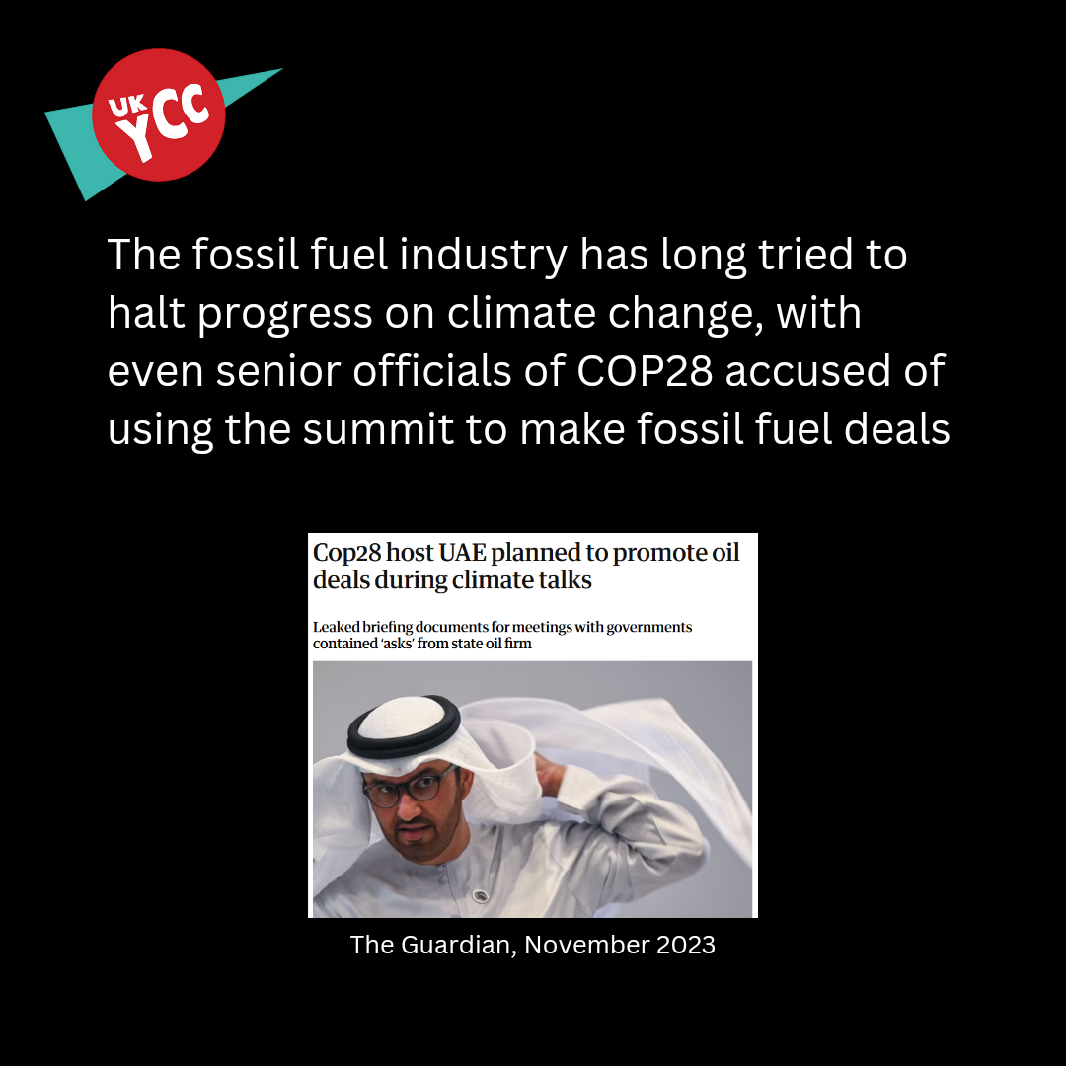
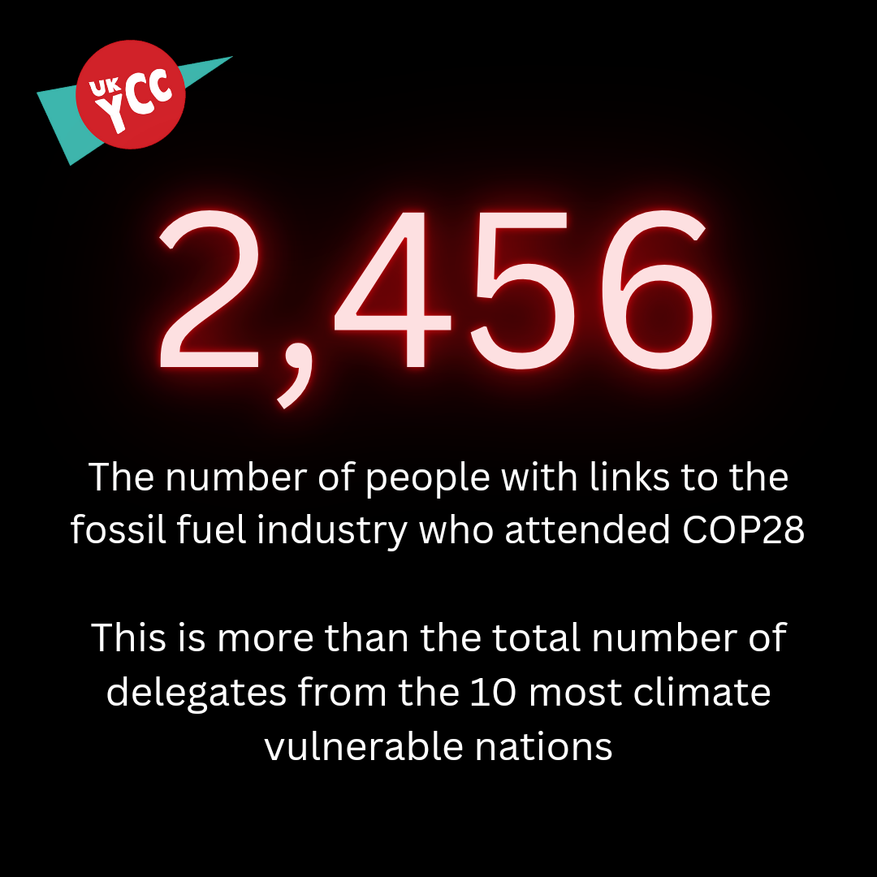
Setting the scene

Slide 3
The UK Youth Climate Coalition

Slide 4
The UNFCCC needs a Conflict of Interest policy
This would involve:
1) Recognising that vested interests present a problem for the UNFCCC process
2) Endorsing the negotiation of a comprehensive conflict of interest definition and policy in the UNFCCC, and supporting a robust accountability framework within the UNFCCC to protect against the undue influence of corporate actors.
3) Consider developing a domestic conflict of interest policy for UNFCCC Party delegations, including a transparent declaration of interests for delegates on Party badges.

Slide 5
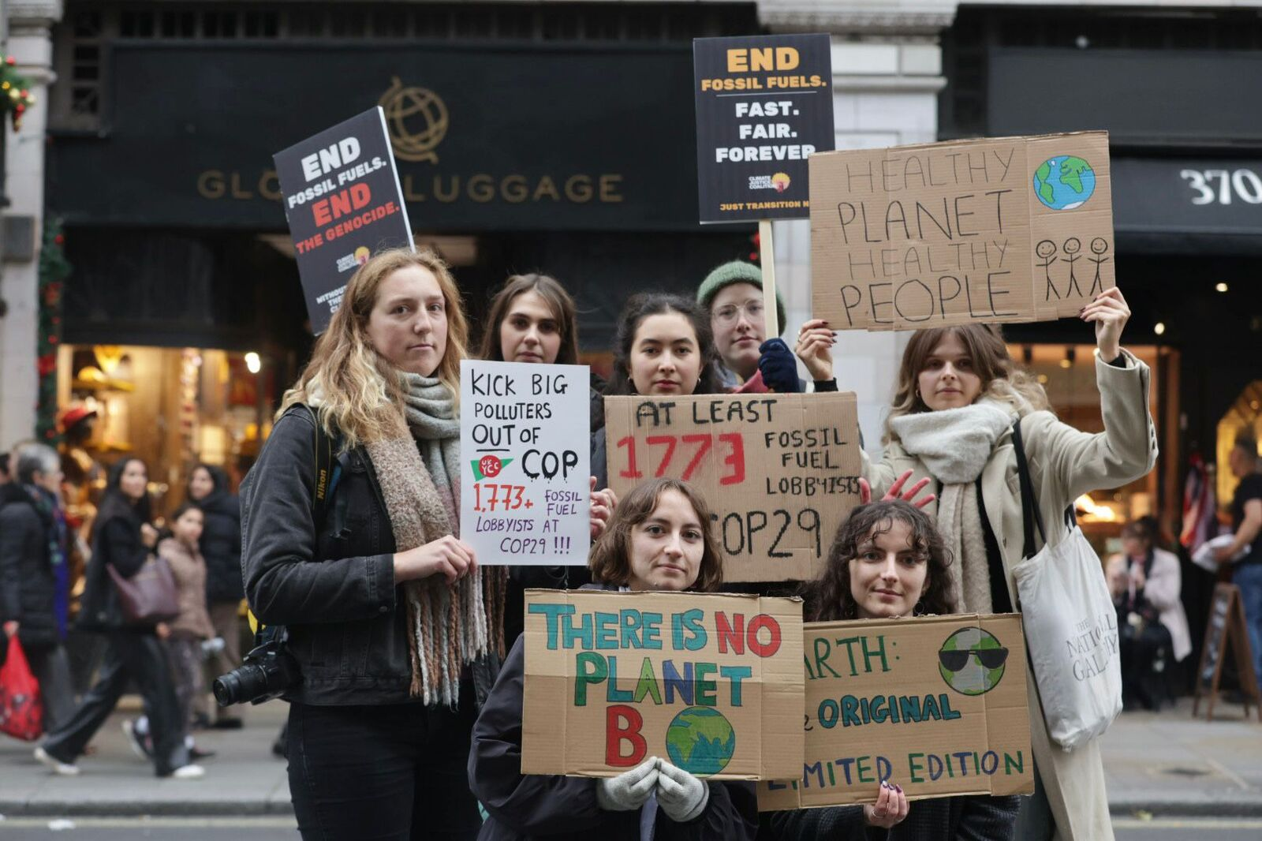
Impact on the Just Transition

