Slide 1
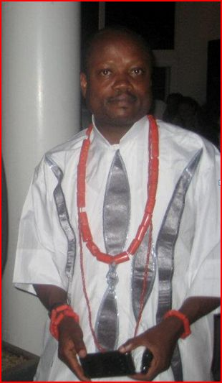
Pastor Peters Omoragbon
Nurses Across the Borders Durban, South Africa November 30, 2011 UNFCCC/ COP17

Slide 2
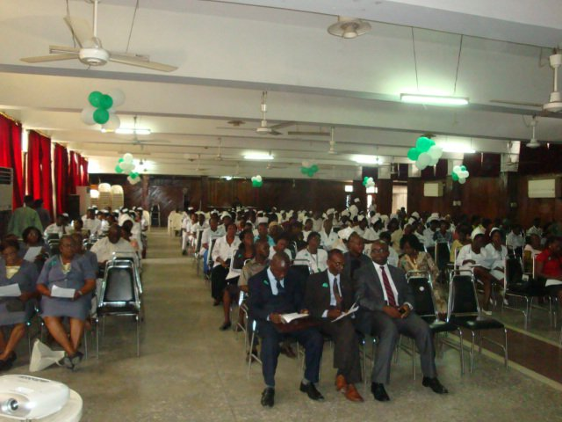
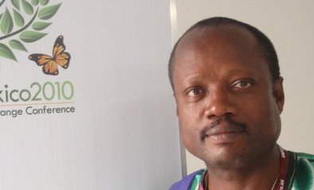
Nurses Across the Borders Durban, South Africa November 30, 2011 UNFCCC/ COP17

Slide 3
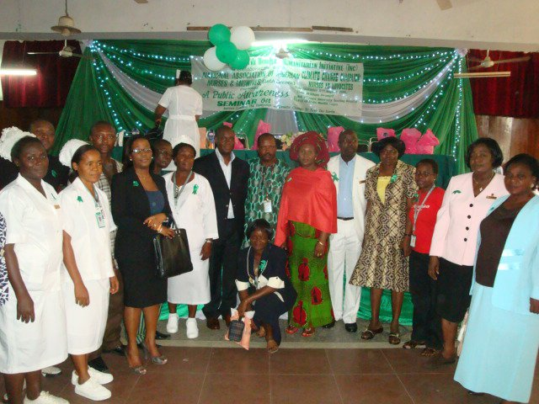
Nurses Across the Borders Durban, South Africa November 30, 2011 UNFCCC/ COP17

Slide 4
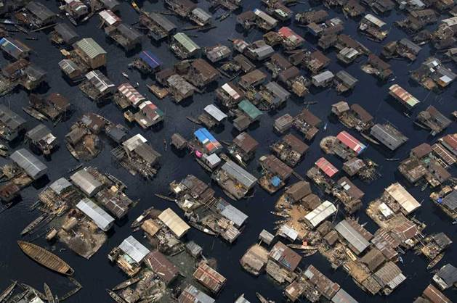
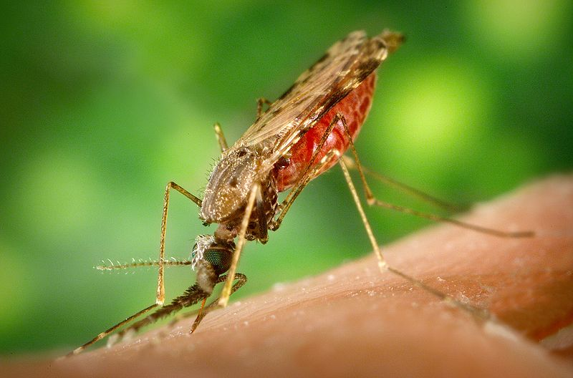
Floods and standing water - a breeding ground for mosquitoes and other disease vectors
Lagos, Nigeria
Nurses Across the Borders Durban, South Africa November 30, 2011 UNFCCC/ COP17

Slide 5
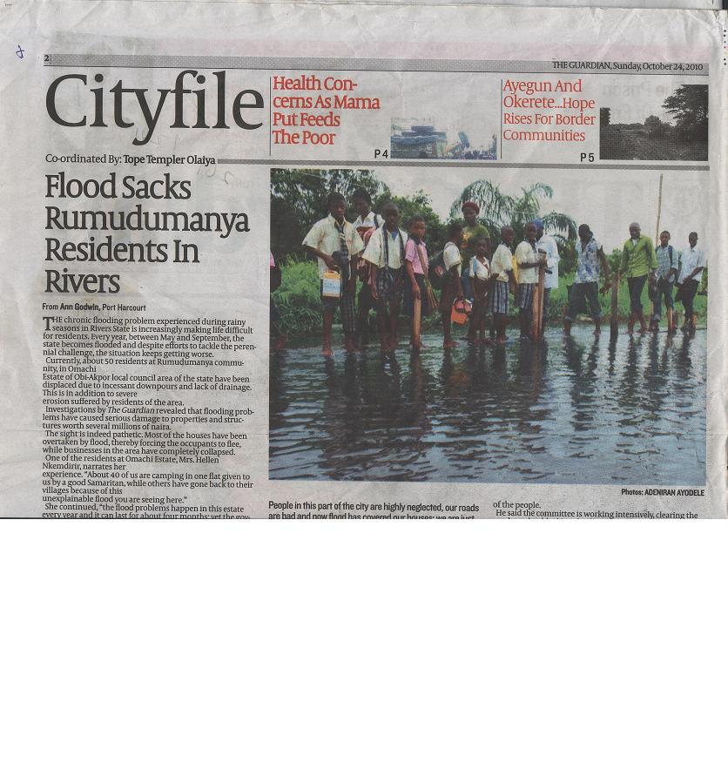
Nurses Across the Borders Durban, South Africa November 30, 2011 UNFCCC/ COP17

Slide 7
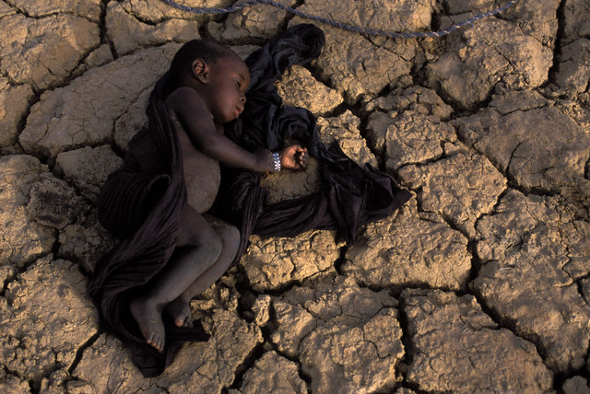
Climate Change Issues and Adaptation Responses
Extremes – nimble institutions for risk reduction and disaster response, collection and distribution of timely information before and immediately after disaster
Heightened Variability - flexible decision making
Long Term Change – durable support from institutions yet remain flexible enough to accommodate the unknowns that emerge
Nurses Across the Borders Durban, South Africa November 30, 2011 UNFCCC/ COP17

Slide 8
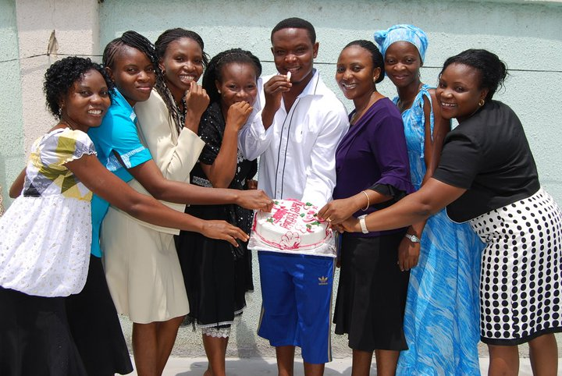
Nurses Across the Borders Durban, South Africa November 30, 2011 UNFCCC/ COP17

Slide 10
By empowering health professionals in low adaptive capacity areas, this South/North partnership between Nurses Across the Borders and SeaTrust Institute links research and capacity building with global policy and action to build momentum for health as the universal societal and environmental driver for climate policy.
SeaTrust Institute Dr. Lynn Wilson lwilson@seatrustinstitute.org +1 360 9613363
Nurses Across the Borders (NAB) Mr. PETERS OMORAGBON nursesacrosstheborders@yahoo.com +234 805 2658024

