Slide 1
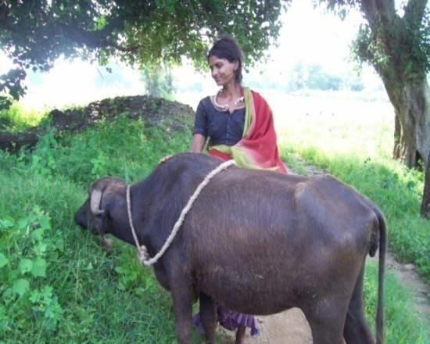
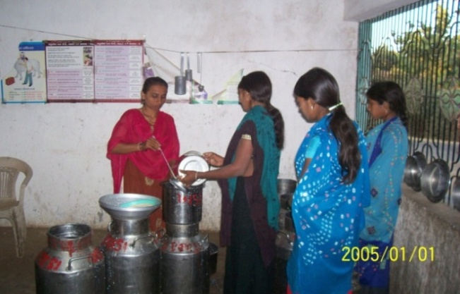
Initiative V: Animal Husbandry and
Dairy Development
12 Dairies formed, Started with only 12 lit/day milk; now collecting avg. 12119 lit/day milk.
Curative services in 45 villages with increased Vaccination up to 85%
Scientific approach adopted for animal husbandry
39 individual Gobar gas units are established
Animal husbandry promoted as continuous source of Alternative Livelihood
1

Slide 2
Initiative V: Animal Husbandry and
Dairy Development
12 Dairies formed, Started with only 12 lit/day milk; now collecting avg. 12119 lit/day milk.
Curative services in 45 villages with increased Vaccination up to 85%
Scientific approach adopted for animal husbandry
39 individual Gobar gas units are established
Animal husbandry promoted as continuous source of Alternative Livelihood
2

Slide 3
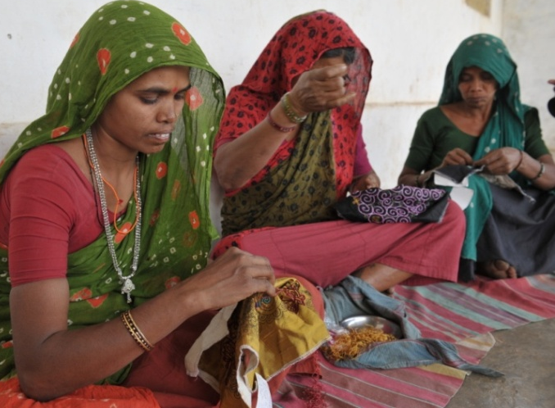
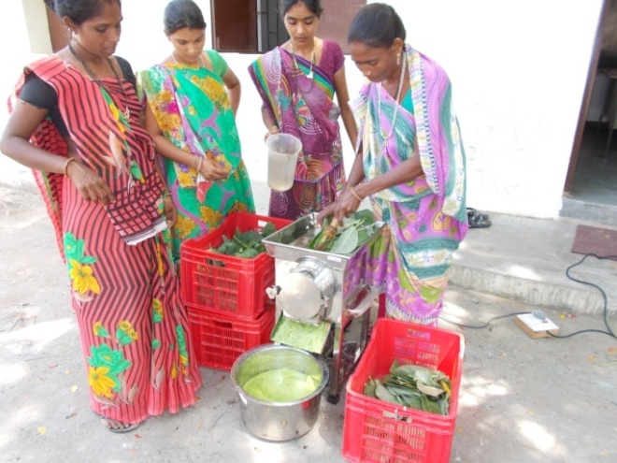
Initiative VI: Livelihood Enhancement
Mobilized & organized 8820+ women in self help groups
Sharda Gromodhyog Society has achieved business of Rs. 18 Million till date benefitting 750 women artisans.
Food processing & Production of Bio Agri Products initiated
3

Slide 4
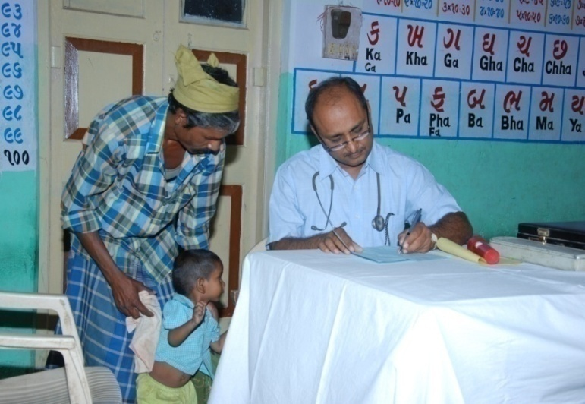
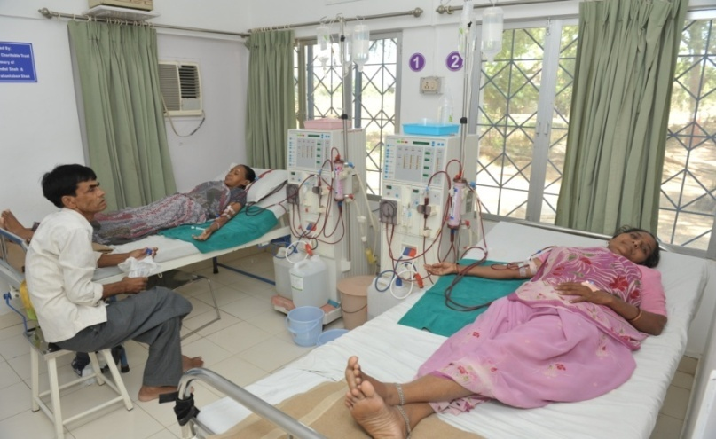
Initiative VII: Community Health programs
Established well equipped Sharda Medical Center (18 bedded hospital)
Initiated Mobile Medical services for remote area outreach
Initiated blood storage services to facilitate sickle-cell anemia treatment, Thalassemia and critical operative patients served
Extended annually curative services to 6000+ patients
4

Slide 5
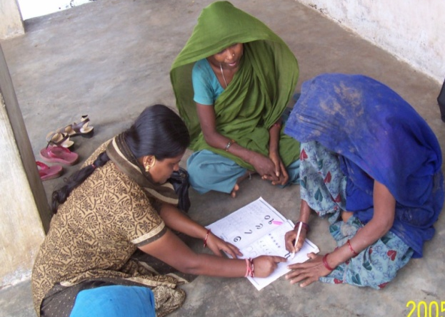
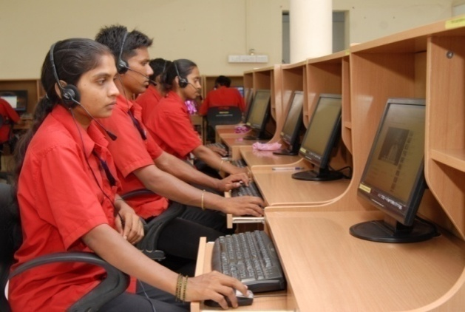
Initiative VIII: Education
and Skill development
Turning
&
Milling
CNC Milling
&
CNC Turning
Structural
Fabrication
Mechanical
Maintenance
Tractor
Mechanic
Welder
Manufacturing
Technologies
Agronomy
Automobile
Agricultural
Services
Horticulture
Two Wheeler
Mechanic
Dairy Forming
Plumber
Electrician
Civil
Electrical
House wiring
Mason
Information
Technology
Rewinding of
AC/DC motors
Scaffold
Tally
Data Entry
Operator
Welder
AutoCAD
Front Office
Assistant
Trained : 2500; Employed : 2000
Earning Rs. 5000-12000 per month, Girls’ ratio 50%
5

Slide 6
Initiative VI: Livelihood Enhancement
Mobilized & organized 8820+ women in self help groups
Sharda Gromodhyog Society has achieved business of Rs. 18 Million till date benefitting 750 women artisans.
Food processing & Production of Bio Agri Products initiated
6

Slide 7
Initiative VII: Community Health programs
Established well equipped Sharda Medical Center (18 bedded hospital)
Initiated Mobile Medical services for remote area outreach
Initiated blood storage services to facilitate sickle-cell anemia treatment, Thalassemia and critical operative patients served
Extended annually curative services to 6000+ patients
7

Slide 8
Initiative VIII: Education
and Skill development
Turning
&
Milling
CNC Milling
&
CNC Turning
Structural
Fabrication
Mechanical
Maintenance
Tractor
Mechanic
Welder
Manufacturing
Technologies
Agronomy
Automobile
Agricultural
Services
Horticulture
Two Wheeler
Mechanic
Dairy Forming
Plumber
Electrician
Civil
Electrical
House wiring
Mason
Information
Technology
Rewinding of
AC/DC motors
Scaffold
Tally
Data Entry
Operator
Welder
AutoCAD
Front Office
Assistant
Trained : 2500; Employed : 2000
Earning Rs. 5000-12000 per month, Girls’ ratio 50%
8

