Slide 1
Will Developed Countries Meet their US$100 Billion Commitment in 2020?
Bertram Zagema
12 12 2019

Slide 2
Will Developed Countries Meet their US$100 Billion Commitment in 2020?
What did the OECD countries project in their 2016 Roadmap to $100bn?
What are current OECD projections (September 2019, looking at 2013-2017)?
Oxfam Climate Finance Shadow Report 2018 (looking at 2015-2016).

Slide 3
OECD Projection in 2016

Slide 4
OECD Projection in 2016
Under different assumptions on mobilisation of private climate finance.

Slide 5
OECD Projection in 2019 (Public)

Slide 6
OECD in 2019 (Public + Private)
Applying new accounting methodologies for mobilised private finance: lower numbers

Slide 7
Oxfam Climate Finance Shadow Report 2018
Biennial reports 2015-2016, OECD DAC database
Not just the numbers but what do they tell us:
Climate relevance of projects
Financial instruments: grants, loans, other
Adaptation or mitigation
Least developed countries

Slide 8
Climate Relevance?
Source: Oxfam 2018

Slide 9
Grants or Loans?
Source: Oxfam 2018

Slide 10
Net Climate Specific Assistance
Source: Oxfam 2018

Slide 11
Adaptation or Mitigation?
Source: Oxfam 2018

Slide 12
Adaptation Finance over the years
Source: Oxfam 2018

Slide 13
OECD: Mitigation or Adaptation (Public)

Slide 14
OECD: Mitigation or Adaptation (Private)

Slide 15
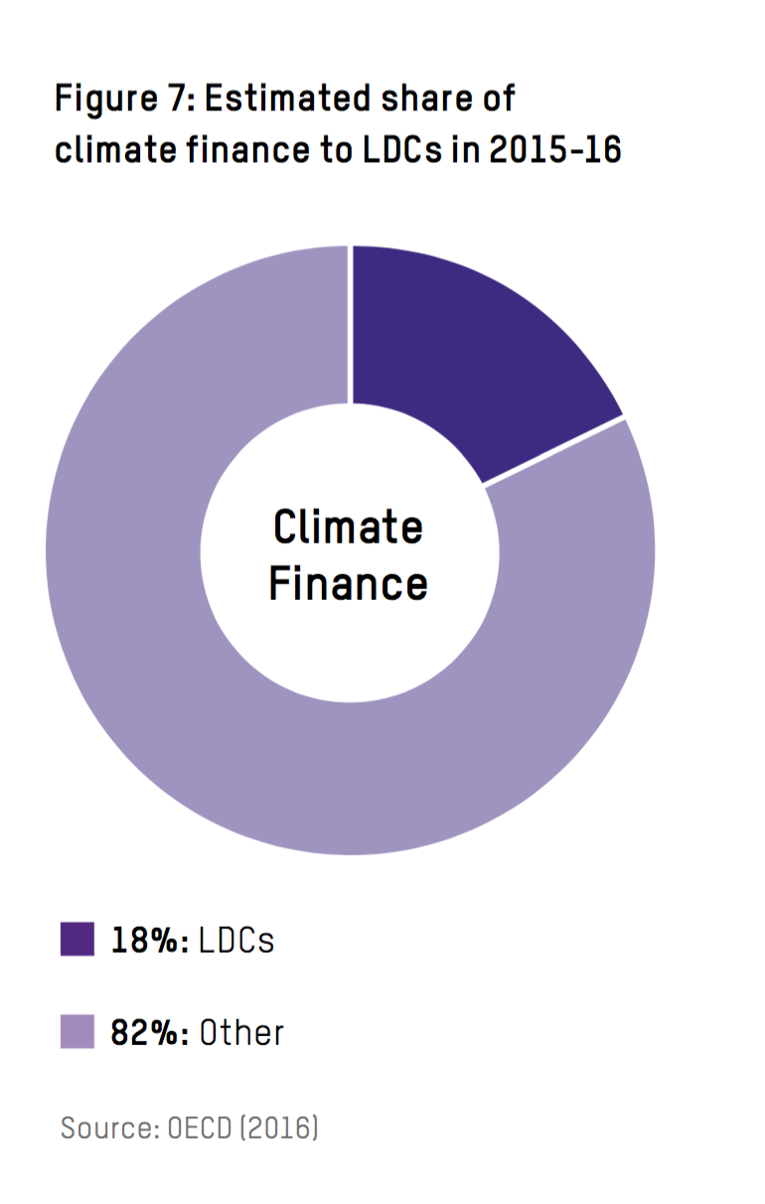
Least Developed Countries?

Slide 16
New and Additional to ODA?
Source: OECD 2019

Slide 17
Takeaways
The developed countries may reach their $100 billion commitment on their own terms (mobilised private finance is uncertain factor).
In terms of net climate specific assistance, this will be much lower.
The $100bn combines very different strands: public and private; gifts and loans – apples and oranges.
Future commitments – be more specific about public finance, grants, adaptation, vulnerable countries and groups.
Transparency of reporting of climate finance in the CTF:
Project by project, both public and private
Show both full value and climate relevant value of projects
Show both full value and grant equivalent of non grants

