Slide 1
Evaluating Adaptation
Rob D. van den Berg
GEF Evaluation Office

Slide 2
Outline
Definitions
GEF and Adaptation
GEF Evaluation Office involvement
LDCF Evaluation
SPA Evaluation
SCCF Evaluation
Key success factors

Slide 3
Definitions
Adaptation:
Adjustment in natural and human systems in response to actual or expected climatic stimuli or their effects, which moderates harm or exploits beneficial opportunities. Types: anticipatory and reactive; private and public; autonomous and planned.
Vulnerability:
The degree to which a system is susceptible to, or unable to cope with, adverse effects of climate change, including climate variability and extremes. It is a function of the character, magnitude and rate of climate variation to which a system is exposed, its sensitivity, and its adaptive capacity.
Resilience:
Amount of change a system can undergo without changing state. Capacity of a system, community or society potentially exposed to hazards to adapt, by resisting or changing in order to reach and maintain an acceptable level of functioning and structure.
No-regret adaptation:
Adaptation options (or measures) that would be justified under all plausible future scenarios, including the absence of manmade climate change
Maladaptation:
Any changes in natural or human systems that inadvertently increases vulnerability to climatic stimuli

Slide 4
Involvement of GEF
Main Trust Fund:
Special Priority for Adaptation program: $50 million – local adaptation needs plus generation of global environmental benefits
GEF5 strategies identify climate change as a risk and support climate resilience of activities when applicable
Two Special Trust Funds (COP7 decisions):
LDCF: National Action Plans for Adaptation (NAPAs) and implementation of priority projects for 48 LDCs
SCCF: adaptation plus support to technology transfer, several sectors, economies dependent on fossil fuels
COP7 also set up the Adaptation Fund, funded by Kyoto Protocol, for which GEF provides Secretariat and Evaluation Function

Slide 5
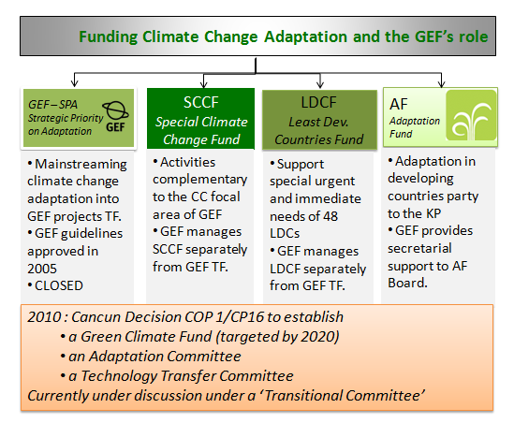

Slide 6
GEF Evaluation Office involvement
Joint Evaluation with Denmark on Least Developed Countries Fund (LDCF) – 2009
Evaluation of the Special Priority for Adaptation (SPA) in the main GEF Trust Fund – 2010
Joint work with Secretariat of LDCF/SCCF on developing RBM and M&E framework for adaptation, as well as with the Adaptation Fund Secretariat for the Adaptation Fund
Climate-Eval, community of practice for evaluating climate change and development (www.climate-eval.org)
Evaluation of the Special Climate Change Fund (SCCF) – 2011
Evaluation Function of the Adaptation Fund – September 2011

Slide 7
LDCF Evaluation
Evaluation undertaken by independent team of evaluators, managed by DANIDA and GEFEO
Focus on National Action Plans for Adaptation (NAPAs): process, products, catalytic effects (until May 2009)
Fund portfolio US$ 176.5 million – all 48 LDCs had NAPAs funded; in addition 26 NAPA priority projects
UNFCCC/COP7 decision was fulfilled in set up and initial implementation
NAPAs: increased awareness and were useful statements on adaptation; they identified priority projects but not thematic/transformative approaches to climate change
Scale and unpredictability of funds available to LDCF was not appropriate – it would be impossible to fund all identified priority projects
Process of funding approval slow and complex, although improvements were noted
No evidence yet of impact on the ground

Slide 8
LDCF Recommendations
To Parties: review role of fund given changes in context since creation
To LDCs: better coordination among all sources of funding; further mainstreaming; stronger institutional arrangements
To development agencies: support governments to implement NAPA priorities
To LDCF Council: improve KM; procedures commensurable to diverse clients and complex topic: responsiveness and flexibility
To LDCF management: improve project tracking system; improve KM

Slide 9
GEF Strategic Priority for Adaptation (SPA)
SPA
Characteristics
Mandated by COP7 of the UNFCCC (Marrakech, 2001) to fund within the context of the GEF Trust fund
“pilot or demonstration projects to show how adaptation planning and assessment can be practically translated into projects that will provide real benefits.”
Approved by GEF Council in November 2003
Allocation of $50 million from the GEF Trust Fund: 26 projects and programs
Projects with SPA component amount to $777 million total volume (6%): adaptation measures do not have to be extremely costly
SPA is a learning pilot to generate lessons about reducing vulnerability and increasing adaptive in the context of GEF Trust Fund projects

Slide 10
The SPA evaluation
SPA
Ten Conclusions
All SPA projects fulfilled the GEF requirement regarding Global Environmental Benefits and explicitly included climate change impacts on these, and are relevant to the GEF mandate.
The $50 million SPA initiative has the potential, to varying degrees, of providing climate resilience to $780 million of investments. Represent diversity in sectors, themes and focal areas, with an emphasis on biodiversity and land degradation.
The portfolio of projects represents diversity in sectors, themes and focal areas, with an emphasis on biodiversity and land degradation.
Projects were developed in accordance with the elements and requirements of the SPA Operational Guidelines, with some exceptions.
Adaptation measures proposed in SPA projects were found to be generally “no regrets” measures, dealing with management of natural resources.
Results achieved so far have been at the output level; most projects are either in early stages of implementation or have not started yet.
There was evidence of mainstreaming of adaptation at the GEF mainly at strategic level and to some extent in project design but some limitations are preventing this integration from becoming fully effective
Although the portfolio is still in the early stages of implementation some lessons could be extracted for the GEF as a whole.
There were weaknesses in the management of the SPA portfolio but there is still time to correct them.
As a learning pilot within the GEF, the SPA has yet to achieve its full effectiveness.

Slide 11
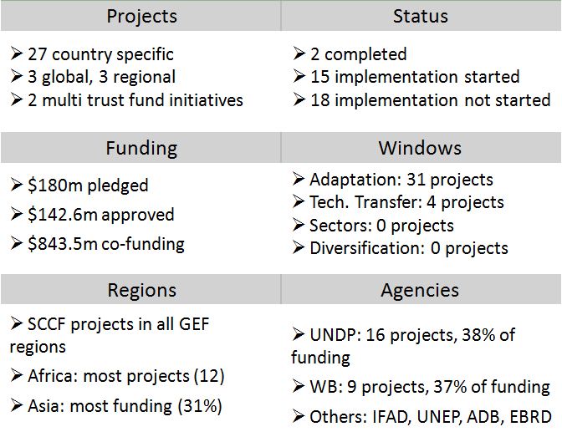
SCCF Evaluation (2011)

Slide 12
SCCF Conclusions (1)
The four SCCF programming strategies are relevant to the COP guidance
Programming documents provide clear guidelines for operationalization
The adaptation projects are relevant to the COP guidance and SCCF programming
All COP priority areas are addressed by the SCCF project portfolio (31 projects receiving $127.5 million)
The technology transfer projects are relevant to COP guidance and SCCF programming
Coverage of technology transfer limited (4 projects receiving $15.2 million)

Slide 13
SCCF Conclusions (2)
The funding of SCCF is not commensurate with the global mandate of the COP guidance
$127 million for adaptation window: not sufficient to support eligible countries and not sufficient to program in a sensible way
$15 million for technology window: what can one do?
Although SCCF programming was formulated to implement activities under windows C and D, COP guidance for these windows was not implemented because of lack of funding
Guidance for windows C and D approved by LDCF/SCCF Council in June 2007
No funding pledges for either of these windows received

Slide 14
SCCF Conclusions (3)
The adaptation projects are highly relevant to national sustainable development agendas of beneficiary countries, contributing to socio-economic development goals
Most SCCF projects contribute to strengthening livelihoods of vulnerable communities
Projects employ innovative approaches to overcome the lack of data on many emerging adaptation issues
High quality of vulnerability assessments and participatory approaches in adaptation activity design
In general projects are well geared towards replication and up-scaling, yet follow-up is uncertain due to lack of funding

Slide 15
SCCF Conclusions (4)
The SCCF has been managed by the GEF in a cost-effective way; its management costs are lowest of comparable funds
Main reason is the lower costs of the governing bodies (Council meetings)
Operating costs as proportion of total funding approved in FY11:

Slide 16
SCCF Conclusions (5)
The formal project cycle is implemented in accordance to GEF standards and rules. However, due to the unpredictability of funding availability, an informal project pre-selection process has been introduced which is non-transparent.
Criteria not formally determined and published; process of pre-selection and application of selection criteria not officially documented and traceable
If no funding is available for project proposals that would qualify, any selection process would be criticized, unless the fund is advertised as “competitive” (as for example research programs tend to do)

Slide 17
SCCF Conclusions (6)
Opportunities for learning – highly relevant given the innovative nature of the projects – may be lost because no knowledge exchange and learning mechanism exists
Some SCCF projects successfully demonstrated how knowledge systematization and sharing can be implemented
At the fund level a comprehensive and pro-active system does not exist yet
SCCF projects are systematically perceived as GEF Trust Fund projects

Slide 18
SCCF Recommendation 1
The LDCF/SCCF Council should appeal to donors to adequately fund the SCCF in a predictable manner, preferably through a replenishment process
Until other Funds become operational, SCCF remains one of the main sources of multilateral adaptation funding accessible to all developing countries
SCCF has built up a portfolio of innovative projects and is cost-effective
For further consideration:
There is no guarantee that adequate funding will materialize
The LDCF/SCCF Council does not participate in international negotiations
In absence of funding increases, a revised targeted niche for SCCF could be considered in international negotiations

Slide 19
SCCF Recommendation 2
The LDCF/SCCF Council should ask the Secretariat to prepare proposals to ensure:
Transparency of the project pre-selection process: If funding levels remain low and unpredictable, a limited time window for project proposals could be opened on a competitive basis, in which projects would be rated according to a precise set of criteria, based for example on concrete benefits to be achieved and potential for replication and scaling up.
Dissemination of good practices through existing channels: of eminent concern where the achievements are relevant beyond the SCCF projects and the Fund as a whole.
Visibility of the fund by requiring projects to identify their funding source: a clear identification of the SCCF in outreach documents, press releases, websites and so on.

Slide 20
Evaluation Challenges
Why is evaluating programs of adaptation to climate change particularly difficult?
Uncertainty of Threat
Precise nature, intensity and frequency of future climate change effects in specific locations remains highly unpredictable
Current state of adaptation program
Future climate change effects
Uncertainty of Response
Limited experience on which activities are most effective in addressing anticipated climate change effects
Unclear benchmark for evaluation
What is successful adaptation to climate change?

Slide 21
GEF EO Evaluation Approach
III
How did GEFEO approach the evaluation of programs of adaptation to climate change?
A. Standard evaluation criteria:
Relevance
Effectiveness/
Results
Efficiency
B. Special considerations* reflecting the particularities of adaptation:
Methods to deal with the uncertainty of threat when assessing vulnerabilities and designing project activities
Provisions for reacting to changes in available information and/or project context
Ways of accounting for the holistic nature of the climate change challenge
What are the key areas from which future effectiveness in addressing climate change effects can be deduced?
* = as used in SCCF evaluation based on prior evaluation experience

Slide 22
Key Areas (1)
What are the key areas for success to be included in RBM and evaluation frameworks?
Factors for success:
Key areas for inquiry:
Use of data
How do projects bridge the uncertainty of available climatic information?
Considering the processes and sources of information used for activity design → source mix, community participation
Adaptation reasoning
How thoroughly and consciously is future climate change considered in the project design?
Considering the change that adaptation reasoning brings to the BAU project activities → magnitude, selection, specifics
Project flexibility
How do projects adjust to changing circumstances under high uncertainty?
Considering the provisions for using internal lessons learned and external changes of info → adaptive mgmt, monitoring

Slide 23
Key Areas (2)
What are the key areas for success to be included in RBM and evaluation frameworks?
Factors for success:
Key areas for inquiry:
Behavioral change
How do projects create a situation conducive to behavioral change in affected communities?
Considering efforts that motivate local communities to take risks
→ information, confidence in approach, monetary guarantees
Systemic change
How do projects contribute to the systemic change necessary for increasing adaptive capacity?
Considering efforts to influence broader political/societal context → demonstration, awareness, policy/regulatory mainstreaming
Innovation and learning
How do projects seize the potential for disseminating innovative approaches?
Considering efforts to systematize and share lessons learned and tested innovation → databases, dissemination, cooperation

Slide 24
Thank you! www.gefeo.org gefeo@thegef.org

