Slide 1
Linking state, non-state and subnational climate action: The case of Sweden Daniel E Stenson & Oscar Widerberg

Slide 2
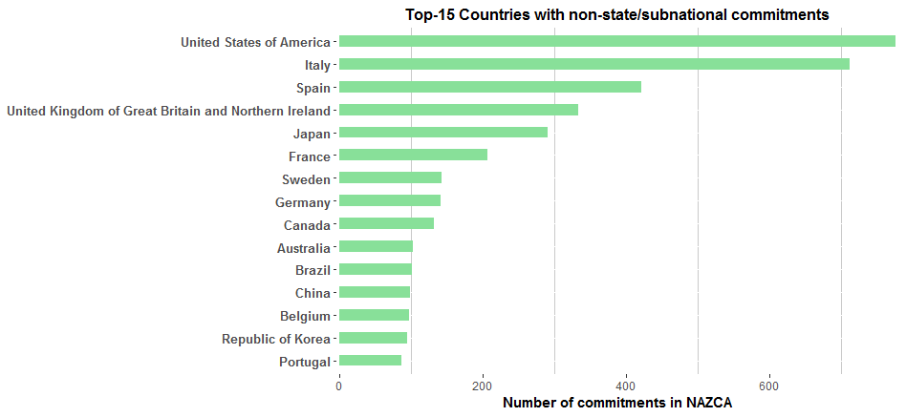
11 600 commitments
140 countries
Notes:
We know actors are from OECD-countries – exception of China and Brazil.
Looking at top 15 US is the top country – no wild guess
Italy are second – mainly due to Covenant of Mayors 90% of Italy’s commitments
Sweden with 150 actors, 350 commitments

Slide 3
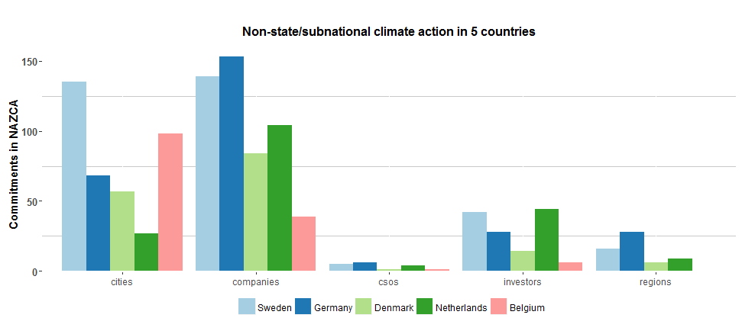
Comparing European countries
Notes:
Sweden outperforms in cities, is doing quite well in companies, investors etc.
Why is this?
In general, the Swedish business is positive towards climate action
2. There is somewhat of a tradition of non-state actors gathering for different initiatives,
These typ of initiatives surely exists elsewhere, but is still part of the explanation.
Another one is the initiative of
Hagainitiativet – more of a spearhead movement with consumer close companies aiming for 100% reductions
Klimatkommunerna – climate municipalities – gathering municipalties aiming to do more than the government

Slide 4
Fossil Free Sweden
200 actors
One of ”first fossil free welfare nations”
Help fulfil ambition – direct emissions reductions
Creating a narrative – to enable future decisions
Encourage to sign up for Nazca –
Notes:
- Launched before the Paris COP – and is to a large an national replica of the LPAA. An from above initiated network to collecy bottom-up action.
200 actors, companies, cities, municipalities, CSO (Fores is one of them). Compared to the CAA and NAZCA – formalities are a lot less strict. No need for targets, just signing up to a declaration.
The Swedish government has a target of becoming on of the world’s first fossil free nations. Excactly what this means, and when this will happen is not yet decided upon, but a cross-parliamentary utredning has said it means XX 2045.
So, the FFS, according to interviews we have done, has a twofold target. For one, it hopes that actors joining will contribute with direct emission reductions, making the target easier to reach, but perhaps even more important, it is believed to help create a narrative, to cite Ban ki Moon – to make the impossible inevitable. Creating a narrative that many are on board, helps politicians to make bold decisions. This is also seen to have been one issue before Paris.
The ambition to create an atmosphere of everyone being on board, is also one of the reason fr having relatively lax requirements for comitments. Better having the steel industry on board with vague ambitions.
Explicitly encourage actors to join NAZCA

Slide 5
Conclusions & Further research
Creating a narrative – does it work?
Different rules for different purposes
Direct emissions reductions or creating a narrative?
Initiate – then live up to expectations
Institutional support
Notes:
If the ambition is to create a narrative, the need for formal rules and commitments are probably less then if the ambition is to fill and emission gap
After initiating the FFS – and many actors joining, they started to have expectations. We want more than our name on a webpage. How do you deal with that, institutionally. Resources?

