Slide 2
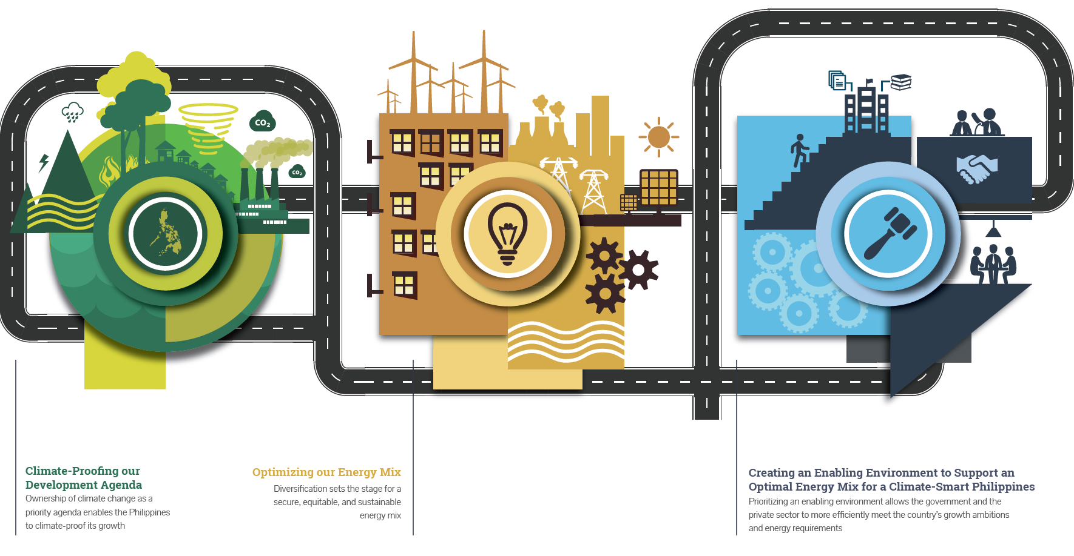
Notes:
This policy brief series is one among many studies the School regularly conducts to contribute to discussions about salient national and international issues
This focuses on the global climate goals and how the Philippines can implement climate actions in line with its national development goals

Slide 3
Climate-Proofing our Development Agenda
Responding to climate change helps fulfill the government’s priority agenda, the SDGs, and SFDRR
The international response to climate change should be sustained
Ways forward for the Philippines:
Notes:
Helps fulfill 7 of 10-point agenda (e.g., promote rural development, ensure security of land tenure, promote science, technology and innovation improve social protection programs, increase infrastructure spending to 5% of GDP, invest in human capital development, increase competitiveness)
Philippines has had a strong voice in the negotiations
As the Philippines moves to ratify the Paris Agreement, it must ensure domestic readiness

Slide 4
Optimizing our Energy Mix
Reducing overdependence on one energy source increases the flexibility to take advantage of rapid RE developments.
Increasing both conventional and emerging RE can be done through the full implementation of policies in the RE Act, which include:
net metering
Feed-in Tariff
renewable portfolio standards
green energy option
Incentives and government assistance for development and construction of conventional RE
Notes:
The government aspires to achieve a high-income economy by 2040. It would entail an average annual GDP
To support long-term growth, the country needs an optimal energy mix10 addressing security, equity, and sustainability. Furthermore, this energy mix should be translated into a tangible program.
Considering the Philippines growth objectives, and the government’s mandate to establish an energy mix that addresses the trilemma, it becomes clear that government’s priority should be to DIVERSIFY. Three immediate courses of action are required: (1) reduce overdependence on coal to address security and e ciency issues to set the stage for (2) an increased share of natural gas (3) and a exible environment to capitalize on rapid market and technological changes in RE .
Optimizing the coal share in the energy mix and reducing the use of imported coal can be done through the following policies: (1) set a cap on coal plant endorsements using a portfolio based approach; (2) create a gold standard for coal plants; and (3) comply with BOI environmental criteria.
Once coal’s share is reduced, natural gas will be allowed to compete and optimize the mid-merit or at the very least, maintain its share in the current energy mix given the expected depletion of the Malampaya reserves. This can be done through (1) the formulation of a comprehensive natural gas policy and legislative framework to attract private sector investment; (2) support for the construction of natural gas infrastructure; and (3) the exploration, development, and production of indigenous natural gas as well as the swift resolution of each Philippine Energy Contracting Round.
Additionally, reducing overdependence on one energy source increases the exibility to take advantage of r
All of these set the stage towards achieving a quality, reliable, a ordable, and more sustainable energy mix which can be easily adjusted to meet innovations in technol

Slide 5
Creating an Enabling Environment to Support an Optimal Energy Mix for a Climate-Smart Philippines
Create a roadmap that clarifies government’s strategic intent around the following fundamental items:
Notes:
The Philippines has a clear legal framework for engaging industry within the power sector. Beyond this framework, what is urgently needed is a comprehensive government roadmap that sets the policy direction and sends a clear signal to the private sector around key priorities that consider climate change and an optimal energy mix:
This roadmap should rst and foremost establish the strategic intent of government across some fundamental issues that immediately need to be resolved and declared.
Secondly, the roadmap should establish a deliberate set of energy, environmental, and economic objectives, in contrast to the current tendency of merely describing incoming supply and demand.
Thirdly, the roadmap should be able to produce the balance among seemingly con icting goals of energy security, equity, and sustainability under an inclusive planning process.
Mechanisms and strategies also have to be put in place to ensure that the private sector responds and works toward the implementation of the roadmap.
From a regulatory perspective, standards should be established for the selection of technologies to be deployed by the private sector. Recognizing that compliance to these standards will entail costs, mechanisms should be in place to de ne how the attendant costs are to be recovered
Finally, the roadmap should take into account the barriers hindering private sector investments, as well as the proposals to address them
complicated permitting process
lack of grid infrastructure
financing
delays and conditions in regulatory approvals for offtake agreements
existing incentive mechanisms for RE

