Slide 1
Adaptation Fund Photo Competition 2012: Food and Agriculture
www.adaptation-fund.org
Notes:
Talk about theme of contest. Mention that it was the second contest.

Slide 2
Jury Members
Mr. Andrew Smith, Photojournalist and Lecturer, University of Technology, Jamaica
Ms. Alexandra Garcia, Director of Operations, International League of Conservation Photographers
Ms. Karen Kasmauski, Professional Photographer
Mr. Pedro Armestre, Professional Photographer
Dr. Samuel Sidibé, Directeur Général, Musée National du Mali

Slide 3
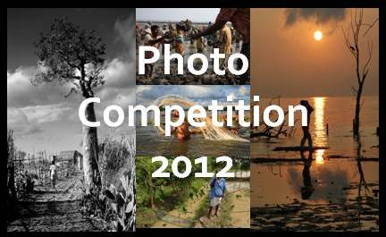
Submissions
170 photo submissions
Entrants from Bangladesh, Germany, India, Indonesia, Iran, Kenya, Mali, Madagascar, Moldova, Morocco, Nepal, Republic of Congo, Spain, Turkey, Uganda, United Kingdom, United States

Slide 4
People’s Choice
Farming Rice and Fruit (Kuntal Singh, India): The Mandla district in the state of Madhya Pradesh, Central India, has lately been seeing erratic rainfall and winters have been extreme. Some farmers have even given up growing winter crops owing to huge losses.
This farmer uses the System of Rice Intensification (SRI) technique to increase productivity from paddy fields. The traditional procedure of sowing paddy plants in India is through sowing of a bunch of plants together in groups in an disorderly manner, which results in low productivity. SRI is necessary for the villagers to shield them from the impacts of climate change.

Slide 5
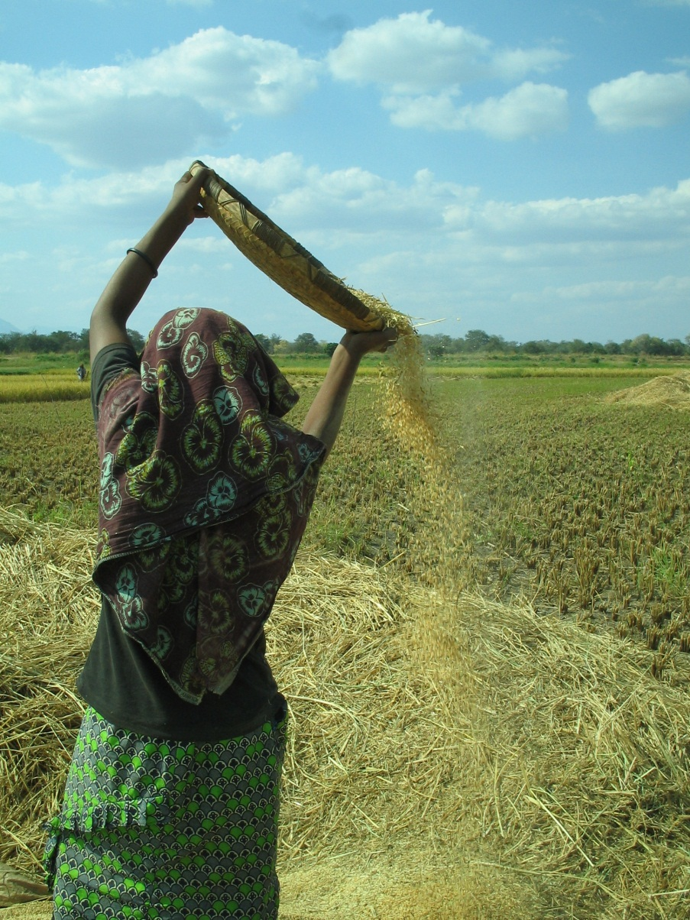
Third Prize
Livelihood Support in a Changing Climate: (Simon Golds, United Kingdom)
A project to expand, rehabilitate and improve the water and irrigation management for a rice farm in Dakawa Village, Tanzania will protect and enhance the water supply to the rice fields on which many local communities rely for economic development, livelihoods and food security in this climate-vulnerable part of Africa.

Slide 6
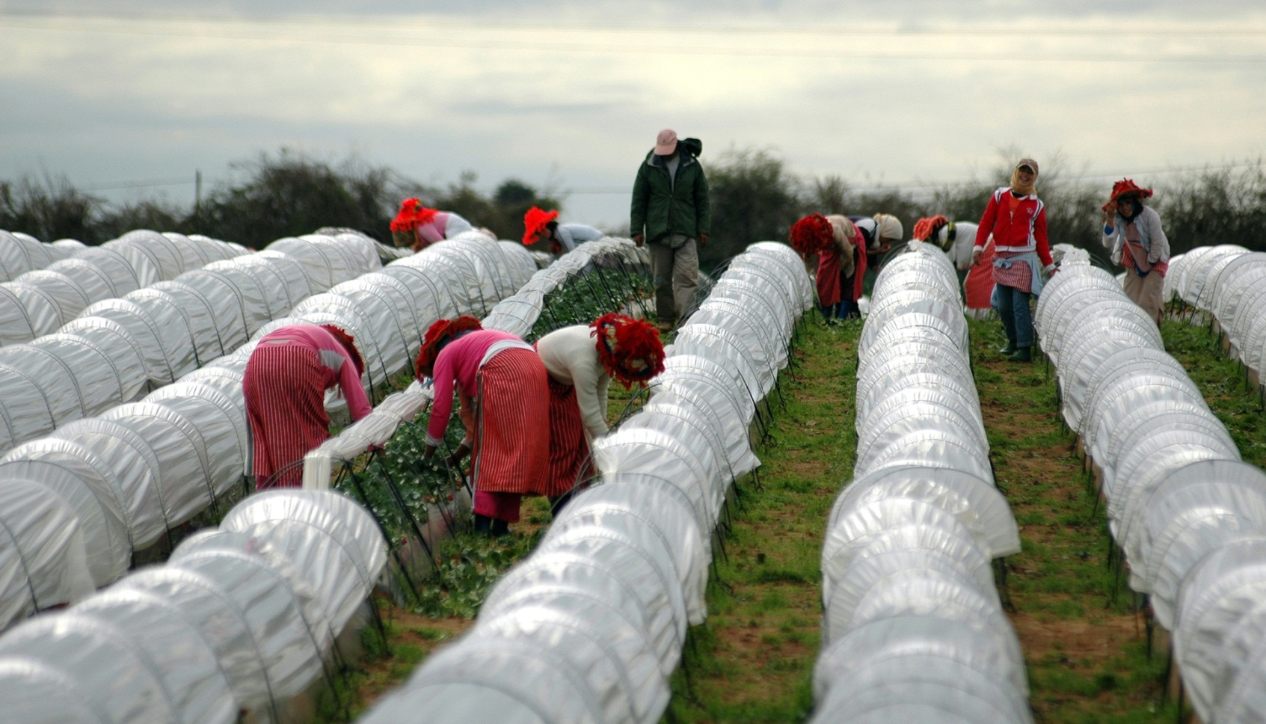
Second Prize
Strawberry Pickers (Antonio Perez, Spain) A large part of the Morrocan Rif suffers from significant rains in winter, which have risen with the passing of time, causing floods to put crops at risk. The use of greenhouses improves production of fruits such as strawberries, allowing them to be competitive with European producers. The use of greenhouses allows the productivity of the soil to be maximized, even during the fallow season. The whole area is broadening its horizons towards economic sustainability, and the strawberries are incredible.

Slide 7
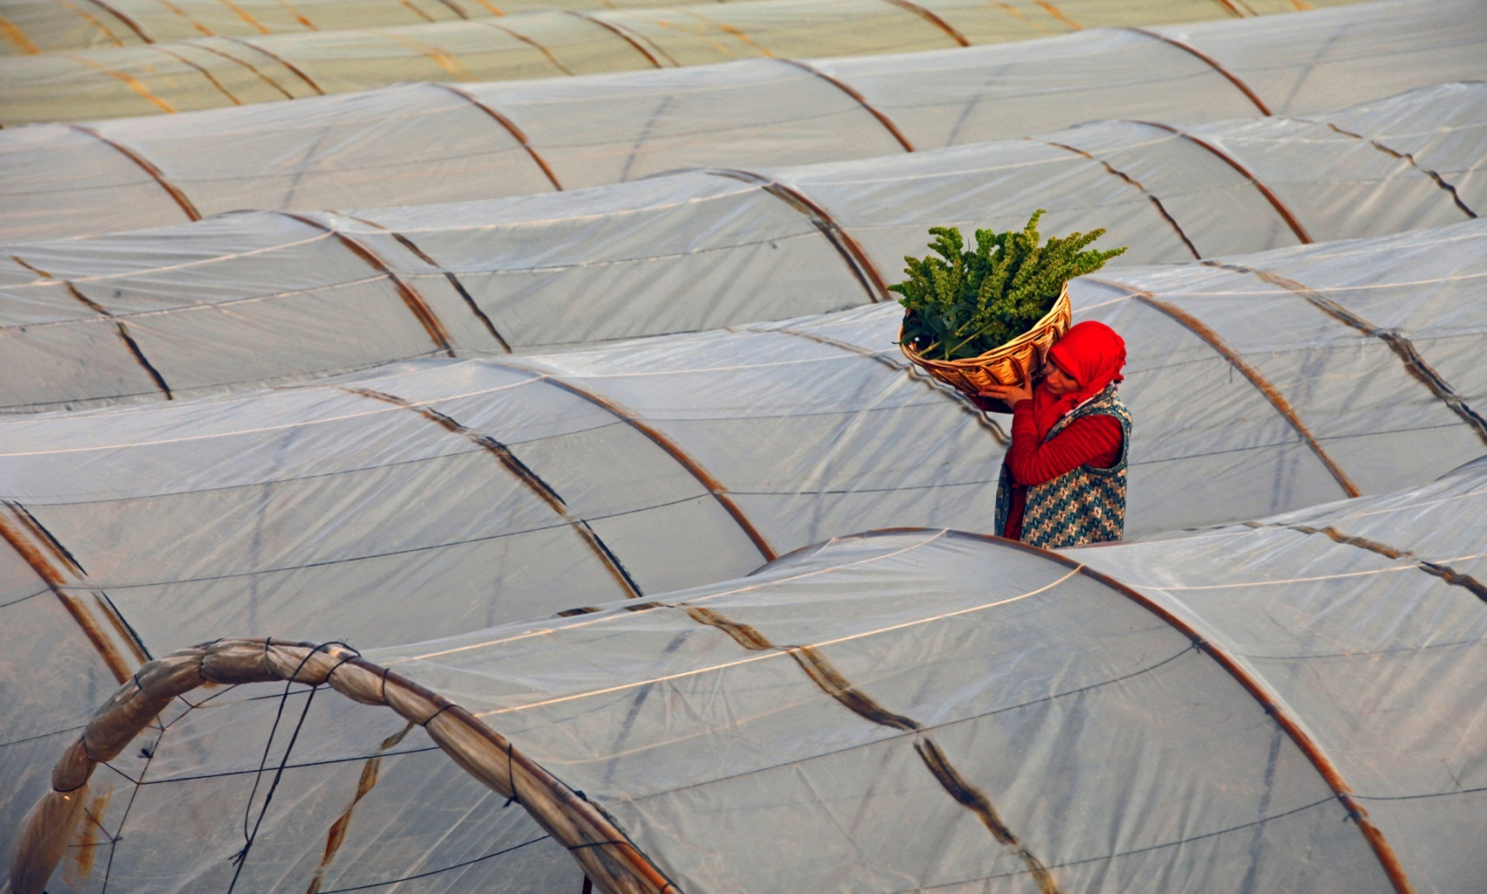
First Prize
Greenhouses for Adaptation (Ihsan Ilze, Turkey) Greenhouse gases and climate change are important factors threatening Erzurumda, Turkey, where the cold climate often damages crops. Greenhouse agriculture is a cheap, but not yet common solution that may be preferred in the future to protect crops.

Slide 8
Thank you.
To view the contest semifinalists, visit us at www.flickr.com/photos/adaptation-fund/

