Slide 1
The CDM and Sustainable Development:
What do we know?
What do we not know?
CDM Policy Dialogue Event Bonn, May 21st 2012
Professor Peter Newell

Slide 2
Evidence Base
Review of 38 studies, 2007 to date
No clear agreed measures of what we mean by SD or common unit of measurement
Some studies compare across PDDs but many PDDs contain sparse or vague information about SD benefits
Others have country, regional, sectoral or technology focus
Much showcasing of ‘positive’ or ‘negative’ case studies
Greater attention to what is more measurable: types of TT hardware + diffusion (> extent of indigenous tech development) rather than less tangible health or environmental benefits etc.
More attention to direct benefits (jobs etc) > indirect benefits (knock-on effects in local economy from EE)
Inevitably give a snap-shot view rather than a longer-term picture required to assess employment, health benefits etc.
Apart from individual case studies, all ex-ante analysis of SD potential!
Notes:
Cover different no.s of PDDs Sutter & Parreno 1st 16 registered projects

Slide 3
Different Methodologies (1)
Different Methodologies
Reviewing PDDs
Understandable but limited
Text analysis features prominently (chronologically or randomly or comparing CDM with Gold Standard)
Follow up with developers
Improvement but not entirely reliable
Reviewing PDDs and then asking project developers if claimed benefits were delivered (EB approach)
Multi criteria assessments
Speculative, resting on subjective assumptions, limited indicator range
Assessing multiple-attributes of sustainability, combined with regression analysis
Notes:
Das 1st 1000, randomly (Boyd et al) comparing GS CDCF and CDM (38) (Nussbaumer)- finds labelled projects do not drastically outperform non-labelled ones. Since comparing only covers RE and EE projects which are focus of GS- not controversial industrial gas or hydro for e.g
Drupp also compares GS and non-GS-looks at 48 projects. Finds GS slightly outperform normal CDM, direct comparisons of projects of same type inconclusive
Sutter + Parreno, Nussbaumer, Lenzen + Schaeffer (multi-criteria)- elicit preferences from stakeholder panels

Slide 4
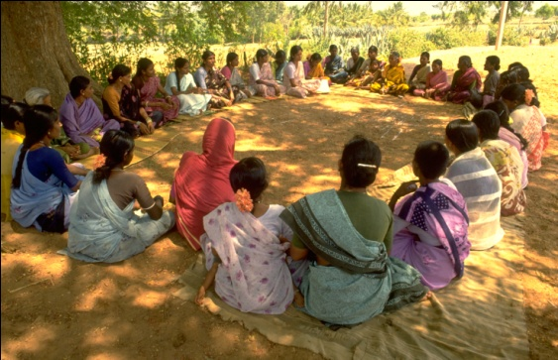
Different Methodologies (2)
Site Visits
Critical but costly and hard to do at scale
In-depth analysis by researchers and interviews with host communities
Qualitative
Ex-post validation of PDD claims is still required
Interviews with keys actors from Executive Board members to DNA to community level
Notes:
“CDM outcomes cannot be anticipated unless a detiled and contextualised analysis of governanance at national and local scales is undertaken” (2012 Corbera + Jover).

Slide 5
Limitations
Clear tension between breadth (searching through many PDDs) v depth (looking at actual projects & talking to claimed beneficiaries)
Given what we know about how PDDs are sometimes produced & the weak capacity and/or willingness at DNA level to check claims of SD benefits at validation stage…
…comparing across PDDs or asking developers involved in them ex-post does not allow us to assess whether SD benefits are being delivered or not
Onus then falls on those managing projects or DOEs to prove this, as neither EB, nor DNAs, nor civil society organisations have the responsibility or capacity to monitor delivery of SD benefits
Notes:
How stakeholders are identified, consultations conducted etc

Slide 6
Key findings in the literature (1)
Ability to improve SD benefits depends on factors such as:
Capacity of DNA (to screen for SD benefits)
Attractiveness of country as investment location (whether it can steer investors to priority areas ); Ability to use policy tools (tax/local producer requirements etc) to secure benefits (China)
How ‘hands-on’ the DNA is: site visits (Peru) v check-list approaches (most DNAs)
Coordination with local development priorities
Project type: Sector: Methane projects showed higher potential SD benefits than EE; Scale: smaller scale projects higher no. of SD benefits than large-scale projects (Olsen & Fenhann 2008)
Social inequalities: which social groups are represented in consultations, have access to the resources, revenues etc
Notes:
CF assist and others
Brazil: employment + income generation
Peru: more local community development
Figures vary on what % likely to deliver SD benefits (less than 1% according to Sutter & Parreño 2007)
Trade-offs between tonnes of CO2e avoided/CERs issued and SD benefits (HFC + methane avoidance- highest TT claimed, RE and biomass the lowest)
Disch 122 projects looks at DNA approaches- finds most unable to deliver ‘development dividend’
GS: sustainability matrix + EIA + stakeholder consultation
China: energy policy

Slide 7
Key findings in the literature (2)
SD benefits are not measured, rewarded or monitored
apart from through Gold Standard (even here uses a ‘tick-box’ methodology)
Big discrepancies between design & implementation
Only 10% of project activities were reported to have the same benefits as those reported prior to implementation (CDM EB 2011)
Fall off the radar screen of most developers
Anticipated CER returns key driver which forces attention to low-hanging fruit projects
Greater interest where NGOs and donors are involved
since this SD benefits are often a primary motivation
If more benefits are being achieved, without ex-post verification…
how would we know?
Notes:
Subbaro and Lloyd (2010) ‘successful projects’ have high levels of community involvement + typically managed by cooperatives- focus on India. Looked at 500 small-scale projects

Slide 8
Some Proposed Solutions…
Positive points system to reward range of SD benefits (with some floors) or
withhold fixed % of CERs where clear failure to demonstrate they have been achieved
Exclude projects that bring few SD benefits (industrial gas projects/large hyrdo) or which cause harm
Build DNA capacity to screen more effectively in the first place when approving
Common global checklists or minimal SD standards and benchmarks
On-going monitoring of projects
Consultations with hosts before CERs released
…but the Executive Board’s selection falls way short:
Option 2 of Concept Note on Highlighting Sustainable Development Co-Benefits which calls for initial declaration, voluntary updating, no validation or verification, no possibility of challenging this or of sanctions if benefits are not delivered.
Notes:
Voluntary guidelines
Minimal: employment, tax revenues- similar to GS standards
Minimal no. of points

Slide 9
An Alternative Process?
Clear national clean development strategies: priorities, preferred sectors and regions
Design Stage
Common guidance on publicising and managing consultation processes (observers, facilitators)
Consultation & Participation
Strengthened DNA capacity to evaluate claimed benefits
Approval
On-going monitoring and ex-post verification of SD by DOEs before CERs issued
Monitoring
Notes:
Peru insists that SD benefits are included in project monitoring plans
Meaningful public comment periods

Slide 10
Conclusions
Clearly positives and limitations concerned with each proposal (capacity, practicability, sovereignty, resources, deterring investment etc.)
But the CDM was set up with 2 key mandates: reducing GHG emissions in a cost-effective way and delivering sustainable development benefits.
Especially as rationale of policy strategy of some key actors (EU) is to only source CERs from least developing countries to improve the development dividend
We have to make sure it meaningfully does both.

Slide 11
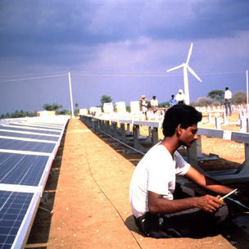
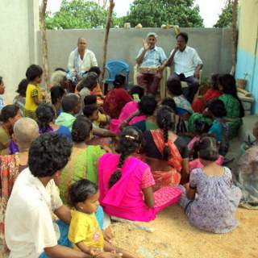
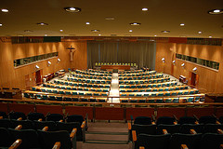
Thank you for listening!
p.j.newell@sussex.ac.uk
www.clean-development.com

