Slide 1
Perspectives for the Technology Mechanism
Heleen de Coninck
Bonn, SB-36 side-event
May 23rd, 2012

Slide 2
Technology Mechanism
Established under AWG-LCA in Cancun to facilitate the enhanced action on technology development and transfer in order to support action on mitigation and adaptation
Technology Mechanism has two “arms”:
Technology Executive Committee operational
CTC&N under development (competitive bidding, proposals being evaluated)
How will they work towards the aim of supporting mitigation and adaptation?

Slide 3
Policy interpretation
Grubb (2008 )

Slide 4
Capability interpretation
R&D
R&D
Diffusion
Demonstration
Diffusion
Demonstration
Deployment
Deployment
income
High -
income
countries
countries
I
I
Capacity
Capacity
VI
VI
Capacity
to
Capacity
to
innovate
innovate
to
to
regulate
regulate
II
II
Capacity
Capacity
to
to
adopt
adapt,
and
and
replicate
manufacture
III
III
Capacity
Capacity
to
to
operate
operate
and
and
Low
Low
-
-
income
income
maintain
maintain
countries
countries
Bazilian et al (2009)

Slide 5
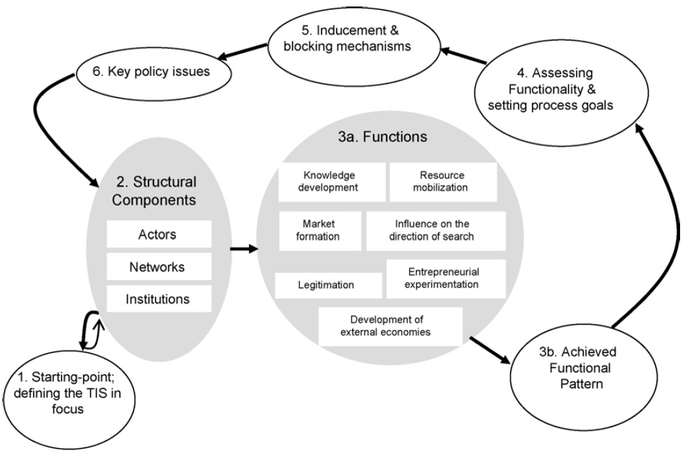
Technological innovation systems
Bergek et al (2008 )

Slide 6
How can we incorporate academic insights in the TM?
Starting point: capabilities differ greatly by country and region; many countries are characterised by weak institutions
“Innovation systems” underdeveloped, but emerging in larger economies
In least-developed countries low levels of capacity
Bottleneck is often not capacity to operate and maintain, but more advanced capacities to regulate and innovate
Often there are universities, smaller NGOs where knowledge and capabilities reside
Weak links lead to small trickle-through to private sector and government
Technology Mechanism should address both the capability and the market side of the “enabling environment”.

Slide 7
So what should the TM do?
Global reach
Network of technology-specific, internationally-oriented R&D centres to advance technologies
International collaboration on technology R&D and demonstration
Internationally agreed technology/sectoral standards, e.g., energy-efficient appliances, personal vehicles
Publicly available technology data and information
Early phases of technological development (R&D, demonstration)
Advanced phases of technological development (diffusion)
National or regional centres for local demonstration and capacity development
Capacity to adapt, manufacture, innovate (knowledge centres)
Capacity to maintain and operate (technical schools)
National/regional hubs aimed at enabling environments
Capacity to regulate and form markets
Entrepreneurial activities
Enable finance and investment
Country- or region-specific
Based on Coninck and De Vita (2010 )

Slide 8
This event…
Provides an introduction to the technology theme in the climate negotiations
Gives examples of activities already going on
Gives a positive vision for what the TEC could do
Hopes to evoke a broader discussion on how the Technology Mechanism should achieve its aims

Slide 9
Thank you for your attention
This presentation was developed jointly with
ECN Policy Studies Radarweg 60 P.O. Box 1
1043 NT Amsterdam 1755 ZG Petten
The Netherlands The Netherlands
T +31 224 56 4316 deconinck@ecn.nl
F +31 224 56 8339 www.ecn.nl
http://www.climatestrategies.org/research/current-projects/climate-technology-and-development-project.html

