Slide 1
Health as a Driver of Climate Change Policy
Local Efforts / Global Action
November 30, 2011 United Nations Framework Convention on Climate Change
Durban, South Africa COP17

Slide 2
From Local to Global -- and Back Again
SeaTrust Institute Durban, South Africa November 30, 2011 UNFCCC/ COP17

Slide 3
Global Recognition of the Necessity for Local Empowerment, Knowledge Building, and Policy Engagement
Declarations and Statements
Local Empowerment
NAPS
LDCs building on experience with NAPAS
Action Frameworks, Guidance Documents & Plans
Hyogo
MDGs
Ultimate Goal of Development – To Expand Peoples’ Choices – UNDP 2011
Nairobi Work Programme
AR5
Engaging civil society with women’s organizations in particular
The NAP process is to be country-driven & owned, transparent, strategic &scalable
RIO+20
PROVIA
Examples
SeaTrust Institute Durban, South Africa November 30, 2011 UNFCCC/ COP17

Slide 4
Climate Science
Nurses
Training
Mentoring
Data Collection
Climate Change
Food/ Agriculture
Water
(
Health Science
Local Capacity Building
Interventions
Community Training
Adaptation/Mitigation
Policy Engagement
Global Governance
Health & Climate Data Surveillance
Coalition on Health & Environment: Climate Change Initiative
Disaster Risk Reduction
Consultation & Research
Data Collection -
Analysis & Distribution
SeaTrust Institute November 30, 2011 COP17

Slide 5
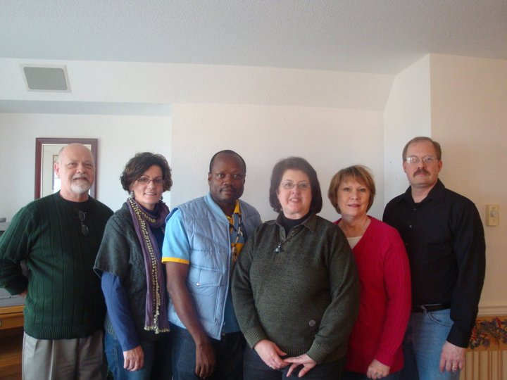

Slide 6
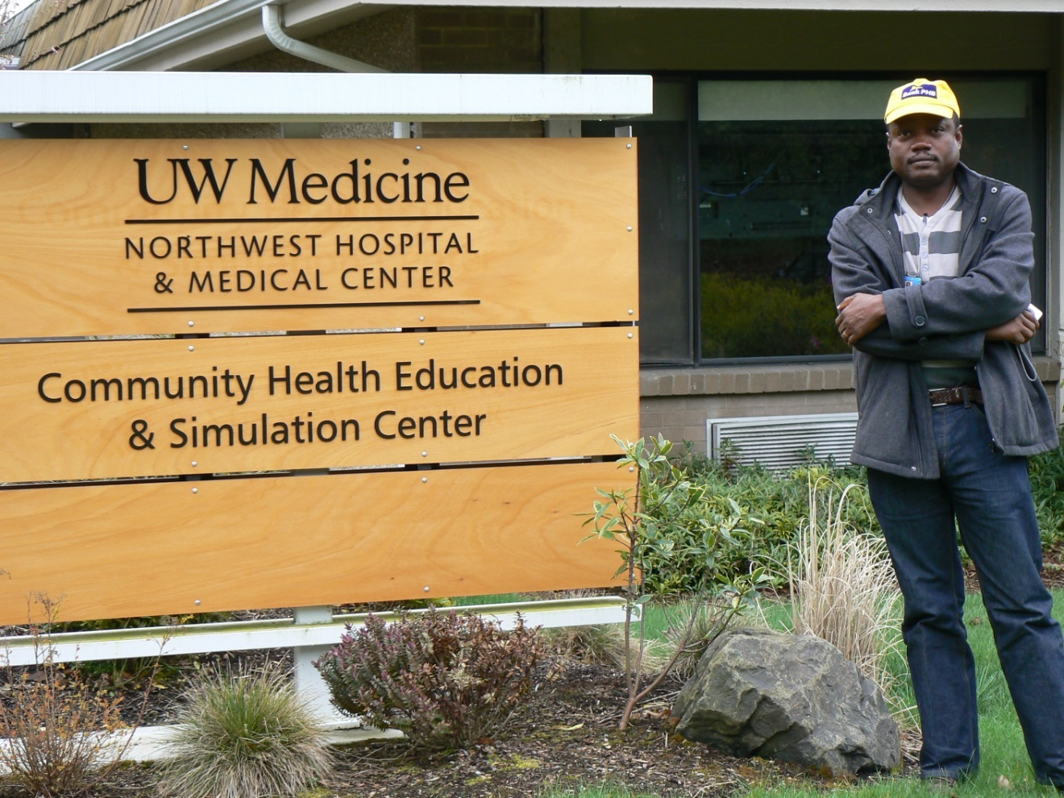
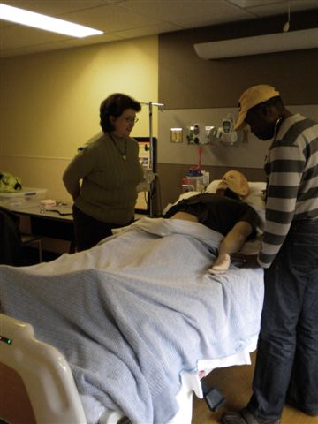
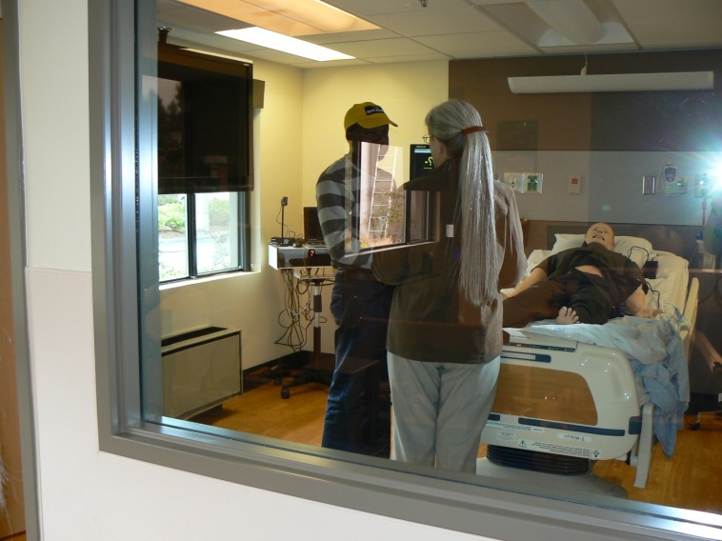
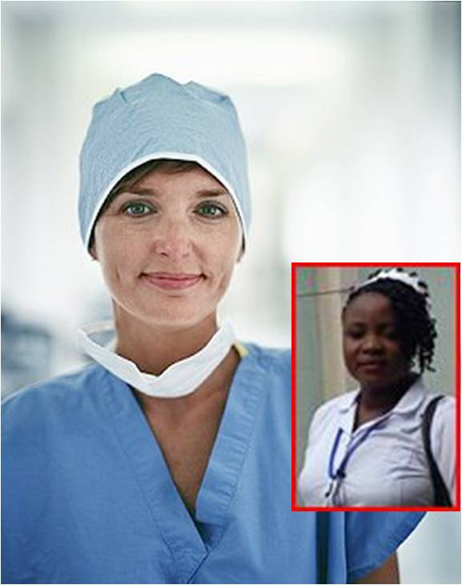
SeaTrust Institute Durban, South Africa November 30, 2011 UNFCCC/ COP17

Slide 7
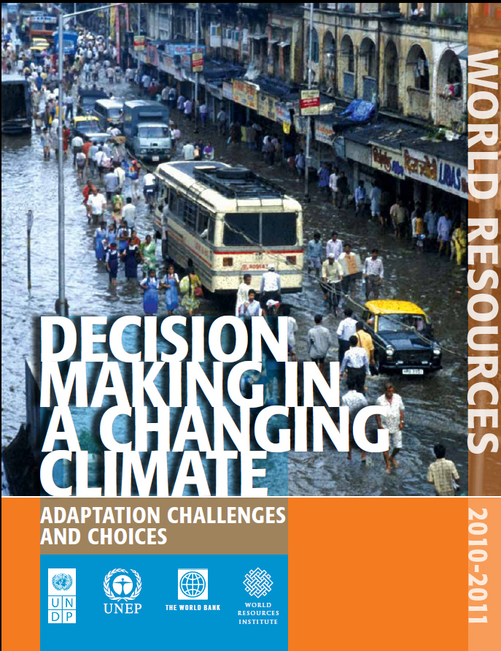
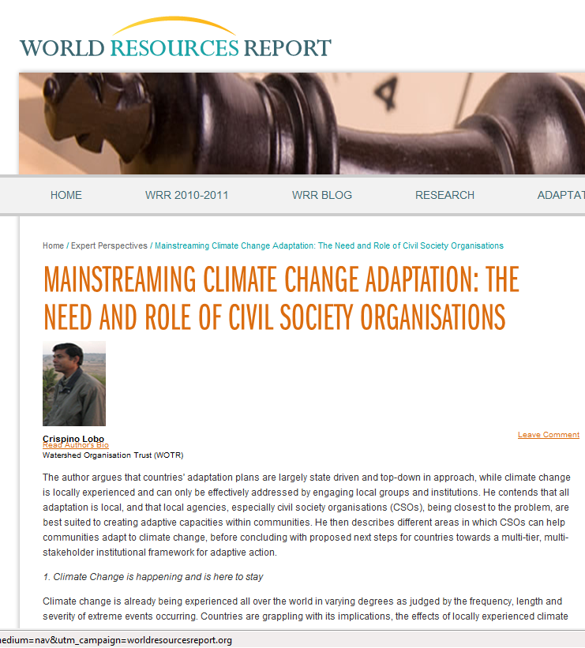
SeaTrust Institute Durban, South Africa November 30, 2011 UNFCCC/ COP17

Slide 8
Local Capacity Building through Training & Support Systems for Climate Change and Health Adaptation:
Knowledge Creation, Data Surveillance/Collection,
Scenario Building, & Policy Action
SeaTrust Institute Durban, South Africa November 30, 2011 UNFCCC/ COP17

Slide 9
Models - Biological and Statistical
How do we use them for adaption choices that leads to greater self-sufficiency?
Combining biological and statistical models for disease, vulnerability
and risk
Biological (explanatory/intensive data use/ dynamic)
Disease process
Transmission
Seasonal variations
What the models are good at/ and not
Statistical ( descriptive/ correlations/ static)
Climate monitoring
Habitat satellite data
4 year herd immunity time scale (malaria specific)
Entomological inoculation rates
# of bites per unit of time X infection rate
Very little data available
Distribution of vectors
Subspecies of mosquitoes and respective habitats
What the models are good at/and not
Integrating other factors beyond data captured in the above models
Other issues
Drug resistance
Habitat change other than from climate change (ie land use,
war, development/deforestation)
Agricultural patterns and proximity to host animals
Other data
Social
Economic “cycle of poverty”
Role of medical informatics
Other methods (example models)
DPSEEA – correlates with this as it is built on stressors
EFA
Reproductive Model for Malaria
(all except R and r may be affected by climate/weather)
R₀ = mbca²e^{-µT}
µr
R₀ = basic reproductive number of the disease
m = vector/host ratio
b,c = transmission coefficients
a = human biting rate
µ = daily mortality rate
T = extrinsic incubation period (days)
r = rate of recovery from infection
Notes:
What is known/being done?
Each has strength and weaknesses
Like a device you buy “battery not included” – each is deprived of what the other has. Much of the scientific work centers how using one or the other model type, or in some cases how to blend them, to see what to do
What I will introduce here is a way of putting the output of this process through LCA to compare impact from different adaptation choices

Slide 10
Local Training for Climate Change and Health Adaptation:
Scenario Building
Using Local Questions and Concerns about Climate Change
Determination of hazards and sensitivity /vulnerability
Determine and project adaptive capacity
Integrate and Map vulnerability
Identify, assess and review adaptation options
Construct local scenarios
SeaTrust Institute Durban, South Africa November 30, 2011 UNFCCC/ COP17

Slide 11
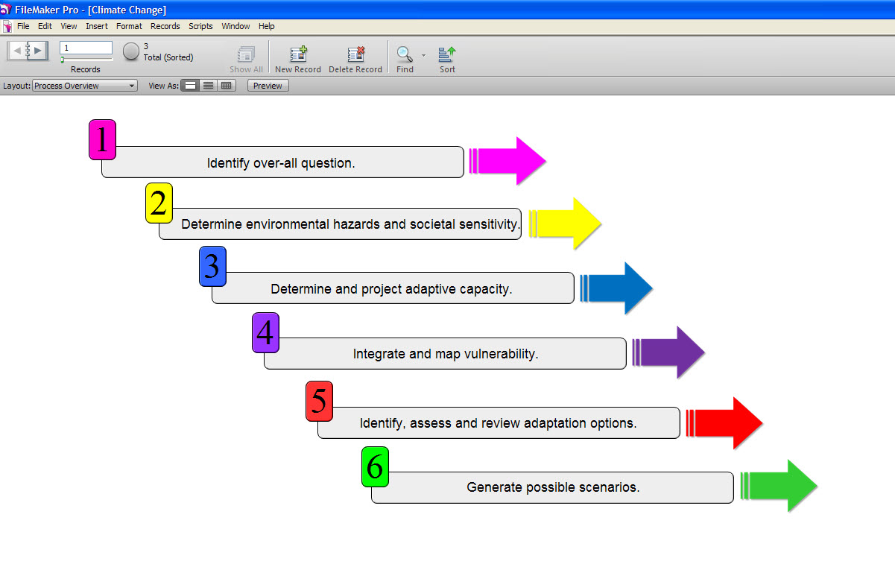
SeaTrust Institute Durban, South Africa November 30, 2011 UNFCCC/ COP17

Slide 12
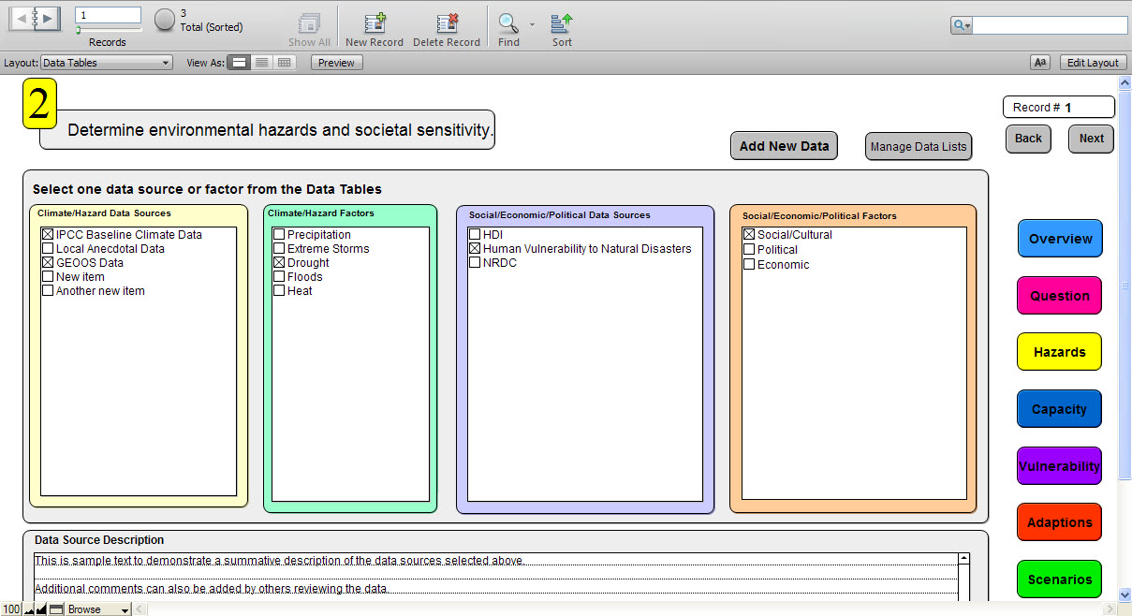
Global and Local Data
DATA AT ANY SCALE AND OF ANY TYPE (numerical or narrative) CAN BE ADDED BY THE USER

Slide 13
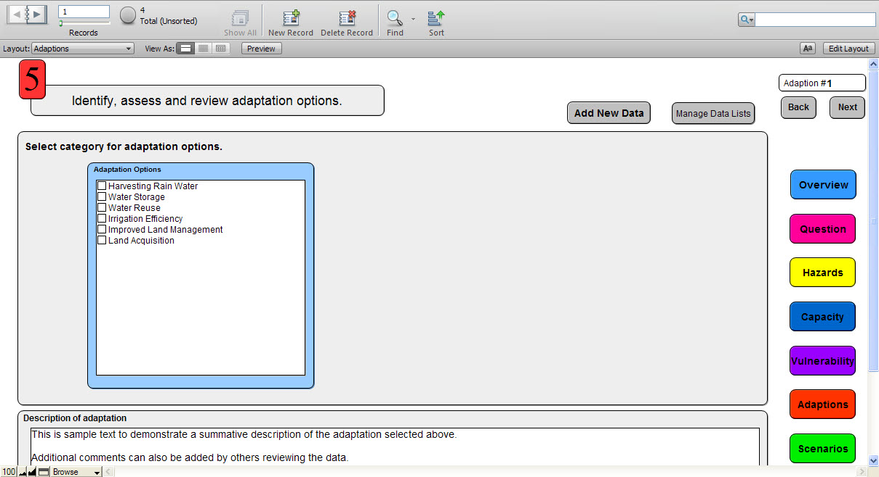
Adaptation Options Can Be Added by the User or Selected: Multiple Selections Allowed

Slide 14
Applying Local Conditions to Scenarios & Decisions
SeaTrust Institute Durban, South Africa November 30, 2011 UNFCCC/ COP17

Slide 15
Nurses: the world’s most trusted profession Nurses were judged the most honest and ethical profession for the last 11 years. – Gallup 2010
SeaTrust Institute Durban, South Africa November 30, 2011 UNFCCC/ COP17

Slide 16
Collaborative Process Support/EKOSYSTEM*
Monitor & Inform
SCIENCE
Assessments
Inventories
Research
ACTIONS
Capacity Building, Policy Action
Project Mgmt.
Data Security
Reporting
Project Validation
Photo/File Library
Tasks
Data Repository
GIS Layers
Communicate
Implement
SPONSORS
UN Agencies, Nations, Industry NGO’s
PRIORITIES
DRR, Adaptation, Data Surveillance
Web Accessible
Simple data entry
Project Map
Public Portal
Map based/GIS
Project Hierarchy
Project Metrics
Configurable
Identify
*Powered by Paladin Data Systems

Slide 17
Policy Support
Education
Collaboration
Outputs
Local Empowerment
Data Augmentation

Slide 18
Linking Process Decisions & Human Health Outcomes
Improved life expectancy (mortality)
Emissions reductions
Pollutant exposure reduction
Interventions, activities & resource extraction changes
Informed process
Selection & Design
Poverty
Reduction / life quality improvement
Employment & wages increase
Health status of individuals improves
Taxes & social revenue increase
Public sector spending increase &
focus
Reduced rate of health impairment (morbidity)
SeaTrust Institute Durban, South Africa November 30, 2011 UNFCCC/ COP17

Slide 19
SeaTrust Institute Durban, South Africa November 30, 2011 UNFCCC/ COP17

Slide 20
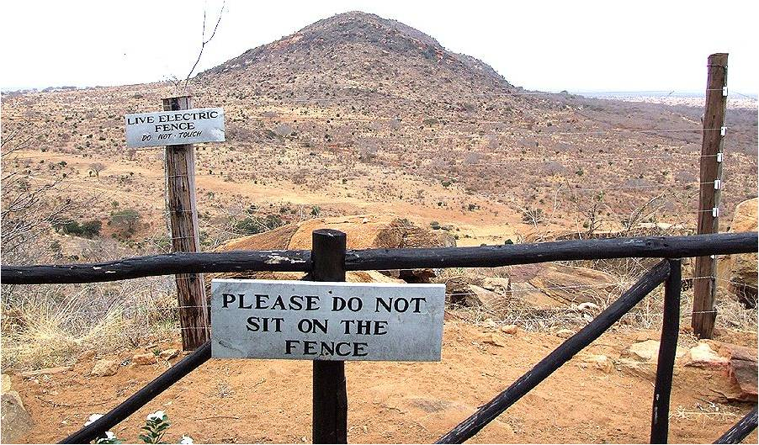
SeaTrust Institute Durban, South Africa November 30, 2011 UNFCCC/ COP17

